Slide 1
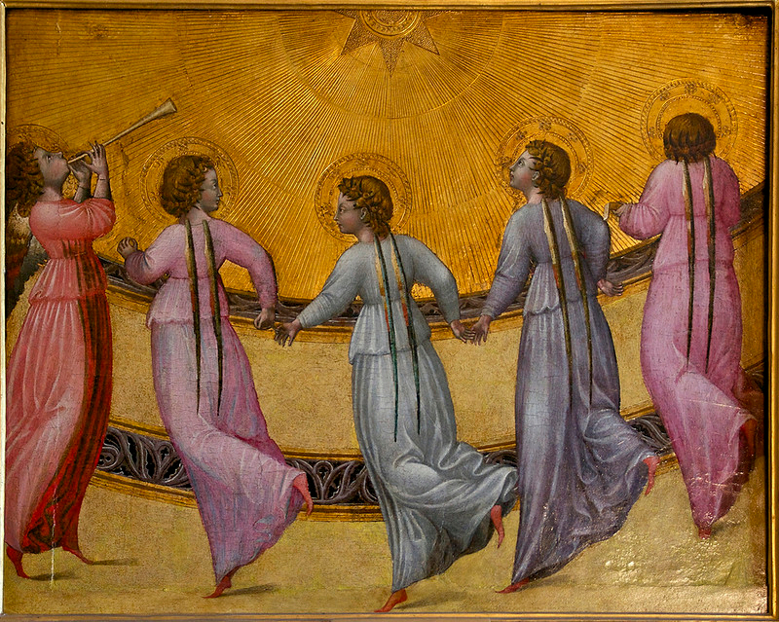
Angels Dancing on Pinheads
F. Sciortino, Sapienza Universita’ di Roma

Slide 2

A little bit of background to the problem (Wikipedia):
Aquinas's Summa Theologica, written c. 1270, includes discussion of several questions regarding angels such as, "Can several angels be in the same place?”
The consensus:
Angels are pure intelligences, not material, but limited, so that they have location in space, but not extension.

Slide 3
How many Angels can Dance on a Pinhead ?
Why was this question raised ?
The question of how many angels can dance on the point of a needle, or the head of a pin, is often attributed to 'late medieval writers'... In point of fact, the question has never been found in this form…
HS Lang, author of Aristotle's Physics and its Medieval Varieties (1992):

Slide 4
How many Angels can Dance on a Pinhead ?
Why was this question raised ?
The question of how many angels can dance on the point of a needle, or the head of a pin, is often attributed to 'late medieval writers'... In point of fact, the question has never been found in this form…
HS Lang, author of Aristotle's Physics and its Medieval Varieties (1992):
One theory is that it is an early modern fabrication as used to discredit scholastic philosophy at a time when it still played a significant role in university education.

Slide 5
Is it still the case ?

Slide 6
Is it still the case ?
YES !!!!
“ To my mind the question of whether there is or is not a reentrant spinodal is similar to the medieval debate concerning angels dancing on pinheads. “
(report of an unknown PRL Referee, January 2017, to the manuscript Re-entrant limits of stability of the liquid phase and the Speedy scenario in colloidal model systems)

Slide 7
Angels Dancing on Pinheads
Re-entrant limits of stability of the liquid phase and the Speedy scenario in colloidal model systems
F. Sciortino, Sapienza Universita’ di Roma

Slide 8
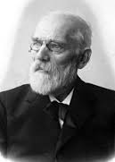
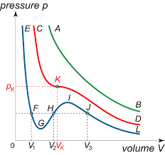
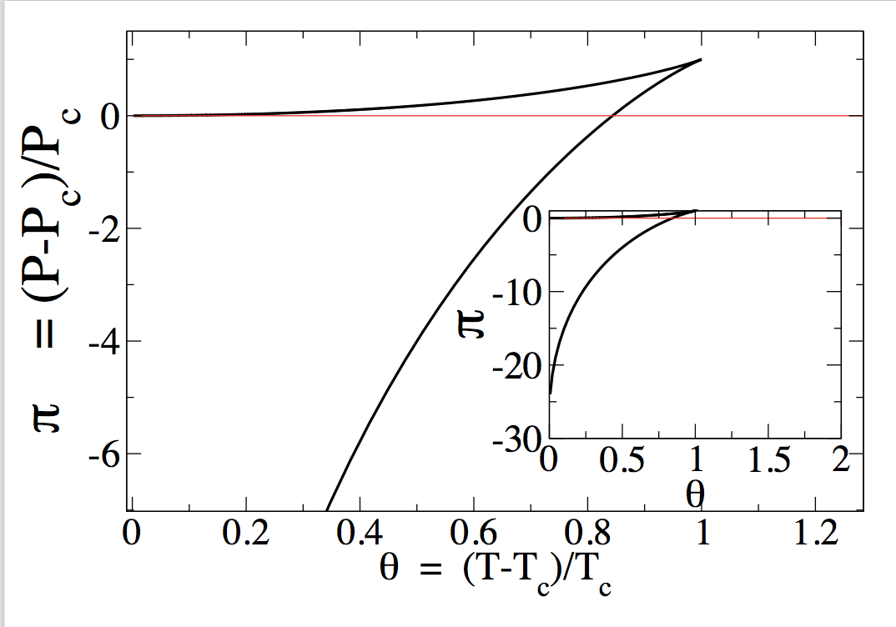
Spinodal: A mean-field concept.
VdW spinodals…….
Gas spinodal (I spot)
Liquid spinodal
(G spot)
Relevant to metastable states

Slide 9
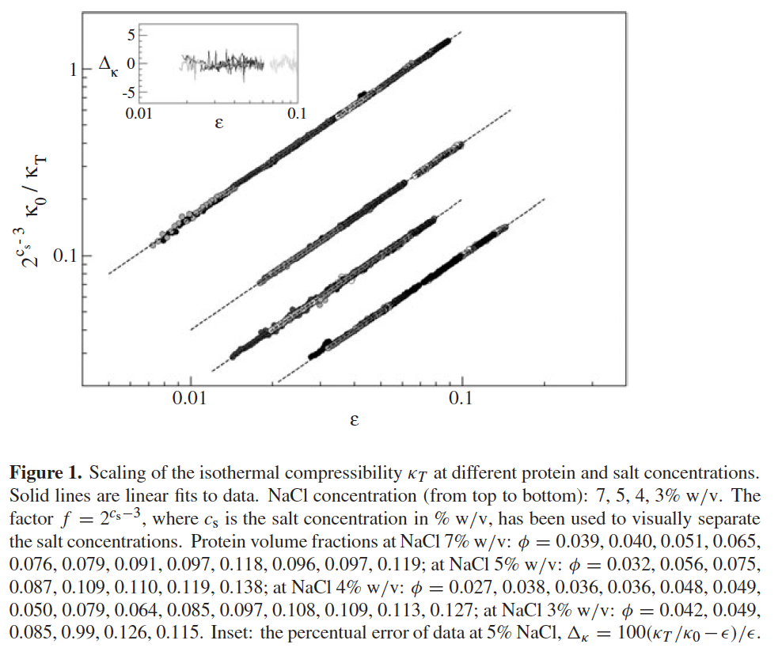
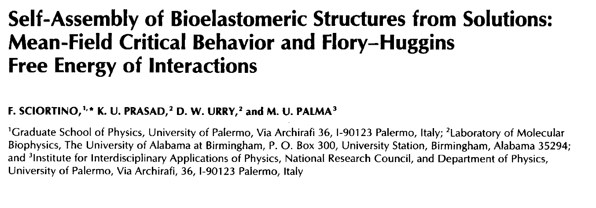
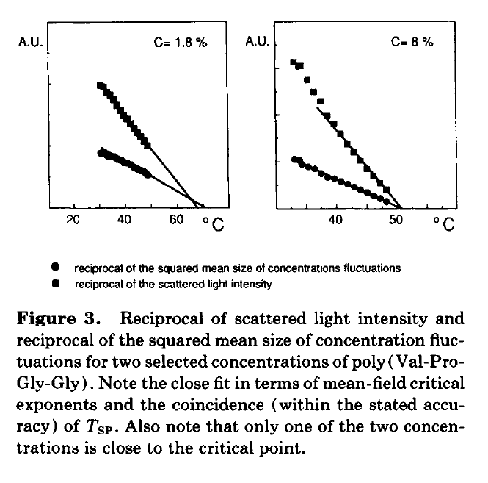
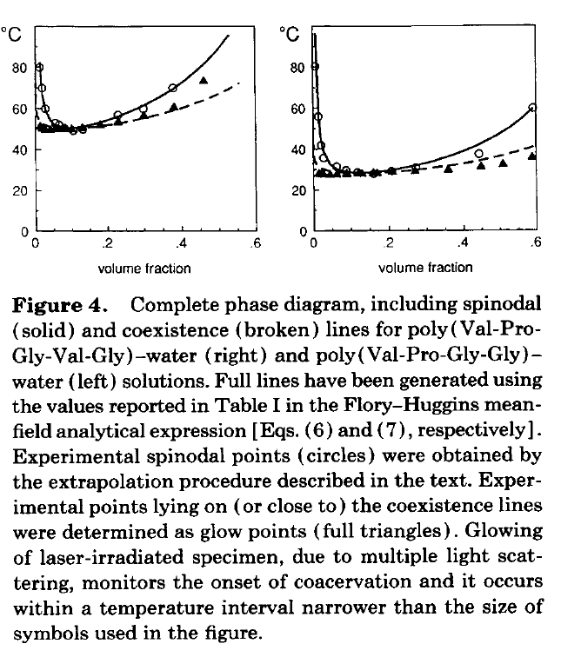
Can spinodal be measured ?
M Manno, D Bulone, V Martorana and P L San Biagio Journal of Physics: Condensed Matter, 16, 42

Slide 10
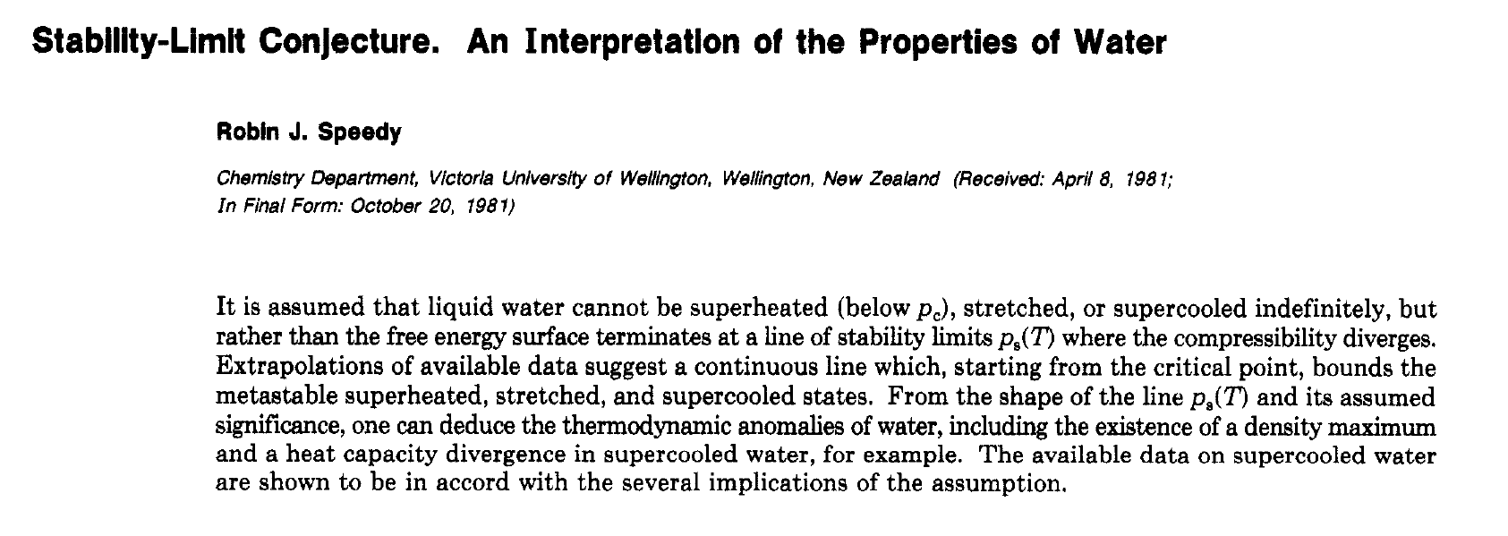
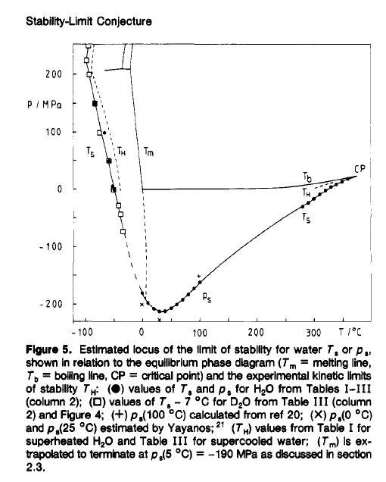
Spinodals of liquid water
Vaporizing liquid water on cooling !!!!

Slide 11
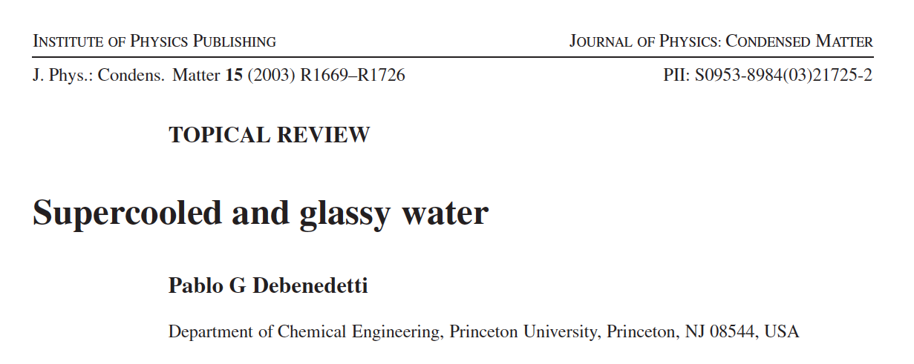
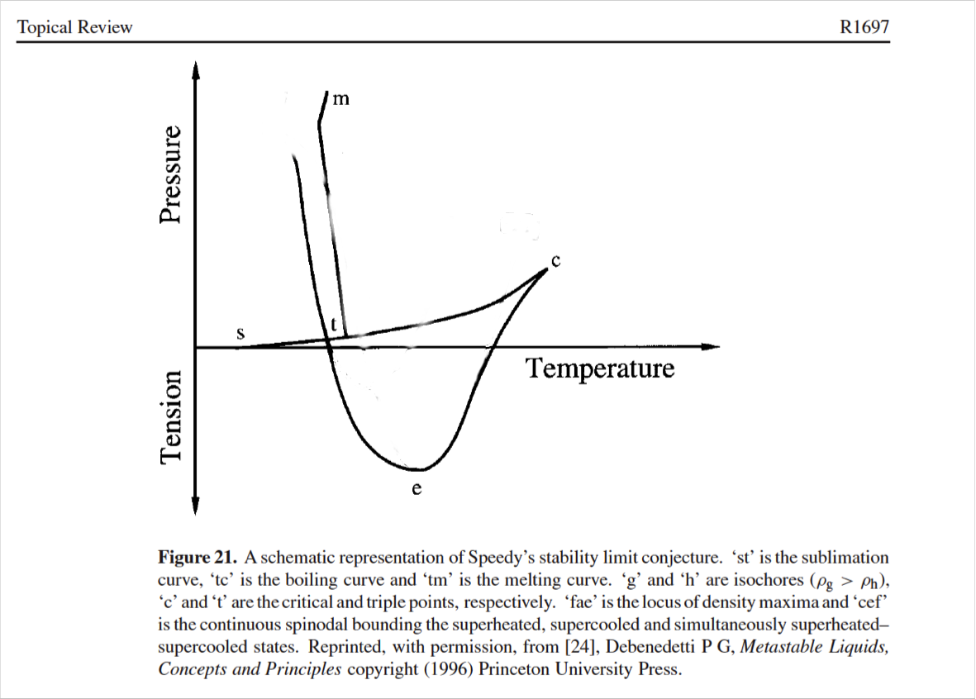
Debenedetti’s criticism

Slide 12
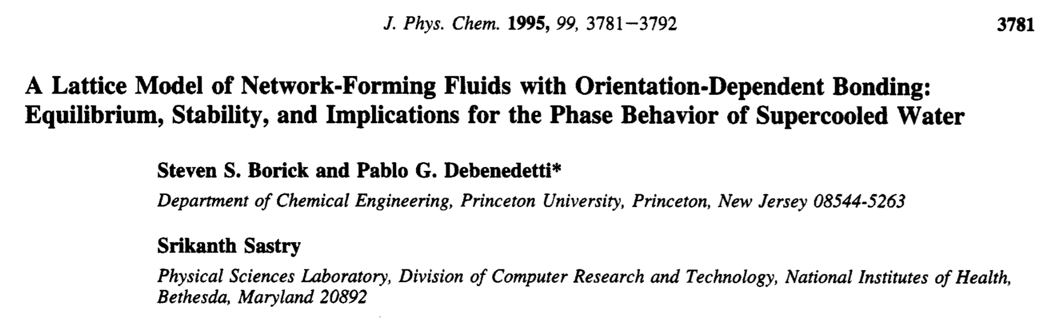
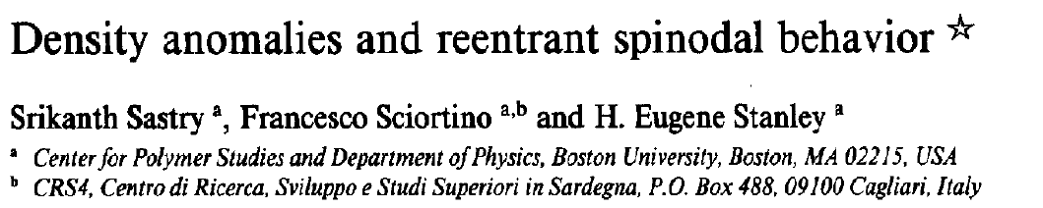
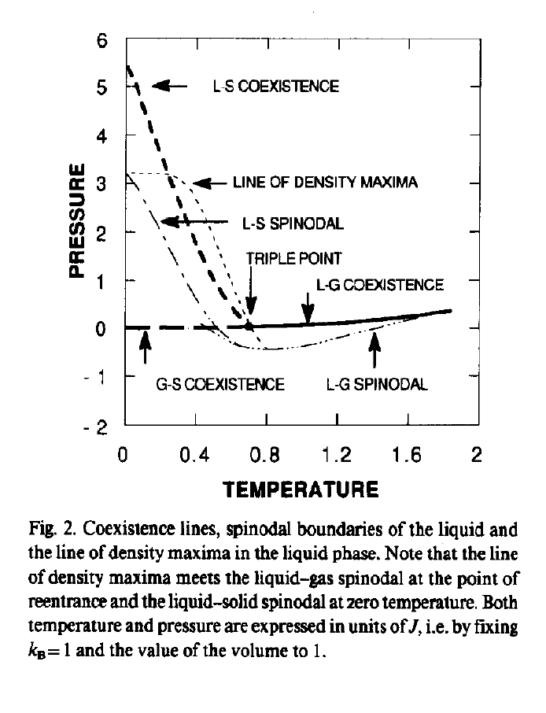
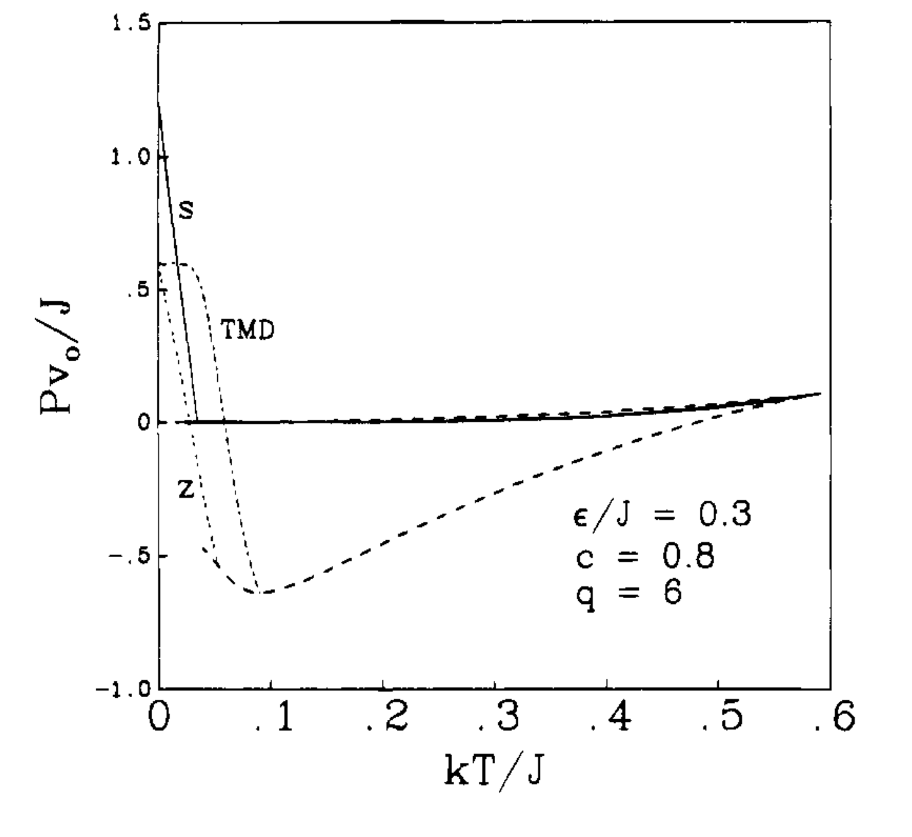
Mean Field Models with Reentrant Spinodal
(but no divergence of compressibility
at positive pressures)
Sasai M 1993 Bull. Chem. Soc. Japan 66 3362

Slide 13

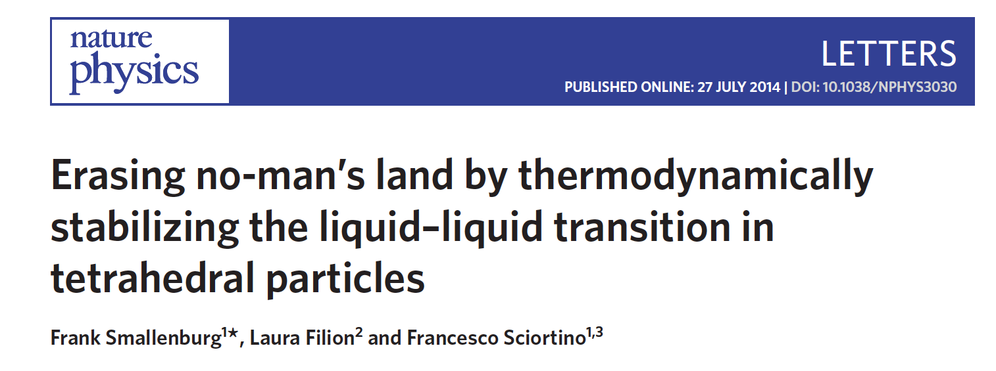
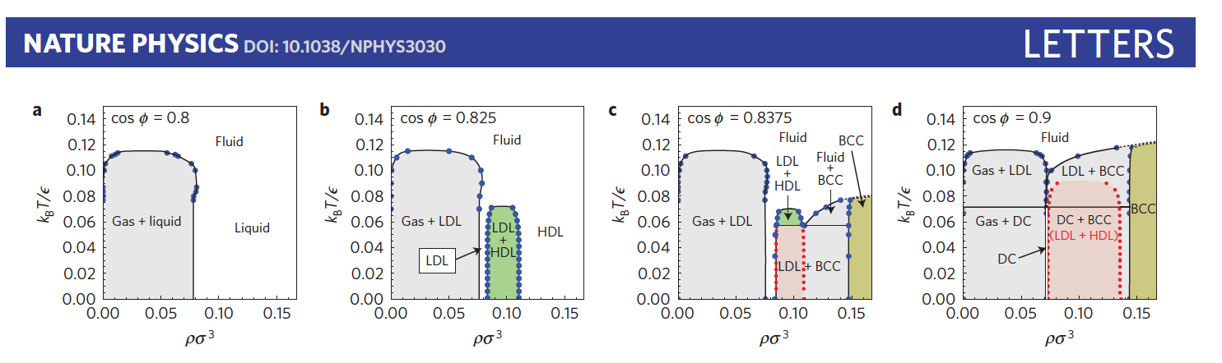
Colloids and water…..

Slide 14
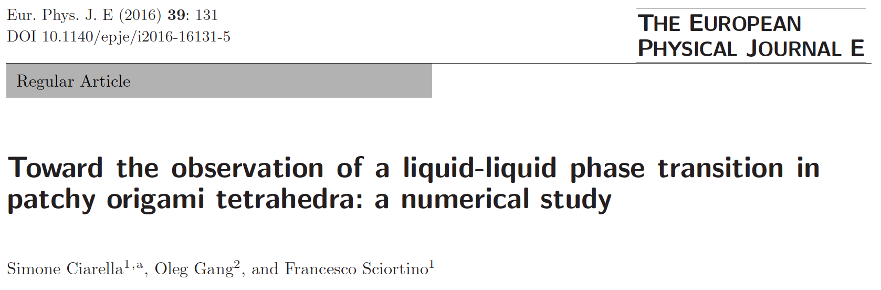
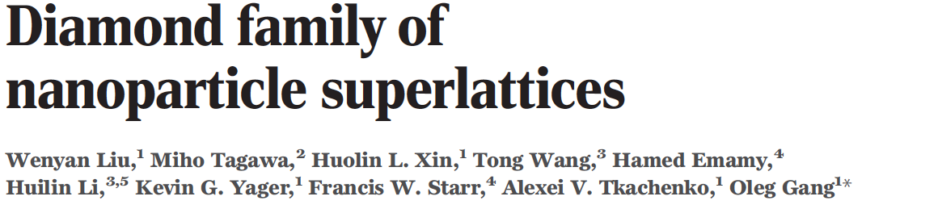
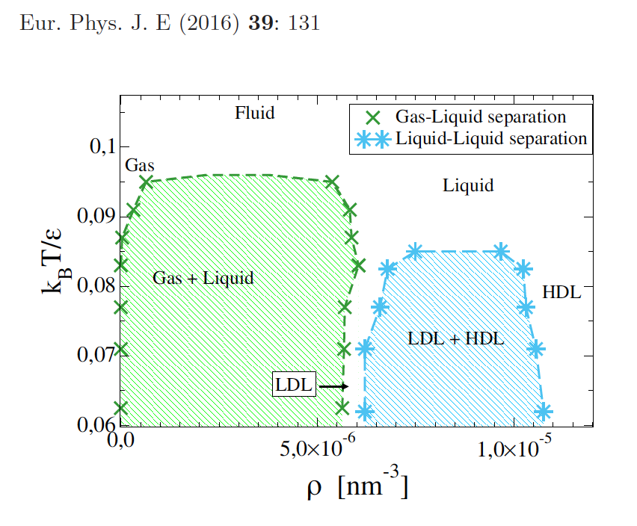
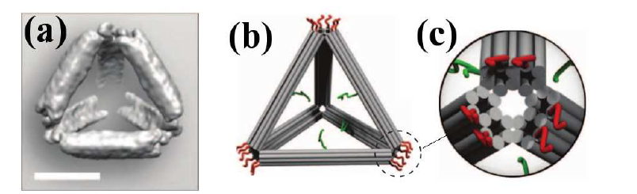
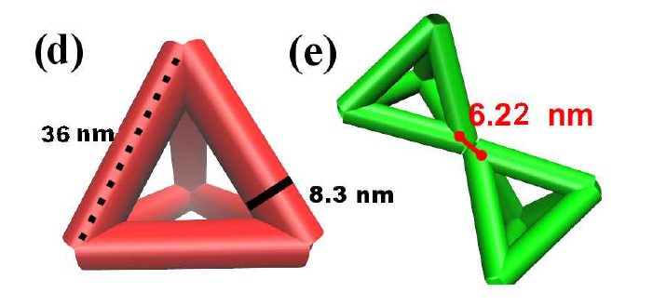
Getting closer to the real colloidal world
Science Vol. 351, pp. 582-586 2016:

Slide 15
Can colloidal models show a
Speedy re-entrant spinodal ?
“ To my mind the question of whether there is or is not a reentrant spinodal is similar to the medieval debate concerning angels dancing on pinheads. “

Slide 16

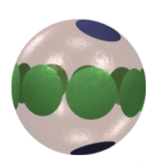
Two pair-wise additive particle models
(one component system with close loops and a structured gas phase)
2) Multiple-patches Particles gas of rings and chains
1) Janus Particles
gas of micelles

Slide 17
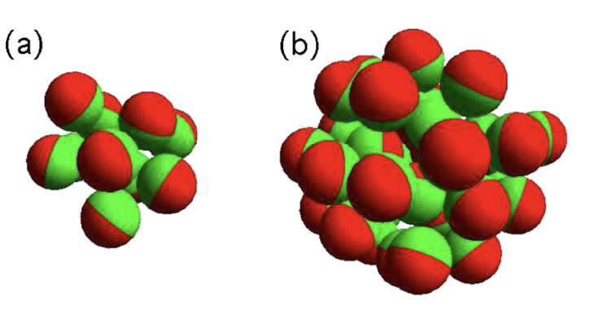
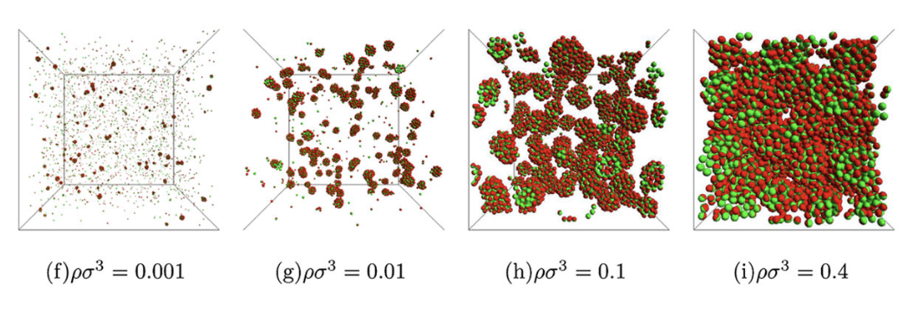
Janus Particles

Slide 18
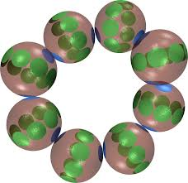
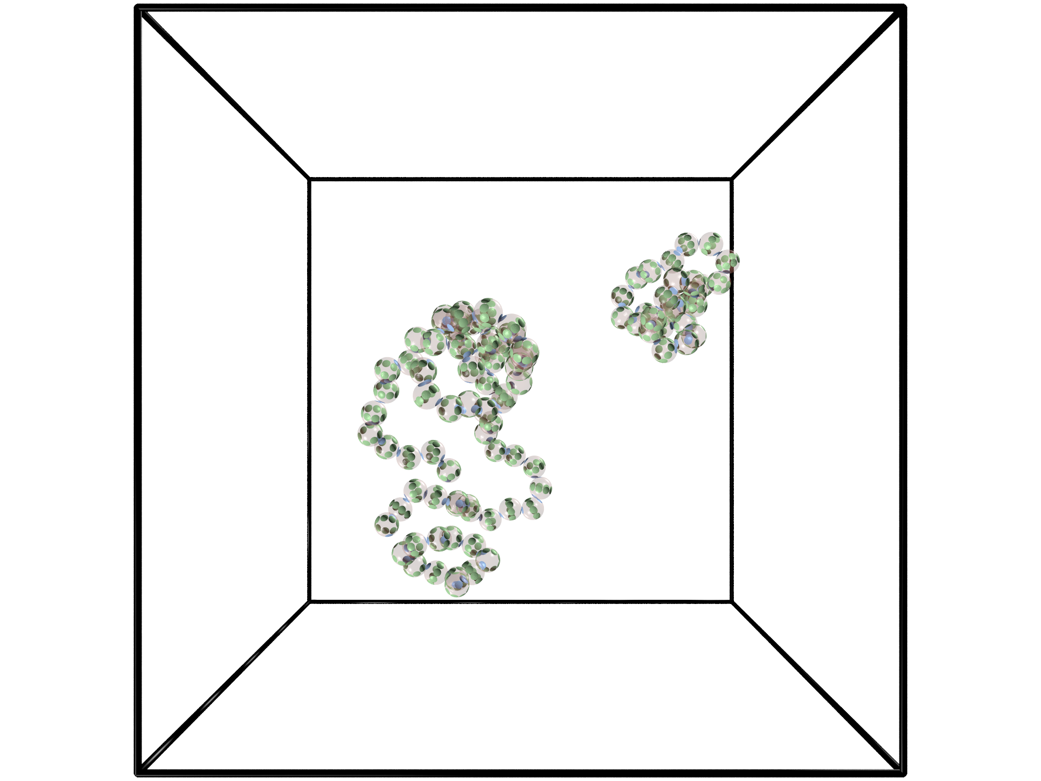
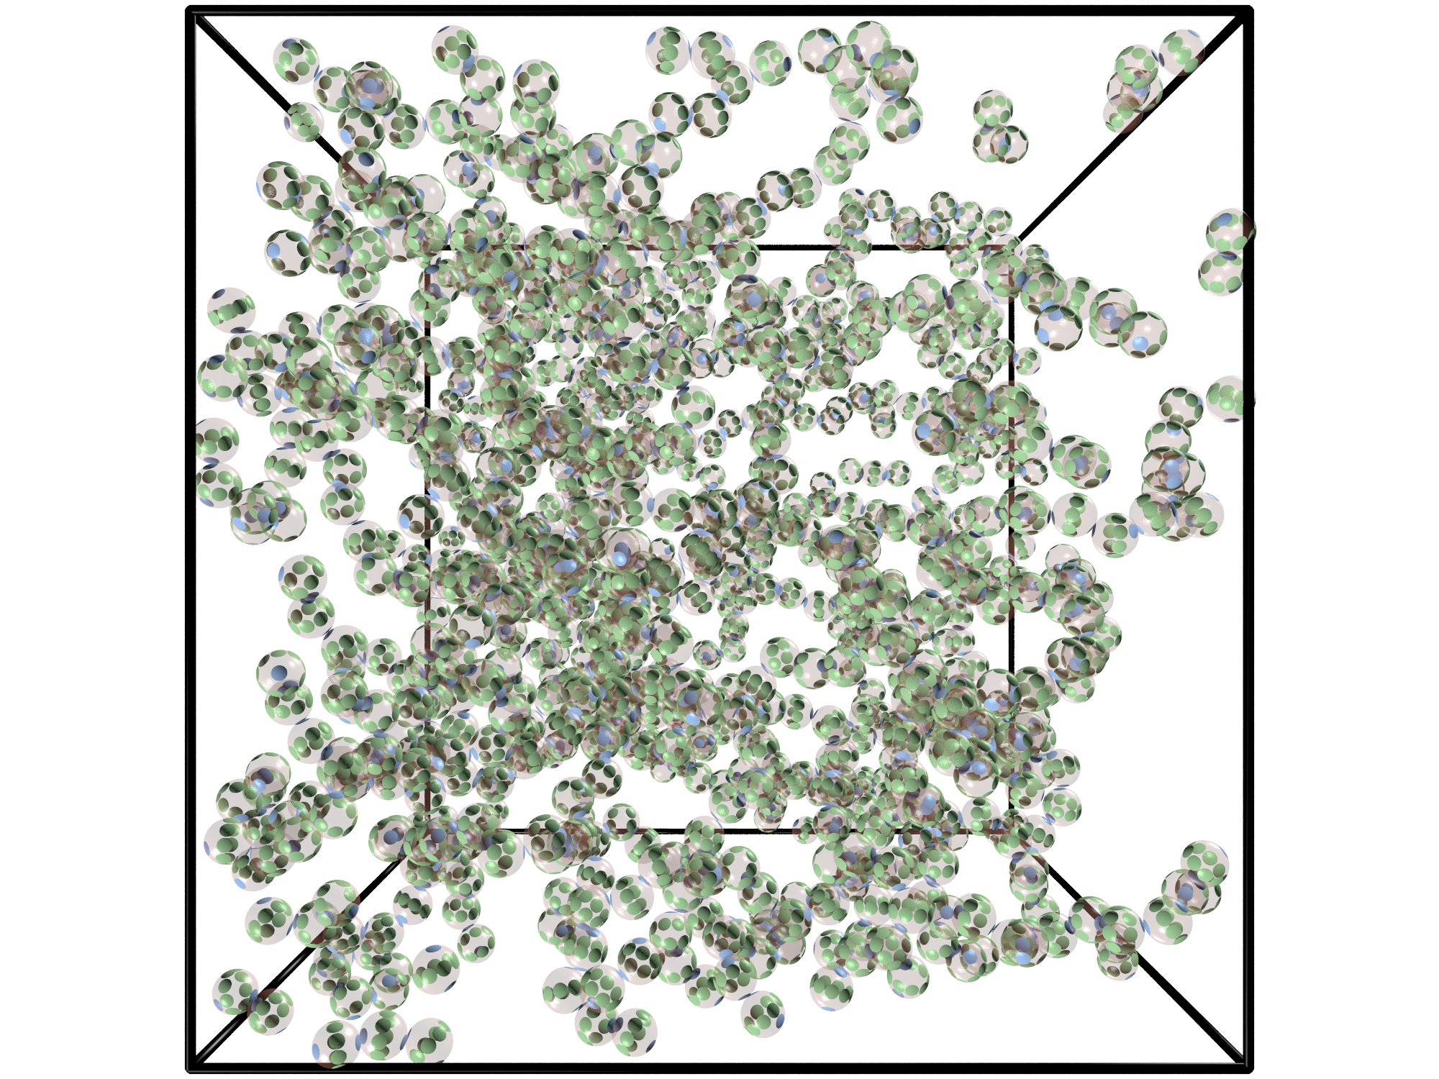
Multiple patches colloids
Gas of rings and chains
Liquid (percolating network)

Slide 19
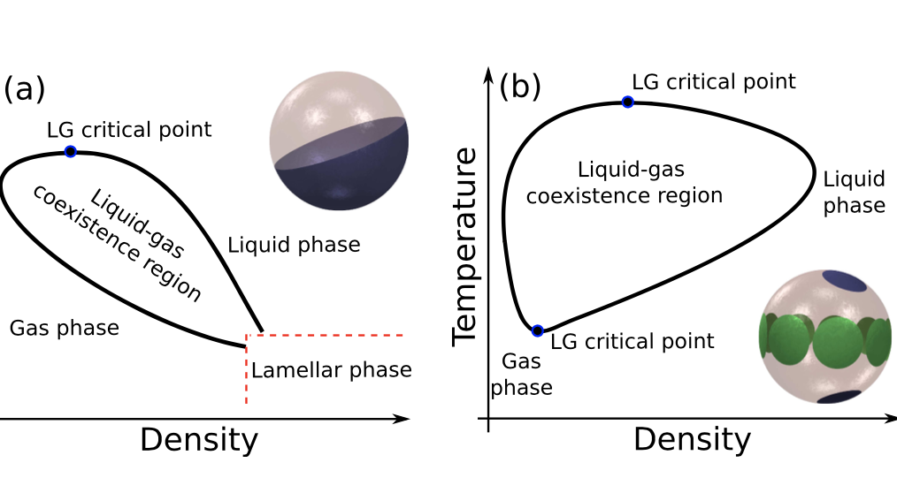
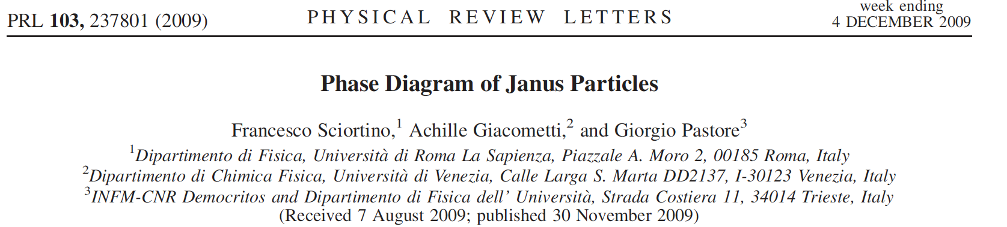
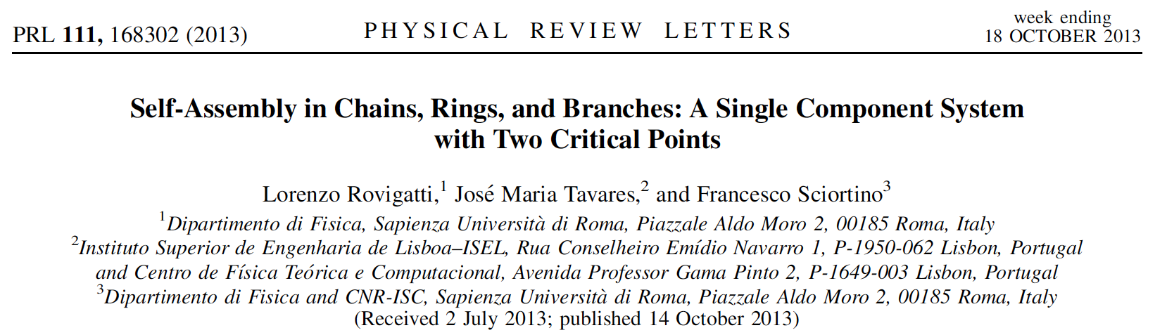
The “gas-liquid” phase diagrams

Slide 20
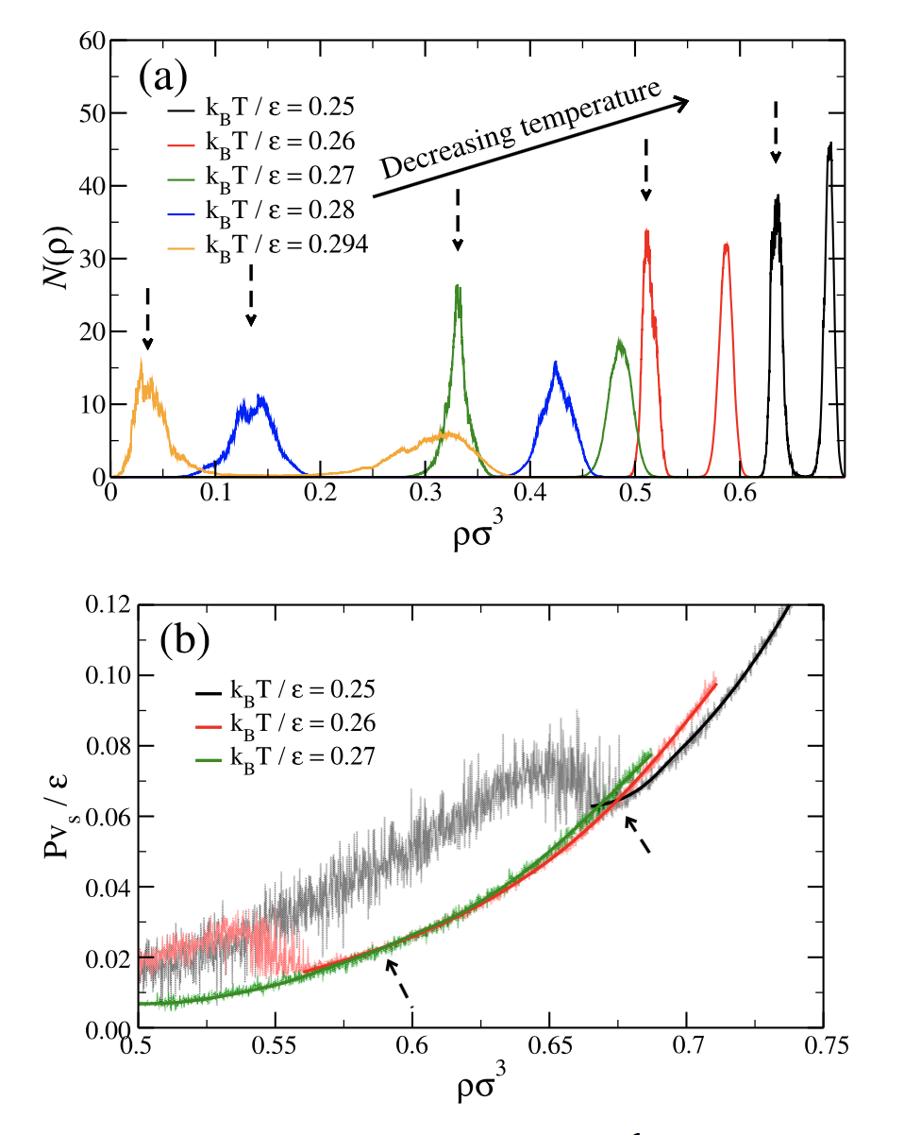
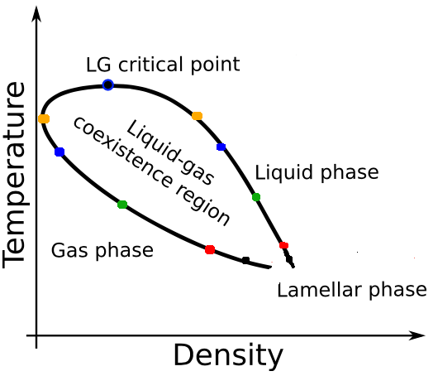
The raw data…. (Janus)

Slide 21
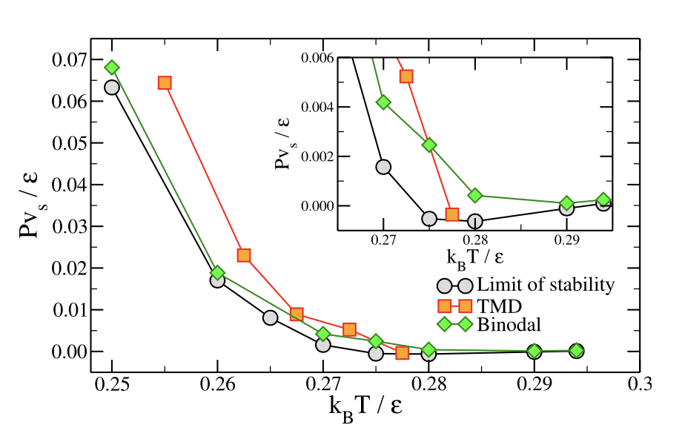
The Re-entrant Spinodal in the Janus system

Slide 22
The patchy model….
← Simulation
(Mean-field) Theory →

Slide 23
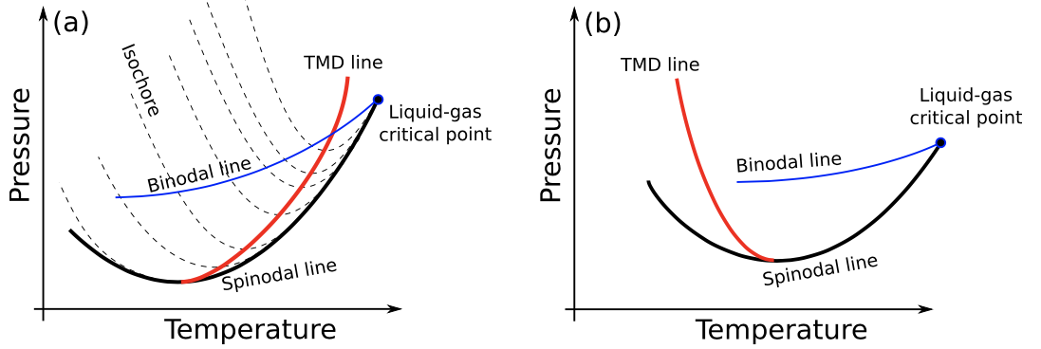
Conclusions:
One component systems can exhibit close-loops phase diagrams.
Re-entrant Speedy spinodals at positive pressures can exists (if the gas-liquid coexistence also retraces) (their presence can be detected by the increasing compressibility on cooling)
“Patchy” colloidal systems offer the possibility to realize these thermodynamic scenarios and perhaps even a colloidal water

Slide 24



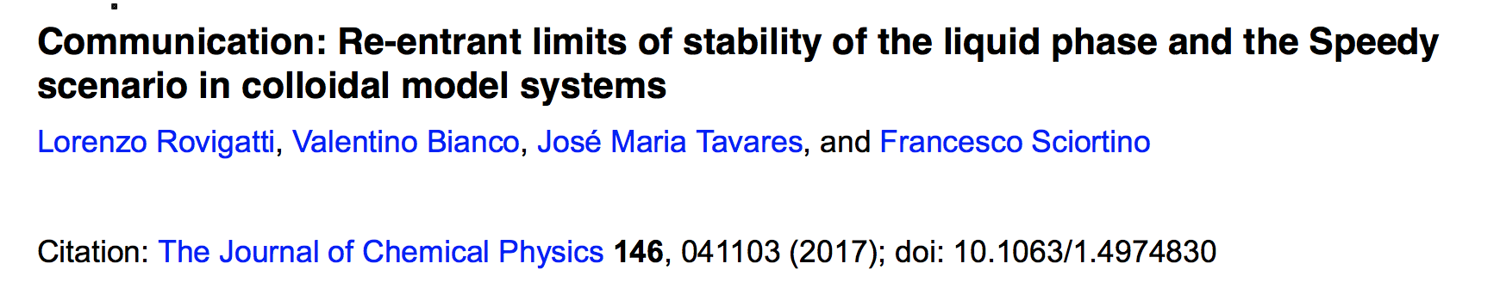
Collaborators
Thanks for listening !
Auguri Piero !
Lorenzo Rovigatti
Valentino Bianco
José Maria Tavares

Slide 25
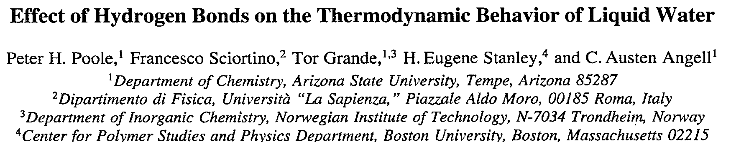
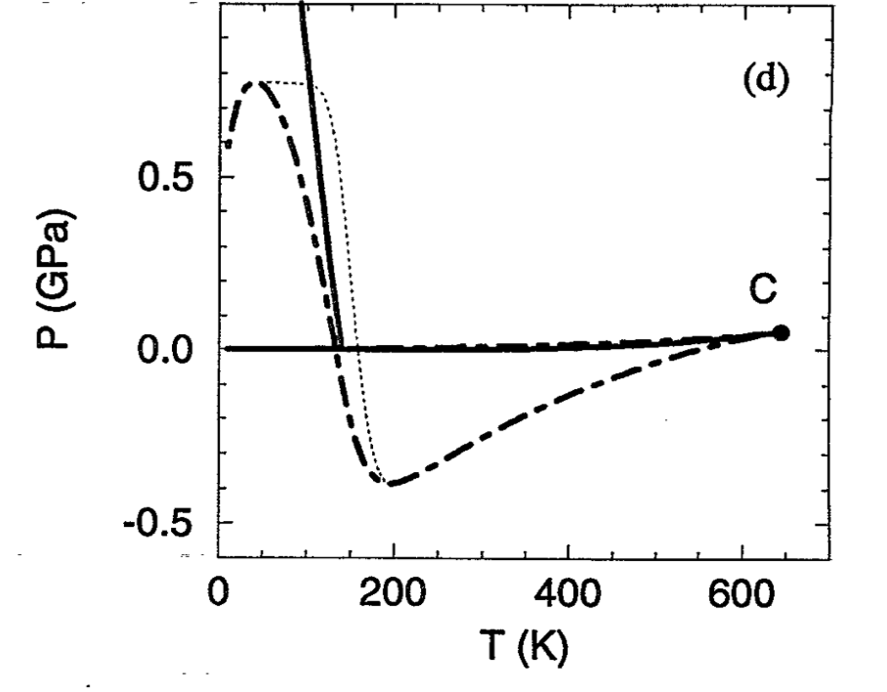
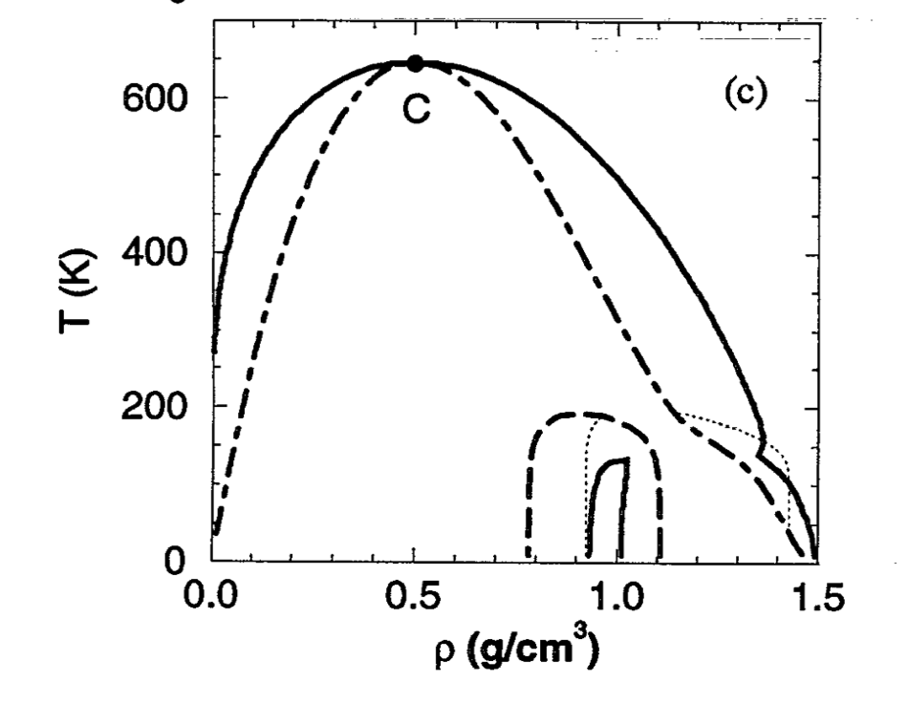
On lattice and analytic models
Sasai M 1993 Bull. Chem. Soc. Japan 66 3362
Borick S S, Debenedetti P G and Sastry S 1995 J. Phys. Chem. 99 3781

