Slide 1


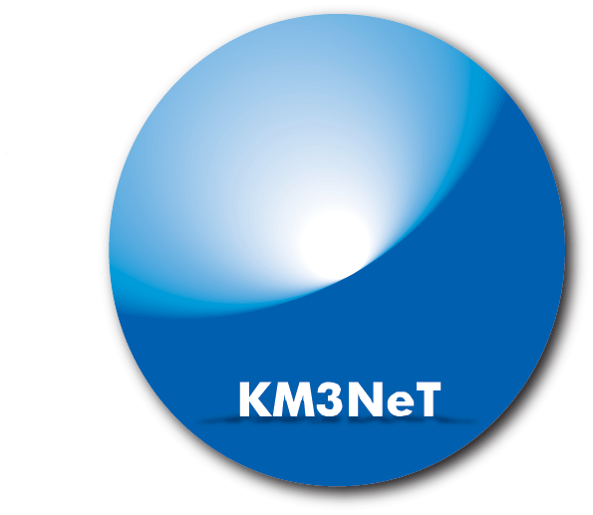

INFN researches and deep Sea activities
Antonio Capone
Physics Department, “Sapienza” University
and
Istituto Nazionale Fisica Nucleare, Roma
Why deep under-water Neutrino Telescopes
Current projects in Mediterranean Sea:
  ANTARES, NEMO, NESTOR
Aiming at a Km³ Neutrino Telescope in Mediterranean Sea:
  KM3NeT “Design Study” and KM3NeT “Preparatory Phase”
    Joining effort of European scientists: design and technologies R&D towards a common project
    Pan-European coordination of funding agencies and research Institutions
    Effective synergy with EMSO and Italian “marine” Institutes: INGV,CNR- ISMAR, OGS, TECNOMARE

Slide 2
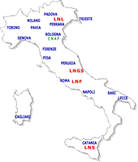





The INFN, National Institute of Nuclear Physics
The INFN, the National Institute of Nuclear Physics, is an organization dedicated to the study of the fundamental constituents of matter, and conducts theoretical and experimental research in the fields of sub-nuclear, nuclear, and astro-particle physics. Fundamental research in these areas requires the use of cutting-edge technologies and instrumentation, which the INFN develops both in its own laboratories and in collaboration with the world of industry. These activities are conducted in close collaboration with the academic world.
PARTICLE
PHYSICS
ASTROPARTICLE
PHYSICS
NUCLEAR
PHYSICS
THEORETICAL
PHYSICS
TECHNOLOGY
RESEARCH
Experiments carried out at accelerators

Slide 3
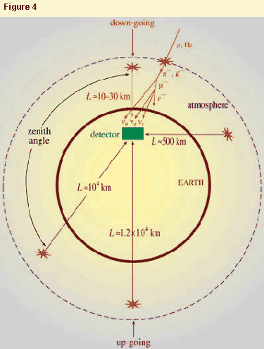
Astro-Particle Physics
search for new phenomena/particles in cosmic rays originated from the more energetic parts of the Universe
often rare events difficult to be distinguished from the more common “atmospheric particles”, usually less energetic. Some amount of matter can absorb this “background”
The Universe “observed” with high energy photons
Underground Laboratories (Kolar Mine, Sudbury, Gran Sasso, Kamioka) have been built to host astro-particle physics experiments.
If the flux to be measured is very faint, the size of the experiment has to grow up, no mine, no mountain can host a 1km³ scale experiment !!!!
A deep-Sea site can host such an experiment !
  3000 water column reduces the amount of atmospheric flux by factor 10⁶
  water is also an excellent medium to identify high energy particles (by exploiting the Cherenkov effect)
  After having solved the technological aspects: a deep sea water site is cheap !

Slide 4
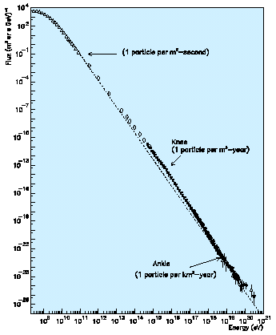
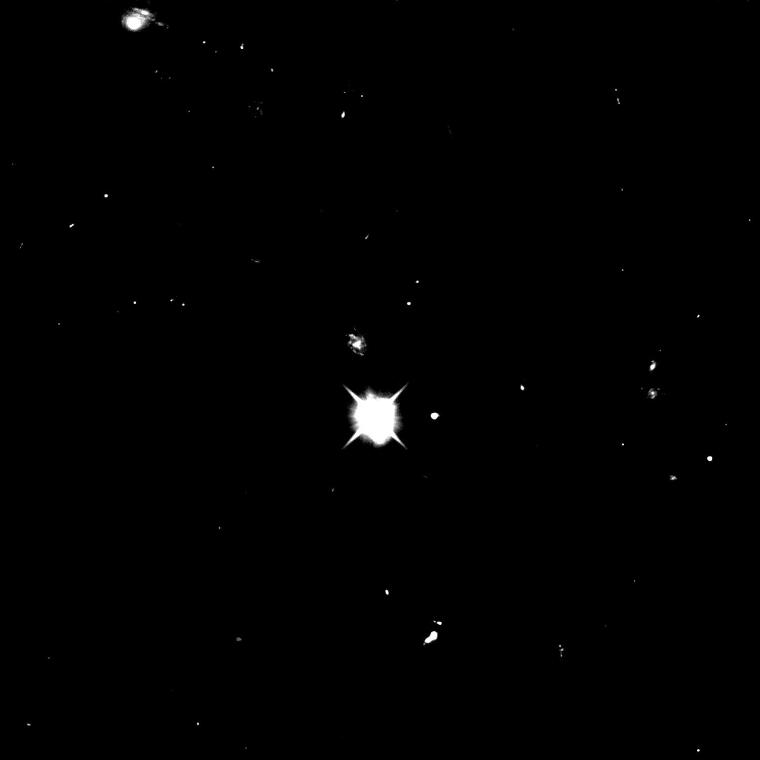
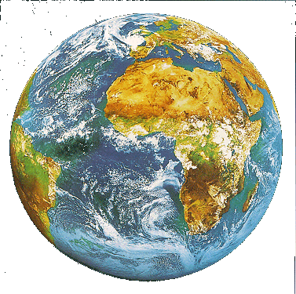
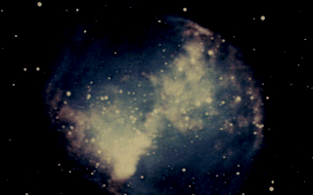
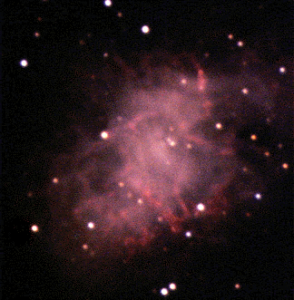
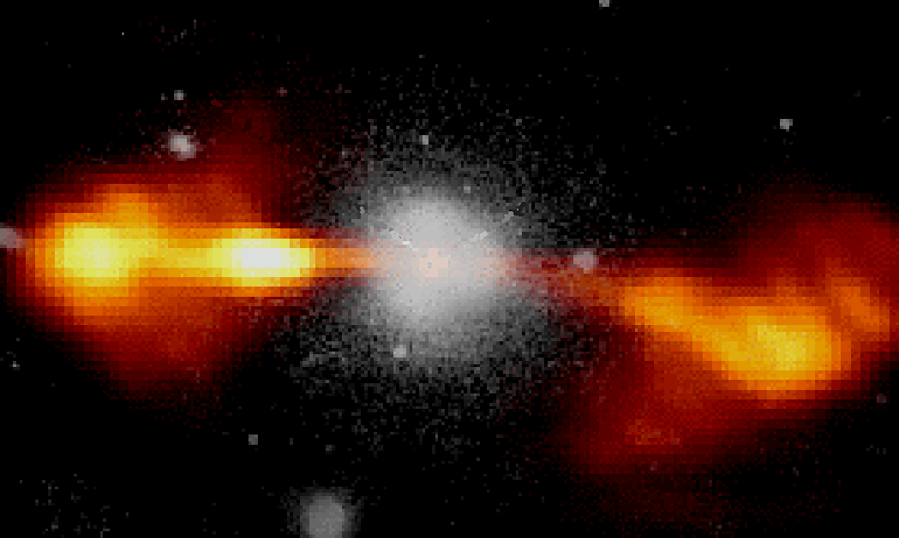
The Universe is transparent for UHE neutrinos !
Observed elementary particles or nuclei carrying a kinetic energy up to 10²¹eV (like a tennis ball moving at ~150km/h)
Many open questions:
  Where they come from ?
  Which acceleration mechanism ?
  …
Flux [particles/(m² s sr GeV)]
protons E>10¹⁹ eV (10 Mpc)
Cosmic accelerator
Our present knowledge about Cosmic Rays
neutrinos
Gamma rays (0.01 - 1 Mpc)
protons E<10¹⁹ eV
AGN, SNR, Microquasars, …
1 parsec (pc) = 3.26 light years (ly)
UHE astrophysical neutrinos will extend the limits of the "visible" Universe.
Energy [eV]

Slide 5
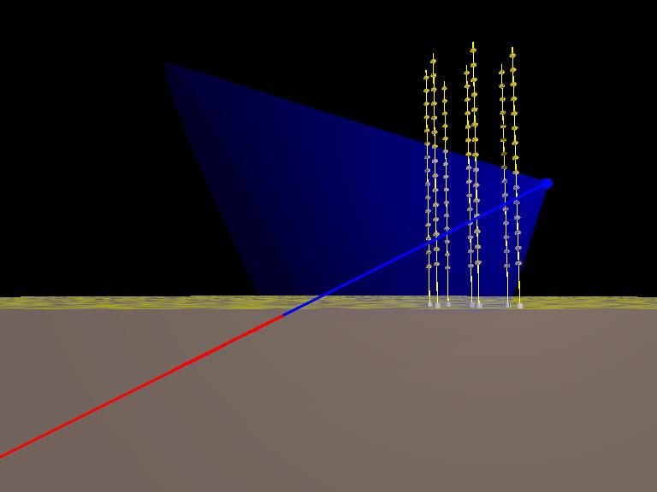
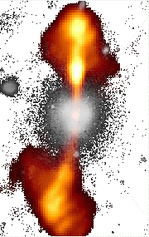
Detection principle
Search for neutrino induced events, mainly ,deep underwater
Atmospheric neutrino flux ~ E_{ν}⁻³
Neutrinos flux from cosmic sources ~ E_{ν}⁻²
  Search for neutrinos with E_{ν}>1÷10 TeV
~TeV muons propagate in water for several km
before being stopped
  go deep to reduce down-going atmospheric µ background.
  long µ tracks allow good angular reconstruction
Down-going µ from atm. showers
S/N ~ 10⁻⁶ at 3500m w.e. depth
p, nuclei
µ direction reconstructed from the arrival time of Cherenkov photons on the Optical Modules: needed good measurement of PMT hits, σ(t)~1ns, and good knowledge of PMT positions (σ ~10cm)
Cherenkov
Neutrino
Telescope
Neutrinos from cosmic sources
induce 1-100 muon evts/y
in a km³ Neutrino Telescope
p, nuclei
Up-going µ from neutrinos
generated in atm. showers
S/N ~ 10⁻⁴
µ and induced Cherenkov cone
43°
up-going neutrino
Picture from ANTARES

Slide 6
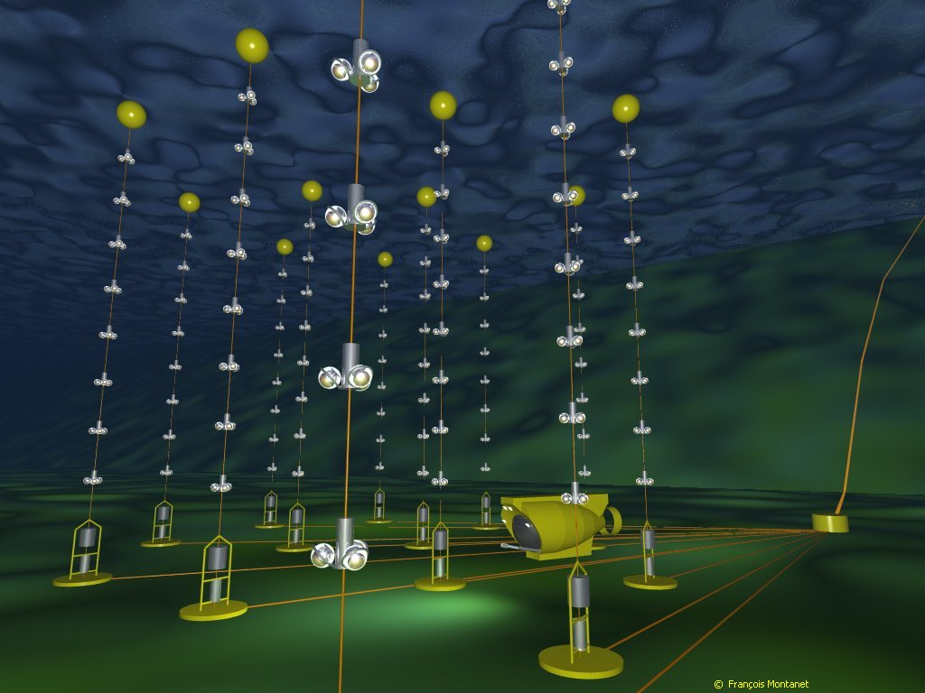
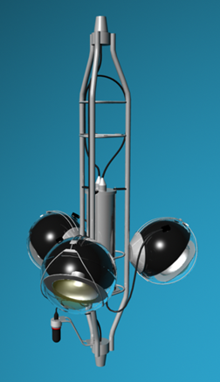
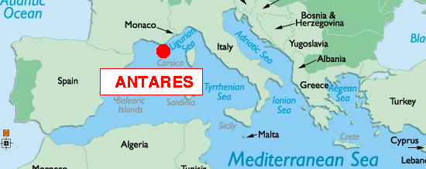
The ANTARES experiment: a pilot project in the Mediterranean
String-based detector;
Underwater connections
by deep-sea submersible;
Downward-looking
photomultipliers (PMTs),
axis at 45^{O} to vertical;
2500 m deep.
25 storeys,
348 m
100 m
14.5m
Junction Box
~70 m

Slide 7
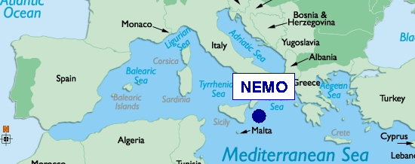
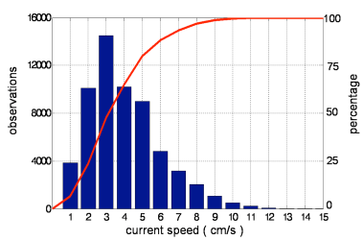
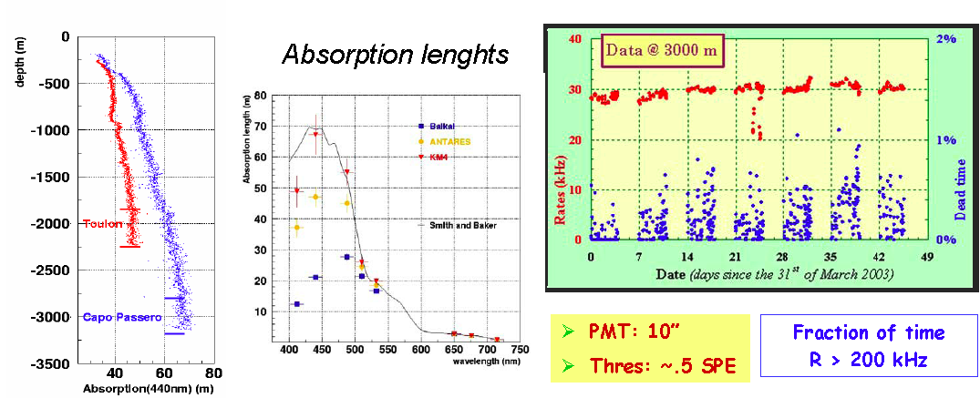
The NEMO Project: NEMO-RD
1998-2004 NEMO R&D and site selection
Extensive site exploration of Mediterranean Sea: selected Capo Passero site near Catania, depth 3500 m
  best optical properties out of studied sites L_{a} ~70m @ 440nm
  No seasonal variations of water optical properties
  extremely low background from bioluminescence
  deep Sea water current are low (3cm/s avg.) and stable
  Wide abyssal plain, far from the shelf break, allows for possible reconfigurations of the detector layout
R&D towards km³: detector architecture, mechanical structures, electronics, readout, cables …, junction box, wet-mateable connectors, deep-sea e/o cables, power transmission, … (see Rosanna Cocimano talk)
Simulation
An effective synergy between INFN and CNR, OGS, INGV, ISMAR, SACLANTCEN !!!

Slide 8
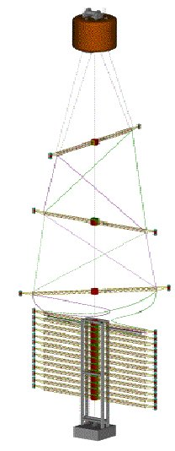
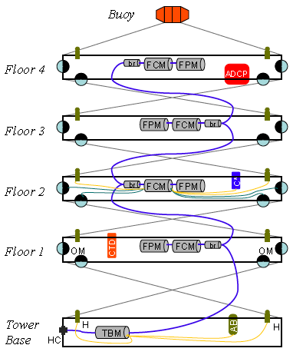
NEMO-Phase1 - 2004-2008
Created a "Deep-Sea Test Site", 20 Km East of Catania at 2000m depth, connected with 25 km long EOC to the shore station of INFN-LNS
Validation of the technological solution proposed for the realization and installation of the km³ detector
Realization of a technological demonstrator including all the key elements of the NEMO km³ concept
  Mechanical structures
  Optical and environmental sensors
  Readout electronics
  Data transmission system
  Power distribution system
  Acoustic positioning system
  Time calibration system
Multidisciplinary activities
  Oνde : measurements of the acoustic background at 2100 m depth, dauphins and sperm whales (in close collaboration with INGV, Tecnomare and NURC)
  SN-1 : first operative node of ESONET

Slide 9
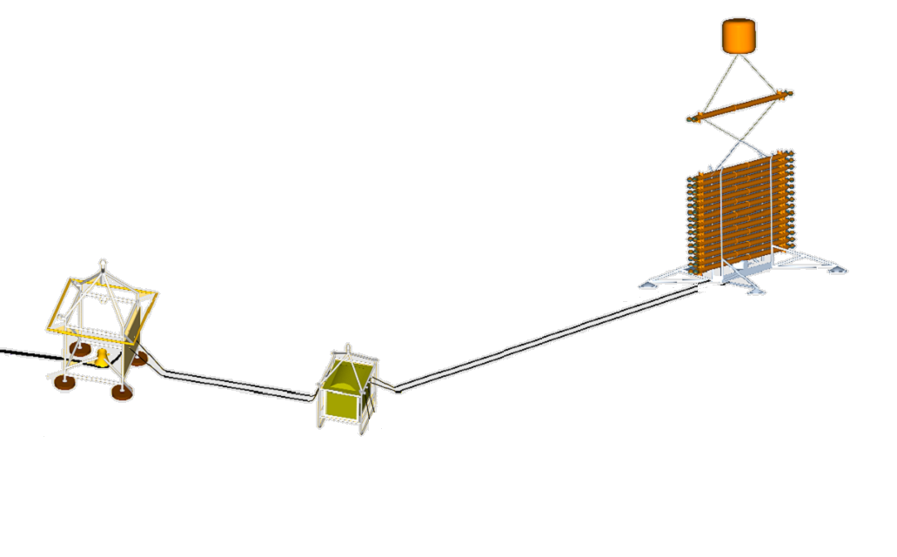
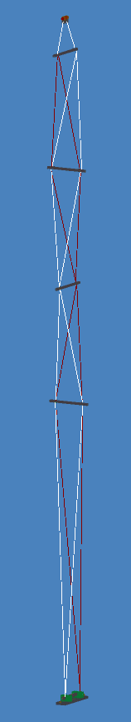
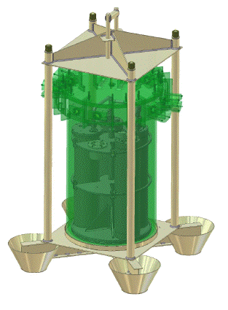
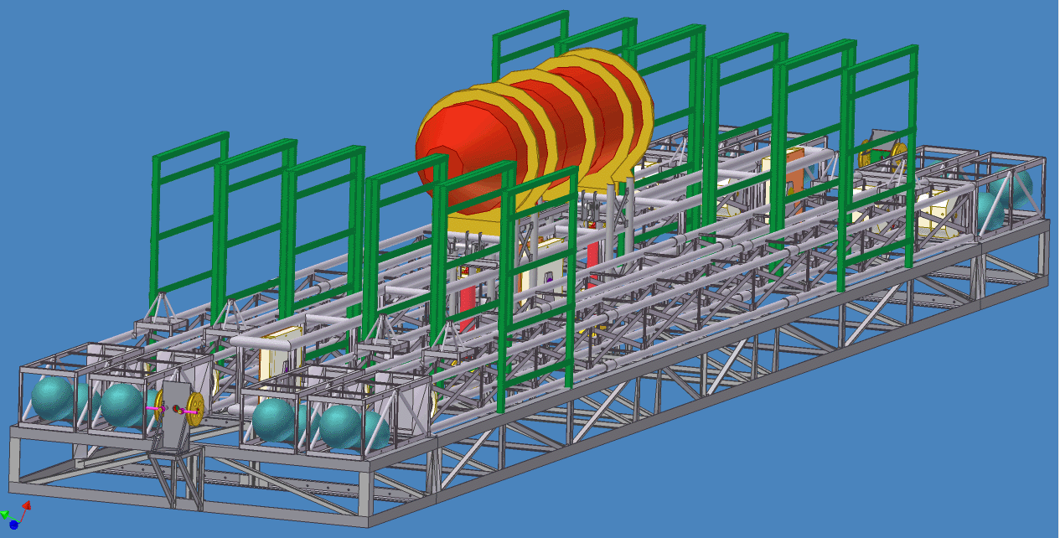
NEMO Phase-1: a 4 floors tower @ 2000m depth
In the INFN NEMO Test Site, 20 km East of Catania
Dec. 2006: Deployment of JB and mini-tower
Deployed
January 2005
Junction Box (JB)
NEMO mini-tower
(4 floors, 16 OM)
TSS Frame
300 m
Mini-tower, unfurled
Mini-tower, compacted
NEMO Junction Box
new low cost technology
15 m

Slide 10
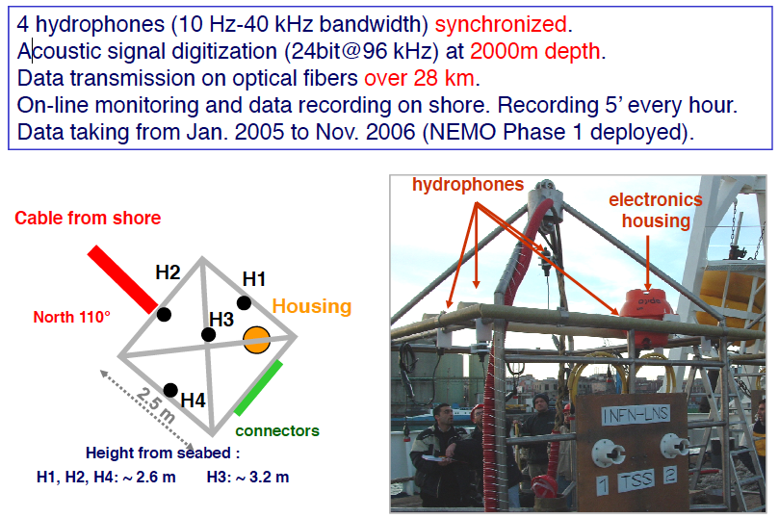
OνDE: Ocean Noise Detection Experiment

Slide 11
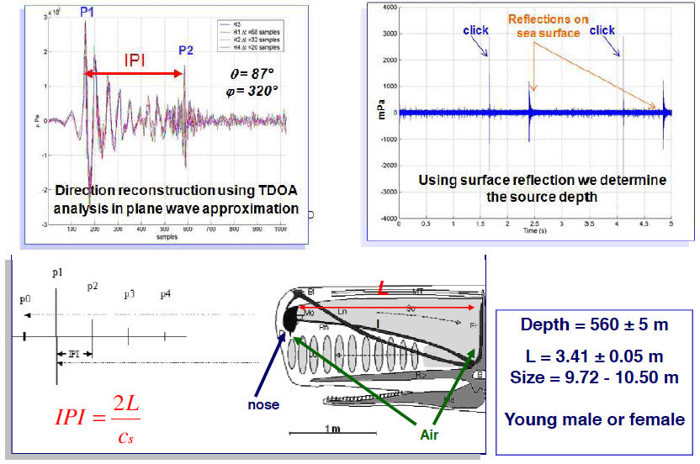
OνDE result: bioacustic: Sperm-whale click analysis

Slide 12
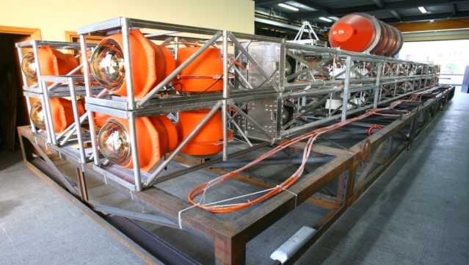
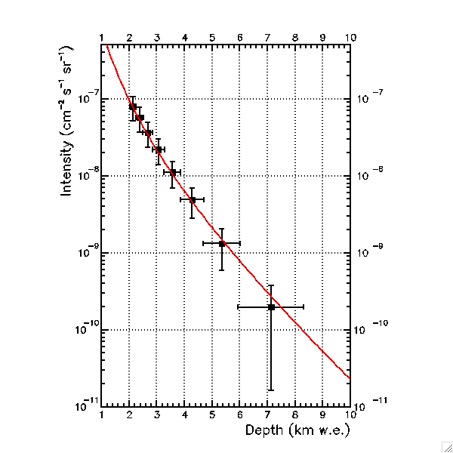
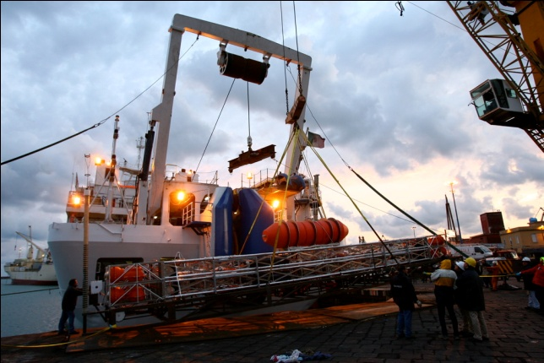
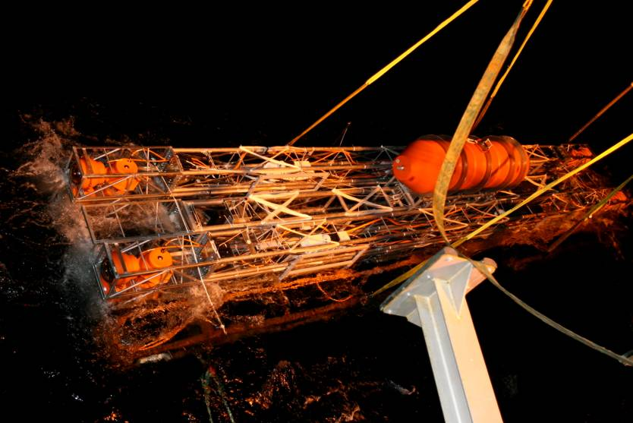
NEMO Towers, prototypes for KM3NeT
  Tested on Catania site
  (2100 m)
“Mini tower” (Dec. 06)
  4 storeys @ 40 m
    4 PMs per storey
  15 m long bars
  Deployment test (unfurling)
  NEMO electronics and readout
    Operated during 6 months
    Data taking (muons)
In press on Astroparticle Physics
300 m
Notes:
12

Slide 13
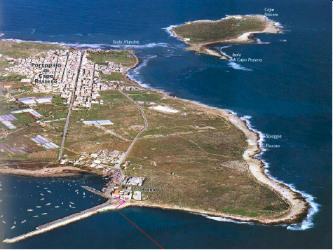
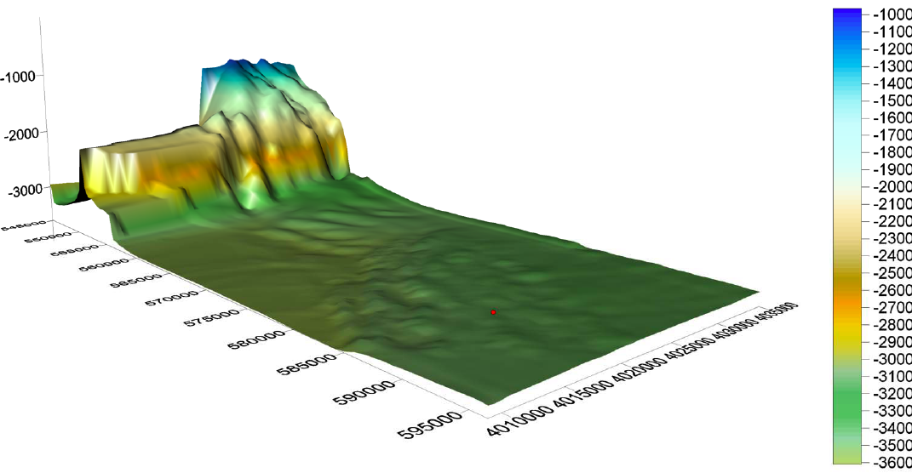
NEMO-Phase2, Capo Passero Site at 3500m depth
On-shore infrastructure under construction (on-shore building completion at beginning 2008)
100 km Electro-Optical cable (>50 KW, 20 fibres) deployed (summer 2007)
On shore Power Feeding System operational
ALCATEL DC(10kV) / DC(400V) converter deployed and connected (winter 2009)
Tower deployment foreseen middle 2011
The Capo Passero Site will
also provide a very useful facility to test KM3NeT technologies

Slide 14
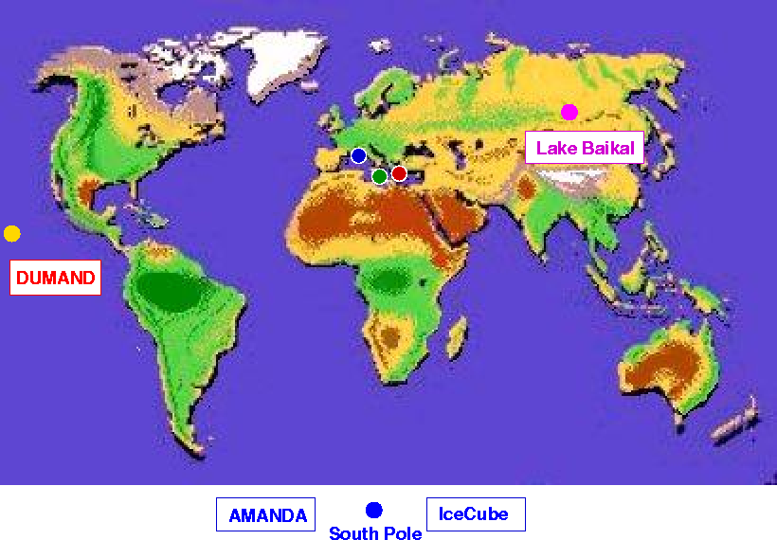
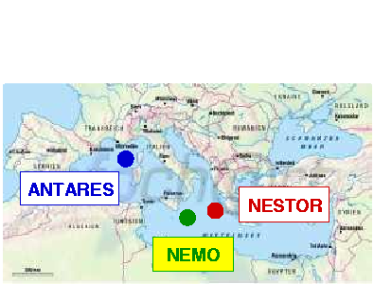
The Neutrino Telescopes World Map
ANTARES + NEMO + NESTOR joined their efforts to prepare a km³-scale Cherenkov Neutrino Telescope in the Mediterranean →KM3NeT Design Study

Slide 15


KM3NeT, what is it ?
A Consortium between the groups/Institutions that originated and support the pilot neutrino telescope projects in the Mediterranean Sea for:
  Design Study for the construction of a Deep Sea Facility in the Mediterranean for Neutrino Astronomy and Associated Sciences
    a next generation water Cherenkov neutrino telescope of 1 km³ volume in the Mediterranean Sea
    a future deep sea Research Infrastructure for ocean sciences:
      Oceanology, Marine Biology, Environmental Science, Geology and Geophysics
  Objective: develop cost-effective design for the construction of a 1 km³ neutrino telescope (~ 200 M€)
  KM3NeT Design Study funded by the European Community (FP6, 2002-2006) → Technical Design Report with all technological issues defined and described
  KM3NeT Preparatory Phase funded by the European Community in the framework of "Frame Program 7" (FP7, 2008-2012)
Participants from existing collaborations (ANTARES, NEMO, NESTOR) and European Sea science and Technology Institutions (ESONET, EMSO, …)
+
+
+ …

Slide 16
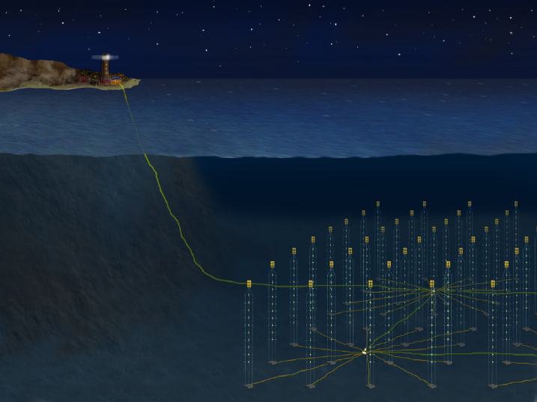
The KM3NeT Research Infrastructure: just a scheme !
Shore Station
(DU)
Marine Science nodes
MEOC = Main Electro Optical Cable to shore
buoy
Storey
deep sea: 2 - 5 km depths
Detection
Unit = DU
deep sea cable network
JB = Junction Box

Slide 17
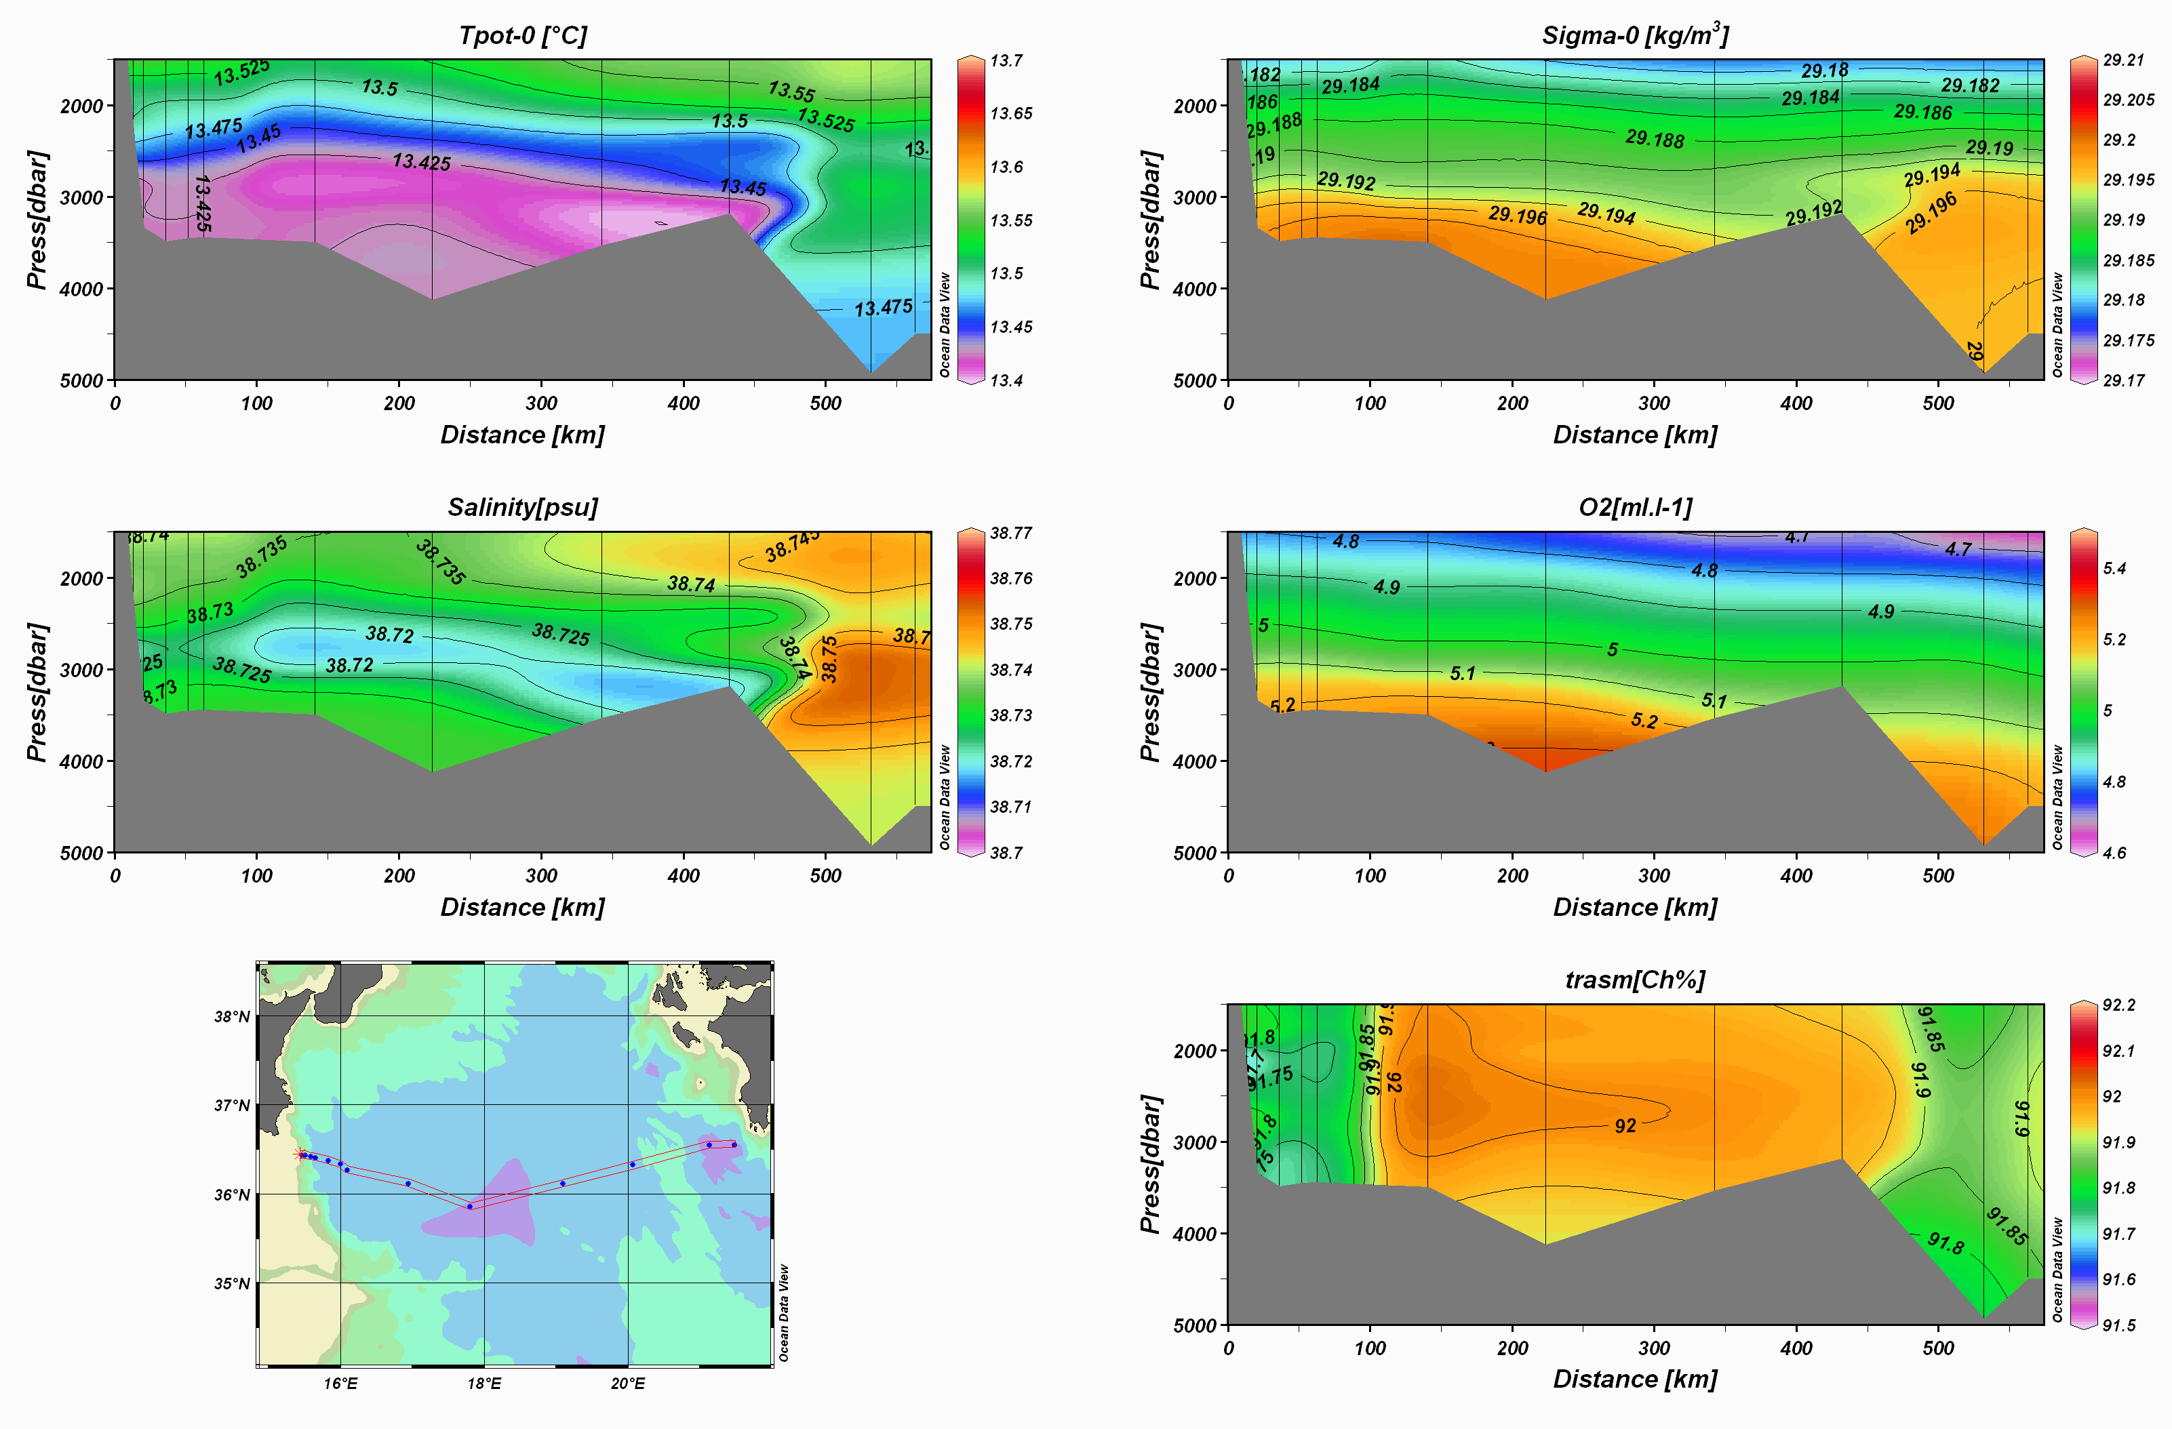
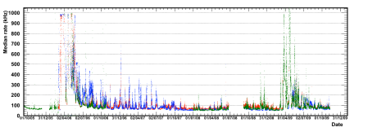
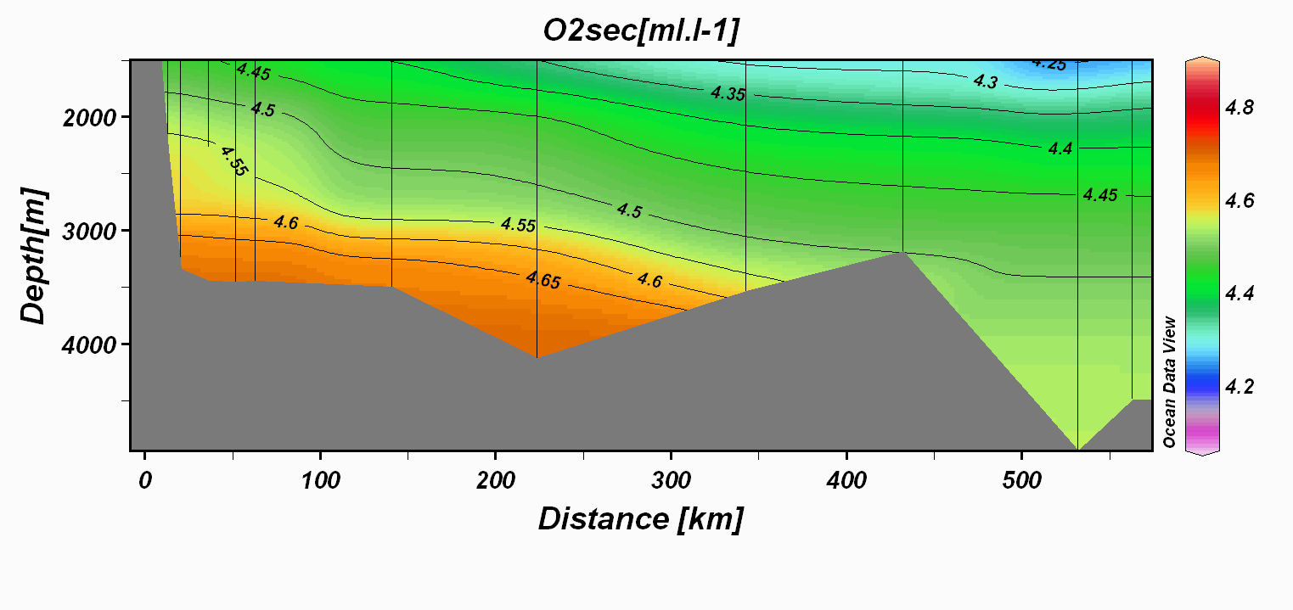
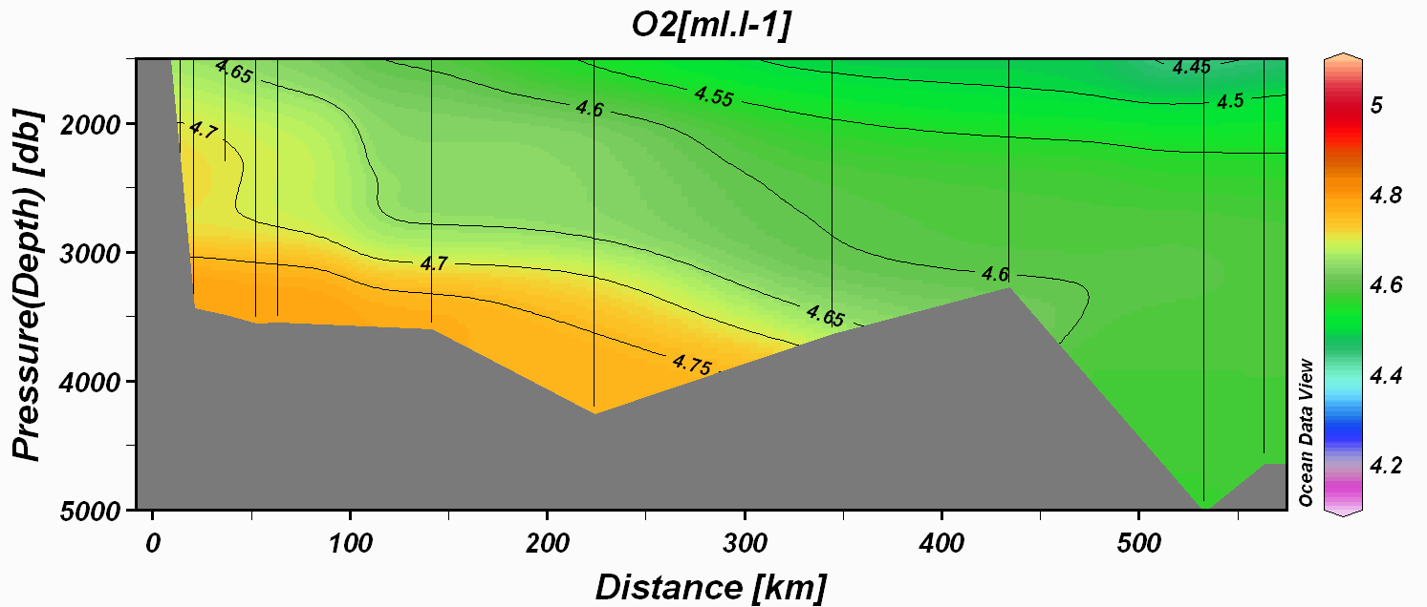
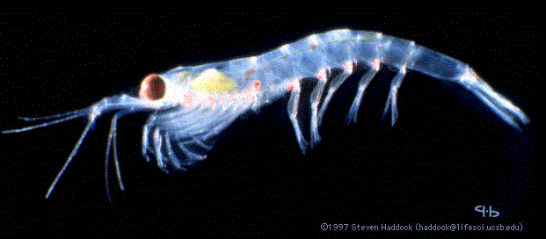
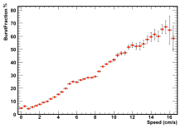
Long term measurements in Mediterranean sites
one example, hydrological properties: salinity, temperature, oxigen, …
CNR hydrographic cruise – July 2007
Optical noise in ANTARES site 2005-2009: Bioluminescence
Background light:
  bioluminescence (bacteria, macroscopic organisms)
  decays of ⁴⁰K (~30 kHz for 10’’ photomultiplier)
Correlation with water current
  Light bursts by macroscopic organisms – induced by pressure variation in turbulent flow around optical modules ?!
Optical noise in ANTARES site 2005-09: Bioluminescence as a function of deep-sea current speed
but also: deep-sea currents, sediments, biofouling, optical properties, …
IFREMER, IN2P3, Saclay, HCMR, CNR, INFN, INGV, TECNOMARE, UNIABDN, NESTOR/NOA, U. Athens

Slide 18
Summary
Compelling scientific interest for the construction of “Neutrino Telescope” in deep-sea
The realization of pilot projects in Mediterranean sea (ANTARES, NEMO, NESTOR) funded by High Energy Physics agencies was possible also thanks to a strong collaboration and synergy with Institutes working in “marine science” research and technology development
The KM3NeT Consortium, funded by European Committee within FP6 and FP7, endorses the common effort of the Mediterranean pilot projects, and new collaborators, for the design of the km³ Neutrino Telescope, the related deep-Sea infrastructures, and the solutions to technological challenges.
Aiming at the construction of an European deep-sea infrastructure housing the km³ Cherenkov Neutrino Telescope and providing an open access for deep-sea research

Slide 19
KM3NeT time schedule
now
Feb 2006
Mar 2008
Mar 2011
End 2009
Design Study
KM3NeT
Preparatory Phase
Prototyping/construction
Data Taking

