Slide 1


High Energy Astrophysical Cherenkov Neutrino Telescope at CapoPassero: status report
Outlook
Physics with deep under-water/ice Neutrino Telescopes
Current projects in Mediterranean Sea:
  ANTARES
  NEMO
  NESTOR
Aiming at Km³ Neutrino Telescope in Mediterranean Sea:
  KM3NeT
    Joining efforts, design and technologies towards a common project
    Pan-European coordination of funding agencies and research Institutions
Status and perspectives
  KM3NeT-Italy, Km3

Slide 2
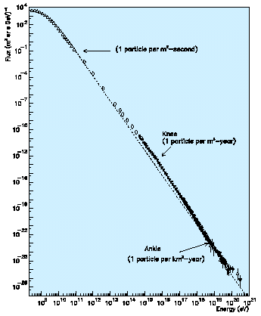
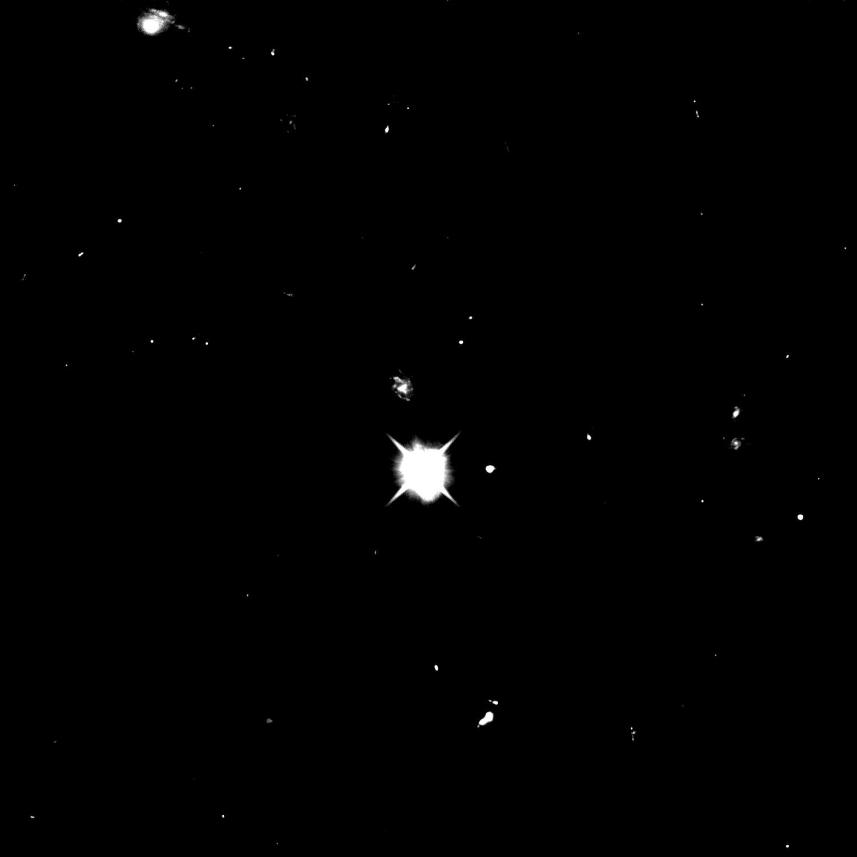

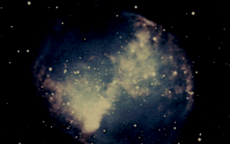
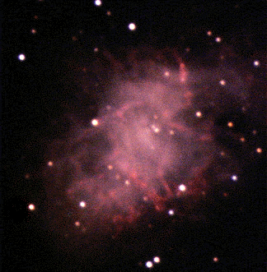
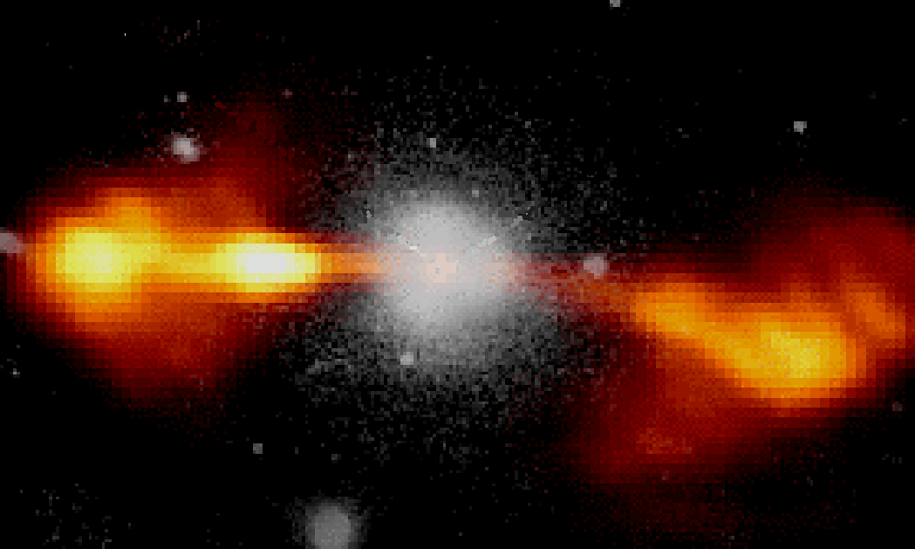
The Universe is transparent for UHE neutrinos !
Observed elementary particles or nuclei carrying a kinetic energy up to 10²¹eV (like a tennis ball moving at ~150km/h)
Many open questions:
  Where they come from ?
  Which acceleration mechanism ?
  …
Flux [particles/(m² s sr GeV)]
protons E>10¹⁹ eV (10 Mpc)
Cosmic accelerator
Our present knowledge about Cosmic Rays
neutrinos
Gamma rays (0.01 - 1 Mpc)
protons E<10¹⁹ eV
AGN, SNR, Microquasars, …
1 parsec (pc) = 3.26 light years (ly)
UHE astrophysical neutrinos will extend the limits of the "visible" Universe.
Energy [eV]

Slide 3
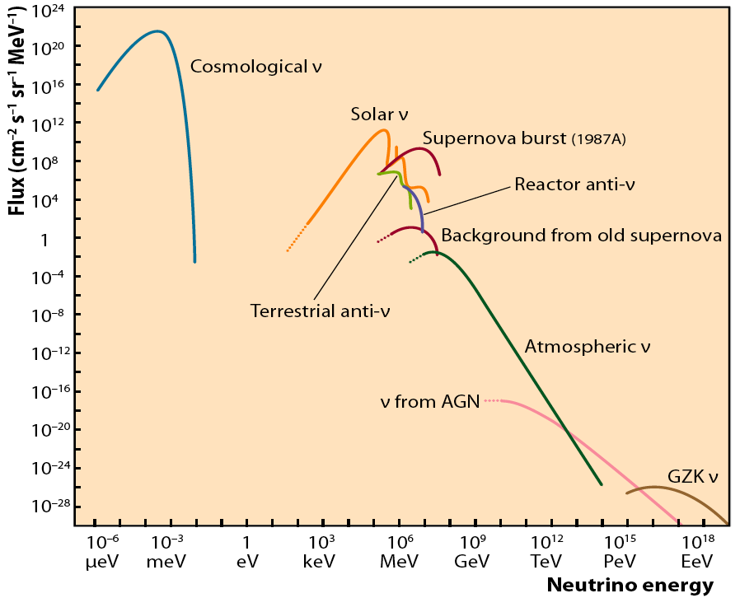
A synoptic view of neutrino fluxes

Slide 4
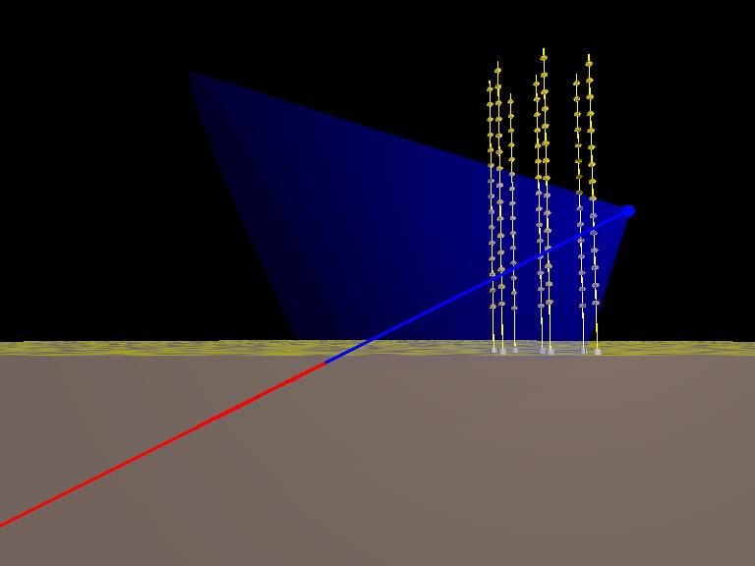
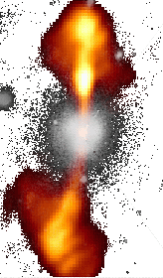
Detection principle
Search for neutrino induced events, mainly , deep underwater
Atmospheric neutrino flux ~ E_{ν}⁻³
Neutrinos flux from cosmic sources ~ E_{ν}⁻²
  Search for neutrinos with E_{ν}>1÷10 TeV
~TeV muons propagate in water for several km
before being stopped
  go deep to reduce down-going atmospheric µ backg.
  long µ tracks allow good angular reconstruction
Down-going µ from atm. showers
S/N ~ 10⁻⁶ at 3500m w.e. depth
p, nuclei
µ direction reconstructed from the arrival time of Cherenkov photons on the Optical Modules: needed good measurement of PMT hits, σ(t)~1ns, and good knowledge of PMT positions (σ ~10cm)
Cherenkov
Neutrino
Telescope
Neutrinos from cosmic sources
induce 1-100 muon evts/y
in a km³ Neutrino Telescope
p, nuclei
Up-going µ from neutrinos
generated in atm. showers
S/N ~ 10⁻⁴
µ and induced Cherenkov cone
43°
up-going neutrino
Picture from ANTARES

Slide 5
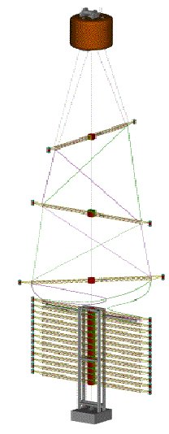
Our Detector concept: a 3D semi-rigid structure holding O.M. in fixed positions

Slide 6
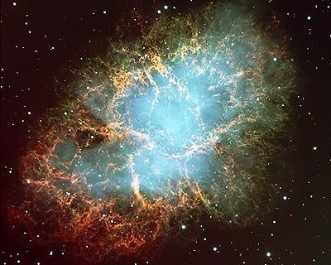
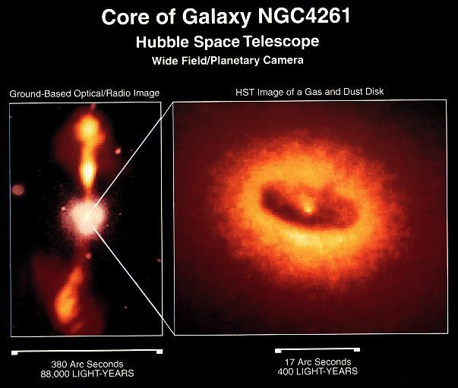
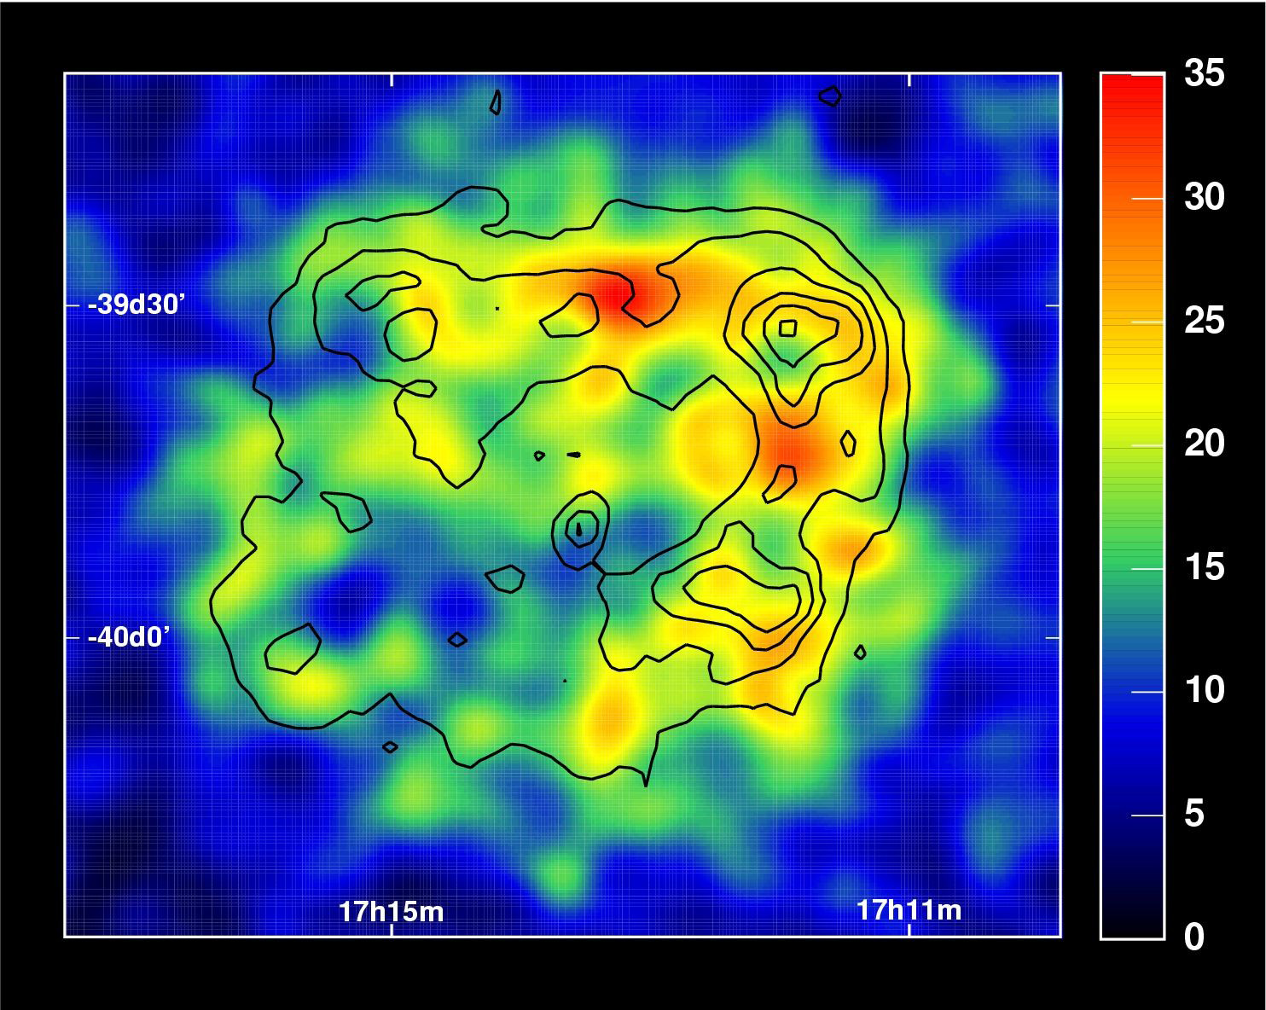
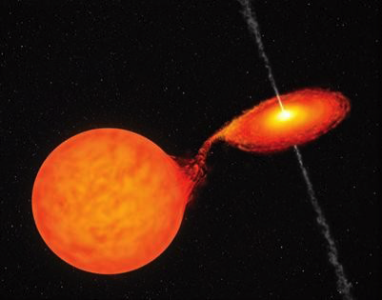
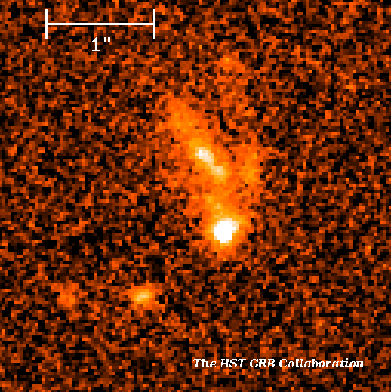
Point like cosmic Neutrino Sources
Galactic
Extragalactic
Pulsar Wind Nebula
Supernova Remnants
Microquasars
Active Galactic Nuclei
RX J1713.73946HESS
GRB 990123
Their identification requires a detector with accurate angular reconstruction
For transient sources the time meas.
improves the signal detection
Experimental signal : statistical evidence of an excess of events coming from the same direction

Slide 7
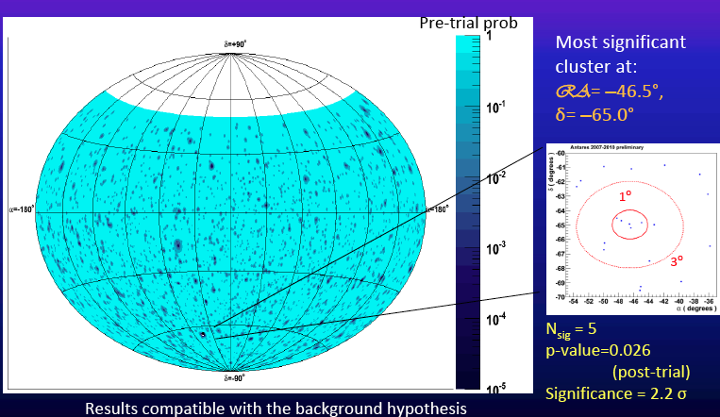
An example: the ANTARES search for point-like sources

Slide 8
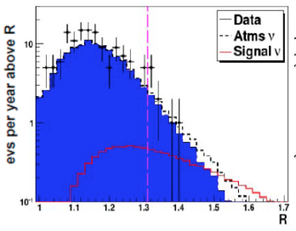
Diffuse Cosmic Neutrino Sources
Unresolved AGN
Neutrinos from "Z-bursts"
Neutrinos from "GZK like" p-CMB interactions
Neutrinos foreseen by Top-Down models
….
Their identification out of the more intense background of atmospheric neutrinos (and muons) is possible at very high energies (E > TeV) and implies accurate energy reconstruction.
Search here !!!
ANTARES 2011

Slide 9
Two VHE neutrino events observed by IceCUBE
T. Stanev
NOW-2012

Slide 10
… not only neutrino astrophysics…
… also open problems in particle physics …
  Dark Matter searches:
    Neutralinos from Sun, Earth, Galactic Center
  Monopoles, Nuclearites
  Acceleration mechanisms
  Neutrino interactions Cross sections
  …
Neutralino search: χχ → ν+…

Slide 11
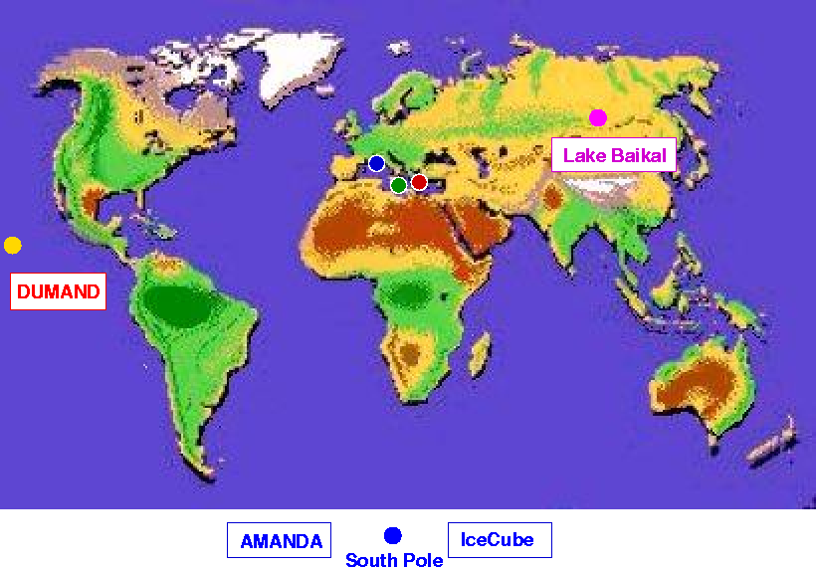
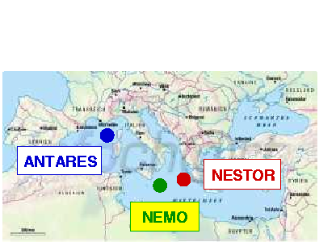
The Neutrino Telescope World Map
ANTARES + NEMO + NESTOR joined their efforts to prepare a km³-scale Cherenkov neutrino telescope in the Mediterranean →KM3NeT Consortium

Slide 12
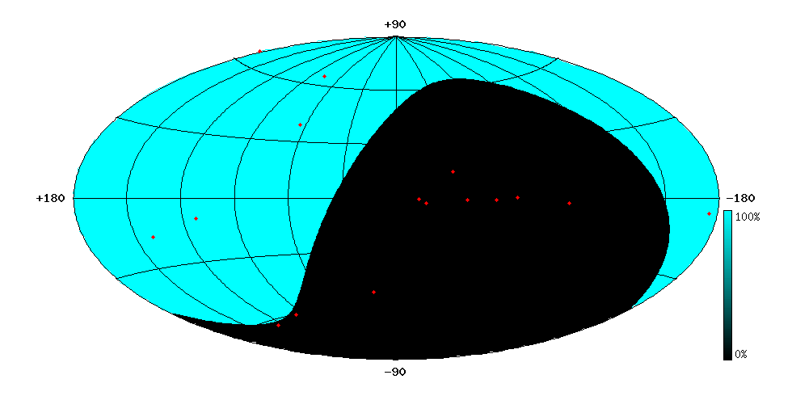
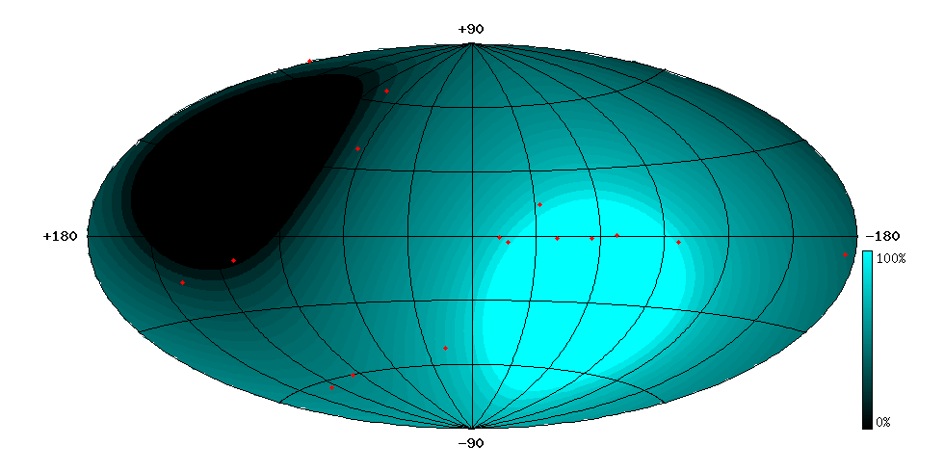
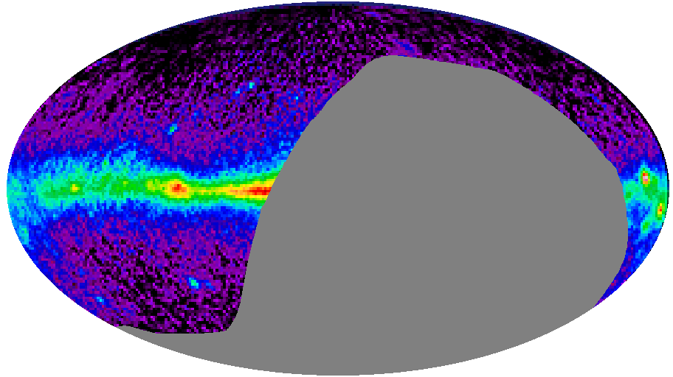
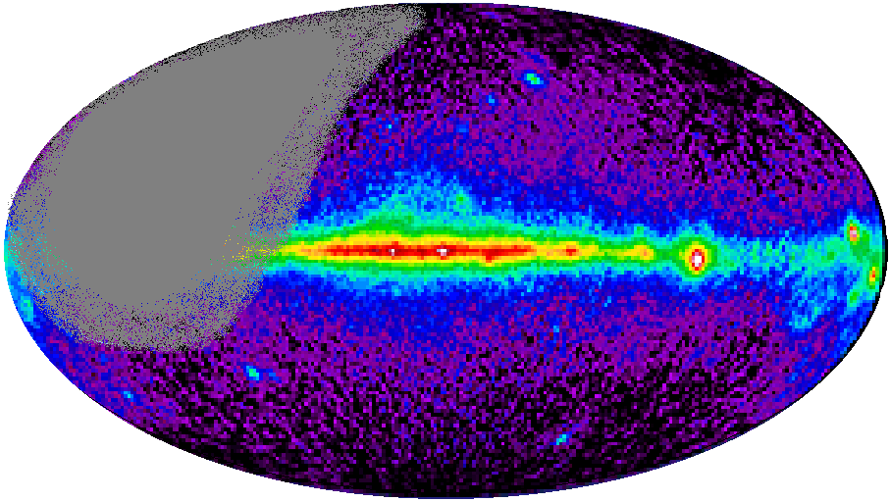
Locations for Neutrino Astronomy
From Antartica
From Mediterranean Sea
Mkn 421
Mkn 501
Mkn 501
CRAB
RX J1713.7-39
CRAB
SS433
SS433
GX339-4
VELA
Galactic
Centre
Mediterranean location provides a 3π sr sky coverage, 0.5π sr instantaneous common view with IceCube, and about 1.5π sr common view per day. The Galactic centre is visible 2/3 of the time.
A Km³ Neutrino Telescope in Mediterranean Sea will be complementary to IceCube and … will search for neutrino sources in the Galactic centre

Slide 13
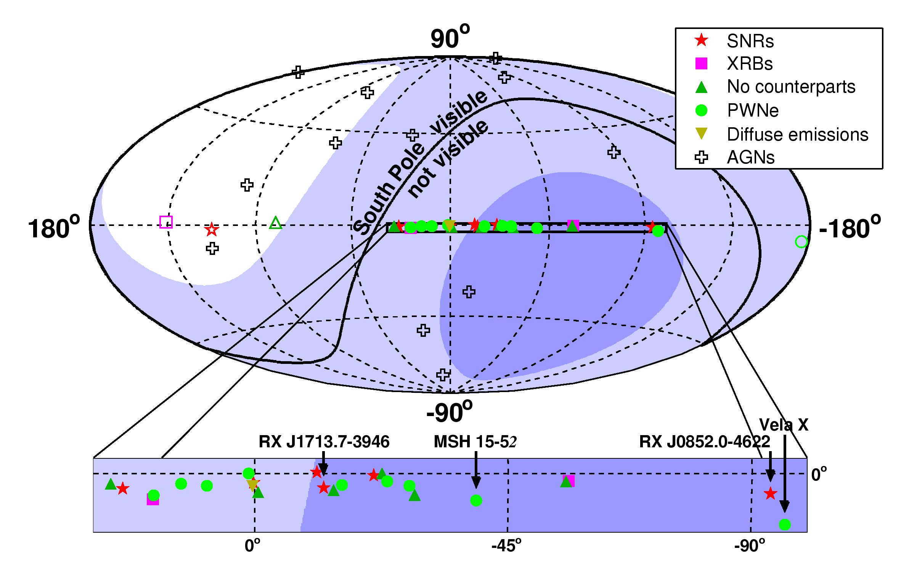
Mediterranean Sea ν Telescope Sky Coverage
Observed sky, in galactic coordinates, by a detector efficient to tracks from below the horizon (up-going tracks).
Mediterranean site:
>75% visibility
>25% visibility
→ We need a km³ Northern ν Telescope to cover the Galactic Plane

Slide 14
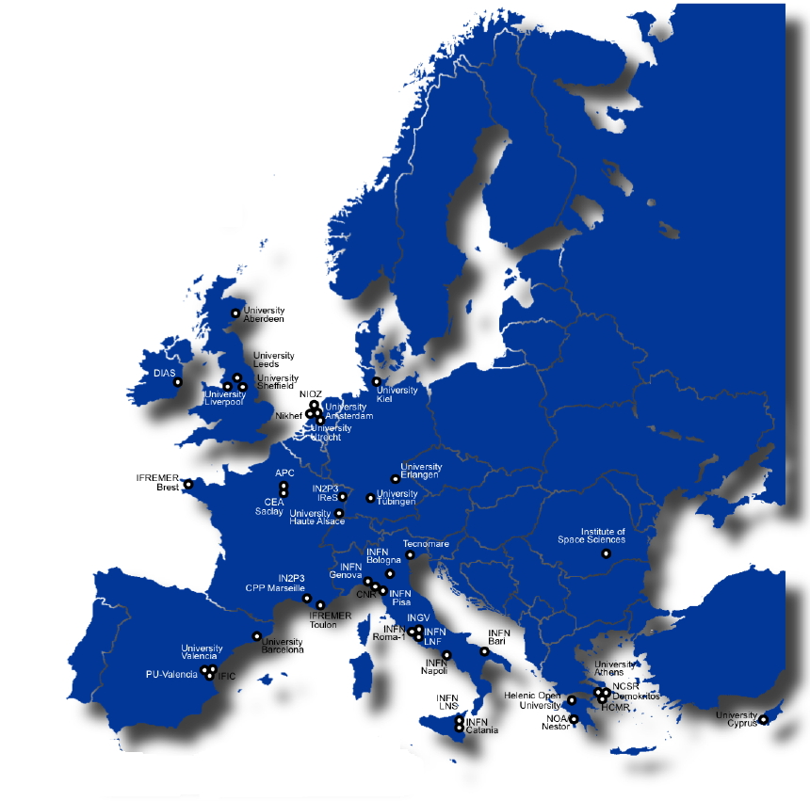
International consortium involving more than 300 scientists from 10 EU countries (CY, DE, ES, FR, GR, IE, IT, NL, RO, UK)
Common objective: build the most sensitive high energy neutrino telescope in the Northern Hemisphere
KM3NeT is on the ESFRI
roadmap since 2006
KM3NeT

Slide 15
A Brief History of KM3NeT
Started in February 2006 with the Design Study project co-funded with 9 M€ under the 6th EC Framework Programme
  Coordinated by University of Erlangen, Germany (U. Katz)
In 2007 included in the roadmap of the European Strategy Forum of Research Infrastructures (ESFRI)
In 2008 co-funded with 5 M€ for a “Preparatory Phase” under the 7th EC Framework Programme and concluded in february 2012
  Coordinated by INFN-LNS, Italy (E. Migneco)

Slide 16
A Brief History of KM3NeT – near past
March 2012: KM3NeT-PP ends, TDR released
DU technologies in the TDR
  Towers (like NEMO) + OM multi-PMTs : DOMBARS, preferred solution
  Strings + OM multi-PMTs
Funding
  FR: for sea/shore infrastr. and DUs in Toulon
  IT: for sea/shore infrastr. and DUs in Capo Passero
  NL: for Dus and DU-production site in Amsterdam
Transition to a Collaboration in preparation

Slide 17
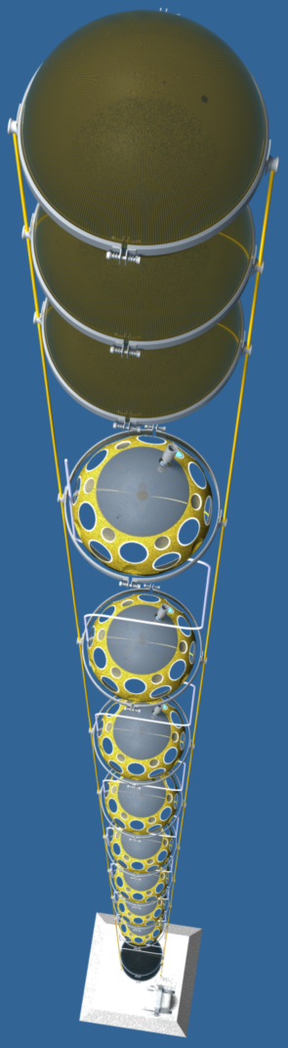
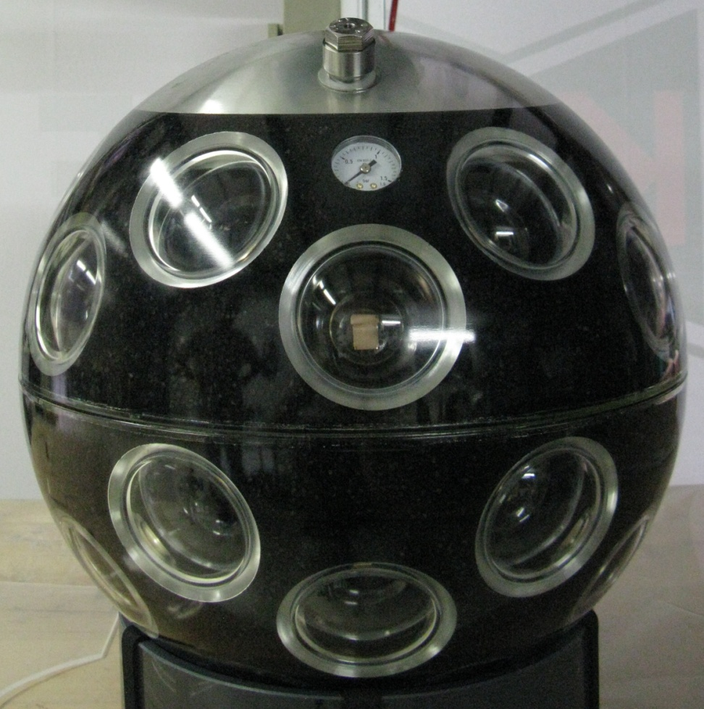
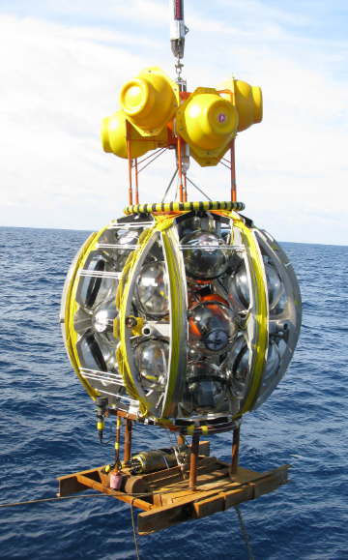
The String Technology
Digital Optical Module
Many small PMTs in one glass sphere
Photon counting
Detection Unit with 20 storeys
40 m inter-storey distance
Compact deployment
17
MANTS Bologna, October 6 2012

Slide 18
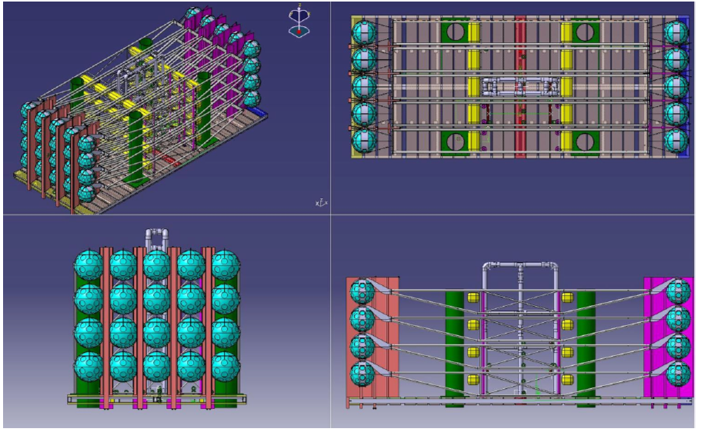
KM3NeT-DU Septembre 2011
13.09.2011

Slide 19
A Brief History of KM3NeT – today
End of 2011
  IT: 20.8 M€ PON budget for detector construction to be spent before end 2014. Need to define the DU technology
June 2012
  Base technology for KM3NeT: the string with OM made by multi-PMTs. But this technology is not still fully proved.
  INFN will start the construction 8 TOWERS equipped by large area single PMT at Capo Passero site
  INFN will build the deep sea infrastructure capable to host Towers and Strings
The validation program of the string-DU has been resumed by the whole KM3NeT Consortium
  If by middle 2013 the string-project will have been validated INFN will switch the production to strings and KM3NeT Europe will construct and install, in Capo Passero site, as many strings as the ones built by INFN

Slide 20
The construction of the first Detection Units of the Neutrino Telescope is now possible and it is started !
The PON project, funded with 20.8M€, foresees, for the end of 2014, the construction of the first block of DUs (up to 30) at Capo Passero site:
At present (November 2012):
NEMO-Phase2 Tower ready to be deployed
The NEMO-Phase2 project has been scrutinized in order to update “old” technological solutions (when needed)
Next future:
  already started and on-going
technology transfer to industry
industrialization of the detector elements production
  December 2012
start the construction and the integration of Km3 DUs for Capo Passero

Slide 21
During the last 15 years a great effort has been done by INFN for the construction of the High Energy Underwater Cherenkov Neutrino Telescope: NEMO, ANTARES, KM3NeT
2013 → Km3 will include all INFN activities in this field
2013 Km3, Italian, Collaboration composition

Slide 22
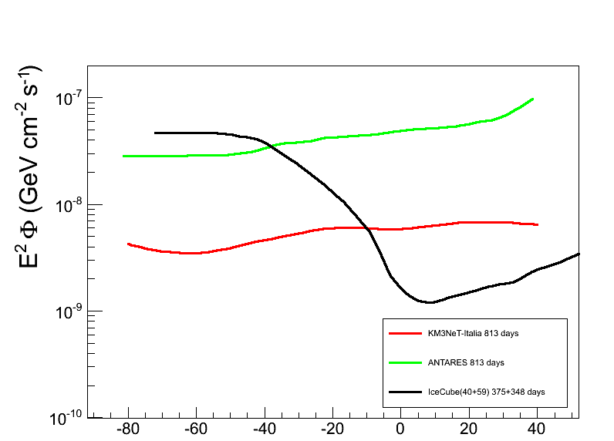
Sensitivity at 90% C.L. for 30 Towers at Capo Passero
ANTARES
ANTARES, Neutrino 2012
IceCube, ICRC 2011
KM3NeT_Italy
KM3NeT_Italy 30 Towers
130m distance between DU
20 floors
40m distance between floors
IceCube
At declination -60° the KM3NeT-Italy sensitivity is 8 times larger than ANTARES

Slide 23
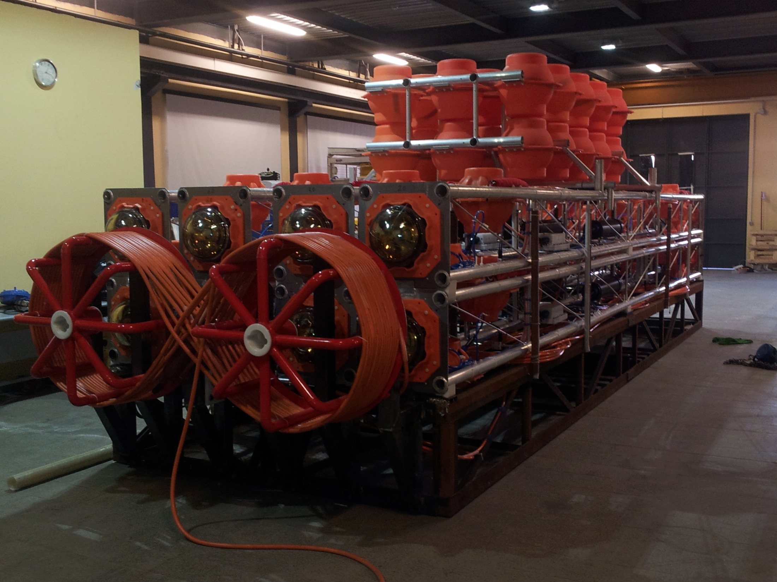
Status of the NEMO tower validation
      Integration
      Tests
      Improvements
      Deployment program

Slide 24
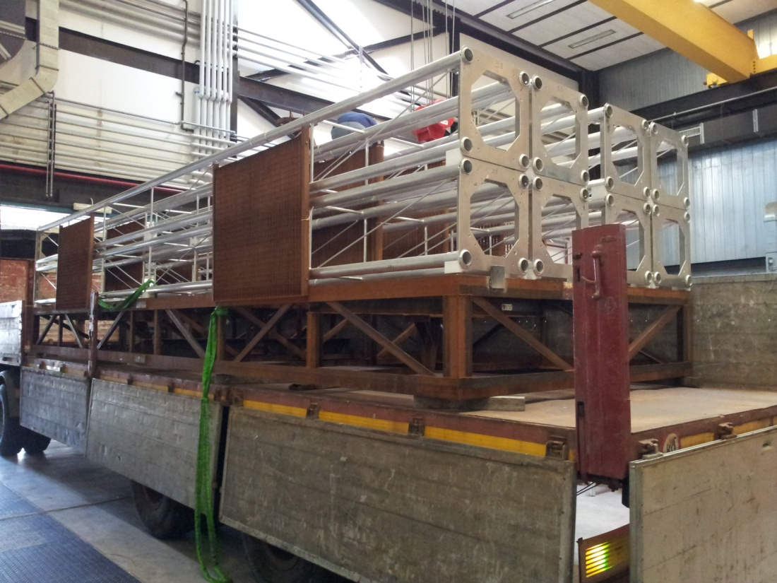
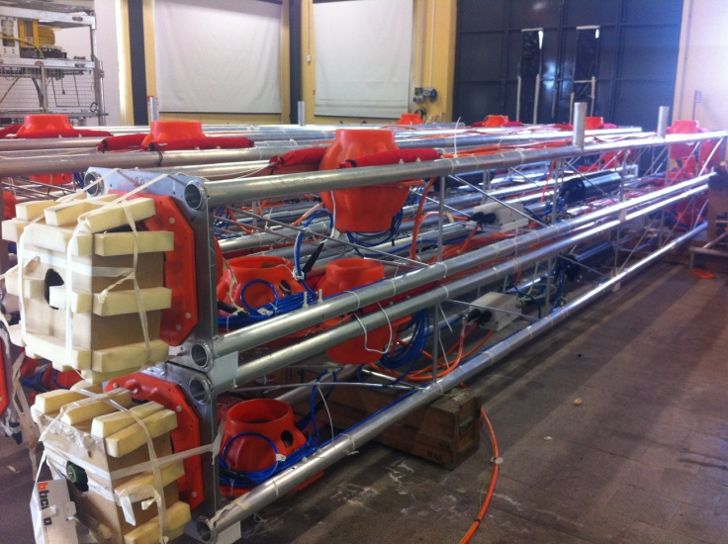
The ‘NEMO-Phase2’ tower
8 floors in Al bars
8 m length
Vertical distance of the floors = 40 m
Total height = 450 m
4 Optical Modules on each floor : 32 OMs
hydrophones+ oceanographic instruments
Acoustic & laser beacon
A validation structure for the production of the 8 initial Km3 Towers

Slide 25
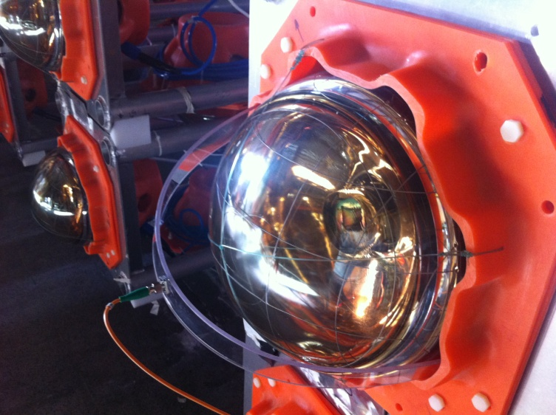
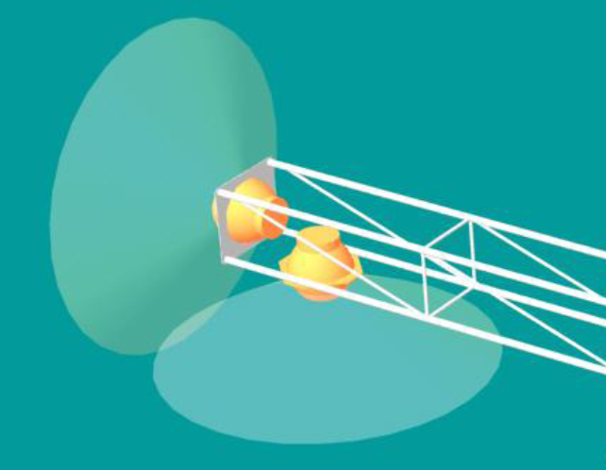
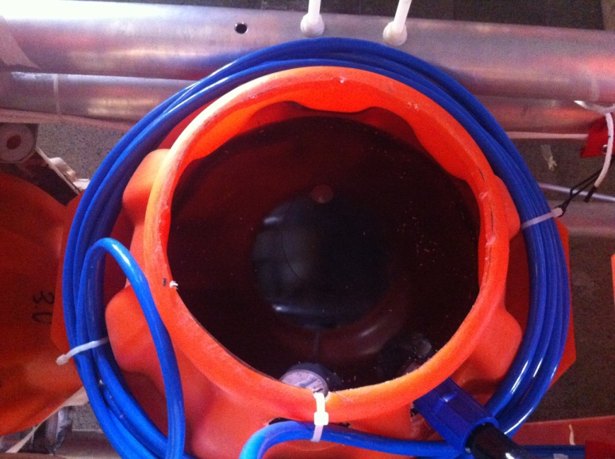
The optical module
Very simple fixation system
2 looking horizontally, 2 looking down
Glass sphere: 13’’Ø
μ metal cage
Optical gel
1 LED looking to the upper floor
    Porfido: temperature RFID sensor
the Optical Module
PMT:
10 stages 10’’ Hamamatsu R7081
TTs =2.8 ns FWHM
Dark count rate ~ 1.3 kHz
After pulse ~4%

Slide 26
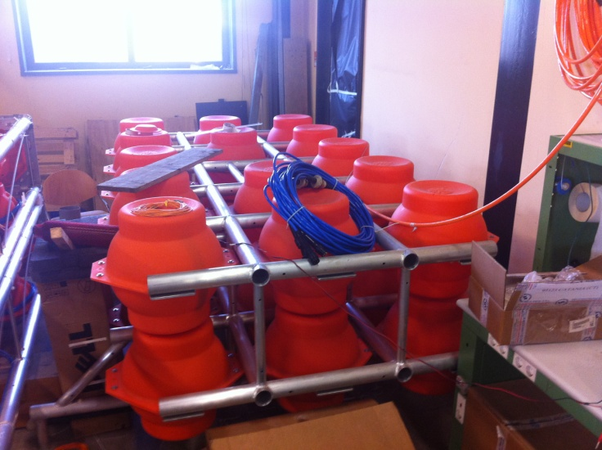
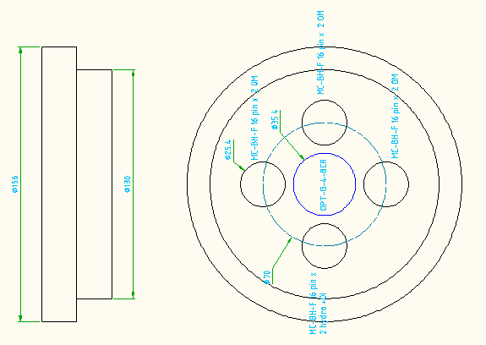
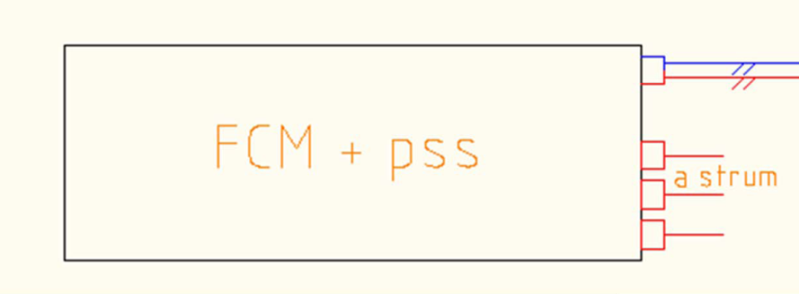
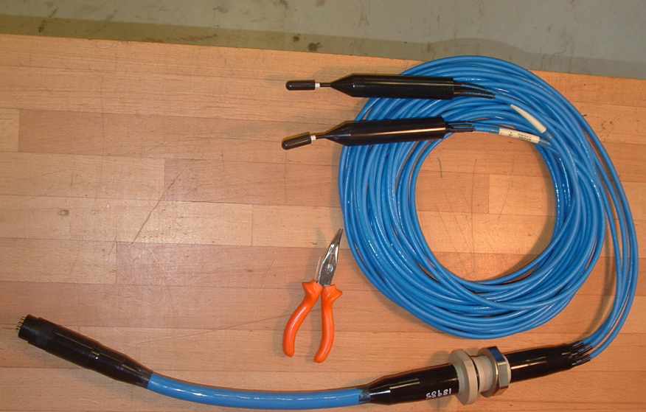
the top buoy
n.28 17’’ glass spheres
Net buoyancy ~800 kg
the floor
4 Al tubes 8m long.
1 central vessel to host electronics
1 break out of the backbone
cables for unfolding
almost neutral in water
L=100 cm, ø= 18 cm
one end cap only
2 hydrophones Smid TR401 in floor 1-6
2 hydrophones LTD SX 30 in floor 7 (Valencia, Gandia)
2 hydrofphones custom from Erlangenin floor 8
1 C-Star in floor 4
1Doppler current sens. in floor 5
2 CTD in floor 1 and 8

Slide 27
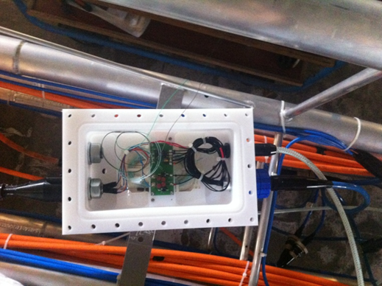
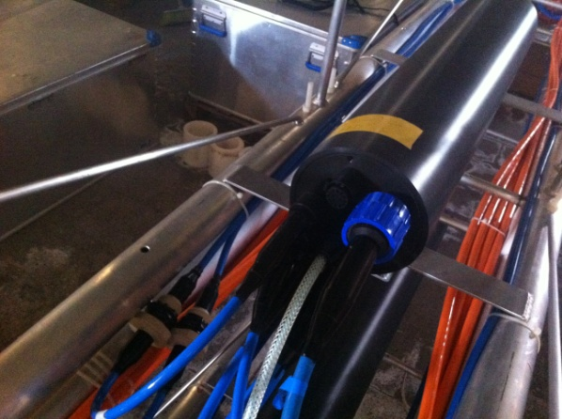
the backbone
Upper Floor
Floor break out vessel
(equi-pressure oil bath)
Electrical cable
12 wires 18 AWG
V=375 V
Floor vessel
(in air)
Backbone
Electro-optical cable
2 f.o. + 5 twisted pairs
Optical cable
2 optic fib.
Lower Floor

Slide 28
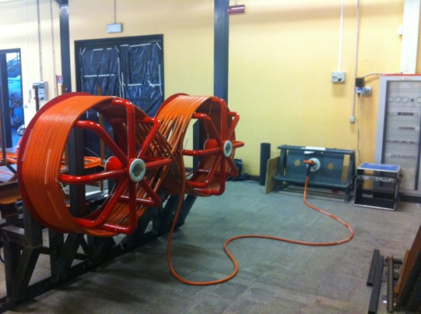
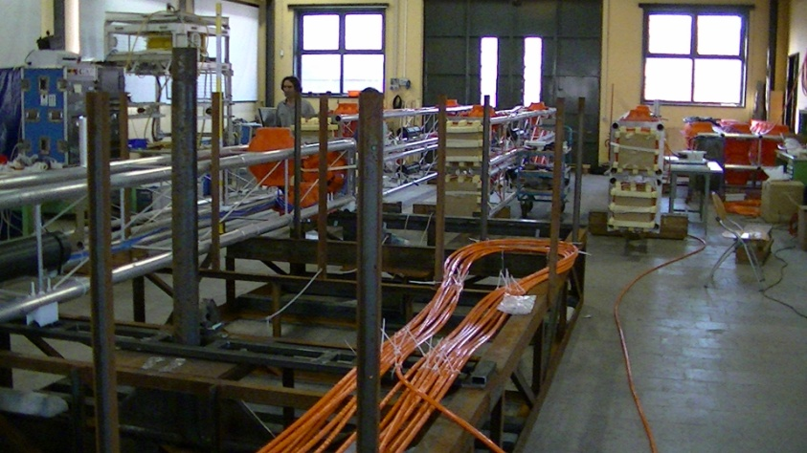
the anchor
Schematic working principle
The interlink cable to the JB
1 laser beacon+ acoustic (Valencia, Gandia)
1 acustic beacon for LB positioning
2 hydrophones (monitor)

Slide 29
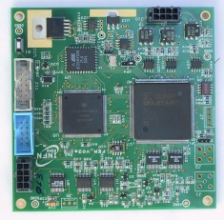
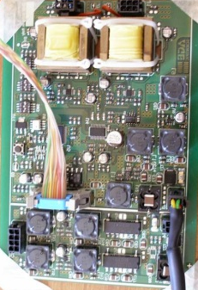
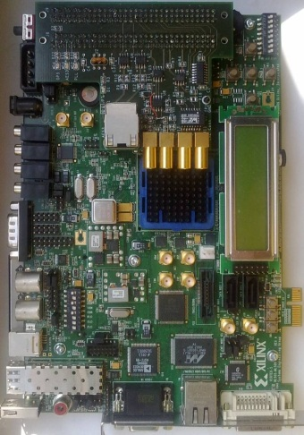
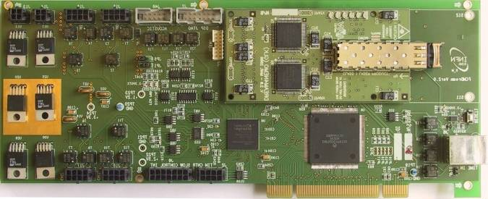
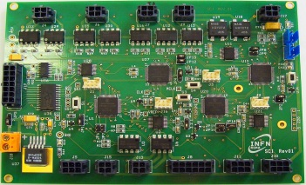
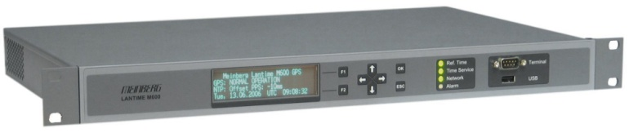
the floor electronics
PMT DAQ Boards
Hydrophones DAQ Board
Ethernet Floor Control Module
100 km
Floor Control Module
Slow Control Interface
GPS receiver
PMT DAQ Boards
Off-Shore
On-Shore
Antonio Capone - LNS User Meeting
28/10/12

Slide 30
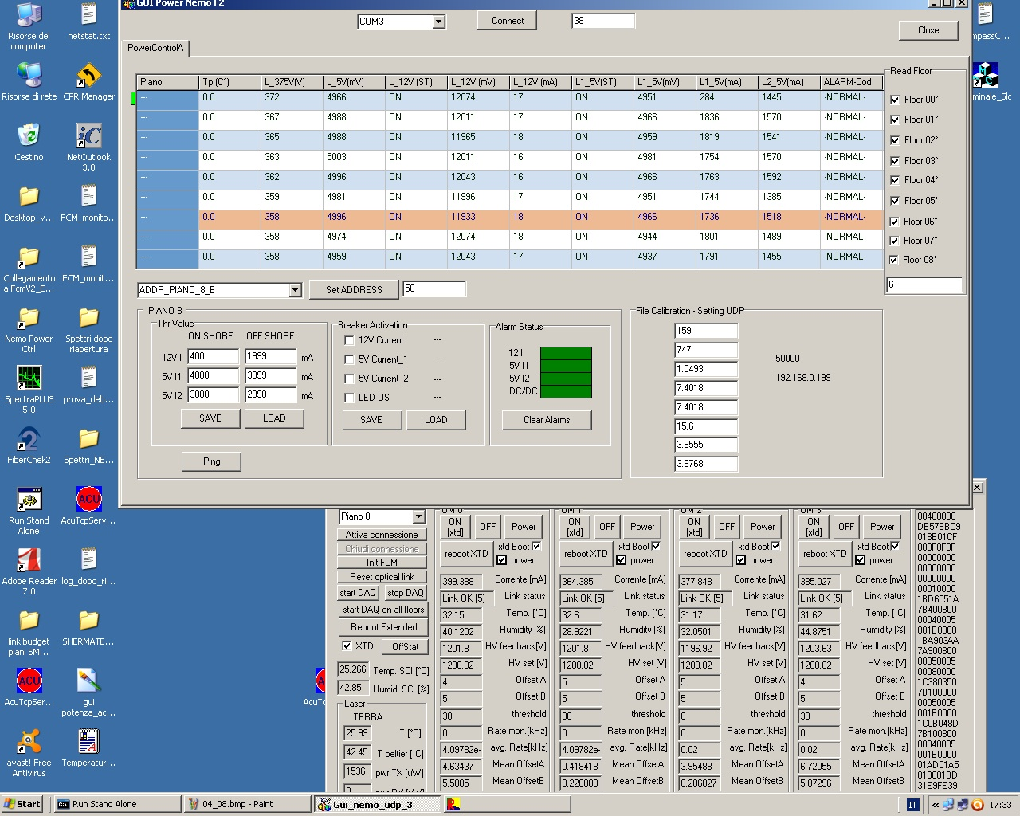
Power consumption
Power supply & currents on each floor
Voltage 12 V
Voltage 5 V
Current @12 V
Currents @5 V
Total consumption on each floor (4 PMTs) ~ 17 Watt

Slide 31

The DAQ system

Slide 32

The tests
Configuration
Floors easy accesible in
the test Lab at the harbour
Light shielding on all PMTs
Interlink cable connected to:
-Power supply
-Optical link to shore station
DAQ to register PMT hits
Laser light source + optic fibres to OMs for timing measurements
To shore electronics
Power supply

Slide 33


Background on single PMT @ nominal power supply
1 pe peak
Rates around 5-8 kHz at nominal threshold (1/3 pe):
light shield not 100% effective
Raw data only:
1 pe peak expected at
ch~100

Slide 34
time calibration with laser light source
0
3
1
2
Laser source
laser light source
Tunable frequency
Tunable amplitude
Illumination on horizontal PMT of the same floor

Slide 35

L1 trigger
Δt= 20 ns
Floor (true) coincidences
Simple (random) coincidences
Charge over threshold
coincidences

Slide 36


Ambient noise on the Hydrophones
Floors 1-6 (except 5):
Smid TR401
Floor 7:
Senso Technologies LTD SX 30
(from Valencia, Gandia)

Slide 37


Test of main electro optical cable at the Capo Passero shore station
P1-P3: the 3 connectors
in the cable termination
Optical loss in 100 km cable: ~ 20 dB

Slide 38
Optimizations
Discussion on
mechanical structure
        >Fix PMT (Hamamatsu R7081)
        Fix OM housing
        >Fix n. of OM /floor (6)
        Fix design of the floor
        >Fix the distance of floor (30 m)
        >Fix the number of floors (14)
Update of the read out electronics
-FRONT END MODULE
-simplified Front-end board, low power (<1W), reduced dimension (3"x3.5"), low cost;
-analog sampling: ADC 200MHz@14bit (same performance, simpler design);
-FLOOR CONTROL MODULE
- Vessel electronics in 2 boards: power and logic;
- low power consumption: ~6W, including DWDM Laser, instrumentation, hydro, compass;

Slide 39
the new backbone
to point to point connection
From daisy chain …
Floor N+1
Floor N
Floor N-1
SEACON cable : 2 optic fibres + 2 e.conductors
Delivered by November:
-1000 m to test attenuation during unfurling
-600 with 2 opt. connectors to test @ 400 bar

Slide 40

New design of the base of the tower
Will be the same as in the JB:
3 vessel + 1 manyfold
1 vessel to host optic fibres routing;
1 vessel for control ;
1 vessel for the power system in equipressure oil bath;
Improved reliability

Slide 41

The deployment
planned at the end of the integration&tests by October 20th;
operated under MECMA consortium agreement: can be stopped according to a long list of «Interruptible Works»;
Predive check of the ROV underway ;
Single operation: CERTAMEN + ROV + tower:
              Test of the ROV at 3500 m and cable termination inspection.
              Deployment &connection of the tower

Slide 43

SUMMARY
The Great effort spent by INFN in the last 15 years finally is close to give the first results
A big European effort is pushing for the construction of the Km3 scale Neutrino Telescope in the Mediterranean Sea
PON funds allow for the construction of a first part of the Telescope
The 8 floors tower is completed and ready for the deployment, it will allow the final Tower detector concept validation
Extensive tests gave positive results
ROV dive test + deployment in the site of Capo Passero is planned by 2nd November .
Design optimisation process completed by end of the year

Slide 44



