Slide 1
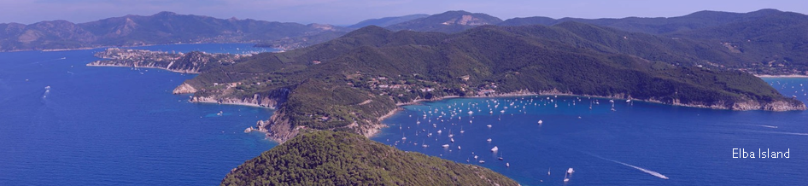
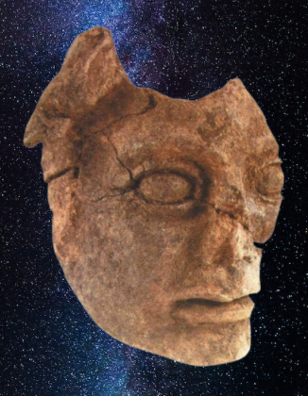
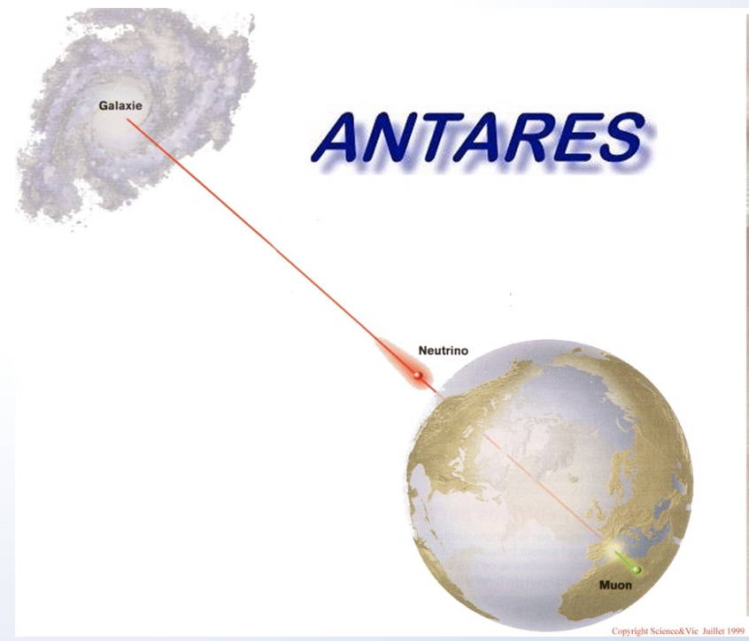
XVIII Vulcano Workshop on Frontier Objects in Astrophysics and Particle Physics
Search for High Energy Astrophysical Neutrinos Experimental status
Antonio Capone
Astrophysical ν detection
Why ?
How ?
Where ?
The ν, γ, HE C.R. connection
Multi-messenger search for H.E. astrophysical sources
Results from Cherenkov ν Telescopes

Slide 2
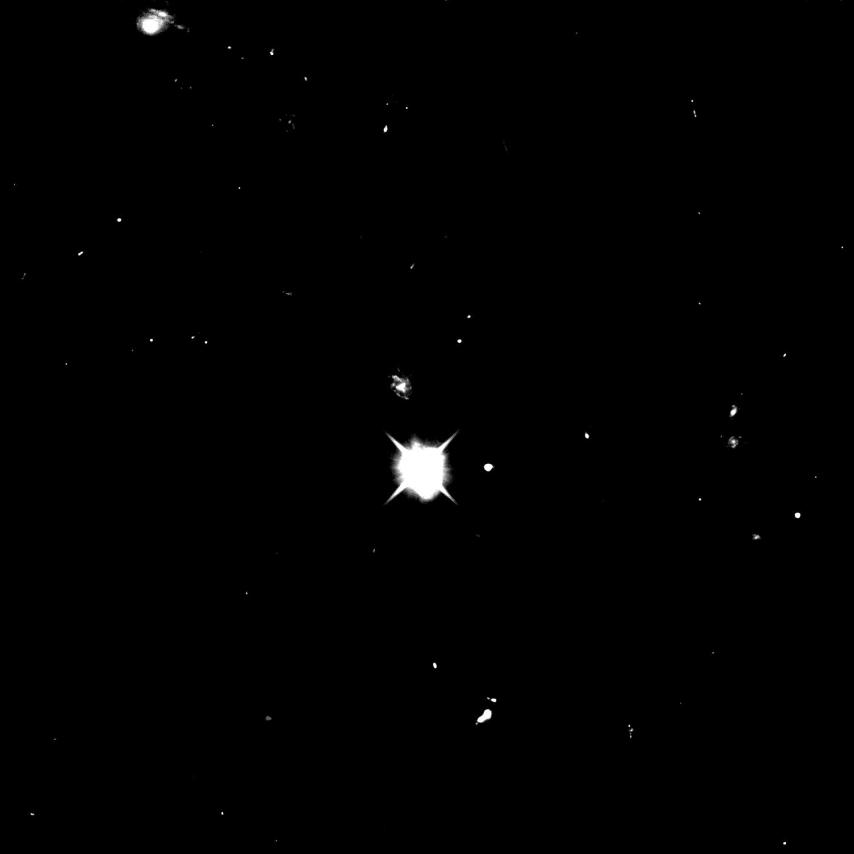

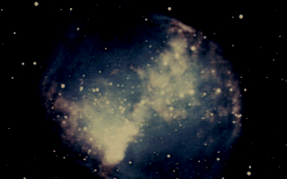
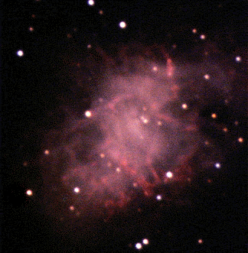
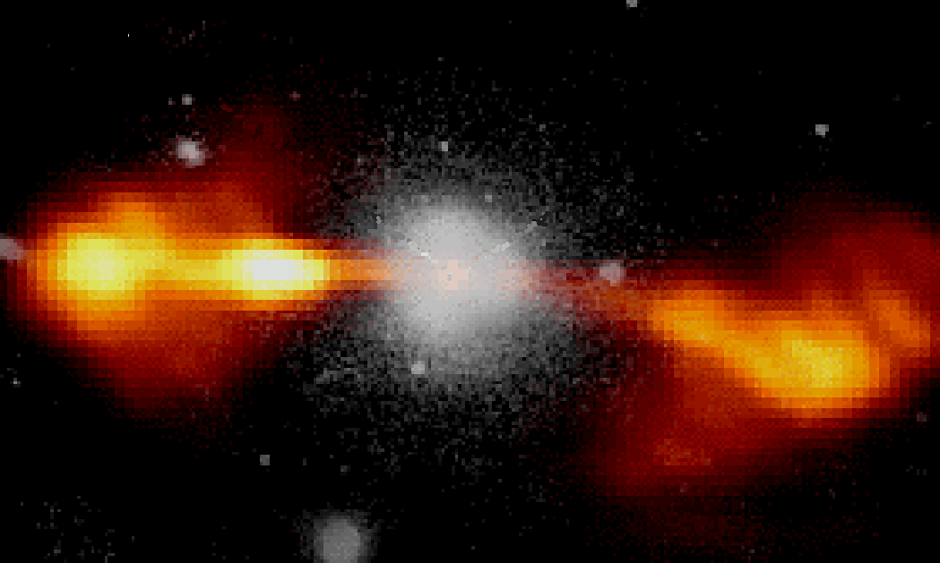
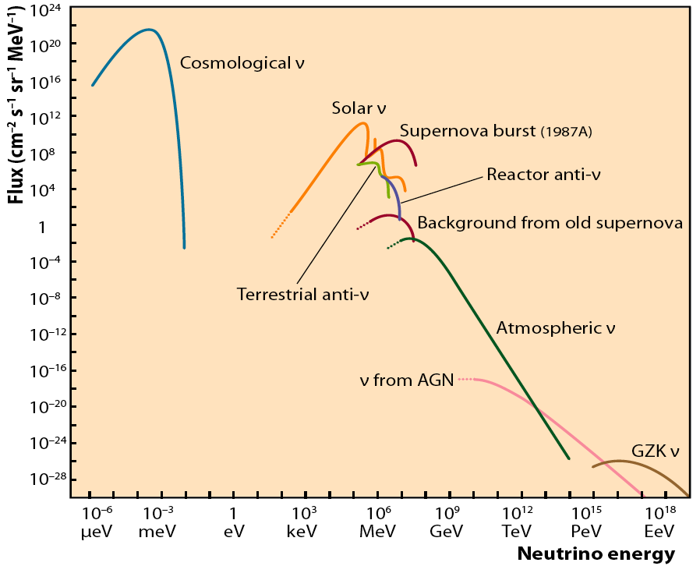
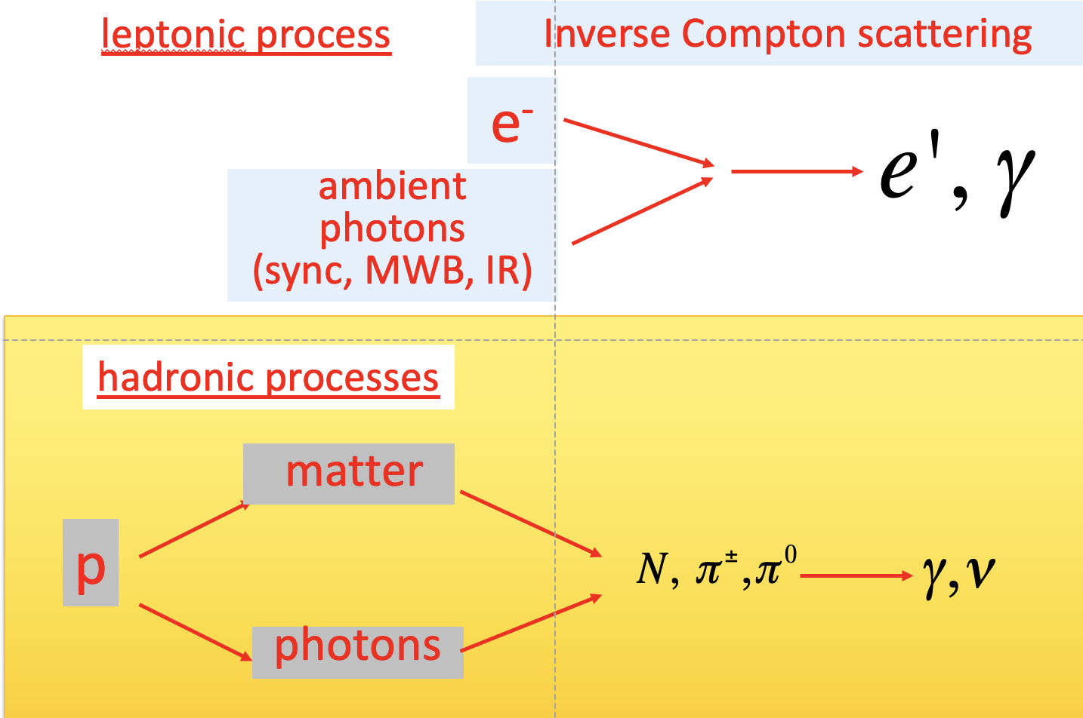
Motivations for High Energy Neutrino Astrophysics
protons E>10¹⁹ eV (10 Mpc)
Cosmic accelerator
neutrinos
Gamma rays (0.01 - 1 Mpc)
protons E<10¹⁹ eV
AGN, SNR, Microquasars, …
1 parsec (pc) = 3.26 light years (ly)
This is our region of interest

Slide 3
Detecting neutrinos in H₂O
IceCube, Gen2
ANTARES, KM3NeT
Neutrinos must interact to be detected: use water as target and Cherenkov radiator, use PMT as detectors

Slide 4
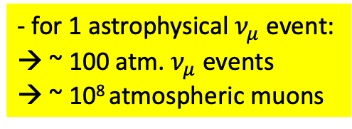
Neutrino Telescopes: signal and background
Atmospheric μ‘s dominate by many order of magnitude the muons induced by neutrinos
- for 1 astrophysical $ν_{μ}$event:
→ ~ 100 atm. $ν_{μ}$ events
→ ~ 10⁸ atmospheric muons
Upward-going particles are the preferred signature for extra-terrestrial neutrino interactions
Upgoing muons from atmospheric neutrinos represent the irreducible background

Slide 5
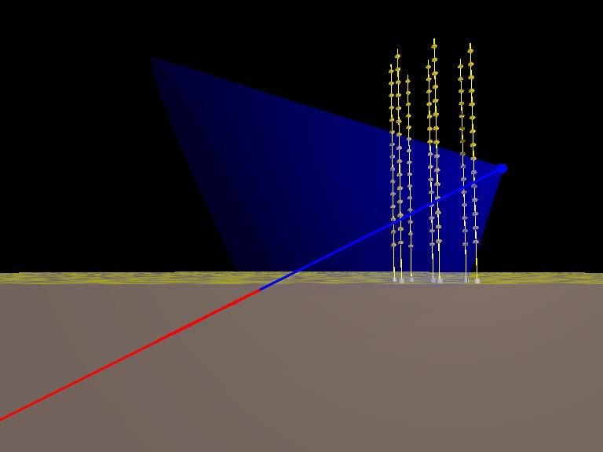
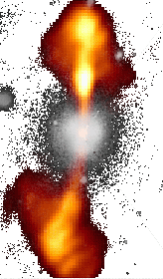
Cherenkov ν Telescope: Detection principle
Search for neutrino induced events, mainly , deep underwater
Atmospheric neutrino flux ~ E_{ν}⁻³
Neutrino flux from cosmic sources ~ E_{ν}⁻²
  Search for neutrinos with E_{ν}>1÷10 TeV
~TeV muons propagate in water for several km
before being stopped
  go deep to reduce down-going atmospheric µ backg.
  long µ tracks allow good angular reconstruction
Down-going µ from atm. showers
S/N ~ 10⁻⁶ at 3500m w.e. depth
p, nuclei
µ direction reconstructed from the arrival time of Cherenkov photons on the Optical Modules: needed good measurement of PMT hits, σ(t)~1ns, and good knowledge of PMT positions: (σ ~10cm)
Neutrinos from cosmic sources
induce 1-100 muon evts/y
in a km³ Neutrino Telescope
Cherenkov
Neutrino
Telescope
p, nuclei
Up-going µ from neutrinos
generated in atm. showers
S/N ~ 10⁻⁴
charge current
interactions
43°
µ
water/ice
up-going neutrino
rock
Picture from ANTARES

Slide 6
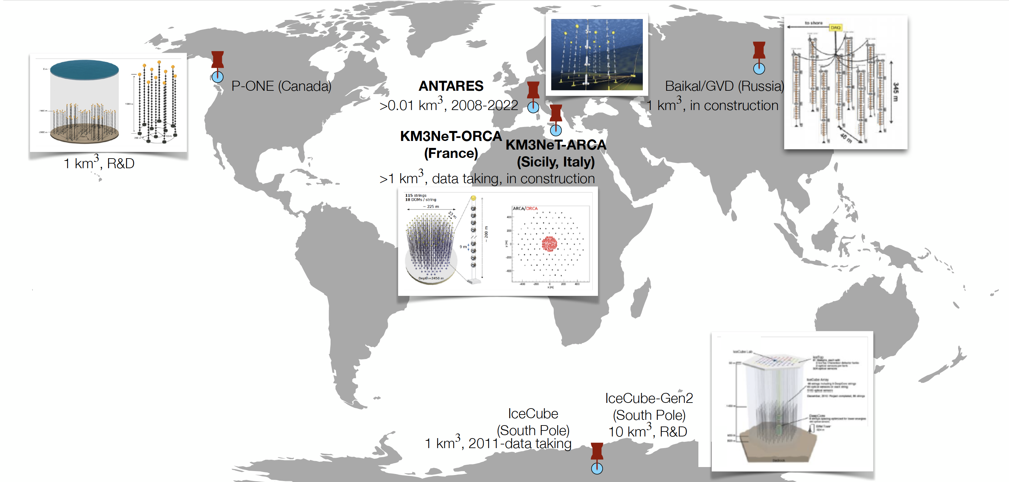
High Energy ν Telescopes world map

Slide 7
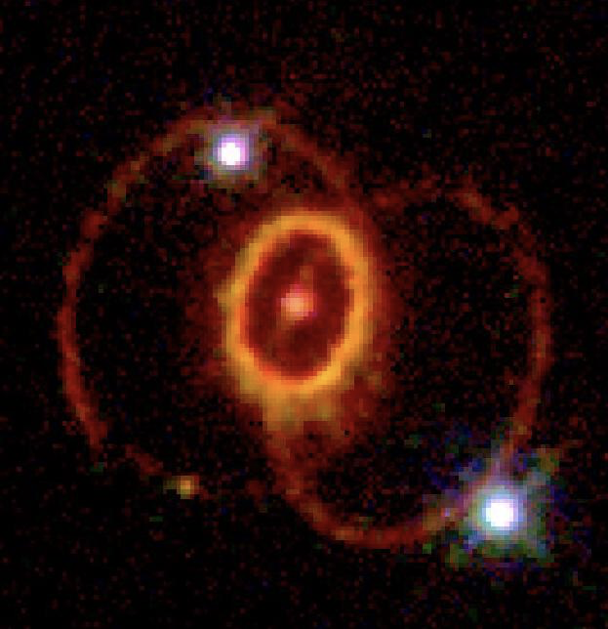
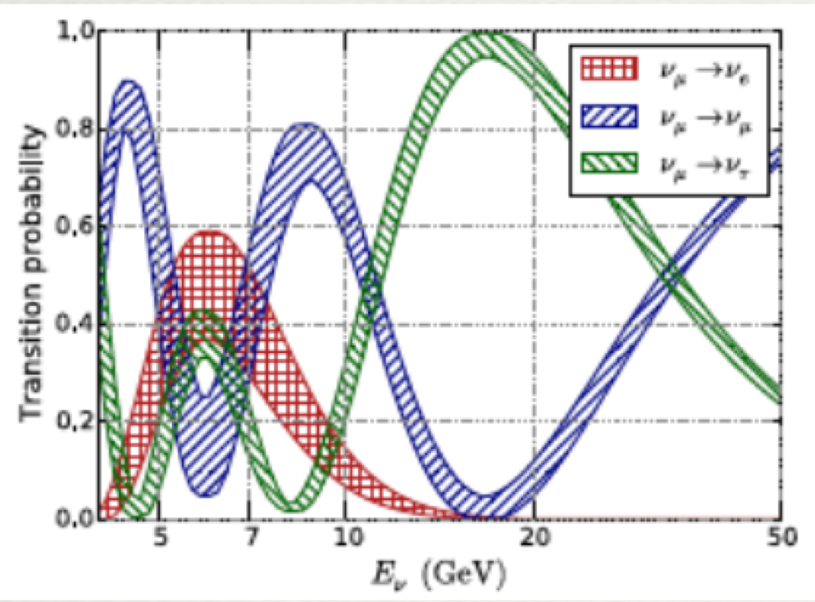
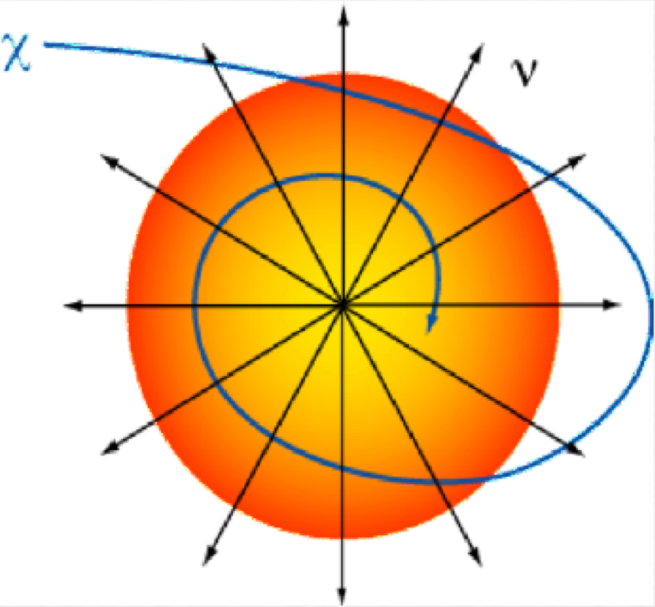
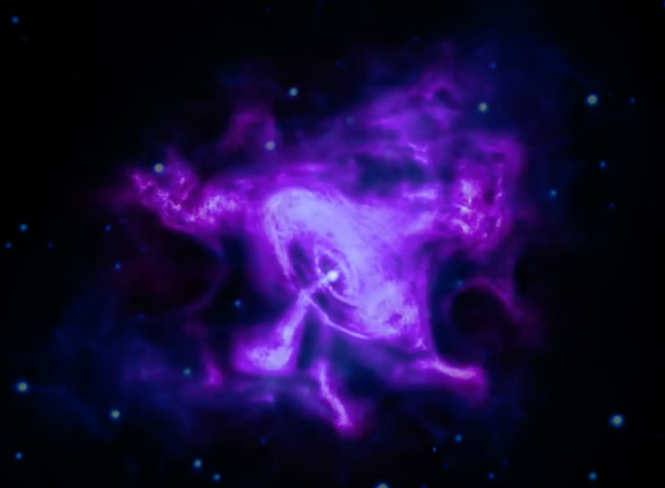
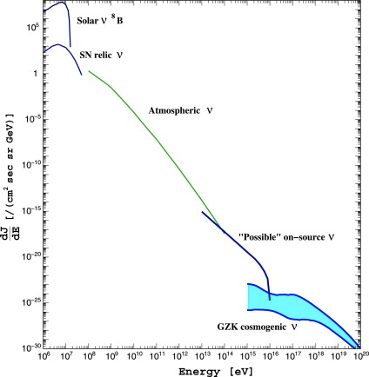
Cherenkov ν Telescope: science goals
CC –SN ν ν Oscillations Indirect D.M search Astroph. Sources GZK ν, ...
MeV 10 < E_{ν} < 100 GeV GeV < E_{ν} < 100 GeV TeV < E_{ν} < EeV > EeV
- ν from SN
- ν Oscillations
- ν Hierarchy
- Sterile ν
- D. M. search
- Monopoles
- Nuclearites
ν from extra-terrestrial sources
Hadronic-leptonic ?
- Origin, acceleration mechanism of HE CR
U.H.E. C.R. nature and propagation

Slide 8
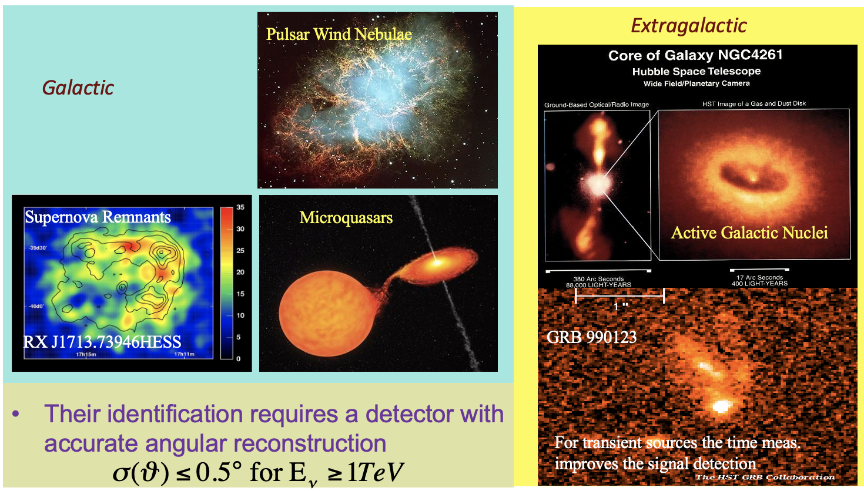
Cherenkov ν Telescope: science goals
Search for point-like cosmic Neutrino Sources
Search for Diffuse flux of Cosmic Neutrinos
Search here !!!
Their identification requires a detector with accurate angular reconstruction
Search for sources from catalogue
Auto-correlation search
Neutrinos from:
  Unresolved AGN
  "Z-bursts"
  "GZK like" proton-CMB interactions
Top-Down models ν
….
Their identification out of the more intense background of atmospheric neutrinos (and μ) is possible at very high energies (E_{μ} >> TeV) and requires good energy reconstruction.

Slide 9
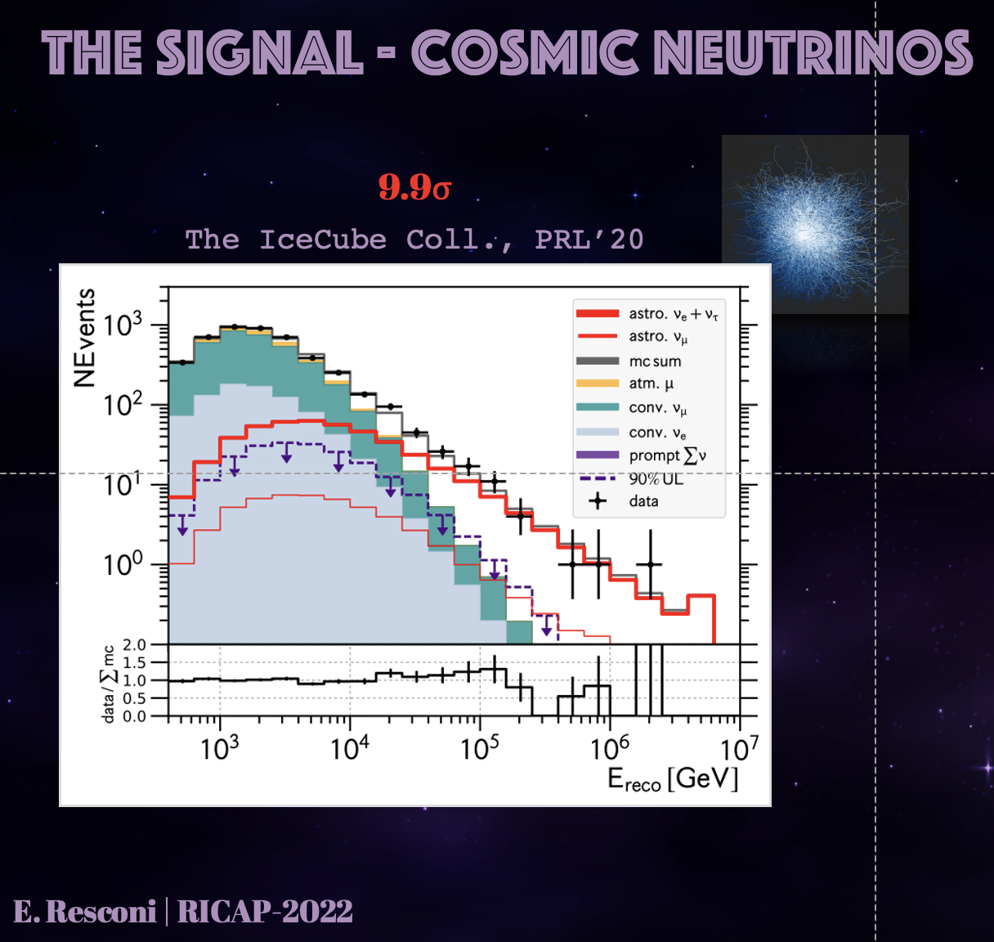

IceCube: a flux of "diffuse" ν identified since 2013
IceTop detector
In operation at the South Pole since 2010
Sensitive to TeV – PeV neutrinos
${\frac{dφ}{dE}=6.45\left(\frac{E_{ν}}{100TeV}\right)}^{−2.89}{10}^{−18}[{GeV}^{−1}{cm}^{−2}$ $s^{−1}$ ${sr}^{−1}$]

Slide 10
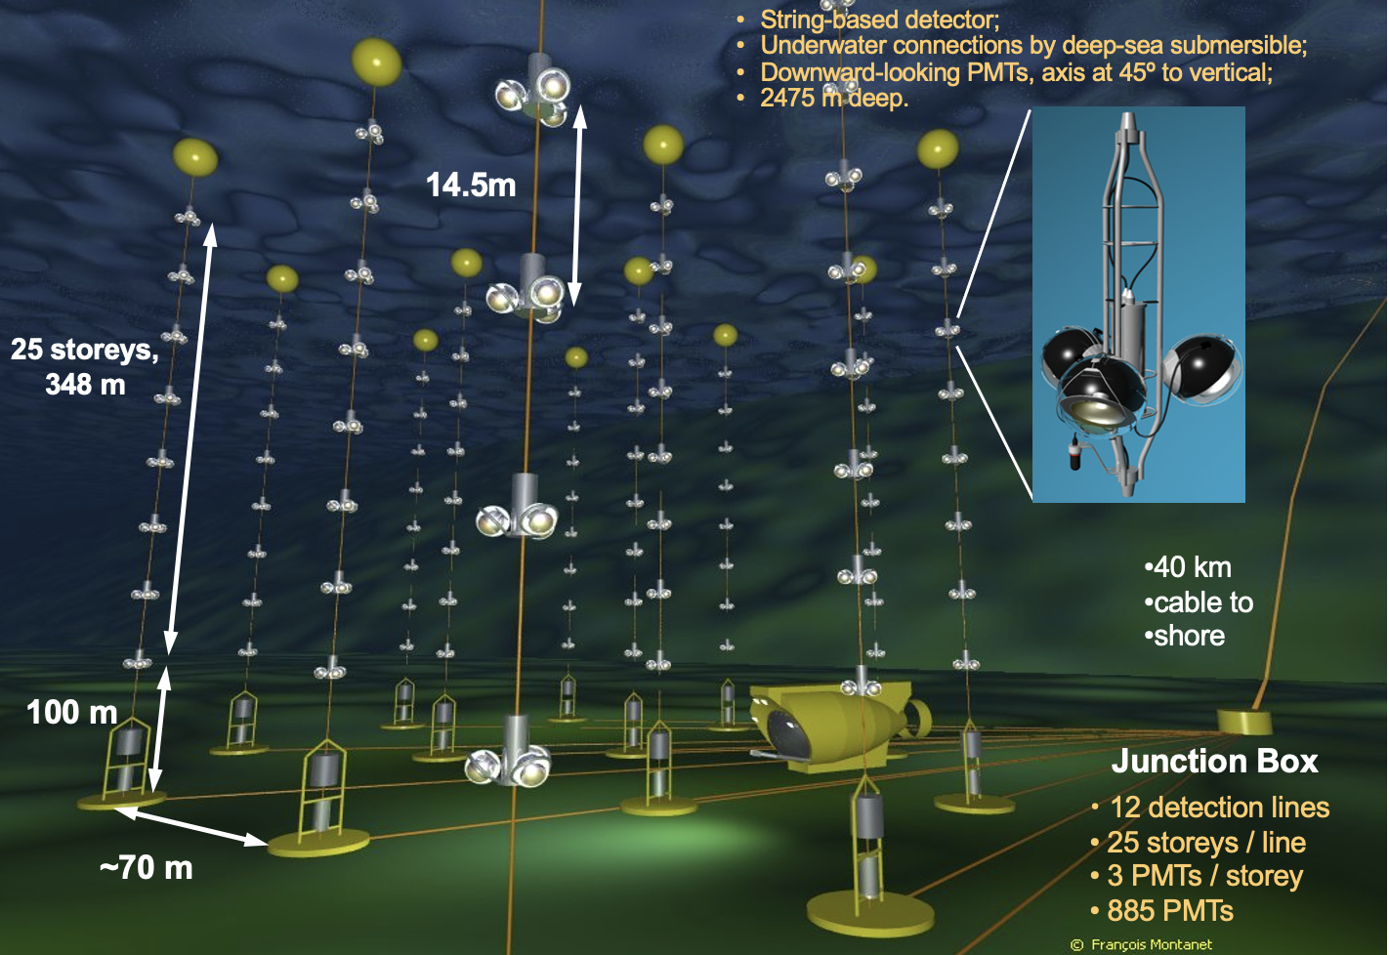
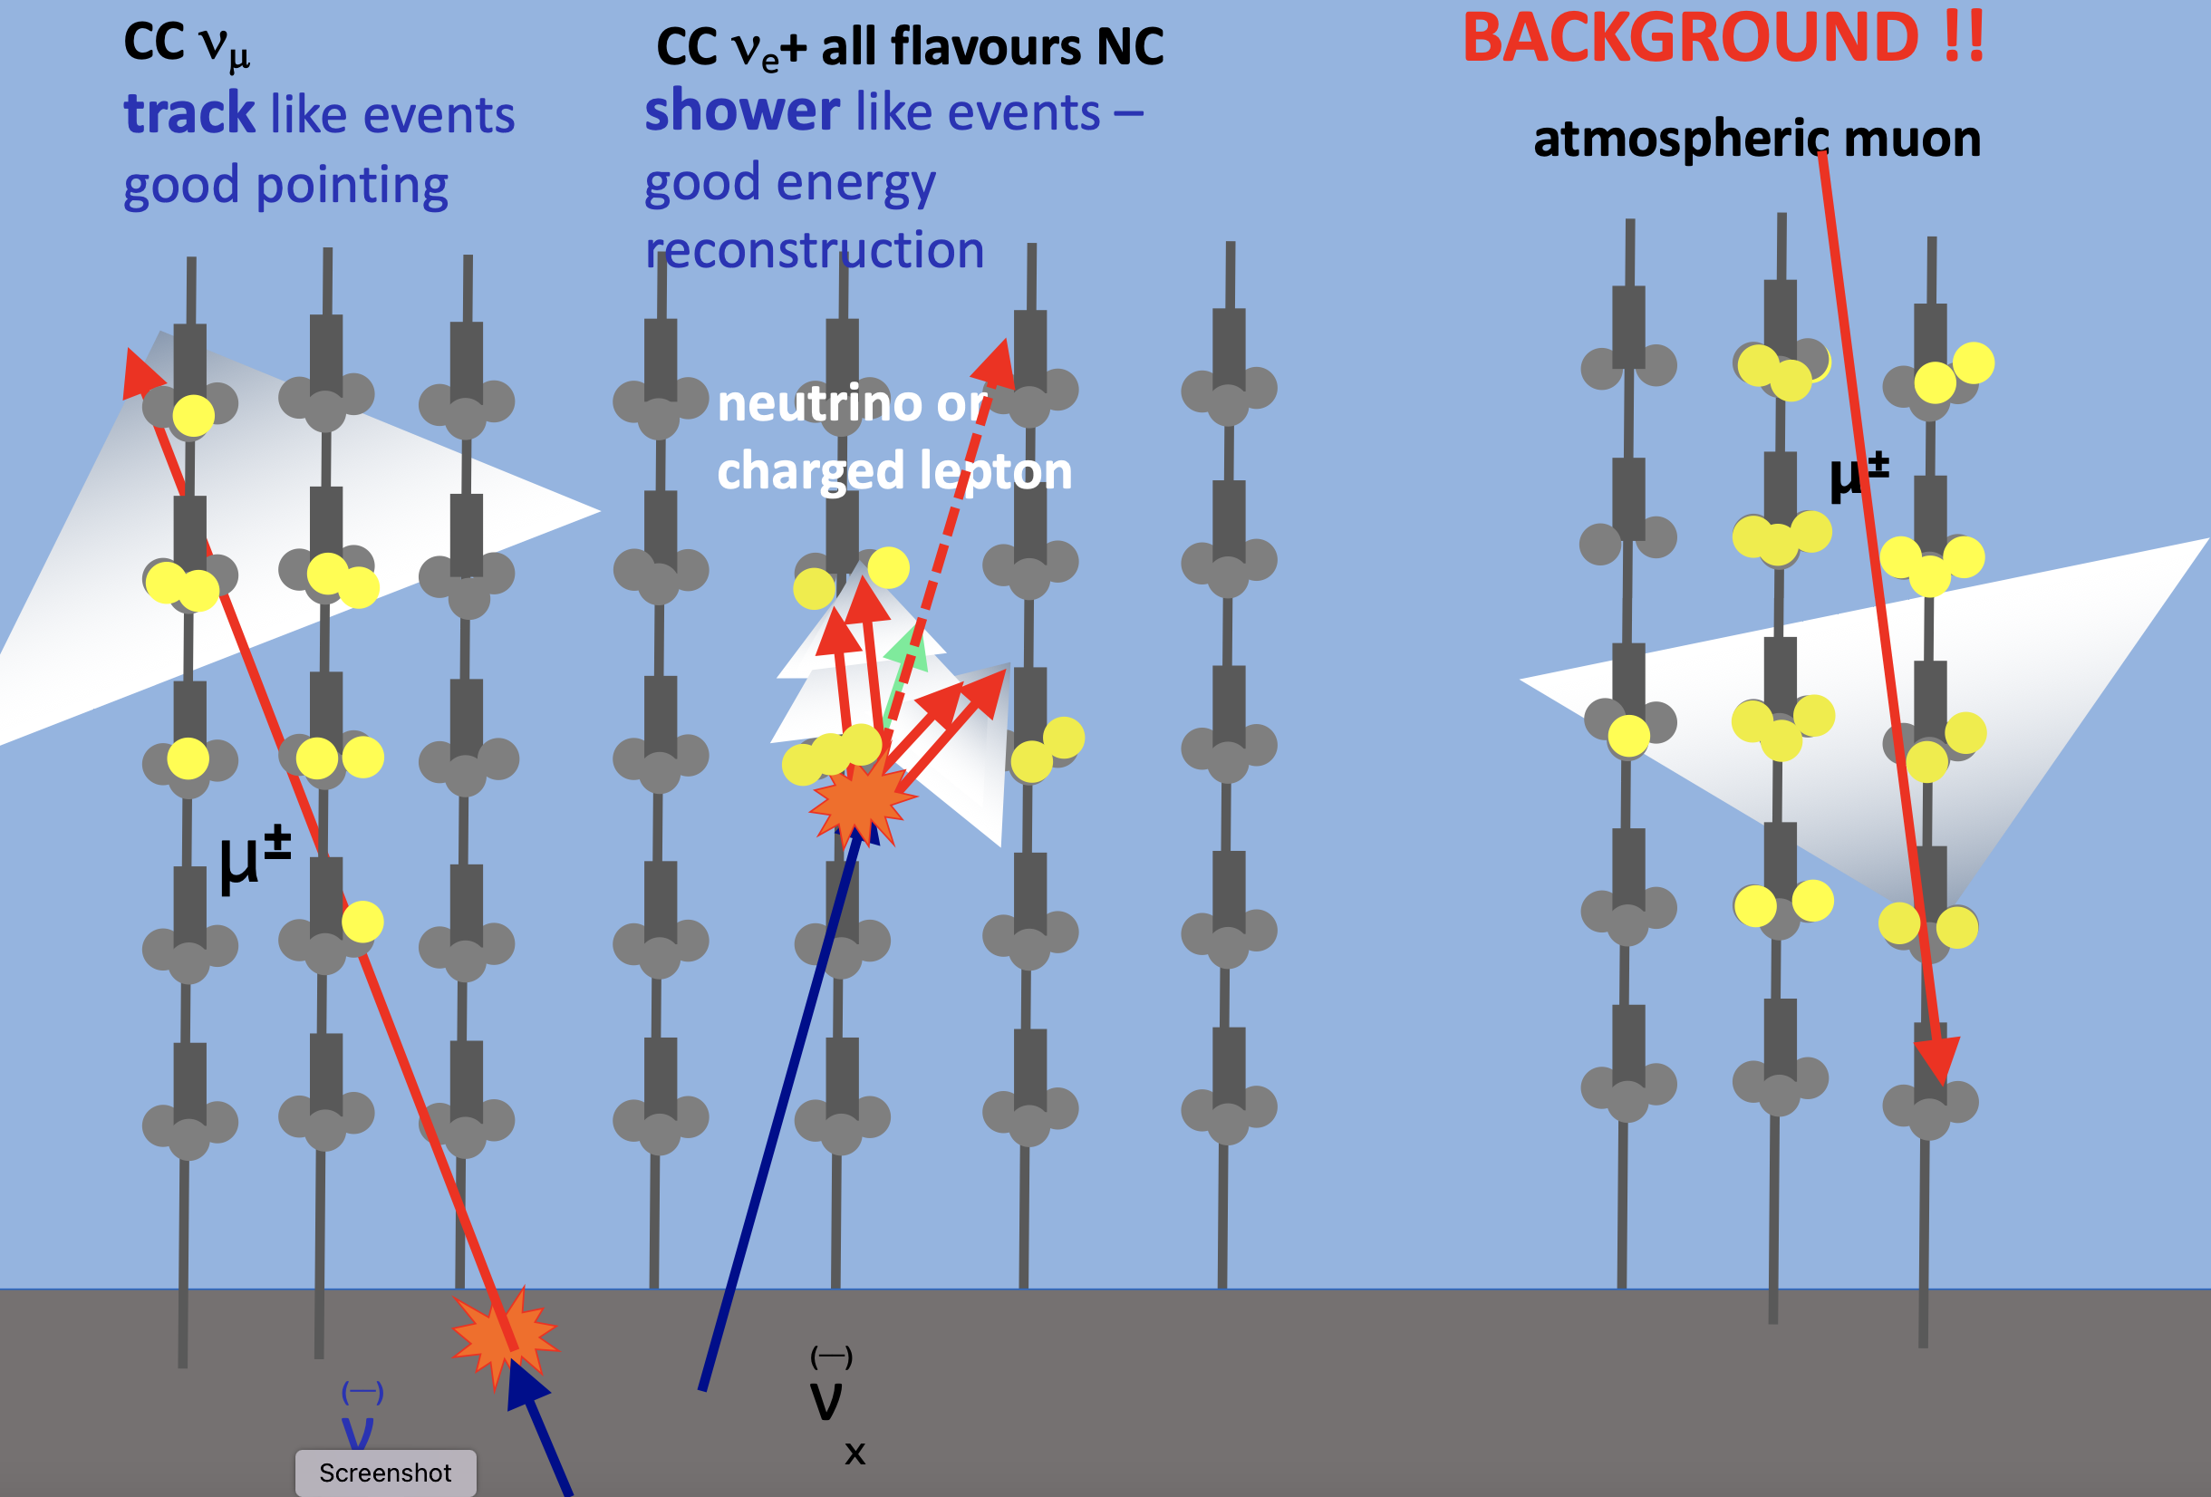
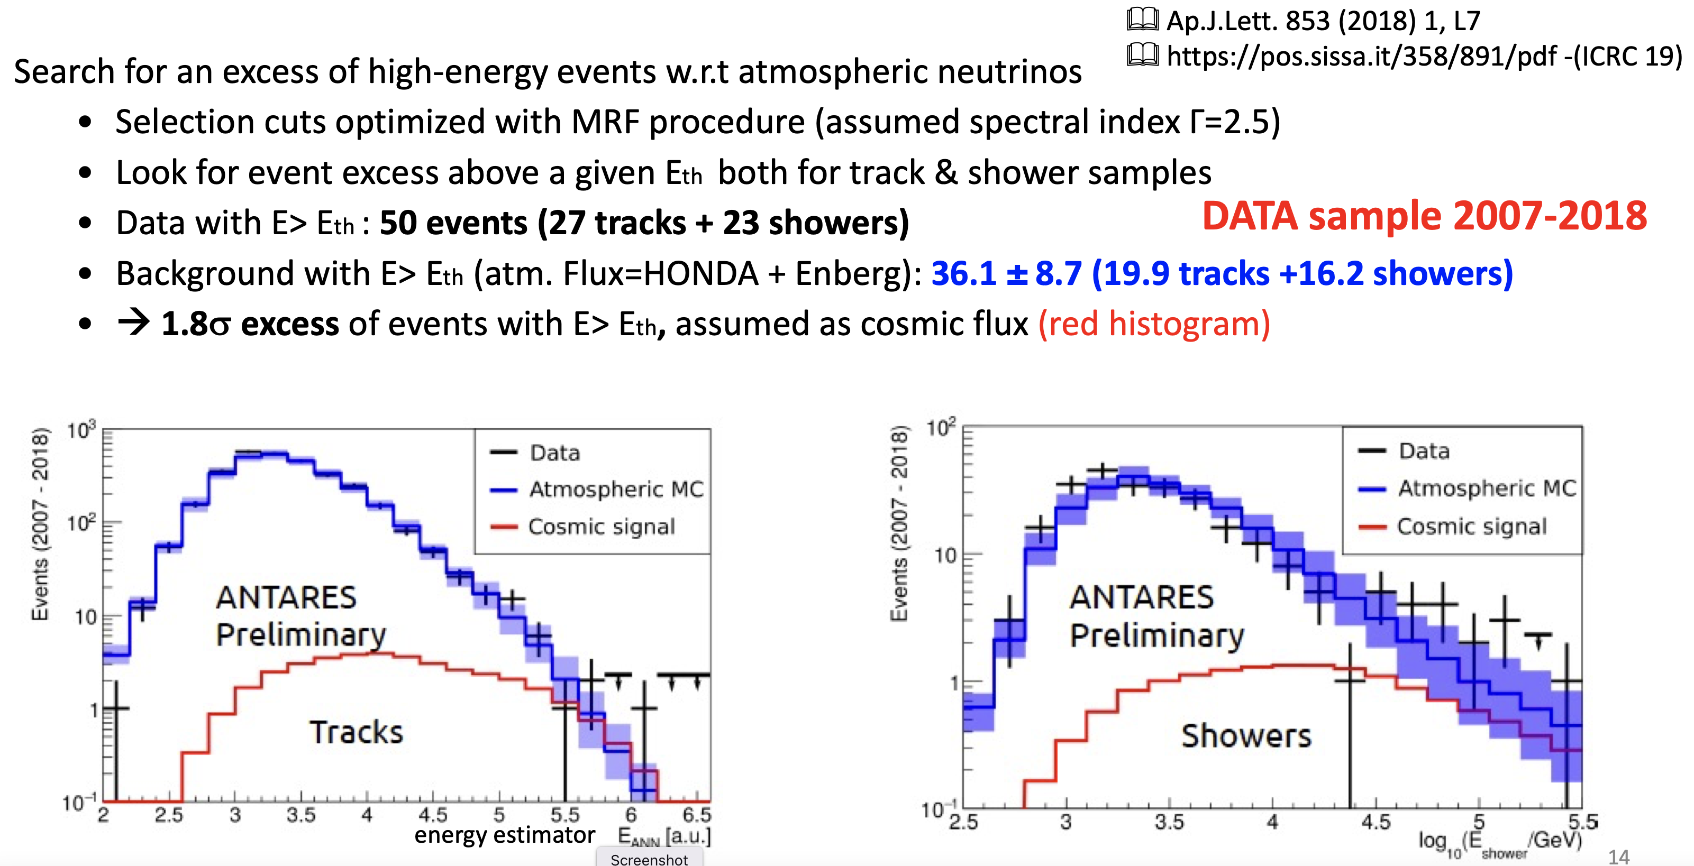
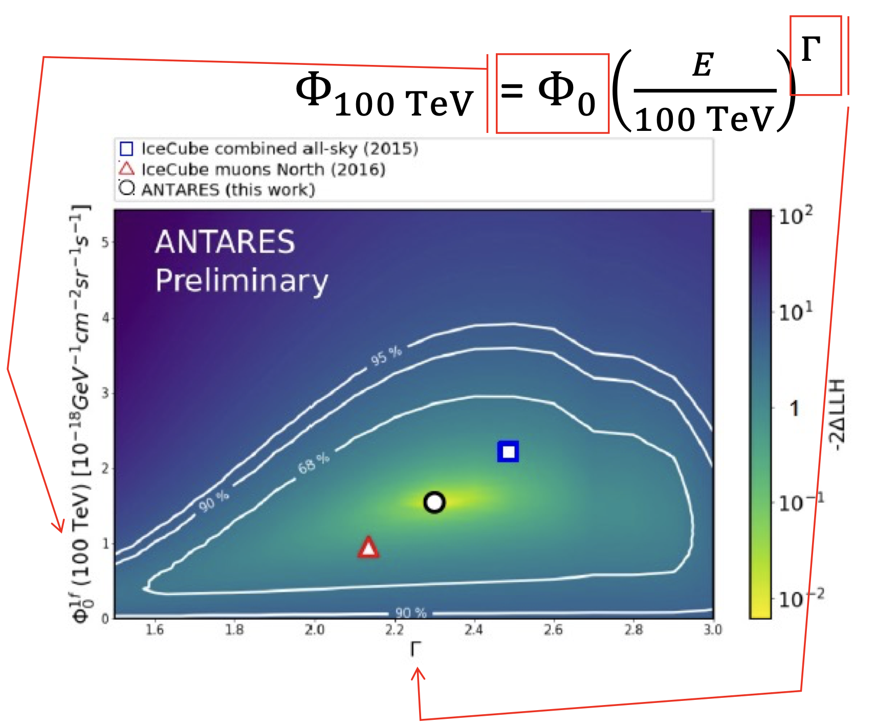
ANTARES: sensitive to the IC "diffuse" ν flux
In operation 2008 - 2022
Sensitive to TeV – 100 TeV ν
Ap.J.Lett. 853 (2018) 1, L7
https://pos.sissa.it/358/891/pdf-(ICRC19)
-
Results fully compatible
with IceCube diffuse flux

Slide 11
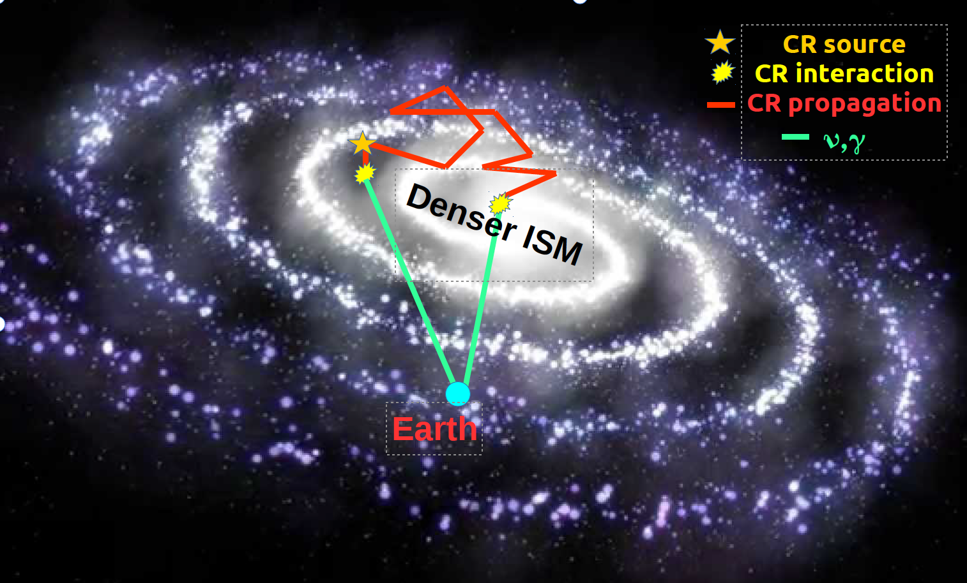
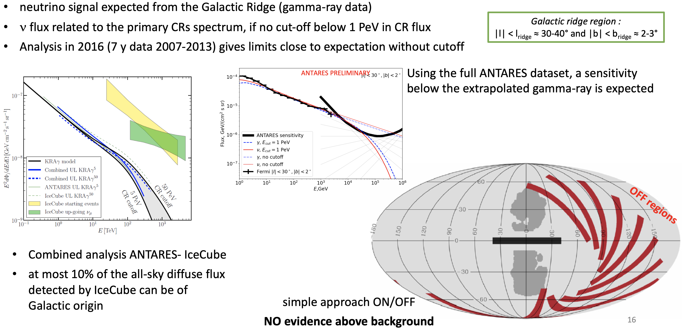
IceCube & ANTARES: search for "diffuse" ν flux from galactic ridge
Neutrinos carry direct information on CR propagation:
-Non-homogeneous diffusion can enhance γ and ν emission
-Molecular clouds/dense environments boost γ and ν fluxes
Astrophys.J. 868 (2018) no.2, L20

Slide 12
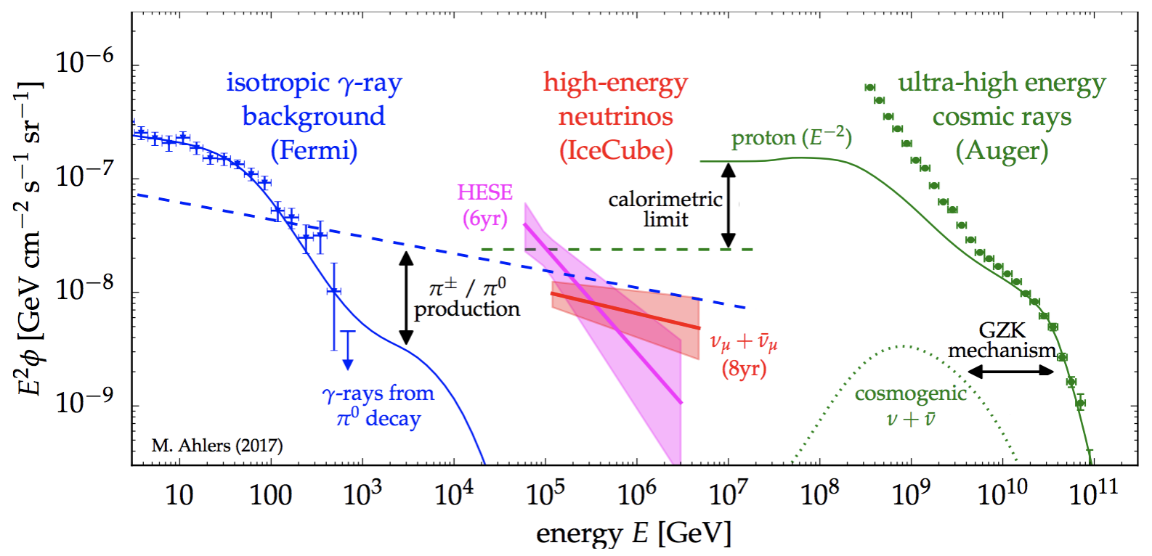
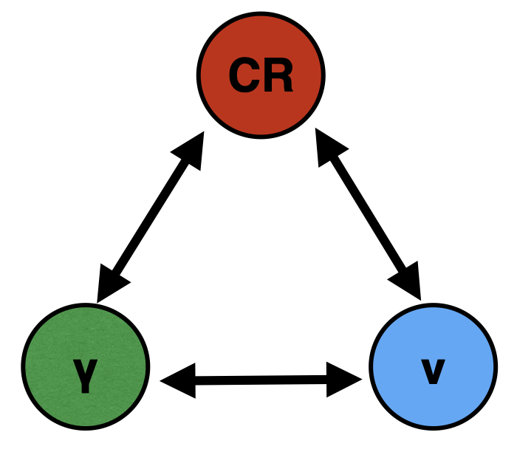
The "diffuse" ν-γ-CR fluxes connection

Slide 13
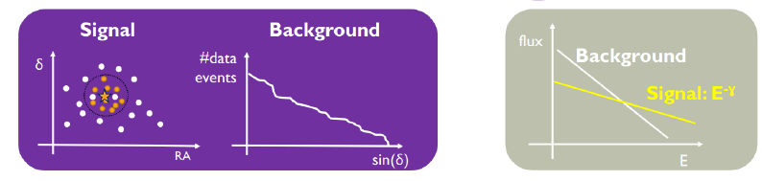
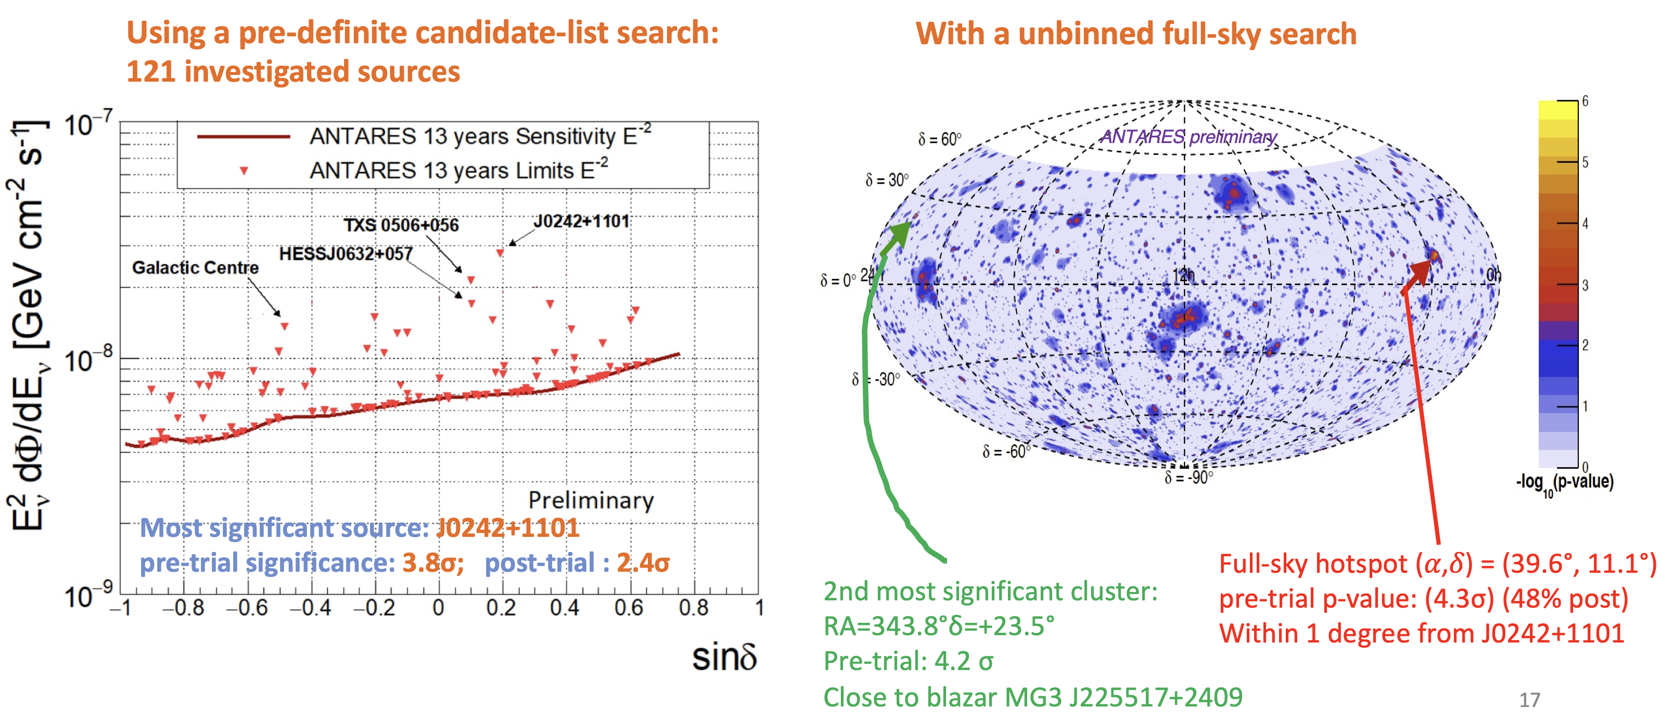
ANTARES: search for point like ν sources
- 13 years (2007-2020) data sample: 3845 days, 10162 traks, 225 showers
- Searching for a statistical excess from given sky point (sources catalogue)
PRD 96, 082001 (2017)
PoS(ICRC2021)1161

Slide 14
IceCube & ANTARES: search for point like ν sources
Skymap of pre-trial p-values for the combined
ANTARES 2007/12 and IceCube 40, 59, 79
point-source analyses.
The red circle indicates the location of the most significant cluster:
(0.7σ post-trial significance)
The Astrophysical Journal, 823:65 (12pp), 2016 May 20

Slide 15
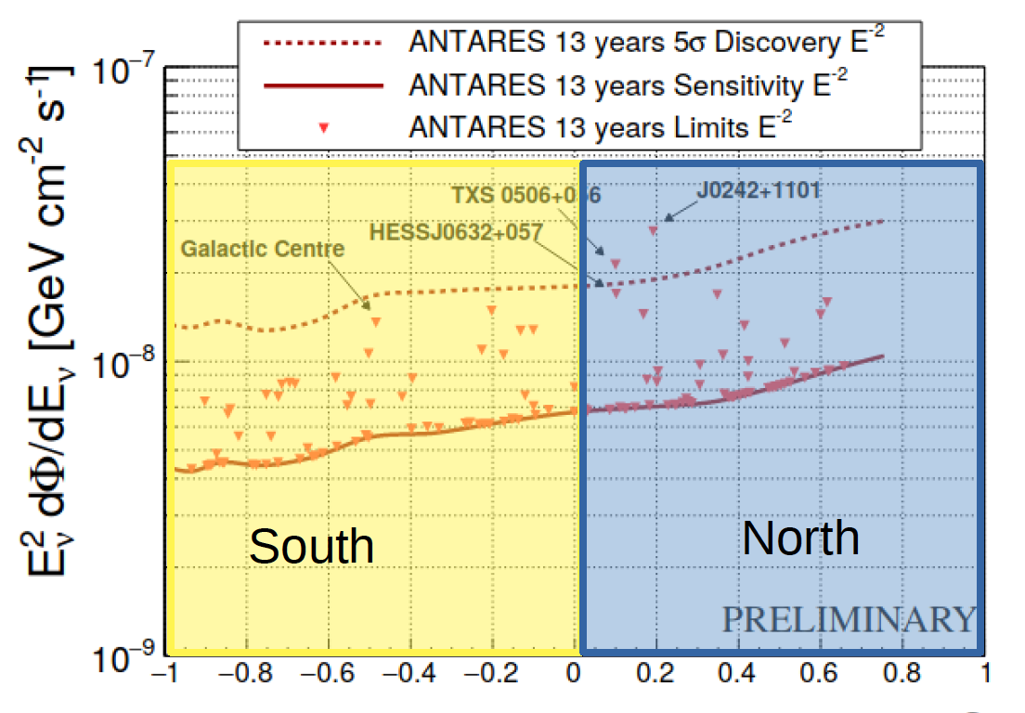
ANTARES: search for point like ν sources
sin δ
POS(ICRC2021)1161

Slide 16
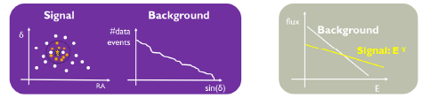
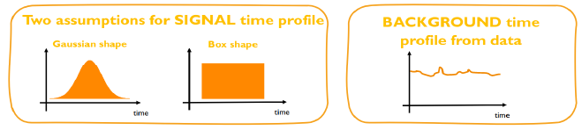
Point like ν sources with a multi-messengers approach
For steady sources (AGN, ...): signal and background integrated over long time
search for a statistical evidence in the distribution of tracks around the source
S/B favoured at high energy
For transient sources (GW, flaring blazars, GRBs, ...) : signal and background integrated over emission time:
e.g.: negligible background for GRB neutrinos
relaxed selection criteria, increased efficiency for neutrinos
need for an external trigger

Slide 17

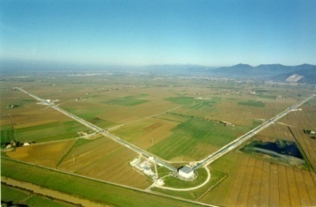

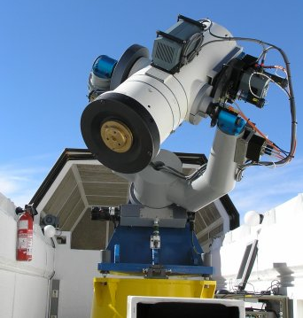
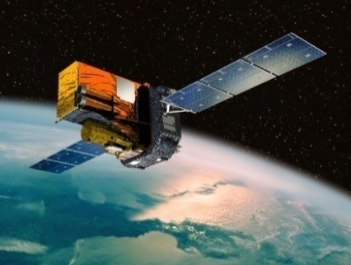
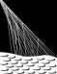
The multi-messengers search program with ANTARES
Neutrinos trigger others
Others trigger neutrinos
Flaring Sources
(ν emission from γ-flaring blazars/μQuasars)
ANTARES
Gamma-Rays
X-Rays
blazars: APP 36 (2012) 304;
μQuasars: JHEAp, 3-4 (2014) 9-7
ANTARES
VIRGO
LIGO
TAToO
(Telescopes – ANTARES Target of Opportunity)
common working group (GWHEN)
S. Adrián-Martínez et al.,
JCAP 06 (2013) 008
Optical follow-up of neutrino alerts for transient source search (GRBs, SNae).
Analysis in progress!
ANTARES AUGER
Adrian-Martinez et al.,
ApJ 774 (2013) 008
GCN (Gamma-ray
Coordination Network)
Optical Telescopes
ANTARES
TAROT & ROSTE + more
ANTARES GCN
A&A 559, A9 (2013),
JCAP 1303 (2013) 006
Ageron et al., Astrop.Phys 35 (2012) 530-536

Slide 18
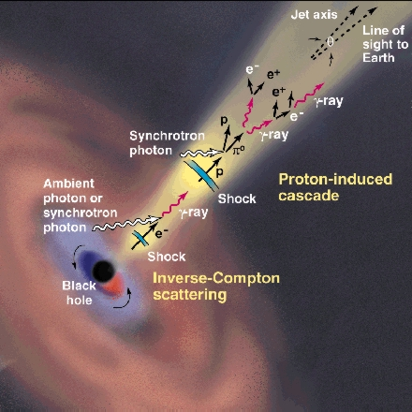
IceCube & FERMI a ν triggered observation of TXS 0506+056 blazar emission
Very H.E. (∼290 TeV) event announced by IceCube with a GCN notice 43s after the trigger
MAGIC
FERMI
Observed γ in time coincidence with Ε_{γ} >100GeV
Observed a blazar with Δθ∼0.06⁰

Slide 19
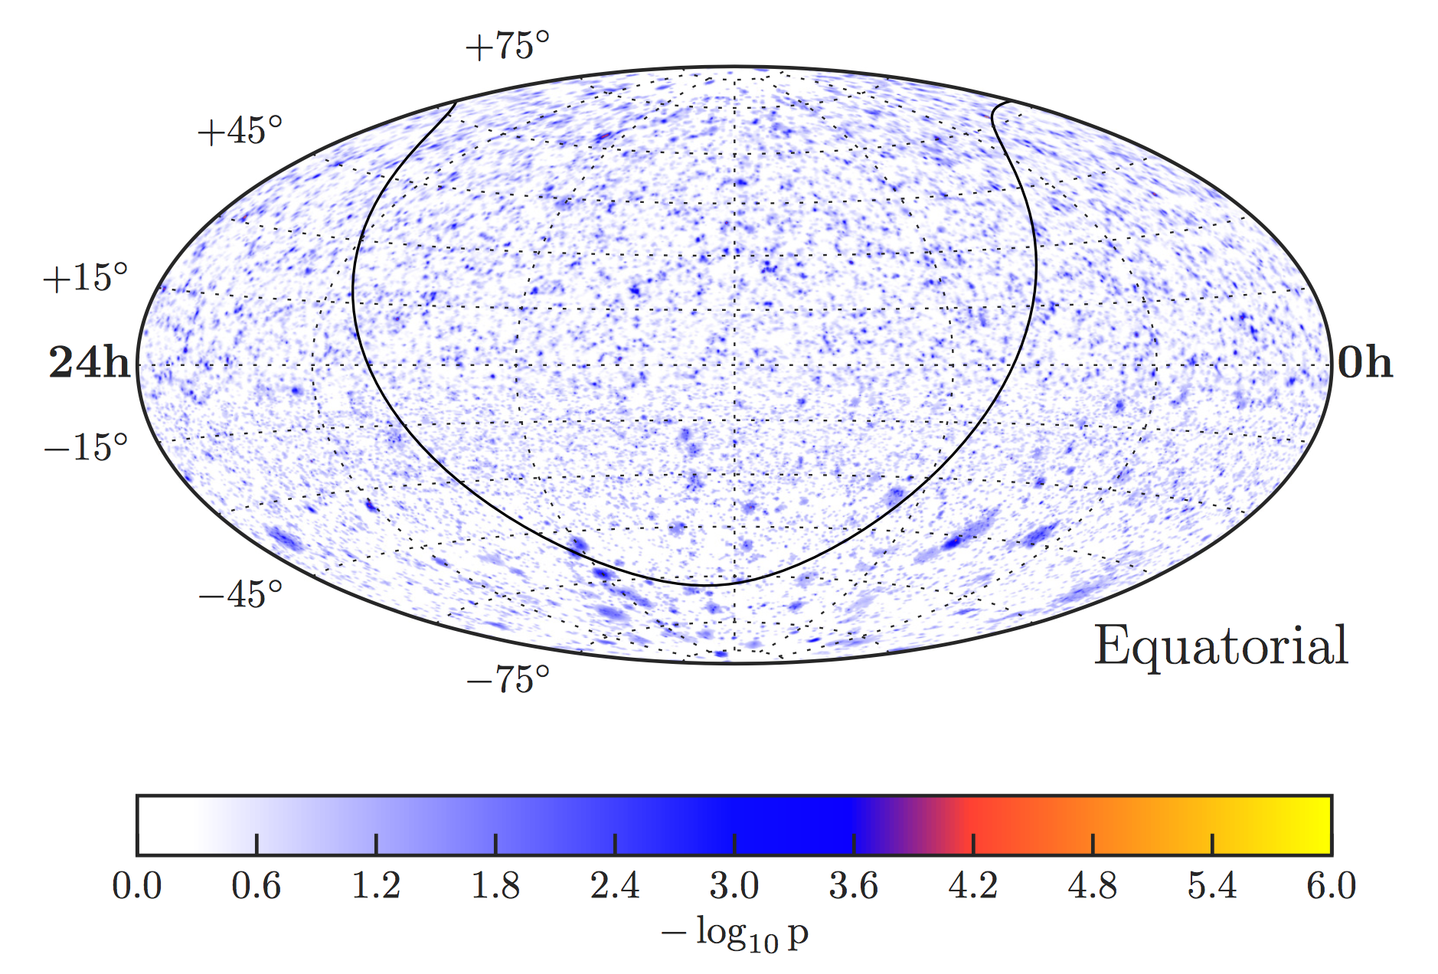
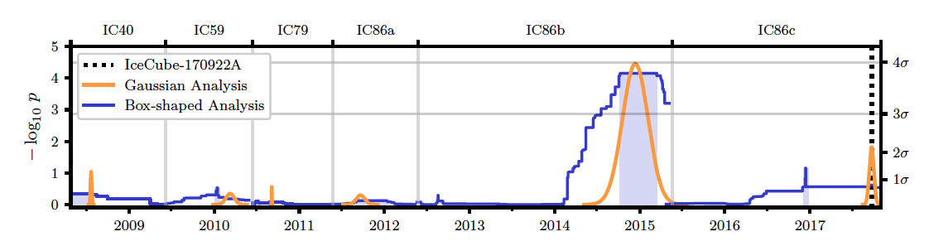
IceCube: searching for other ν from TXS 0506+056 blazar
More neutrinos (∼10) emission from the direction of the blazar TXS 0506+056 IceCube-170922A alert”, IceCube Collaboration: M.G. Aartsen et al. Science 361, 147-151 (2018). pointing to TXS0506+056
3.5σ evidence (a-priori following predefined tests procedures)
E. Resconi | RICAP-2022

Slide 20
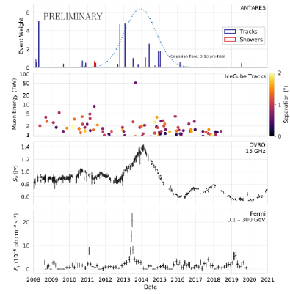
IceCube & ANTARES: search for ν – Radio bright blazars
Search for spatial and temporal coincidence of neutrinos with radio blazars
2774 radio-bright blazars investigated.
No significant evidence of neutrino flare found.
G. Illuminati @Neutrino2022
Notable case of J0242+1101 (PKS 0239+108)
Post-trial p-value of 56% (40%) for the Gaussian (Box) shape.

Slide 21
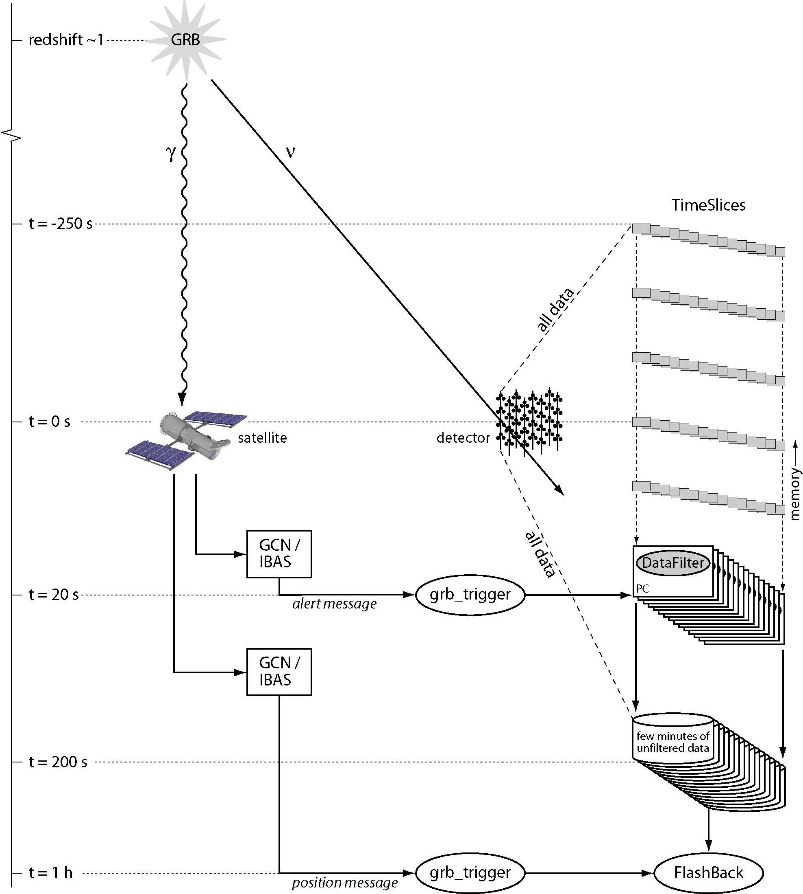
ANTARES: multimessenger search for ν GRBs
GCN alerts trigger the recording of all the low level triggers. A continuous buffer ensures the availability of the data before the alert
GCN=Gamma Ray Burst Coordination Network
t =-250 s
t = 0 s
Data taking triggered by a satellite (FERMI; SWIFT, INTEGRAL)
t = 20 s
All data written to disk
Specific data filtering and reconstruction by searching
for an excess of events in the GRB direction (offline)
t = 200 s
t = 1 h

Slide 22
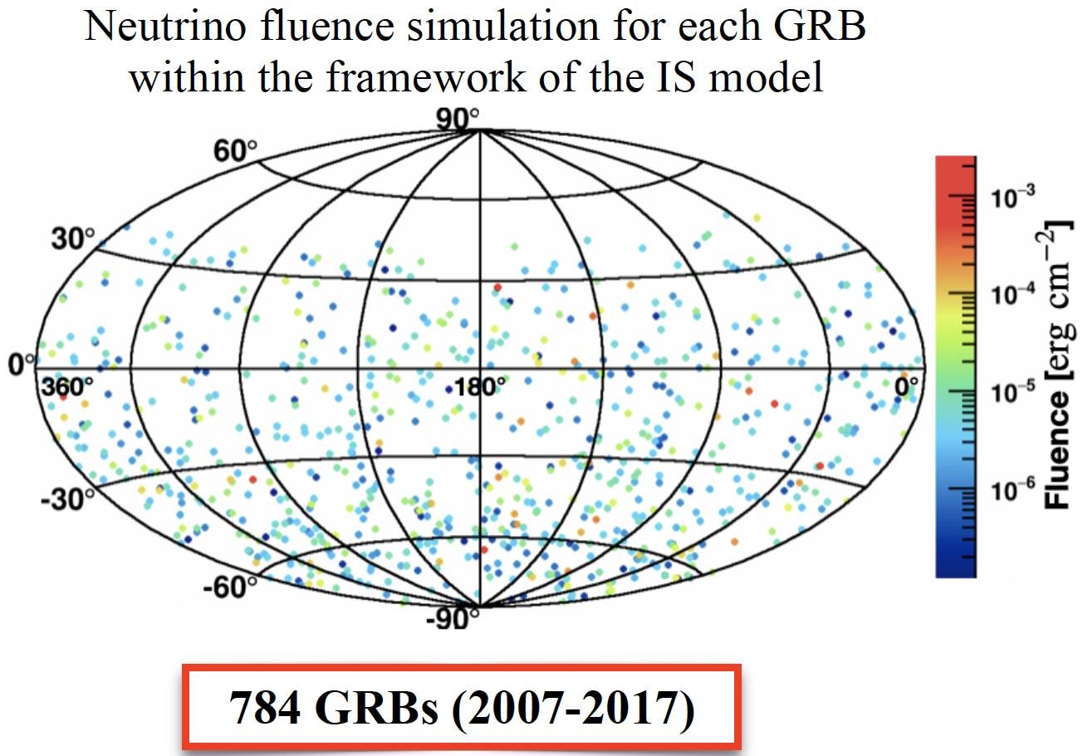
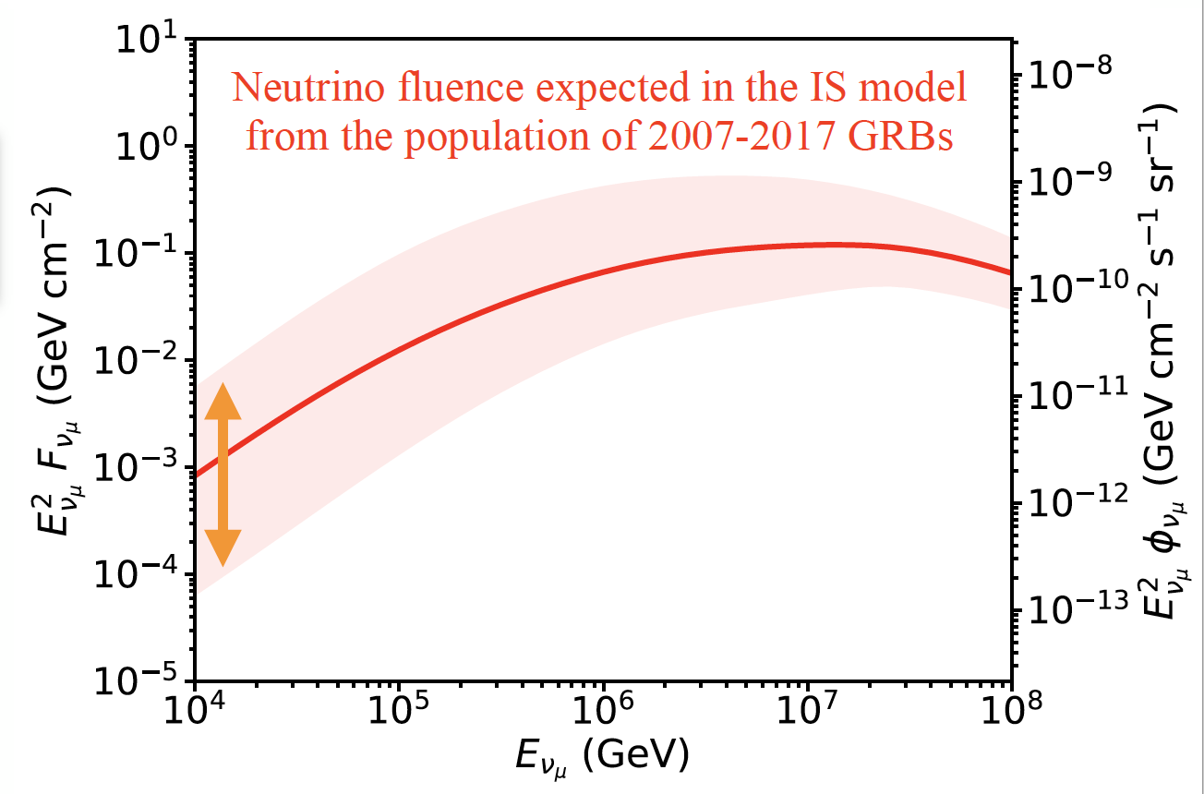
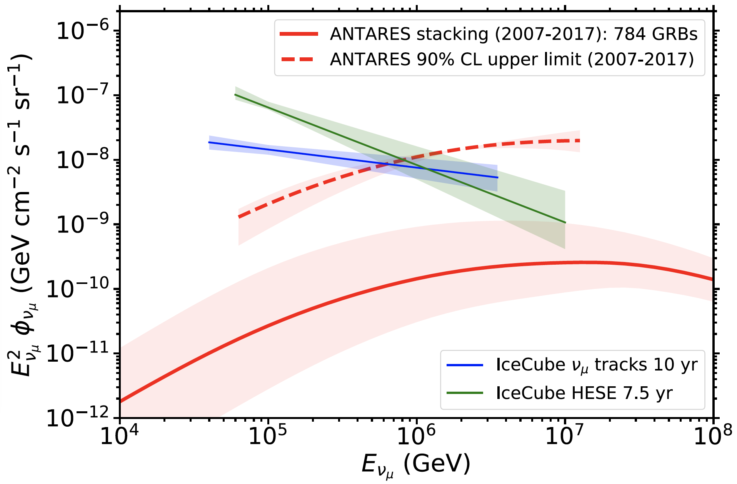
ANTARES: searching for ν from 784 GRBs (10 years)
ANTARES, MNRAS 500, 5614–5628 (2021)
Search for spatial & temporal coincidence with gamma-ray emission:
NO neutrino event found in coincidence with the prompt phase of the long GRB sample
For E_{ν} ∼ 100 TeV GRBs do contribute by ≤10% to the IceCube flux of diffuse ν

Slide 23
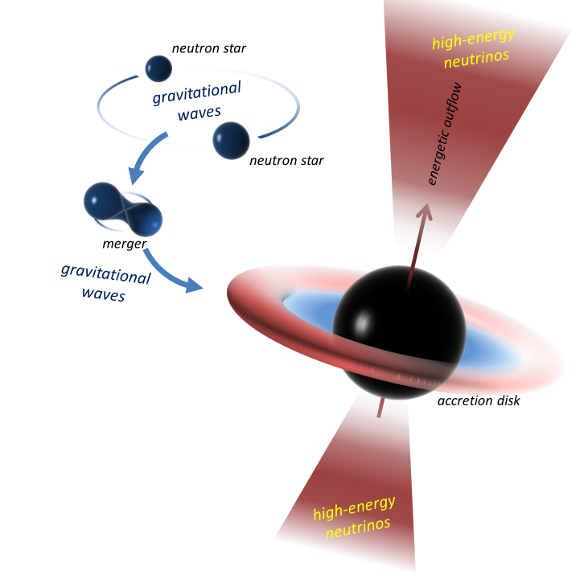
Search for ν from the source of GW170817
ANTARES/IceCube/LigoSC/Virgo/Auger "follow-up" analysis
The Astrophysical Journal Letters, 848:L12 (59pp), 2017 October 20
Advanced LIGO and Advanced Virgo observatories reported GW170817 (binary neutron star inspiral).
A short gamma-ray burst (GRB) that followed the merger of this binary was also recorded by the Fermi-GBM and INTEGRAL.
ANTARES, IceCube, and Pierre Auger Observatories searched for high-energy neutrinos from the merger in the GeV–EeV energy range .
No neutrinos directionally coincident with the source were detected within ±500 s around the merger time. Additionally, no MeV neutrino burst signal was detected coincident with the merger. No neutrino found in an extended search in the direction within the 14-day period following the merger.

Slide 24
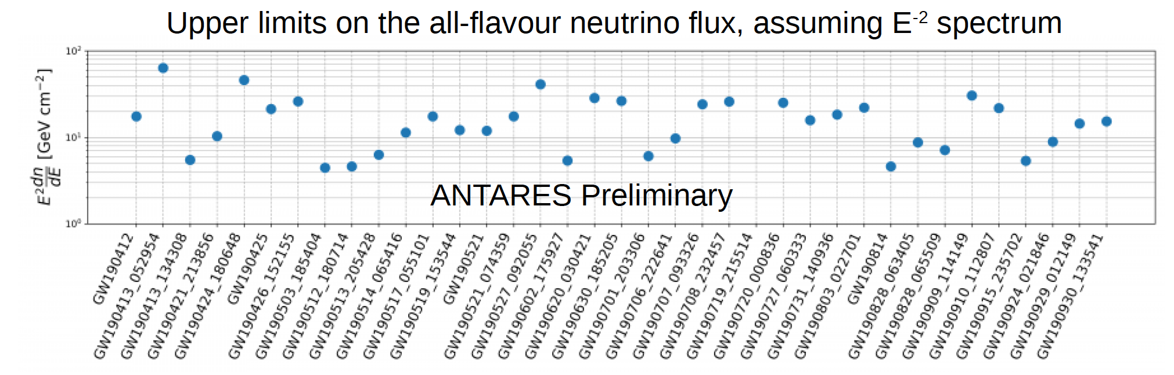
ANTARES: search for ν – GW common sources
39 gravitational wave sources in GWTC-2 catalog
37 sources followed with ANTARES data (2 during downtime)
Total expected background: ~0.38 events over the 37 GWs
Observed number of events: 0 for all sources
M. Lamoureux @Neutrino2022

Slide 25
… not only neutrino astrophysics…
… also open problems in particle physics …
  Dark Matter searches:
    Neutralino annihilation in Sun, Earth, Galactic Center
  Magnetic Monopoles
  Particle acceleration mechanisms
  Multi-messenger searches
  Neutrino Oscillations
  Search for Sterile Neutrinos
  …
search for excess observed over the expected backg.
μ
Ψ
Neutralino search: χχ → ν+…

Slide 26
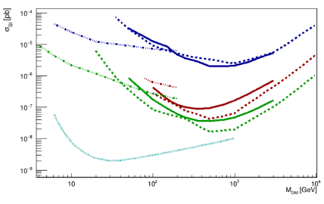
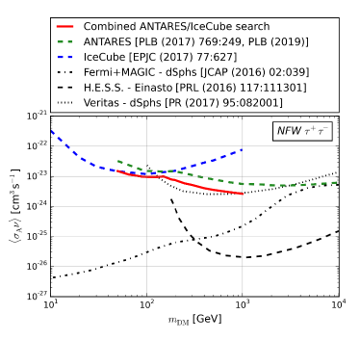

Indirect searches from Dark Matter: ν from massive bodies (Sun, Galactic center, ...)
Galactic Centre → annihilation cross-section
Sun → scattering cross-section
$\frac{dΦ_{ν_{μ}+{\overline{ν}}_{μ}}}{dE_{ν_{μ}+{\overline{ν}}_{μ}}}=\frac{<σν>}{8πM_{WIMP}^{2}}$ $∙\frac{dN_{ν_{μ}+{\overline{ν}}_{μ}}}{dE_{ν_{μ}+{\overline{ν}}_{μ}}}∙J_{int}(ΔΩ)$
Xenon 1T
ττ WW bb
Solid lines: ANTARES
Dashed: IceCube
Dot-Dashed: SuperK
C. Poiré@Neutrino2022
Phys. Rev. D 102, 082002 (2020)

Slide 27
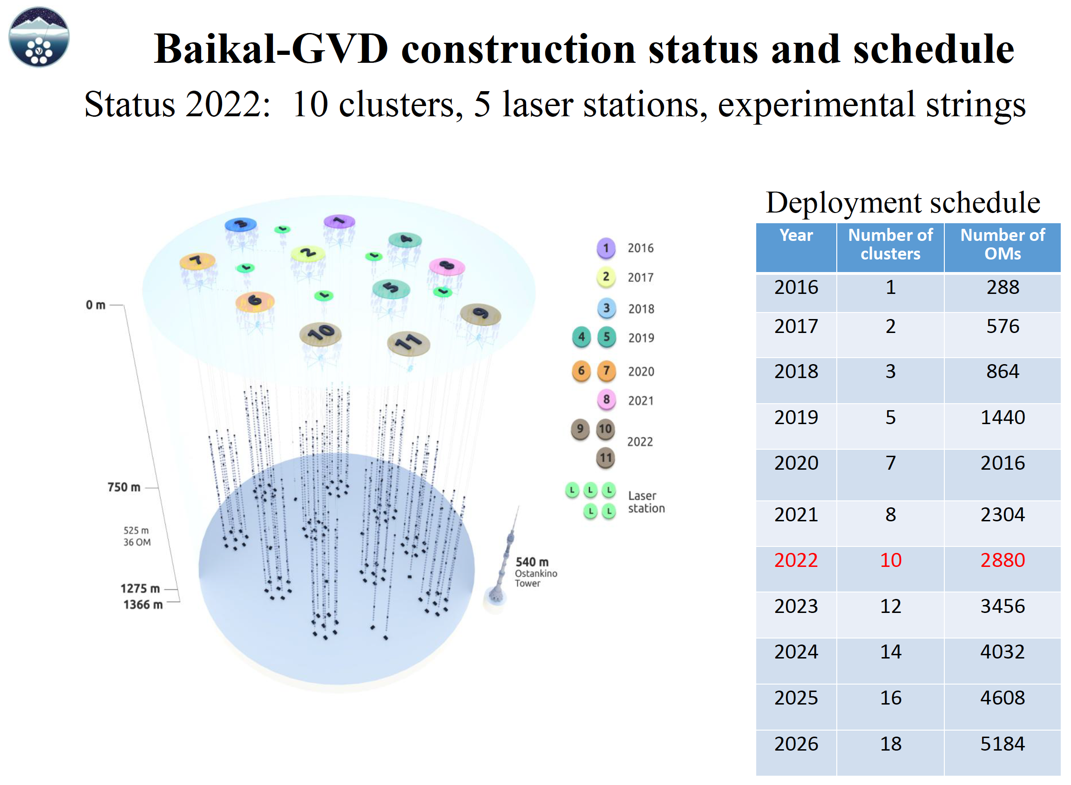
by courtesy of Koljia Budnev

Slide 28



by courtesy of Koljia Budnev

Slide 29







KM3NeT the future of ν astronomy in the Mediterranean
Multi-site, deep-sea neutrino telescope
Selected by ESFRI roadmap
Single collaboration, Single technology
2470m
ORCA
250 scientists
57 institutes
16 countries
Oscillation Research
with Cosmics In the Abyss
3400m
~ 700 or 200 m
ARCA
Naples
Bari
Astroparticle Research
with Cosmics In the Abyss
KM3NeT 2.0: Letter of Intent
J. Phys. G: Nucl. Part. Phys. 43 (2016) 084001

Slide 30





ORCA and ARCA schematic view
9 or 36 m
~ 700 or 200 m
Rapid deployment
Multiple strings/sea campaign
Autonomous/ROV unfurling
Reusable
20 or 90 m

Slide 31


ARCA construction phase

Slide 32

ARCA Reconstruction Performances

Slide 33


ARCA very preliminary results
With only 6 ARCA lines
Eur. Phys. J. C 80 (2020) 99
At present taking data with 21 lines.
Funding assured, procurement and construction in progress, for ∼130 strings

Slide 34

ORCA very preliminary results
With only 6 ORCA lines

Slide 35
Summary
High Energy Neutrino astrophysics has an important role in the Multi-messenger contest
  Absolute and precise pointing to the source
  Wider horizon
  Provides information:
    On the nature of the source (Hadronic ??, Leptonic ??)
    On the acceleration of parent particle
High Energy neutrino astrophysics started:
  Diffuse ν flux measured
  H.E. ν events (IceCube) associated with known gamma sources
New large and high resolution detectors (KM3NeT, IceCube Gen2, BAIKAL/GVD) in construction (or under project: P-One ?) ready to work in a Multi-messenger framework

