Slide 1



Thanks Gerhard
Recent computational studies of the liquid-liquid transition in supercooled water
Francesco Sciortino, Sapienza Universita’ di Roma

Slide 2
Outline
getting closer to predicting realistic values of T_{c} and P_{c}
Future experiments
A continuum of local enviroments or two distinguishible local structures ?
(The LLPT as a topological transition over lunch break)

Slide 3
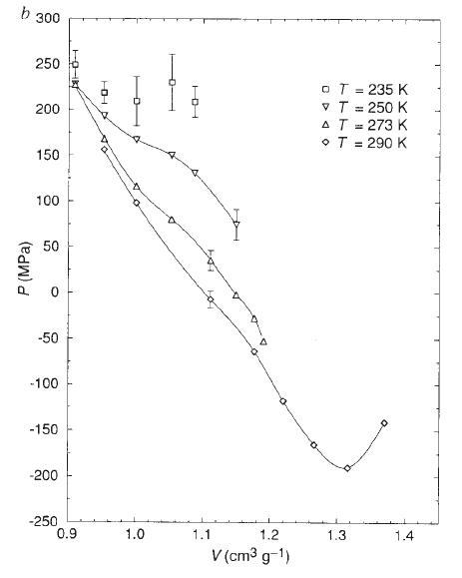
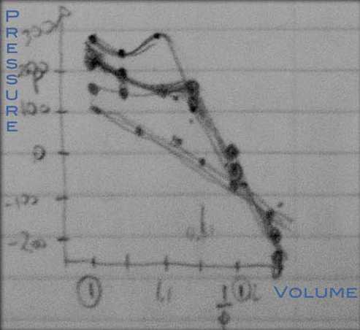

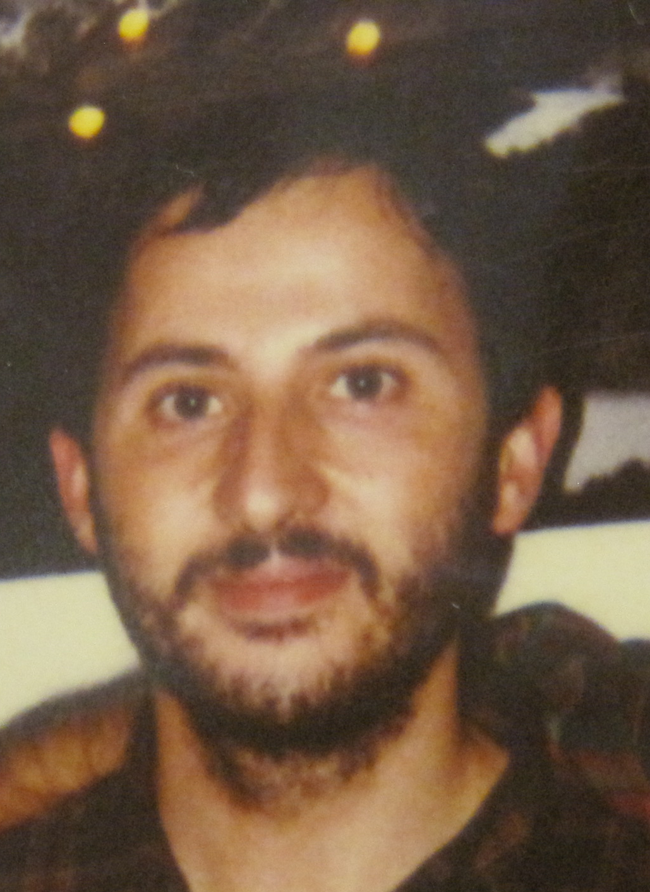

Liquid-Liquid critical point hypothesis: the beginning !
P. H. Poole, F. Sciortino,
U. Essmann and H. E. Stanley,
Phase behavior of metastable water
Nature 360, 324-328, 1992
1992

Slide 4
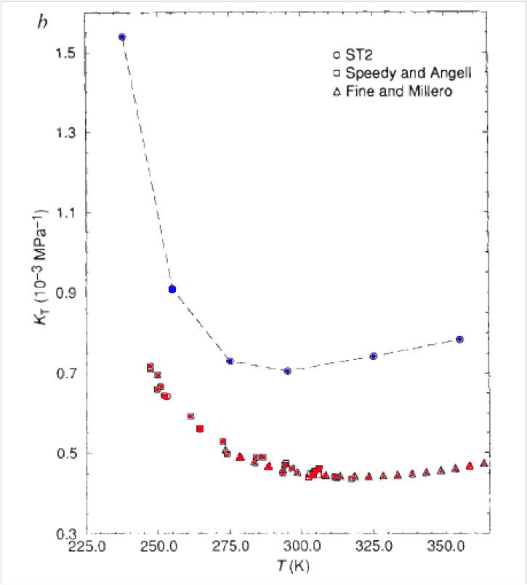
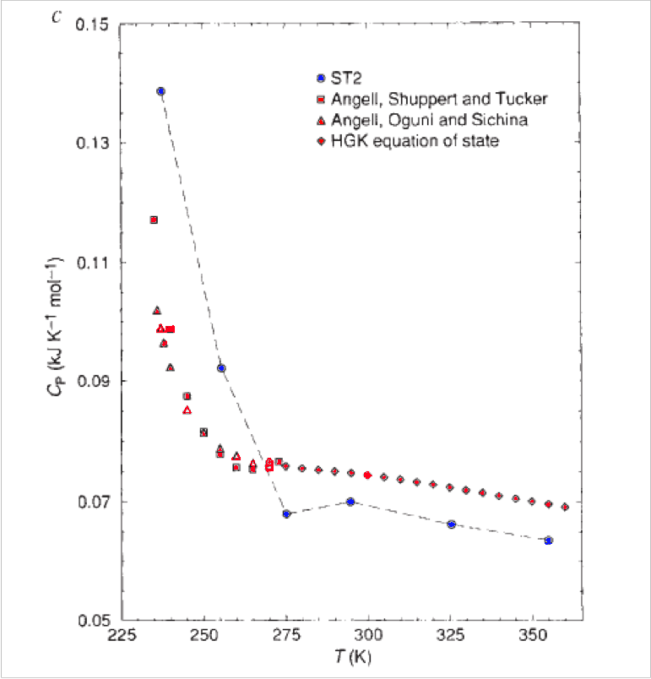
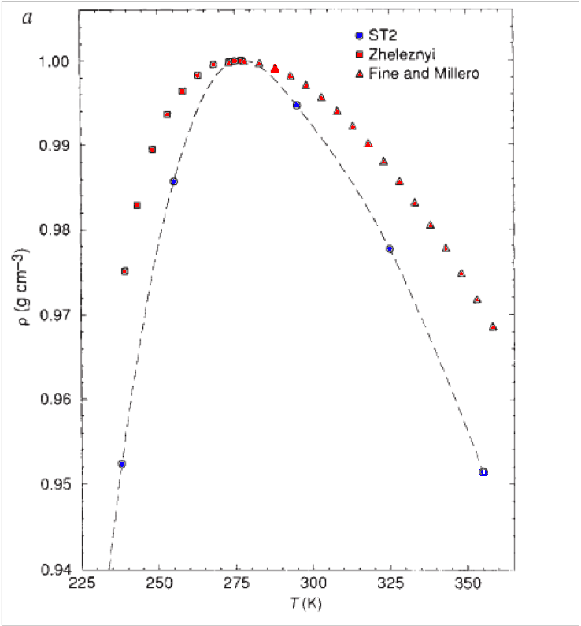
ST2 (shift in 35 K T and 80 Mpa in P)
Poole, FS, Essman, Stanley, Nature 1992
Tc ~ 200 K. Pc~1500 bar

Slide 5
Where are we after 30 years
ST2 (shift in 35 K T and 80 Mpa in P)
Poole, FS, Essman, Stanley, Nature 1992
MB-pol (no shift)

Slide 6
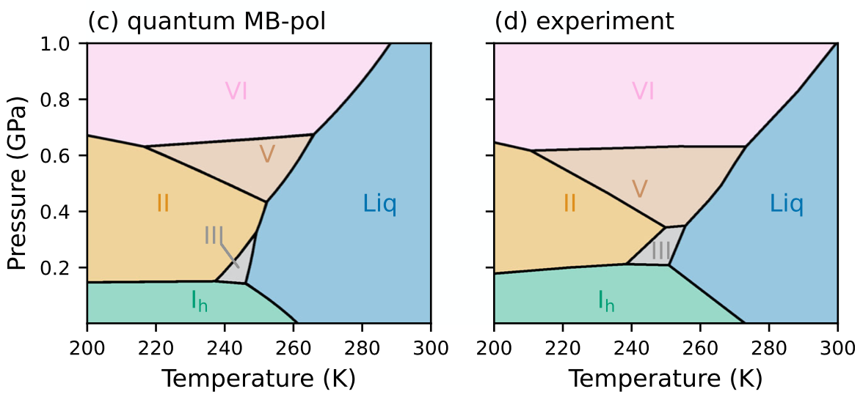
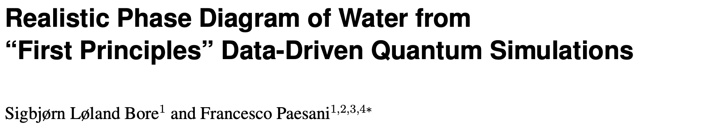

Nature Communications, (2023)

Slide 7
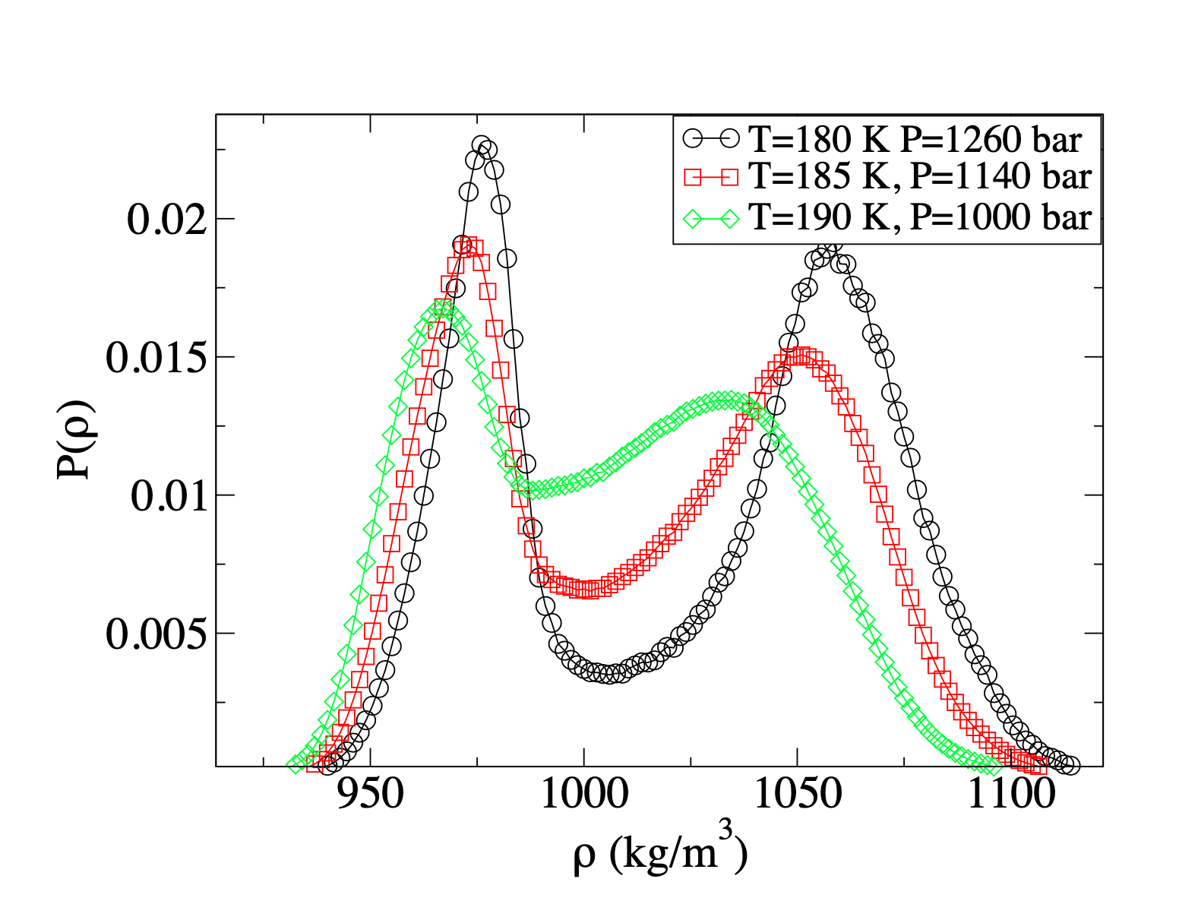
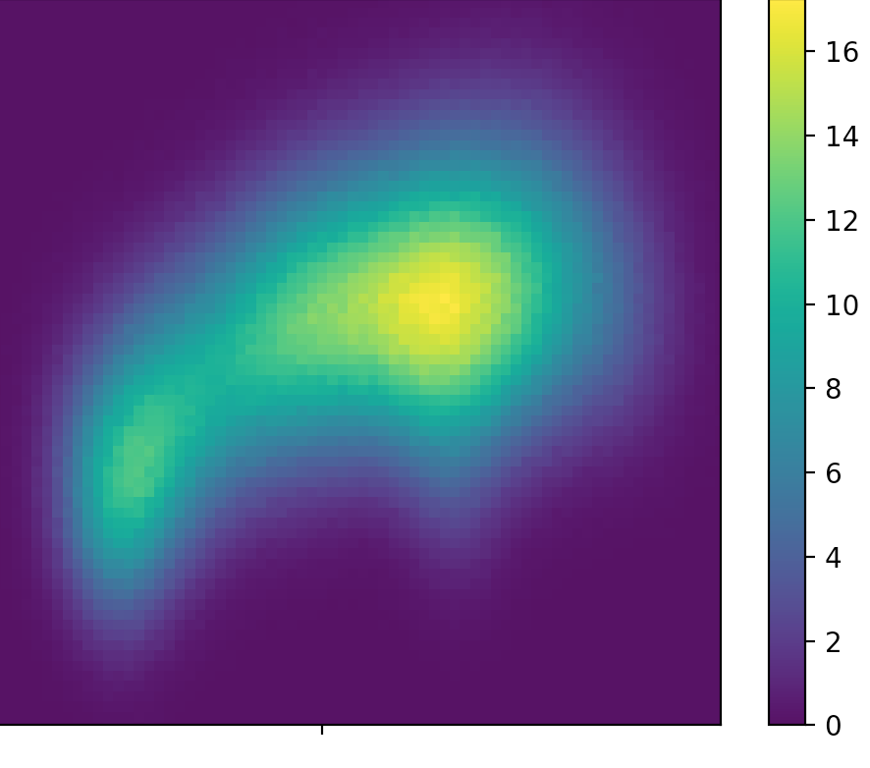
The latest member
of the certified LLCP family:
DNN@MB-pol
by Francesco Paesani
(Tc=187+-2 K, Pc=1050+-100 bar, preliminary)
Energy
Density
(F. Paesani, FS, unpublished data)

Slide 8
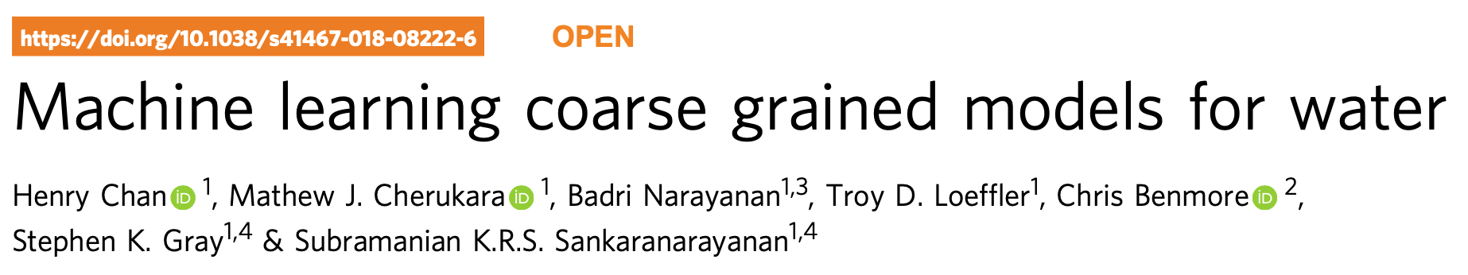
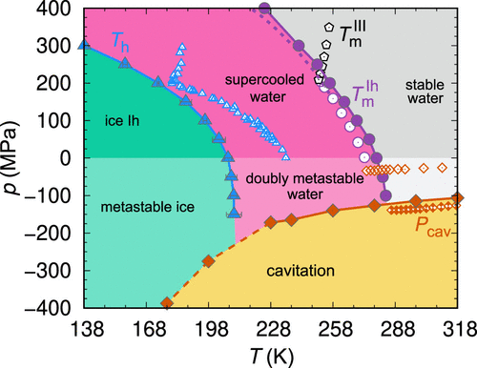
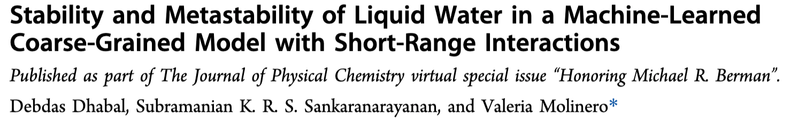

Slide 9
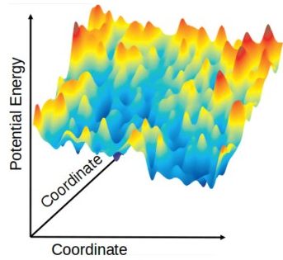
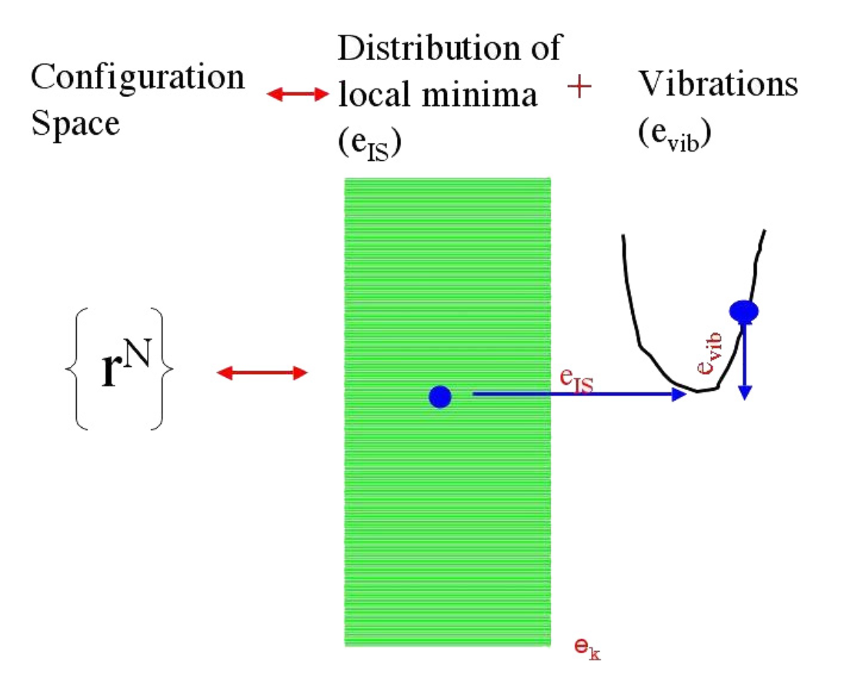
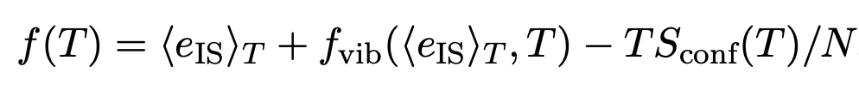
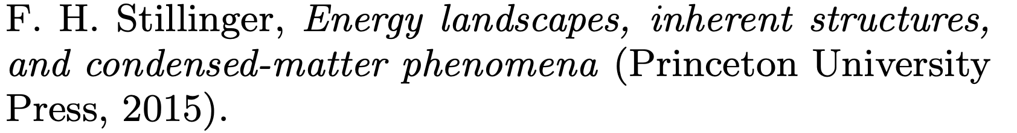
A PEL-APPROACH FOR ML-BOP

Slide 10
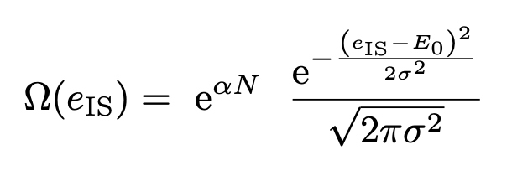
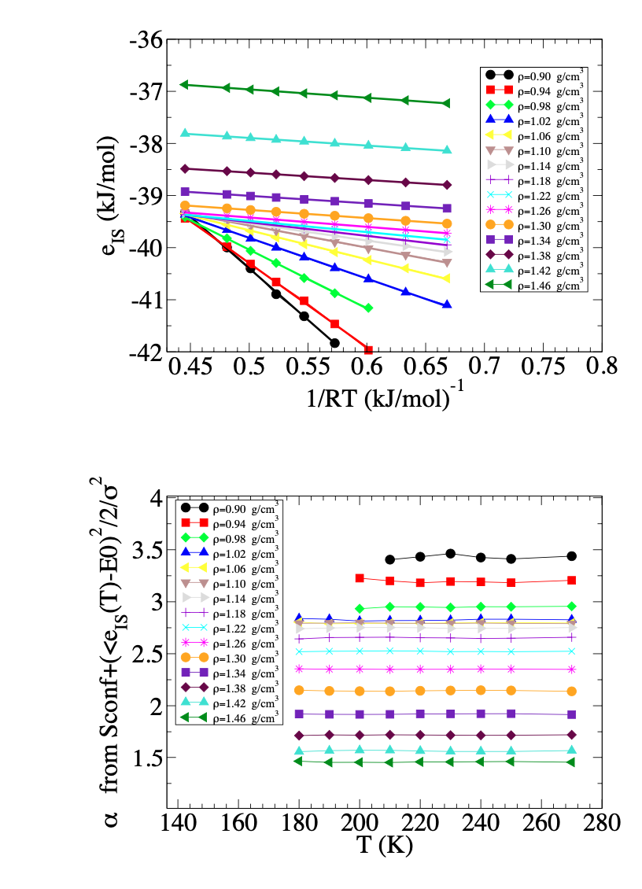
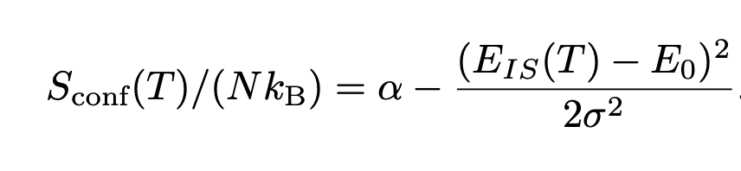
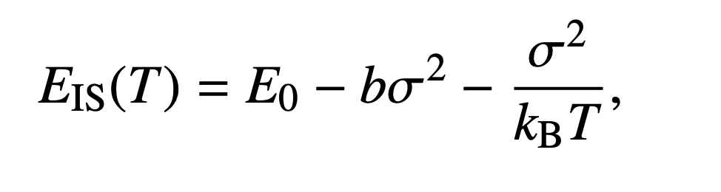
Gaussian Landscape α, E₀, σ²
Submitted

Slide 11
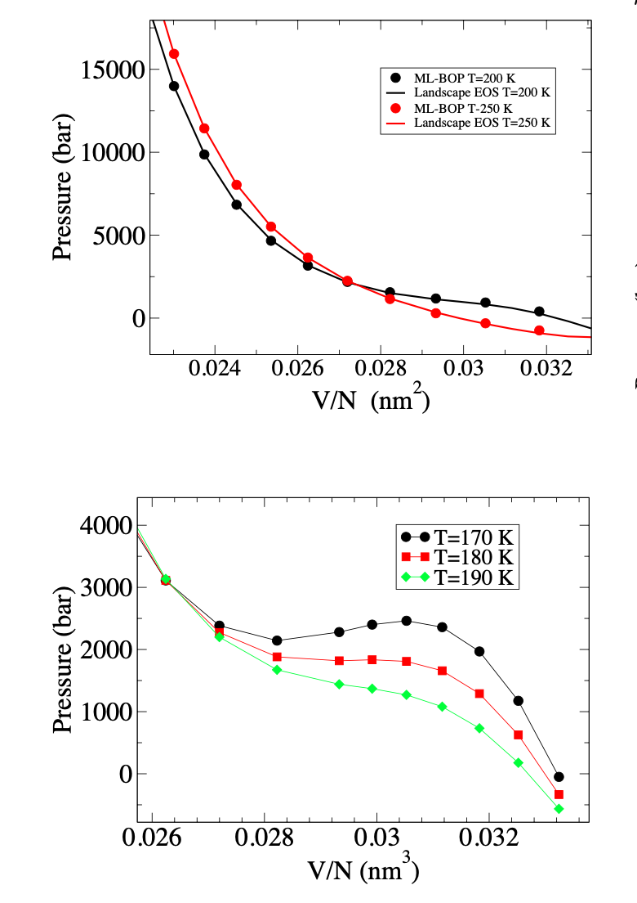
Submitted

Slide 12
What kind of experiments can help ?
Experiments at P_{c}

Slide 13
A recent experiment entering no-mans land:

Slide 14
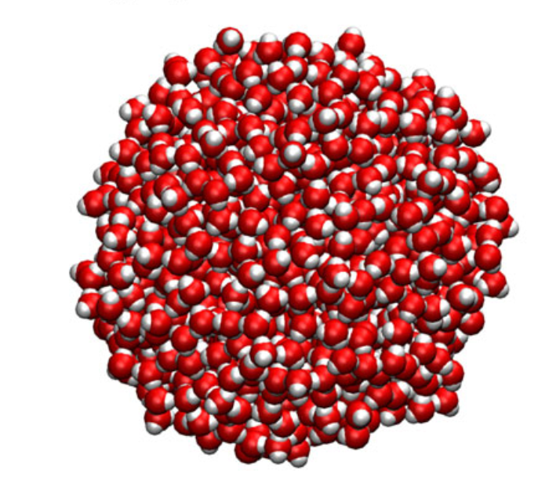
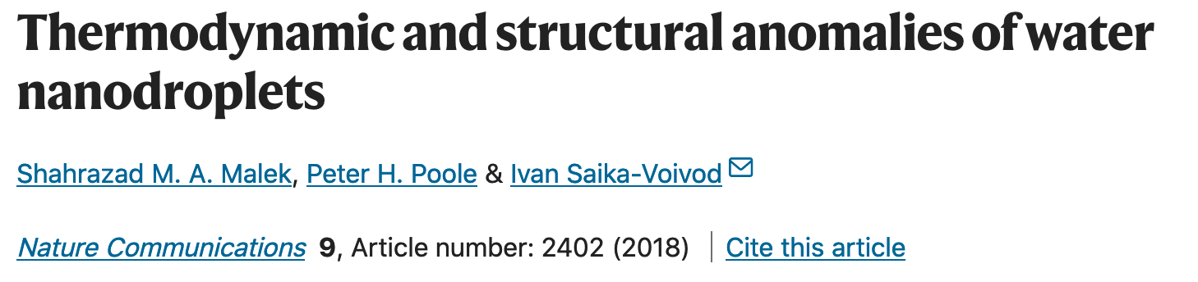
How to enter in the no-mans’ land at 1000 bar to probe the transition ?
Nano Droplets…..
The Laplace pressure can induce
(at low T) a transition from LDL to HDL
(if crystallization can be avoided….)

Slide 15
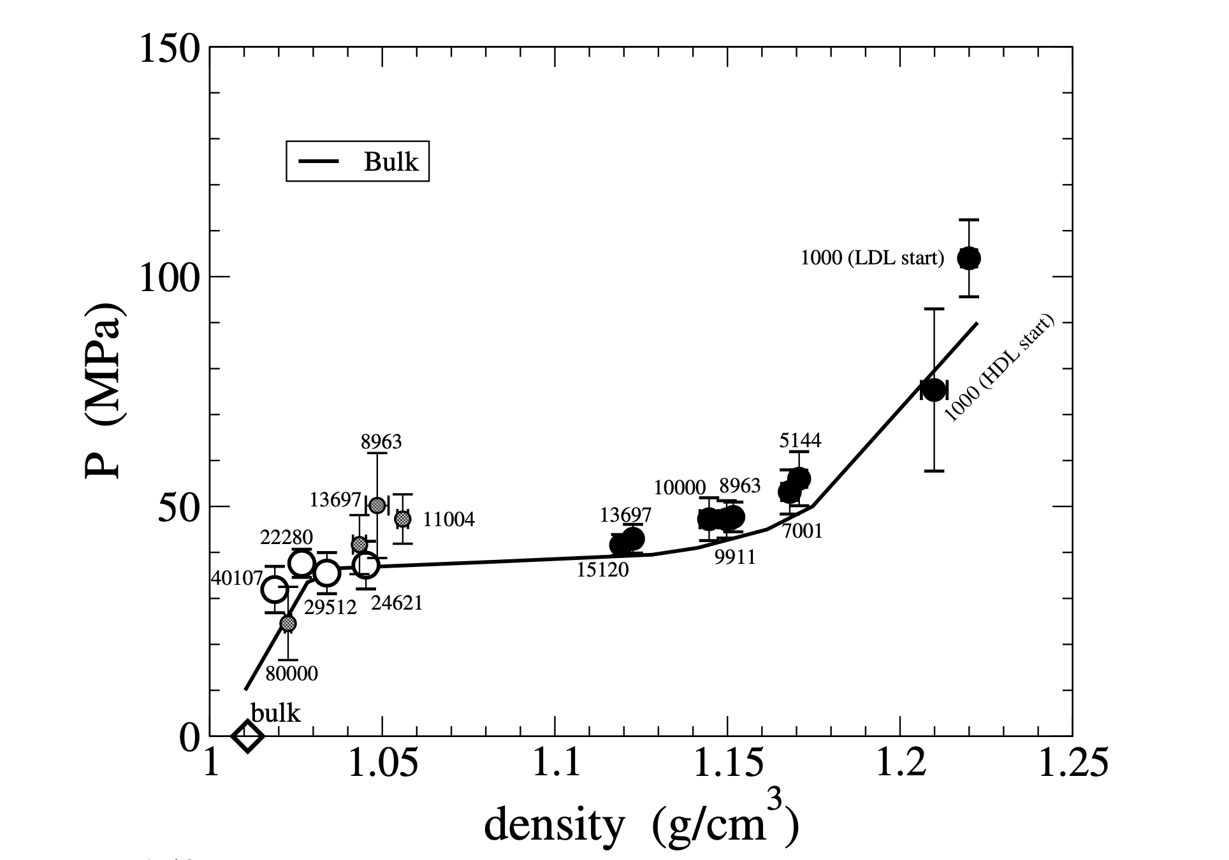
Droplet equation of state (Wail model)
T =T_{c}
(Poole, Saika-Voivod, FS, preliminary data, unpublished )

Slide 16
Oscillating Critical droplets…..
If P_{c}=400 bar (WAIL). Nx=15000 (R= 5 nm)
If P_{c}=1000 bar (MB-pol). N=1000 mols (R= 2 nm)
If P_{c}=1700 bar (TIP4P/2005) N=170 mols (R= 1.0 nm)

Slide 17
Dynamics at low wavevector

Slide 18
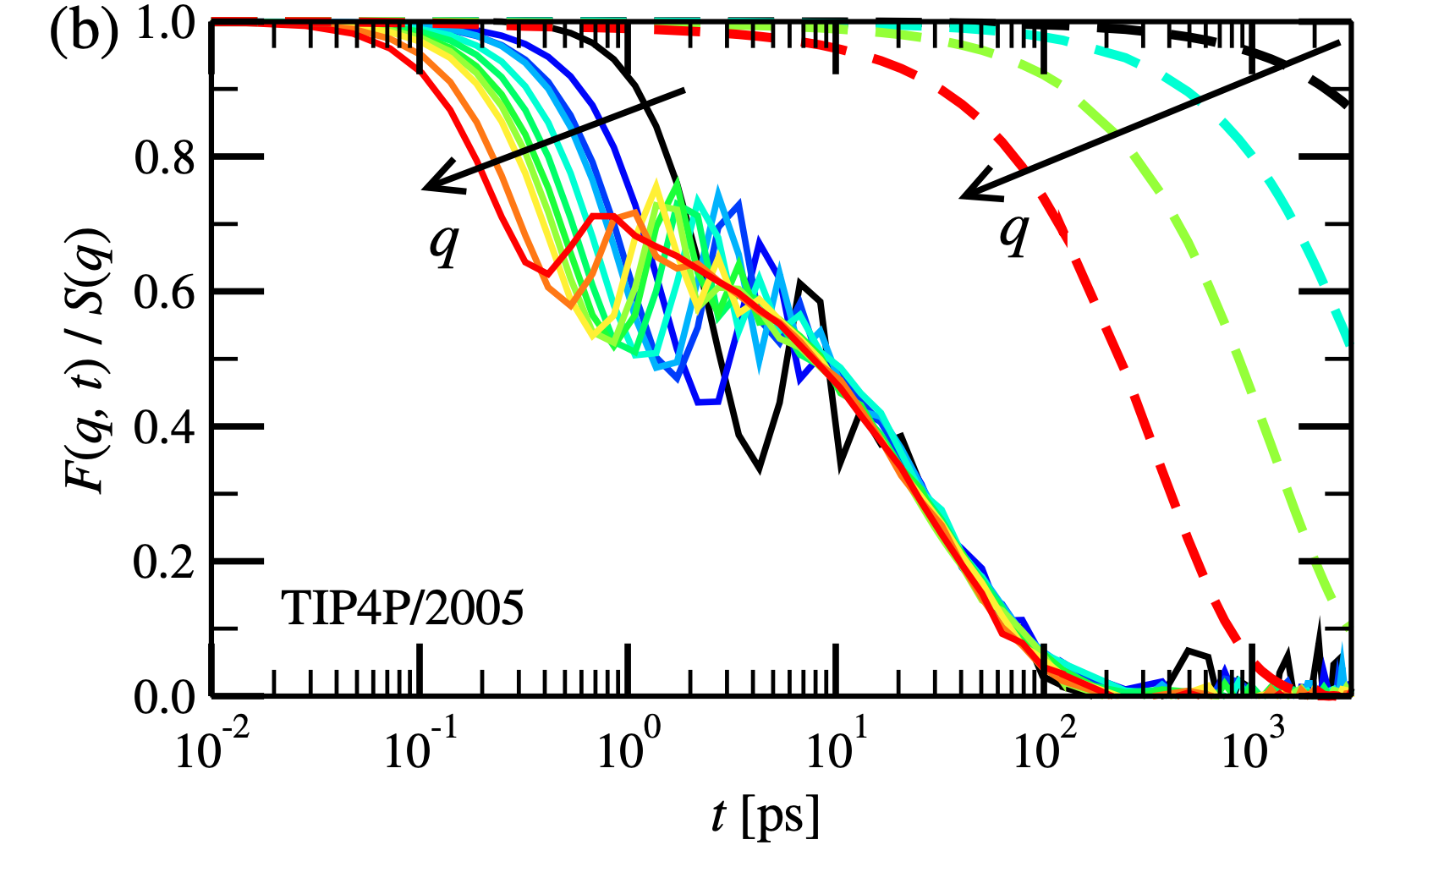
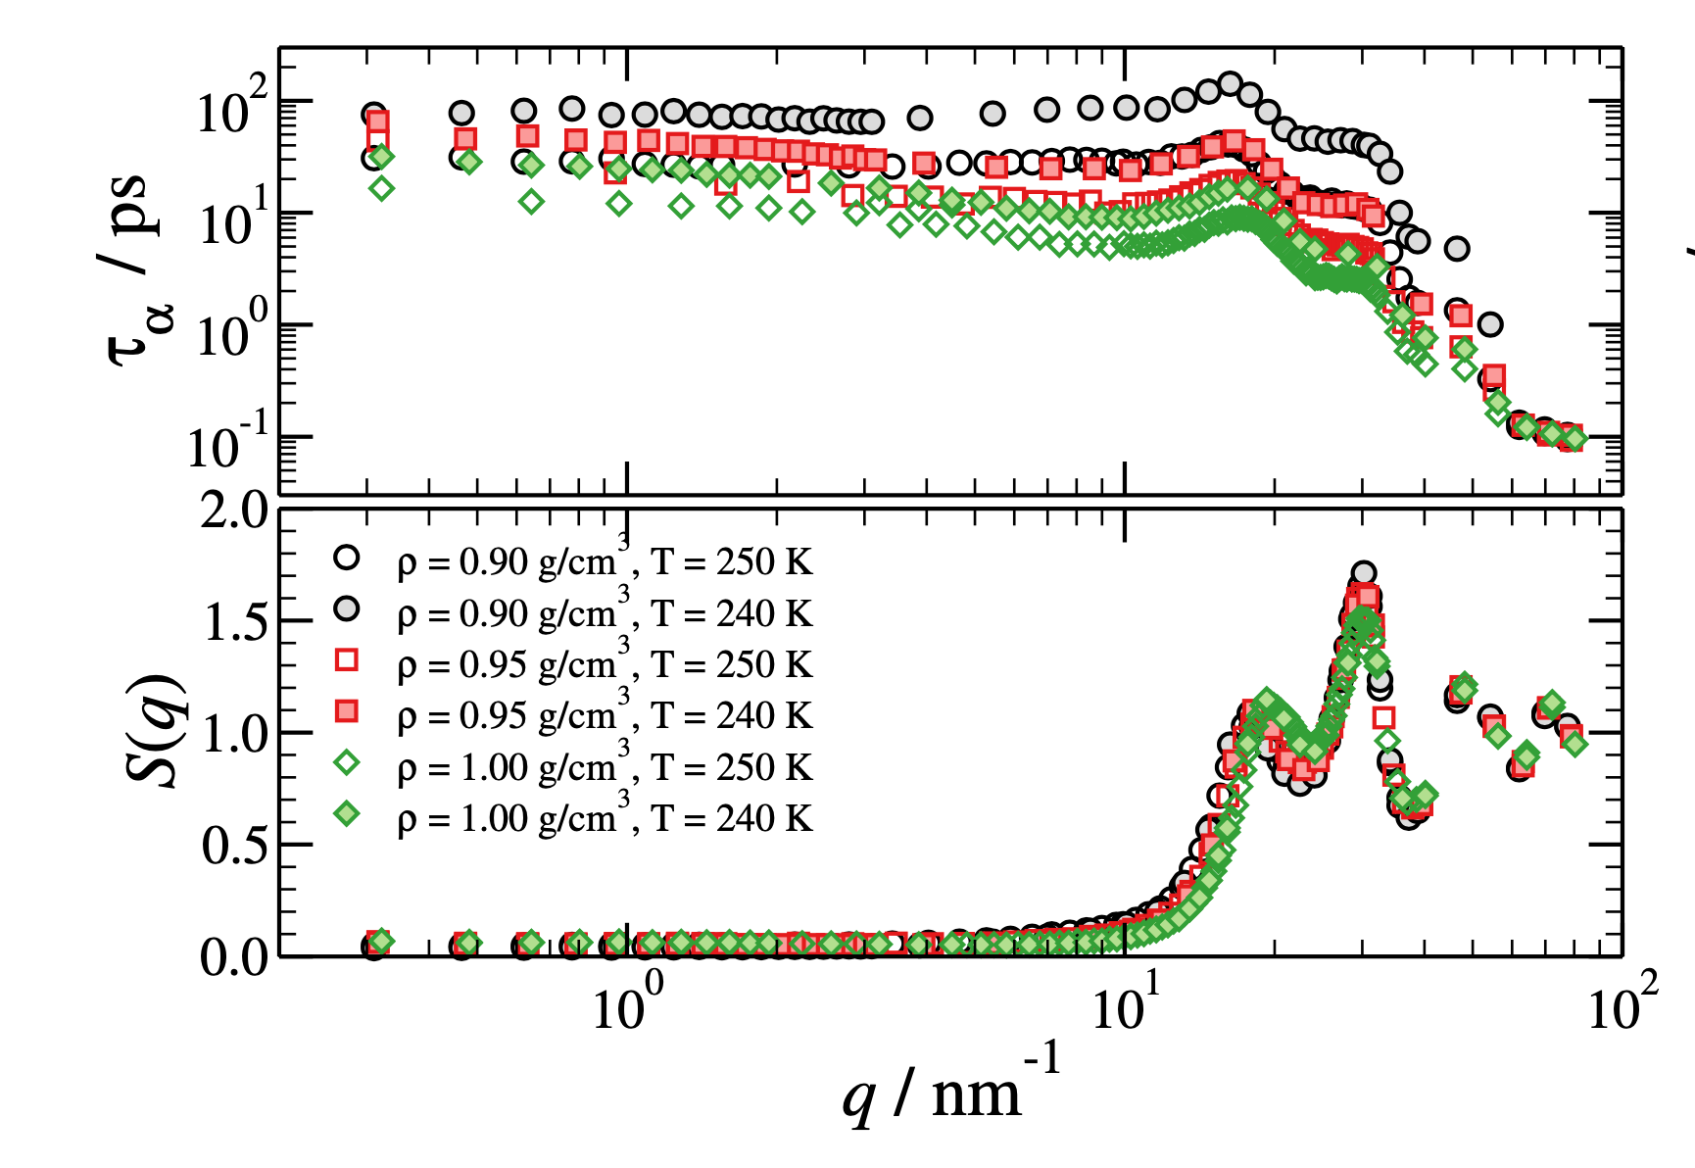
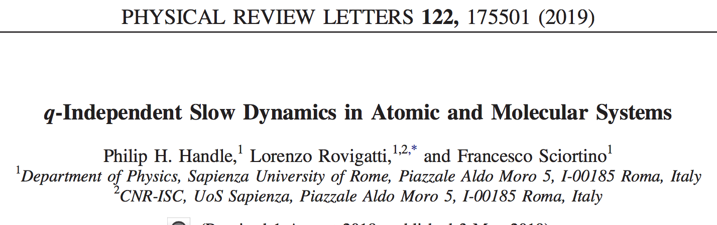
F(q,t) at small q ……
q varies between 0.3 (black lines)
and 3.0 (red lines) nm⁻¹
.
T=250 K, 1 g/cm3

Slide 19
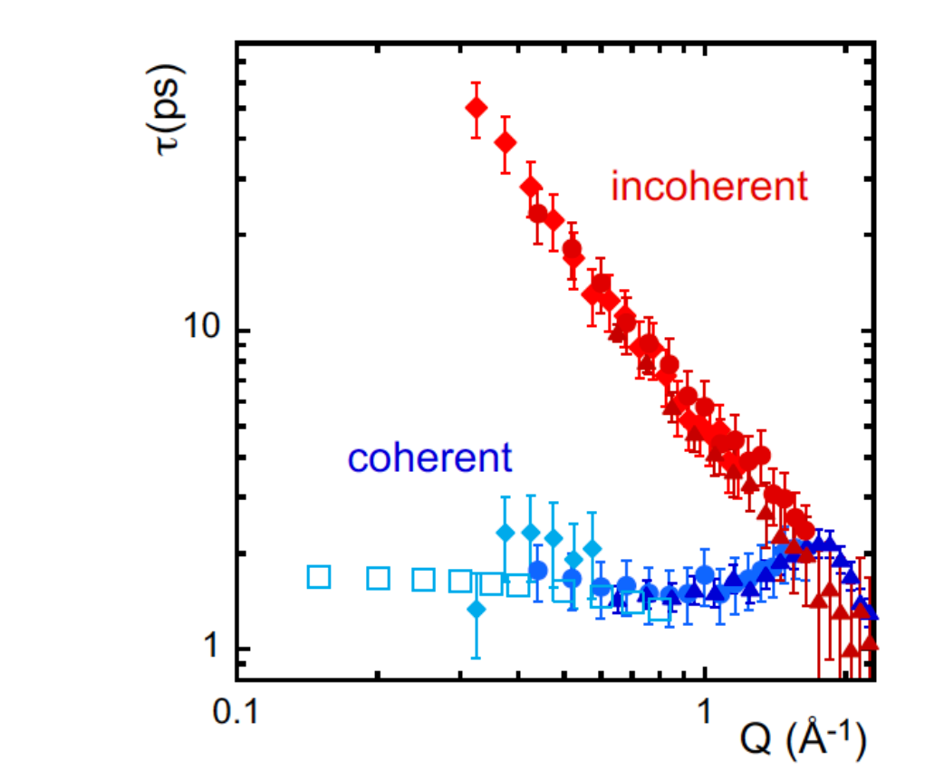
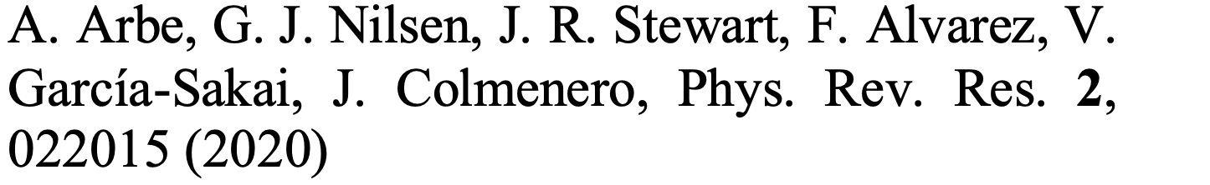

Slide 20
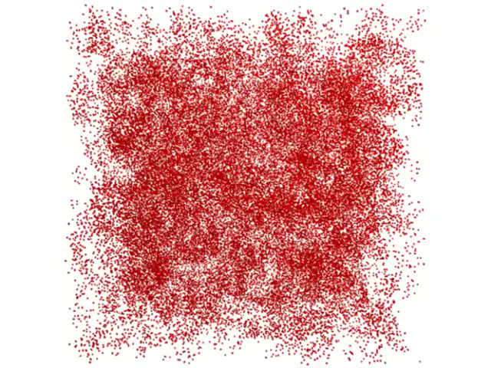
What happens close to the LL critical point ?

Slide 21
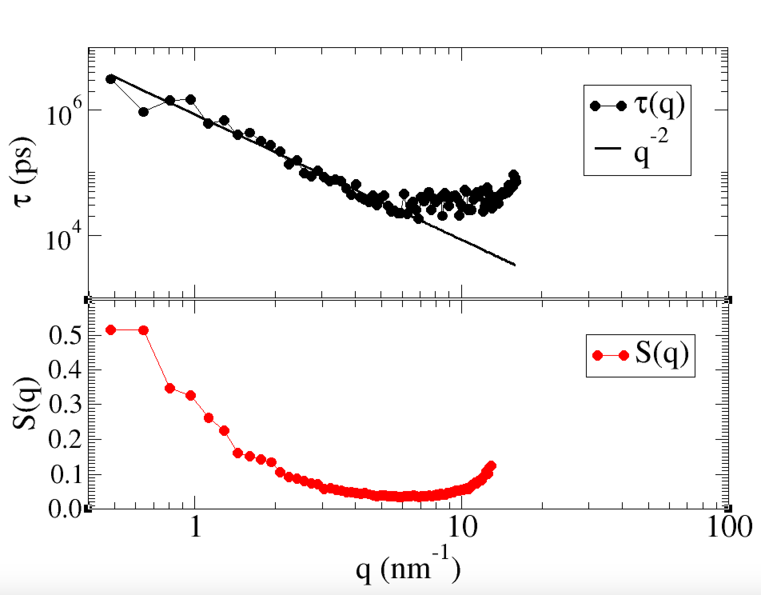
Close to T_{c}

Slide 22
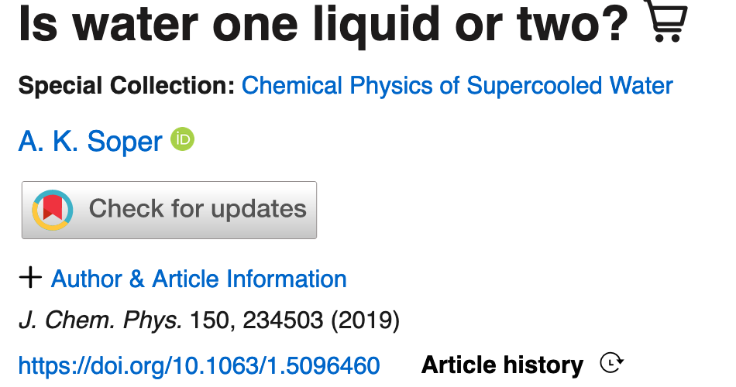
Two families of local environments
or a broad and skewed distribution ?

Slide 23
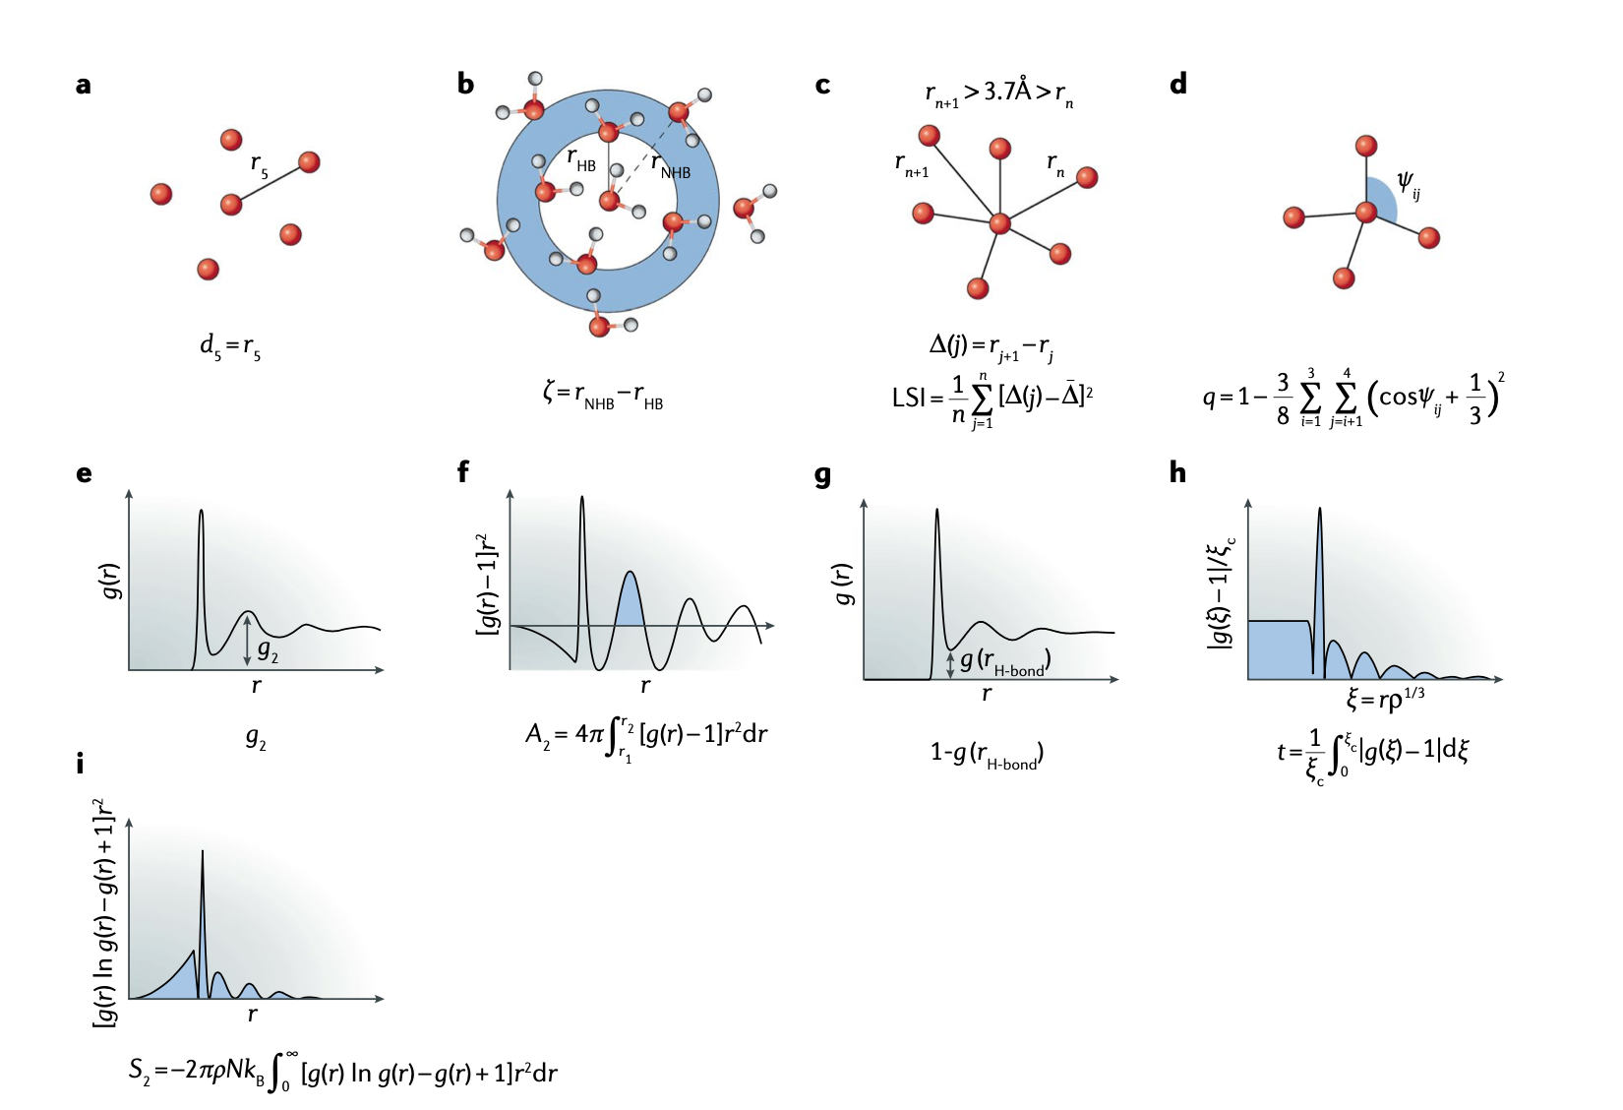
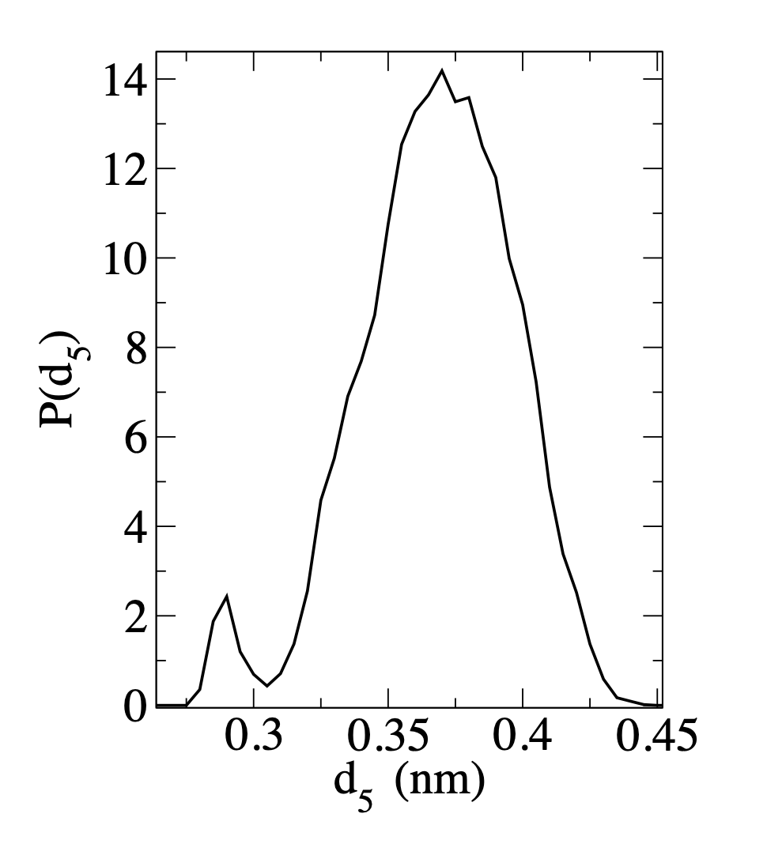
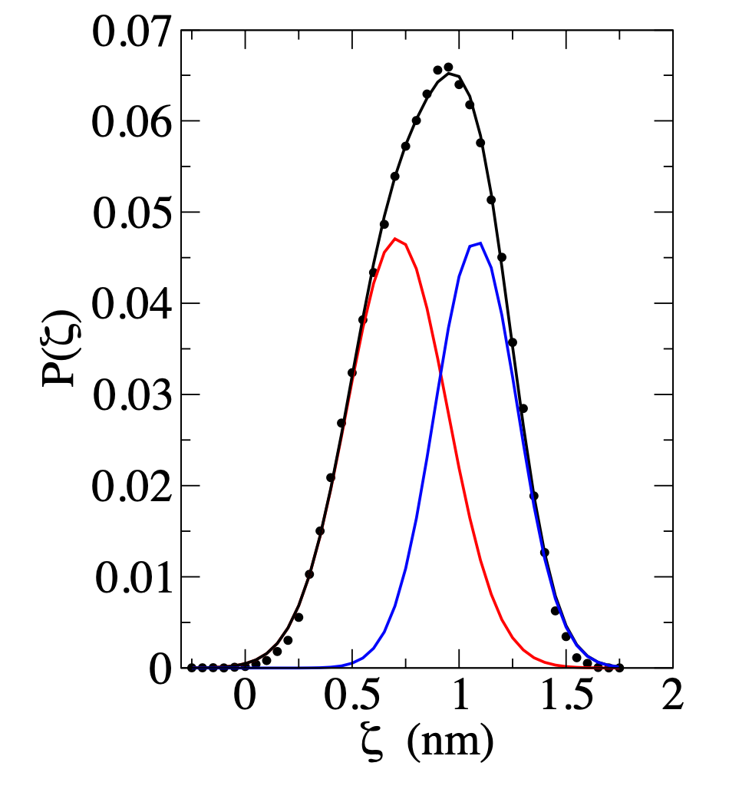

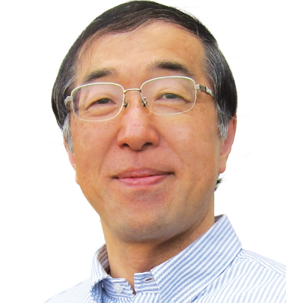


Molecular Distribution
(properties of single molecules)
Hajime Tanaka
Peter Poole
John Russo
Two different local environments ?
T=220 K, P=1000 bar

Slide 24
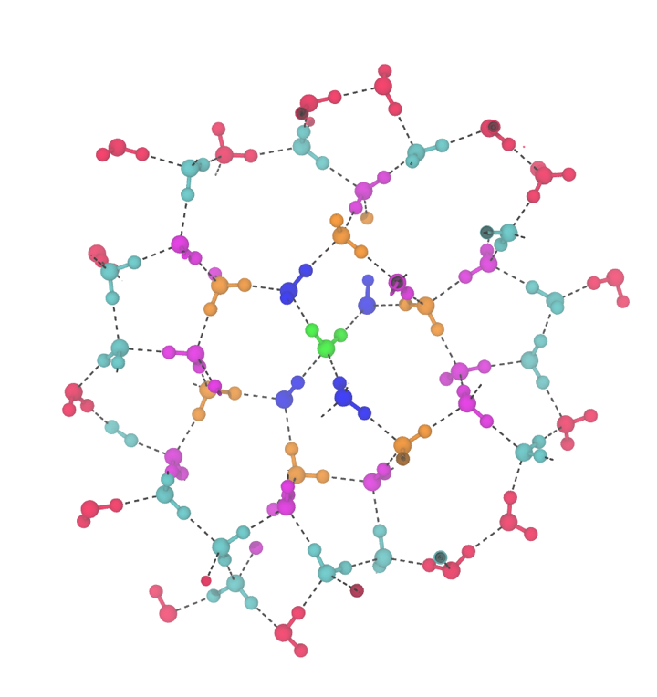

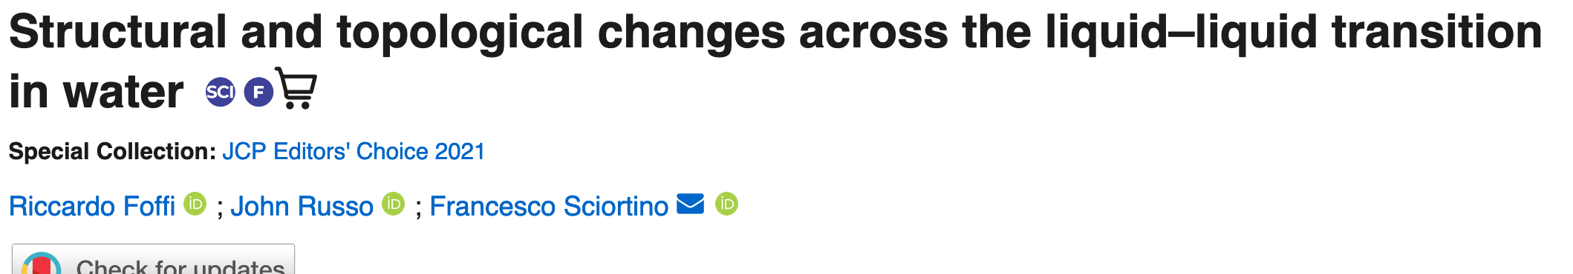
Central Molecule
Chemical Distance D=1
Chemical Distance D=2
Chemical Distance D=3
Chemical Distance D=4
Chemical Distance D=5
RCCARDO
FOFFI
Chemical Distance =
Smallest number of HB
connecting two molecules

Slide 25
Foffi, Russo, Sciortino JCP 2021
Low density liquid

Slide 26
P=1800 bar, T=188 K
Comparing
LDL and HDL
g(r)
P=1800 bar, T=188 K
Molecules far in
# of bonds but close in space !
Possible order parameter
Foffi, Russo, Sciortino JCP 2021

Slide 27
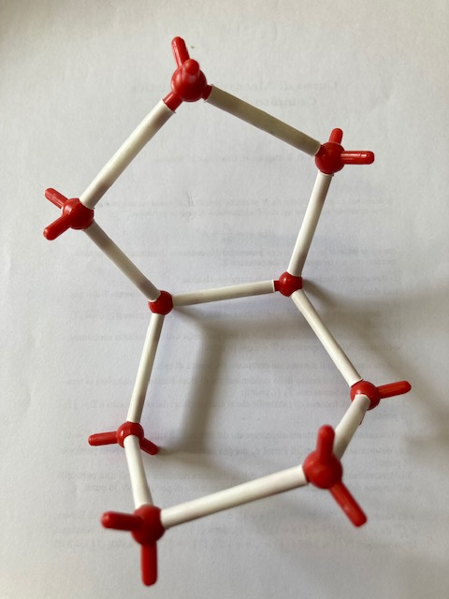
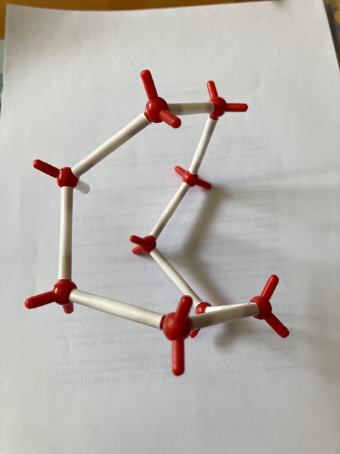
Definition of ψ
Ψ ∼ 3.5 Α
Ψ ∼ 8 Α
i) List all molecules which have chemical distance four.
ii) Calculate for each pair the distance in real space.
iii) Pick the closest distance. This is ψ

Slide 28
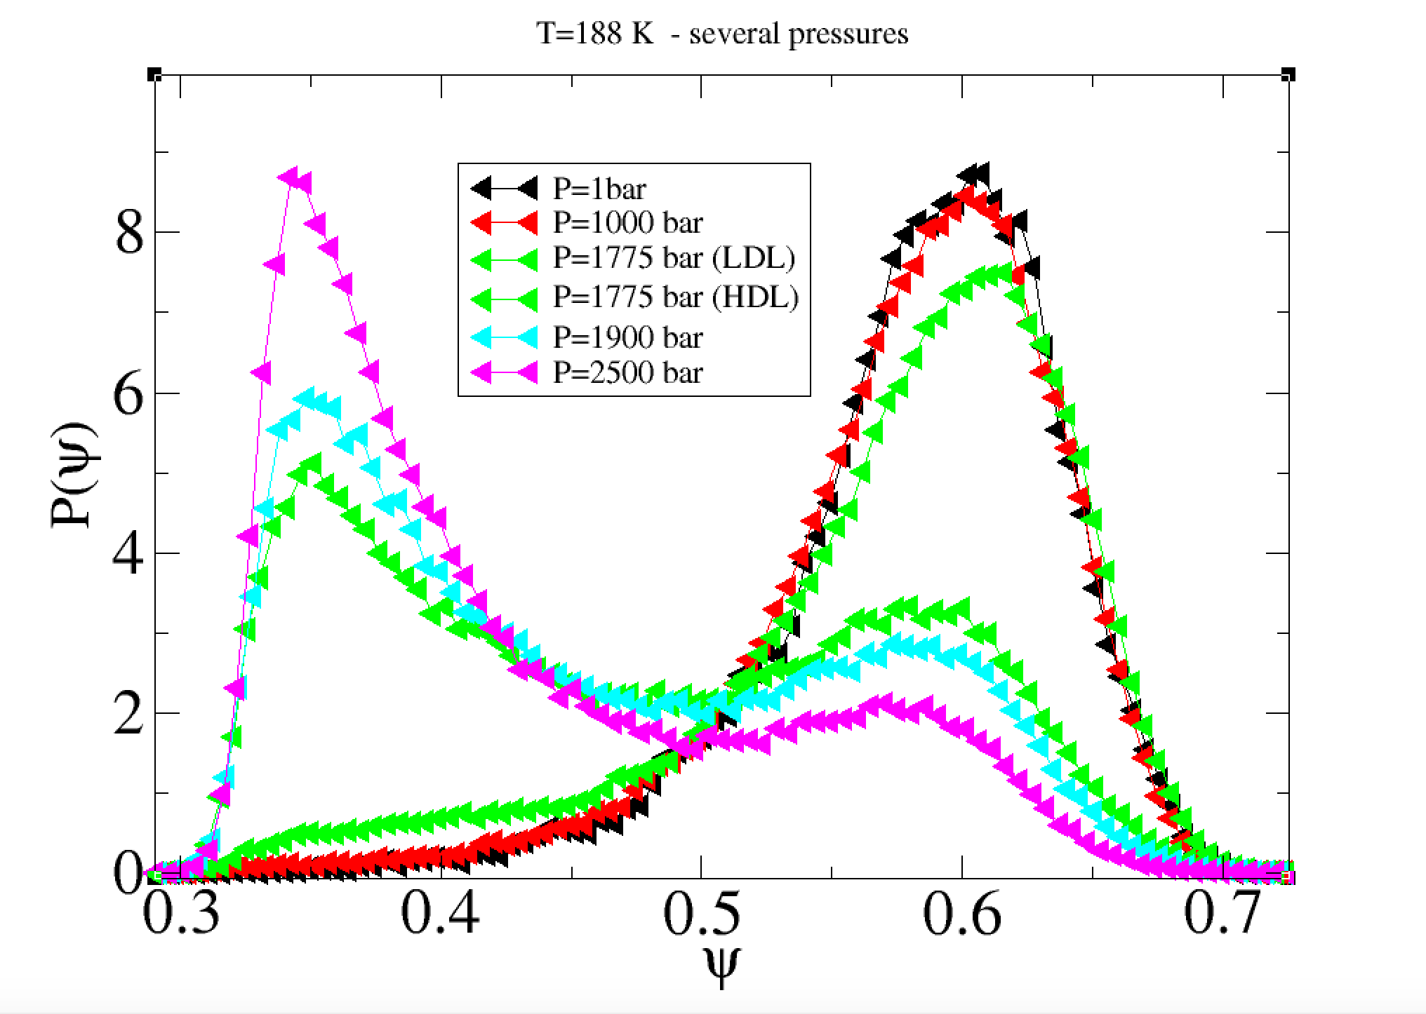
How P(ψ) changes across the LL transition
Submitted to JCP

Slide 29
Take-home messages
Clear evidence of a LLCP in TIP4P/2005, TIP4P/Ice, Wail,
DFT-SCAN, ML-BOP, MB-pol . From a computational point of view…the support to the LLCP scenario is overwhelming.
Entering in the No-man’s land: Nano Droplets can be quite interesting….
The Network topology can offer an alternative way to describe
the liquid-liquid transition.
Interstitial molecules (3.2-3.5A) are separated by several HBs. Interpenetration in disordered networks.
Definitive (computational) evidence of two distrinct local environments. Strong support for two-state models.

Slide 30
Thanks to:
Pablo Debenedetti, Gul Zerze
Thanos Panagiotopolous, Jack Weis.
Riccardo Foffi, John Russo
Francesco Paesani, Sigbjorn Bore
Peter Poole, Ivan Saika-Voivod
Dwaipayan Chakrabarti, Andreas Neophytou

