Slide 1
SISSA Seminar, April 28 2021
Thanks to Cristian Micheletti and Matteo Becchi
“Entropy in Self-Assembly”
Francesco Sciortino
Sapienza Universita’ di Roma
http://www.roma1.infn.it/~sciortif/

Slide 2
Outline
Aims:
Entropy and Order, Ω (Hard-sphere crystallization, Onsager theory)
Entropy in the ground state (Networks, Crystal selection,Vitrimers).
Entropy attracts (Depletion interactions, Safran, DNA functionalized colloids)

Slide 3
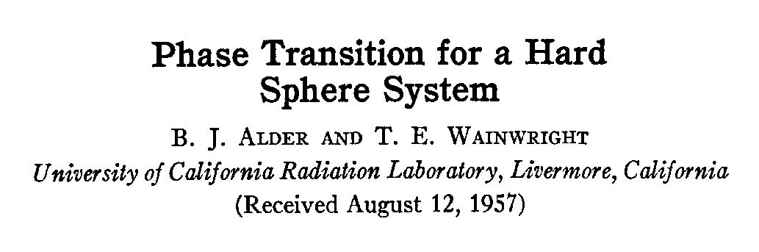
σ
J. Chem. Phys. 27, 1208 (1957)

Slide 4
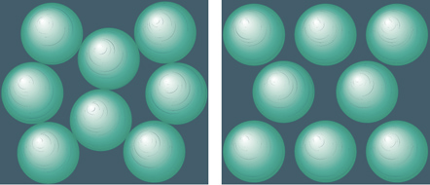
Which one is more disordered ?

Slide 5

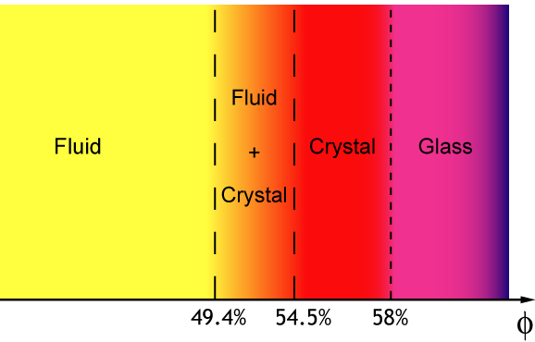
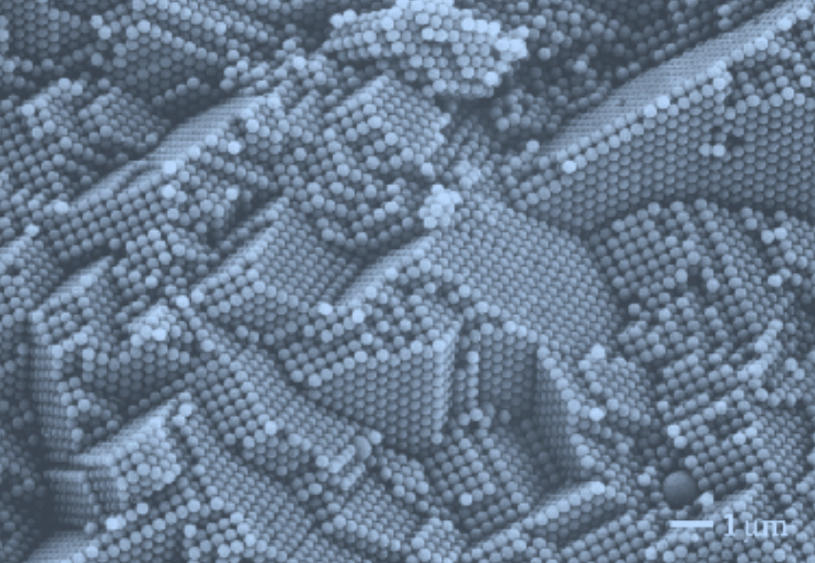
Hard Spheres (HS)
Equilibrium properties
σ
Hard spheres present a fluid–solid phase separation due to entropic effects

Slide 6
How do we understand HS crystallization ?
At constant V, we need to maximize the entropy
“Configurational” entropy (topological entropy)
Translational Entropy (cage entropy, vibrational)

Slide 7
A proxy to translational Entropy...
MSD=|r_{i}(t)-r_{i}(0)|^2

Slide 8
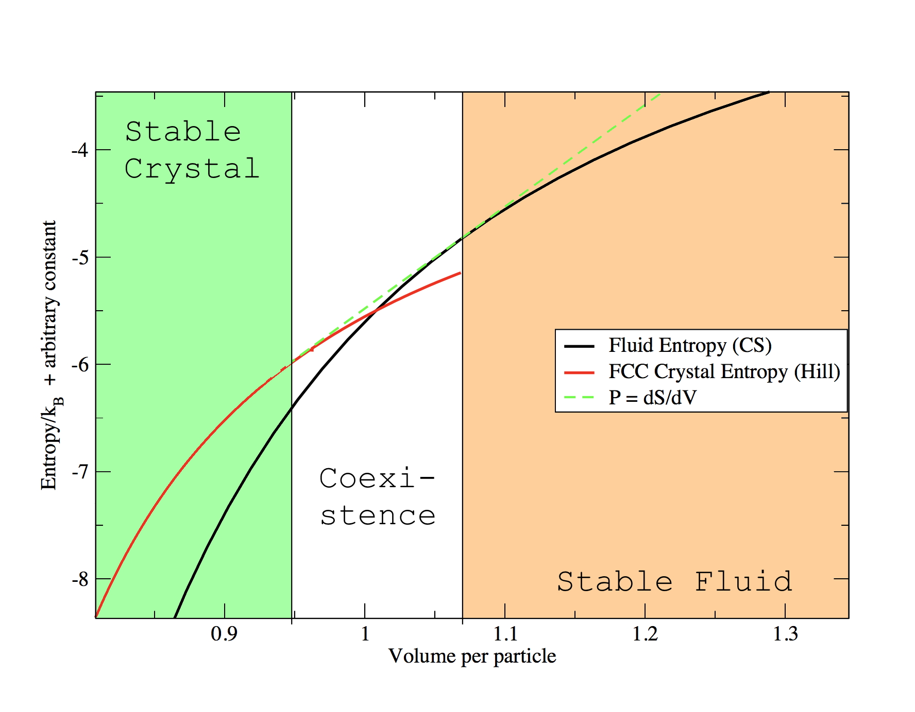
φ=0.54
φ=0.495
β

Slide 9
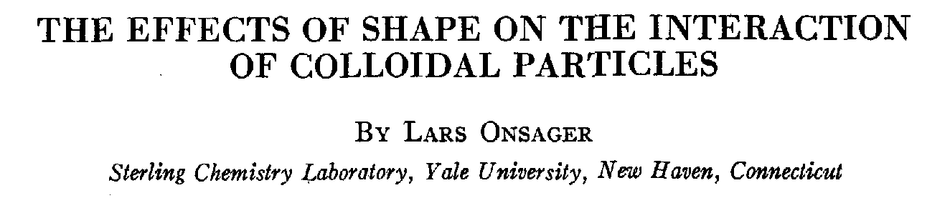
Orientational Entropy
ANNALS NEW YORK ACADEMY OF SCIENCES 1949

Slide 10
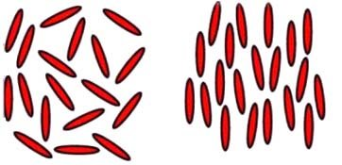
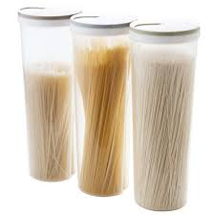
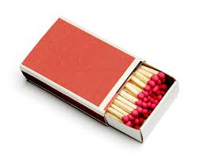
Isotropic-Nematic Transition (Onsager Theory)
n
Nematic
Isotropic

Slide 11
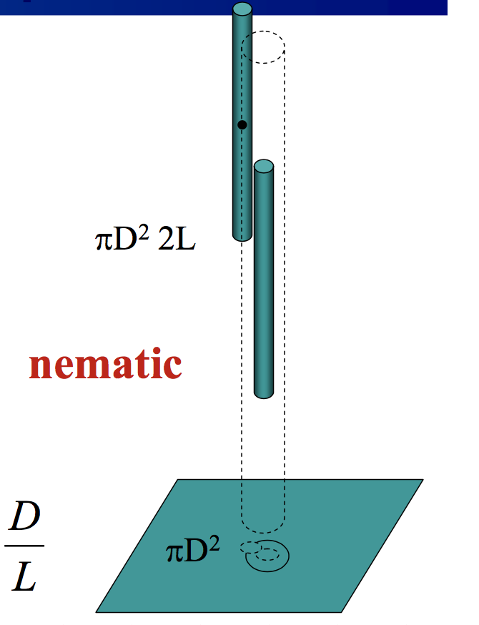
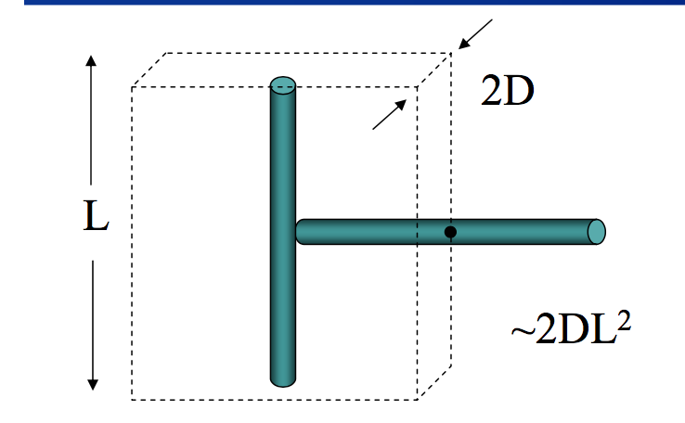
Free energy= Ideal gas + first virial correction
γ=90
significant reduction of sampled
phase space !!!!
γ=0
φ_{I−N} =4D/L

Slide 12
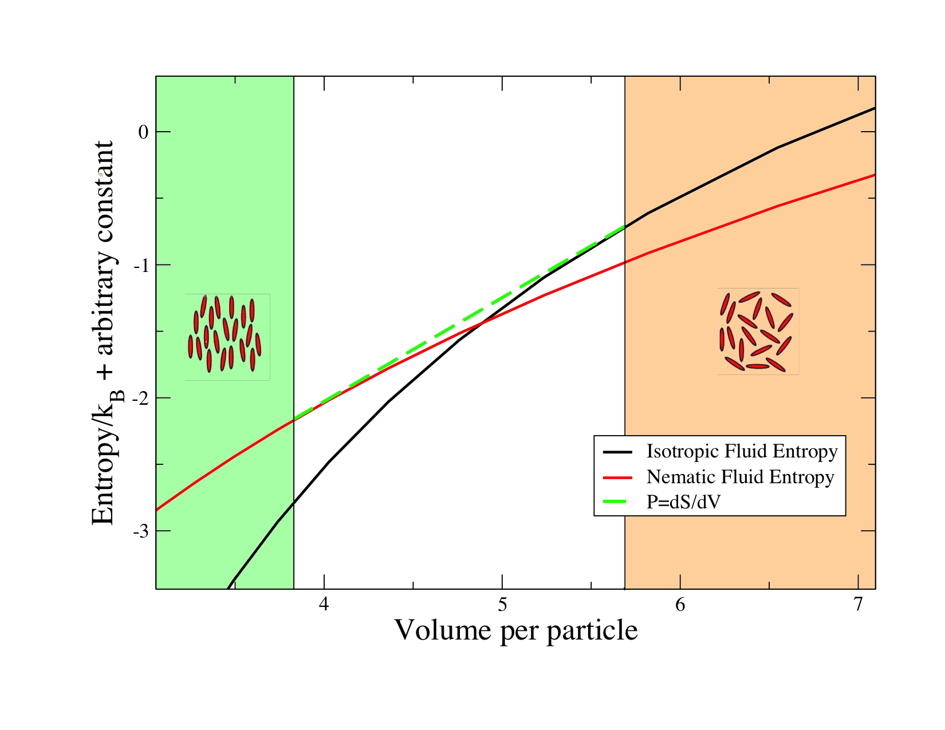

Slide 14
Entropy and flexibility
(translation+rotation)
Entropy of the Ground State
if the liquid reaches a fully bonded state, then it has the same energy of the crystal !

Slide 15
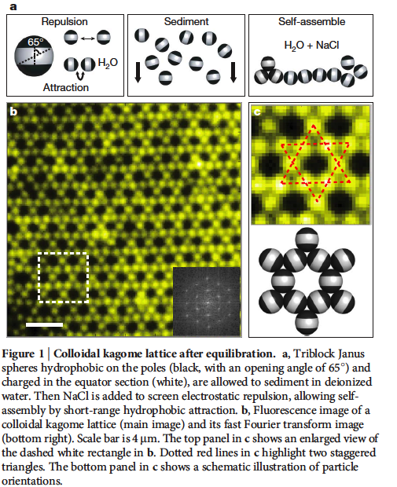
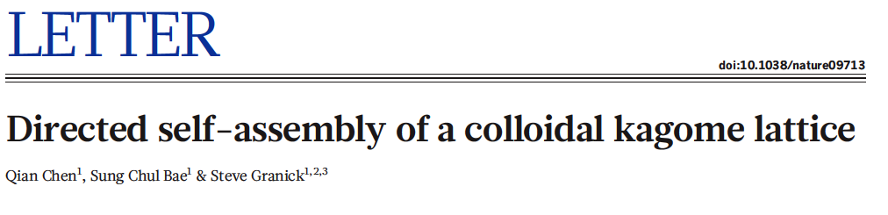
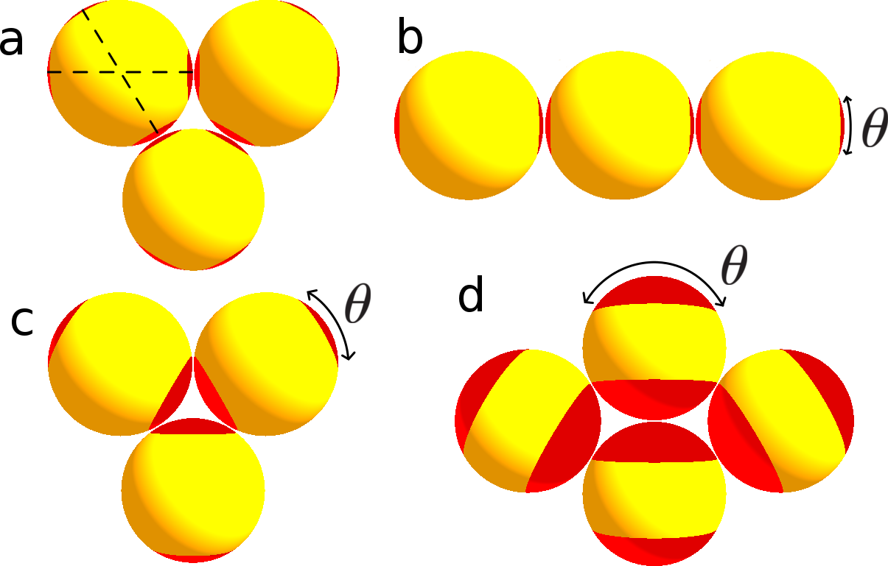
Examples of patchy particles

Slide 16
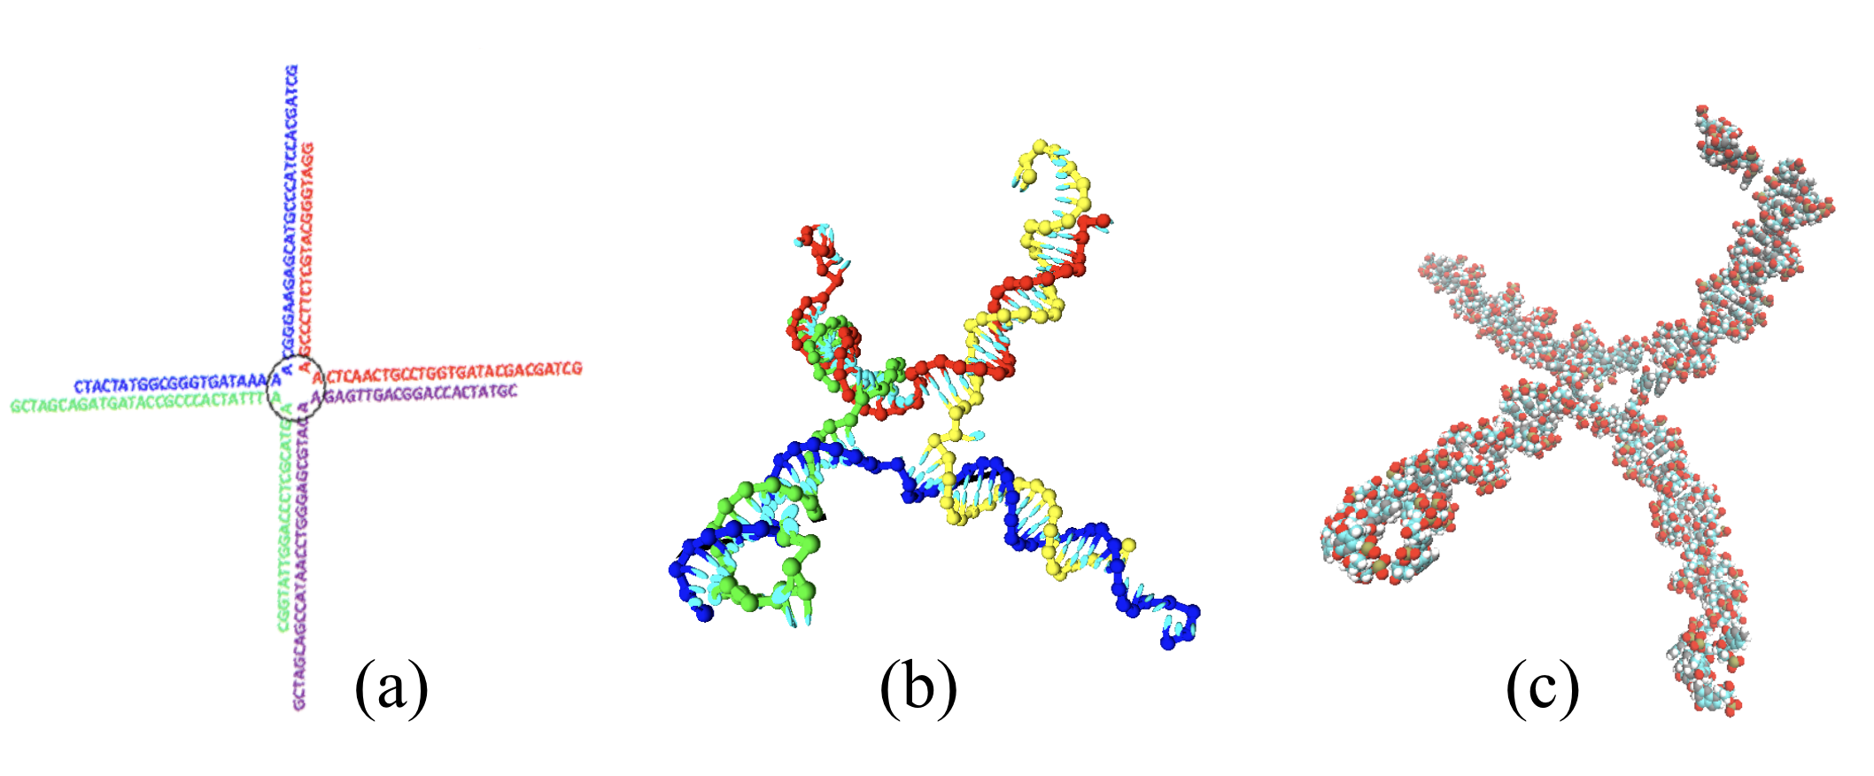

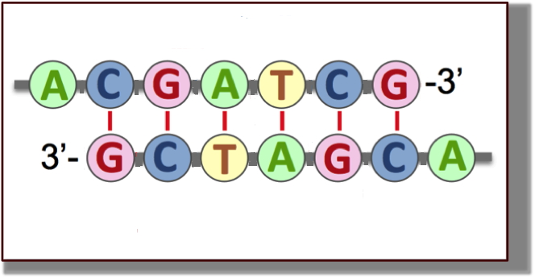
A limited valence colloid: The DNA nanostar
fig1a_wertheim_T0.06.eps
www.pnas.org/cgi/doi/10.1073/pnas.1304632110

Slide 17

All particles
are bonded with
four neighbours
There are loops
of different
length
Particles
“vibrate”
around equilibrium
positions.

Slide 18
How about (low density) crystals ?
Entropy decides the most stable phase (exactly as in HS!)
Competition between:
Number of microstates accessed at fixed bonding” (vibrational entropy) (S_{vib})
- Number of different bonding topologies (configurational entropy) (S_{conf})
S_{xt} –S_{fluid}

Slide 19
S_{xt} --- Crystal Vibrational Entropy S_{vib}
S_{fluid} --- Fluid Vibrational Entropy S_{vib}+
Fluid Configurational Entropy S_{conf}
S_{xt} –S_{fluid}
Increasing the bond angle (flexibility) increases both entropies…..
Same rate ?
flexibility
flexibility

Slide 20
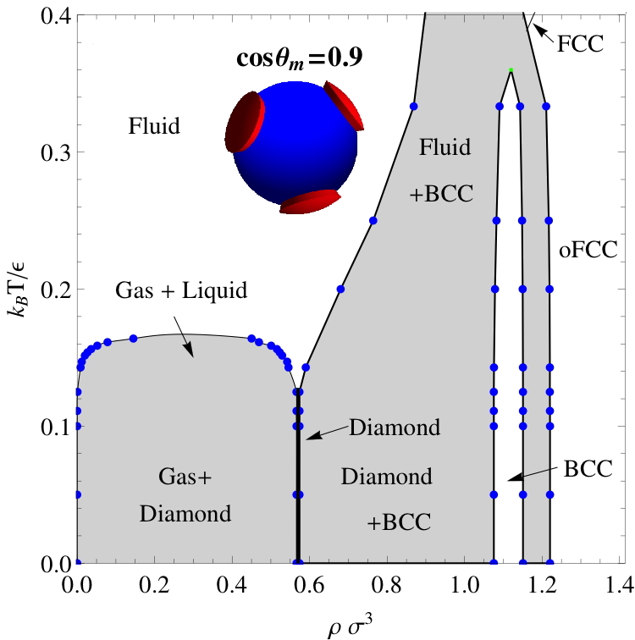

Slide 21
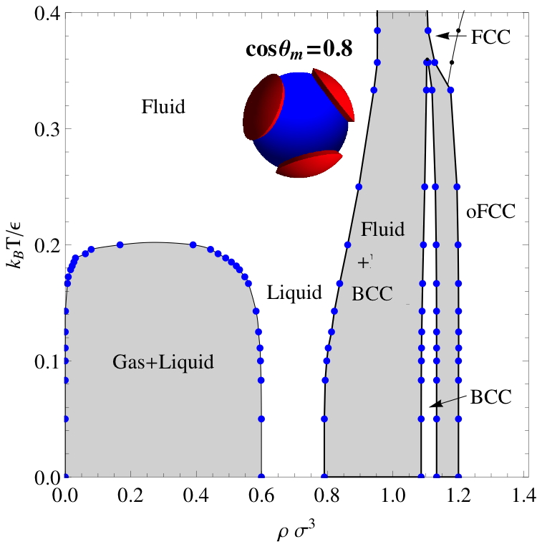
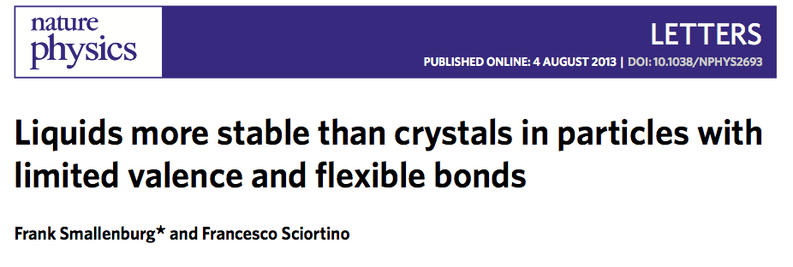
On increasing flexibility: Ultrastable liquids !

Slide 22
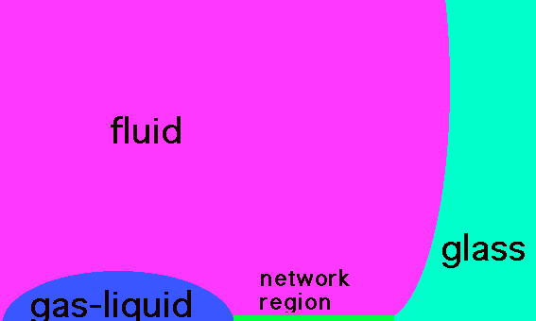
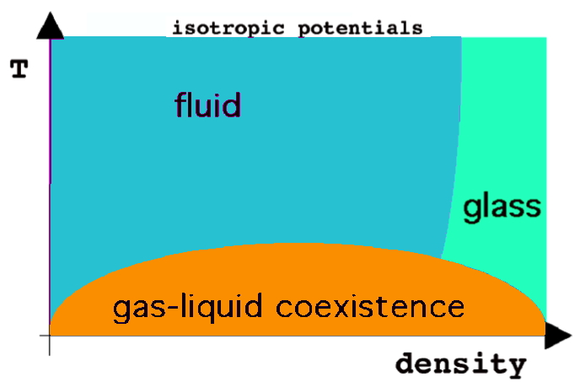
Key elements for liquid stability at T=0 K:
(ultrastable liquids !)
Thermodynamically stable !
Large flexibility of the angular interactions: (wide variety of networks, increasing Sconf)
Low valence. Small density of the coexisting liquid phase

Slide 23
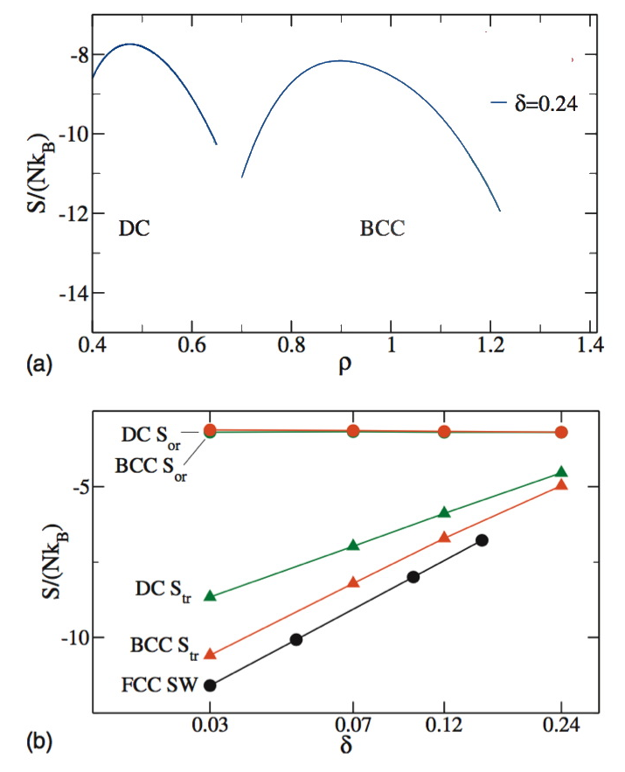
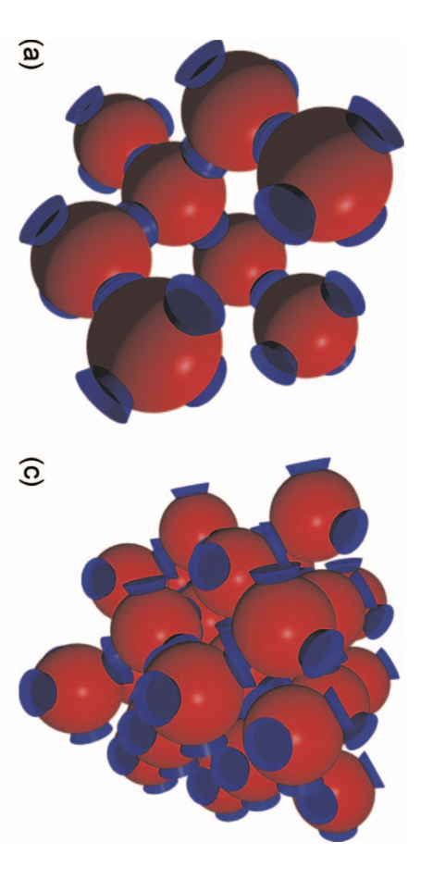
Crystal Selection by Entropy
Diamond
BCC
(2 interpenetrated
diamond)
Pressure=0
J. Chem. Phys 132, 184501 2010

Slide 24
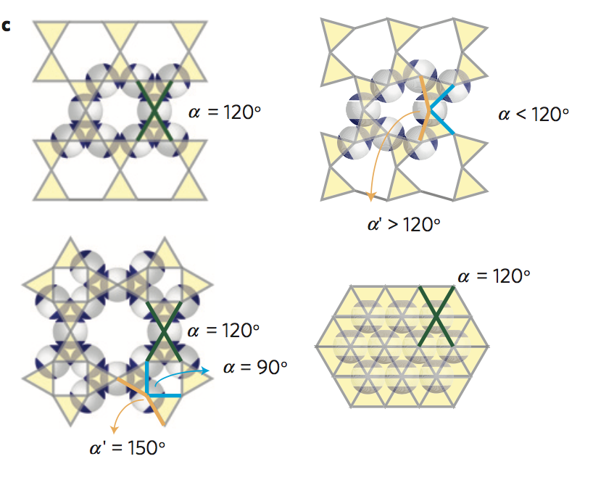
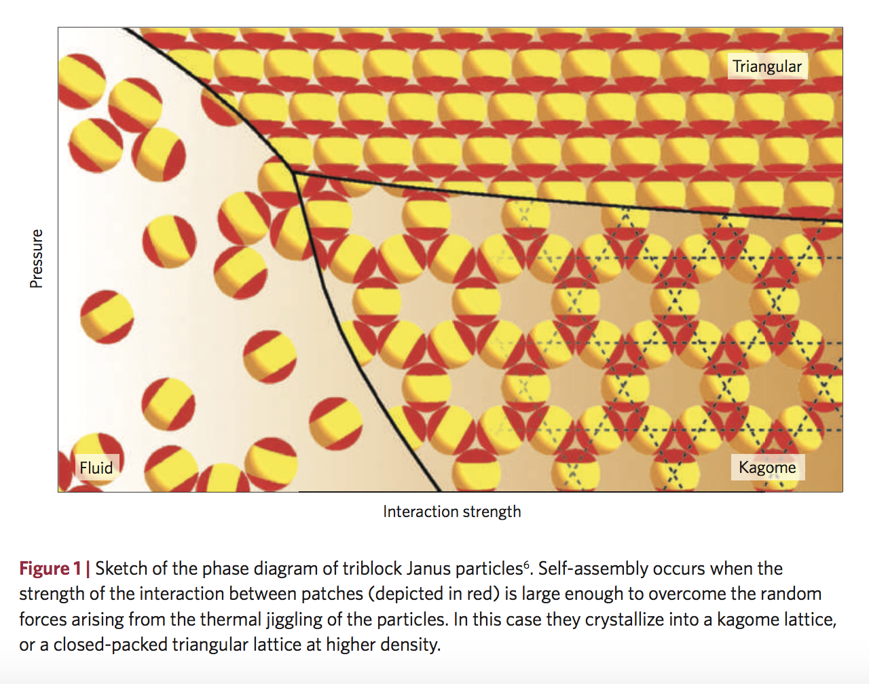
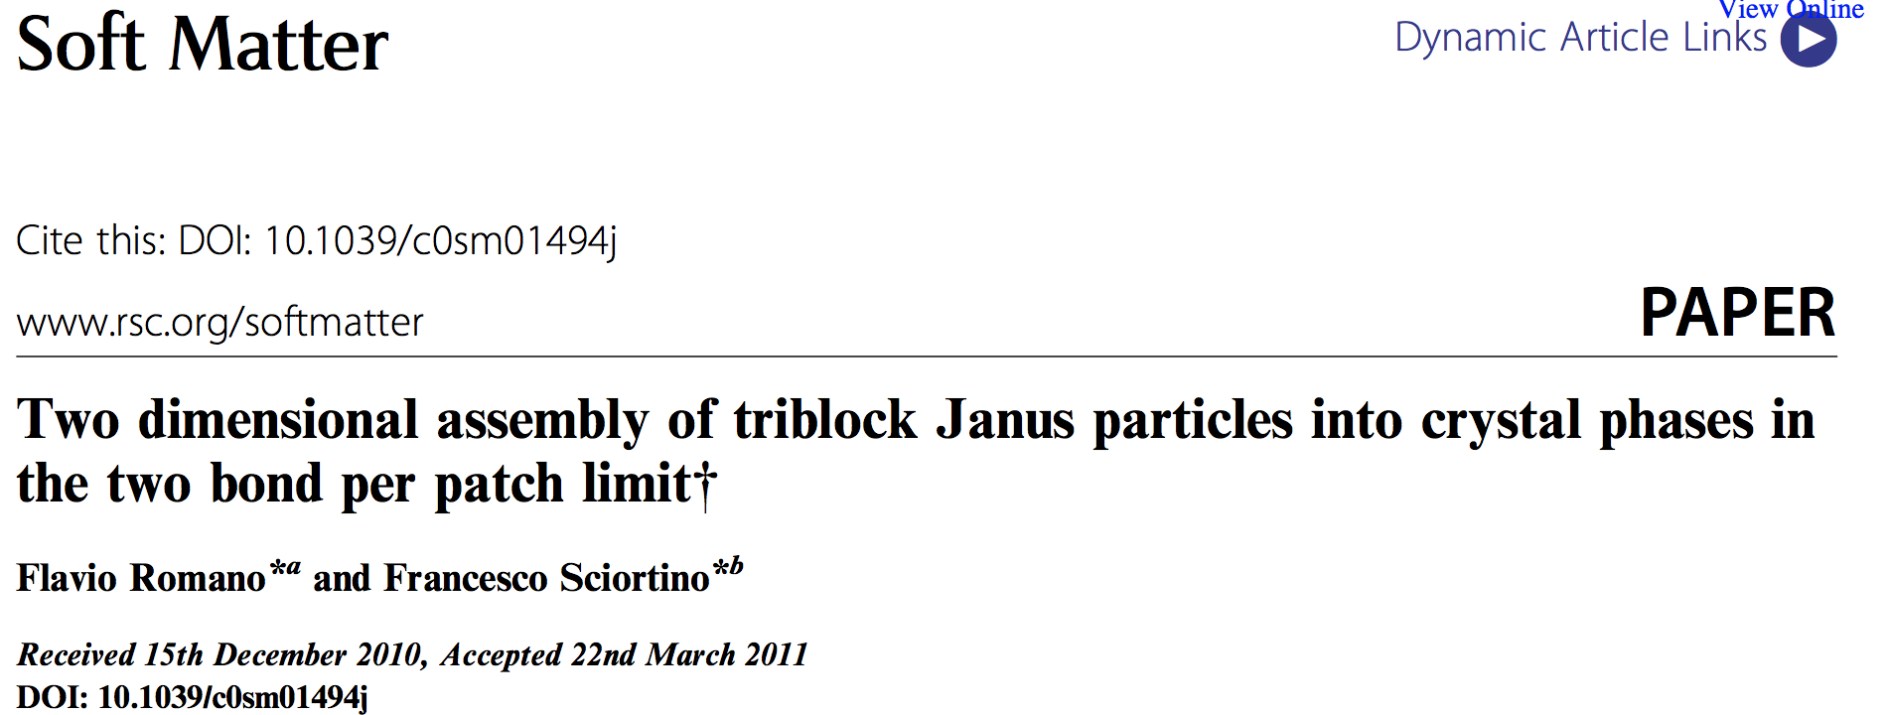
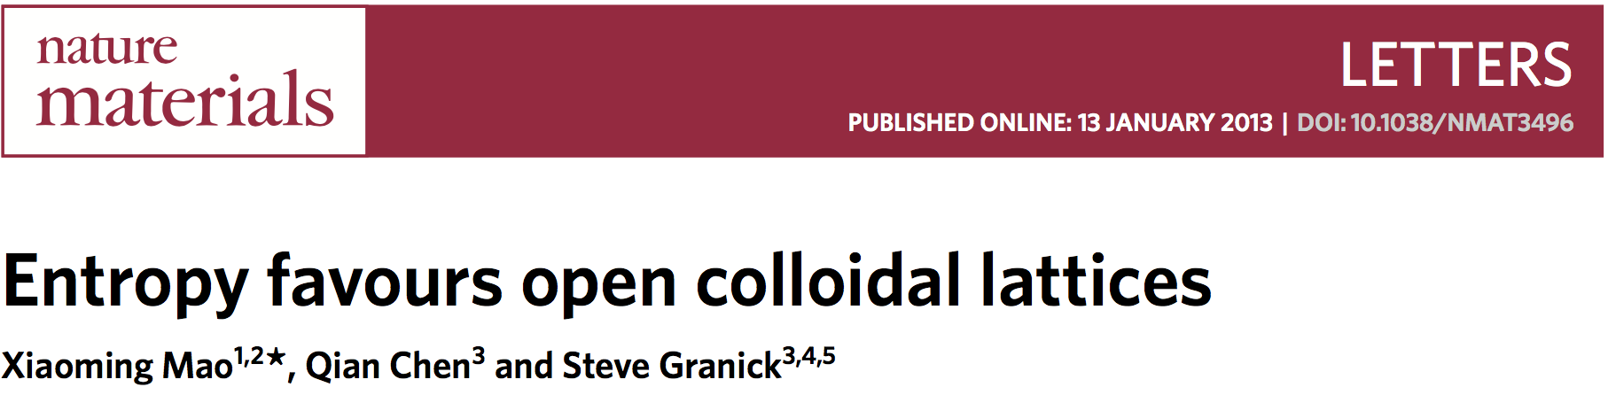
Crystal Selection by Entropy

Slide 25


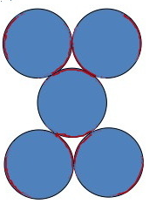
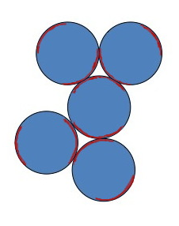
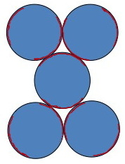





Crystal Selection by Entropy
”regular structure”
”less regular structure”

Slide 26
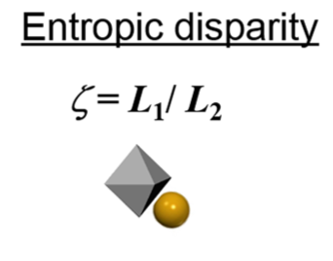
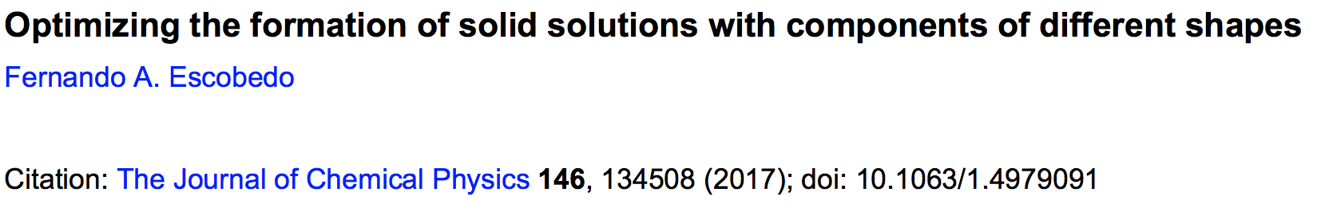
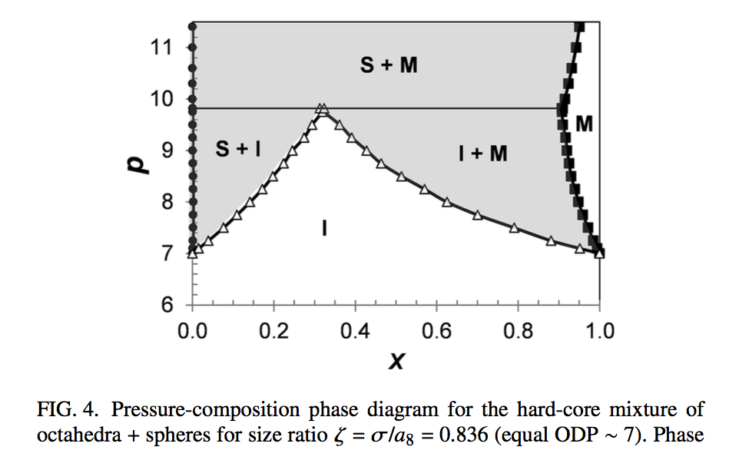
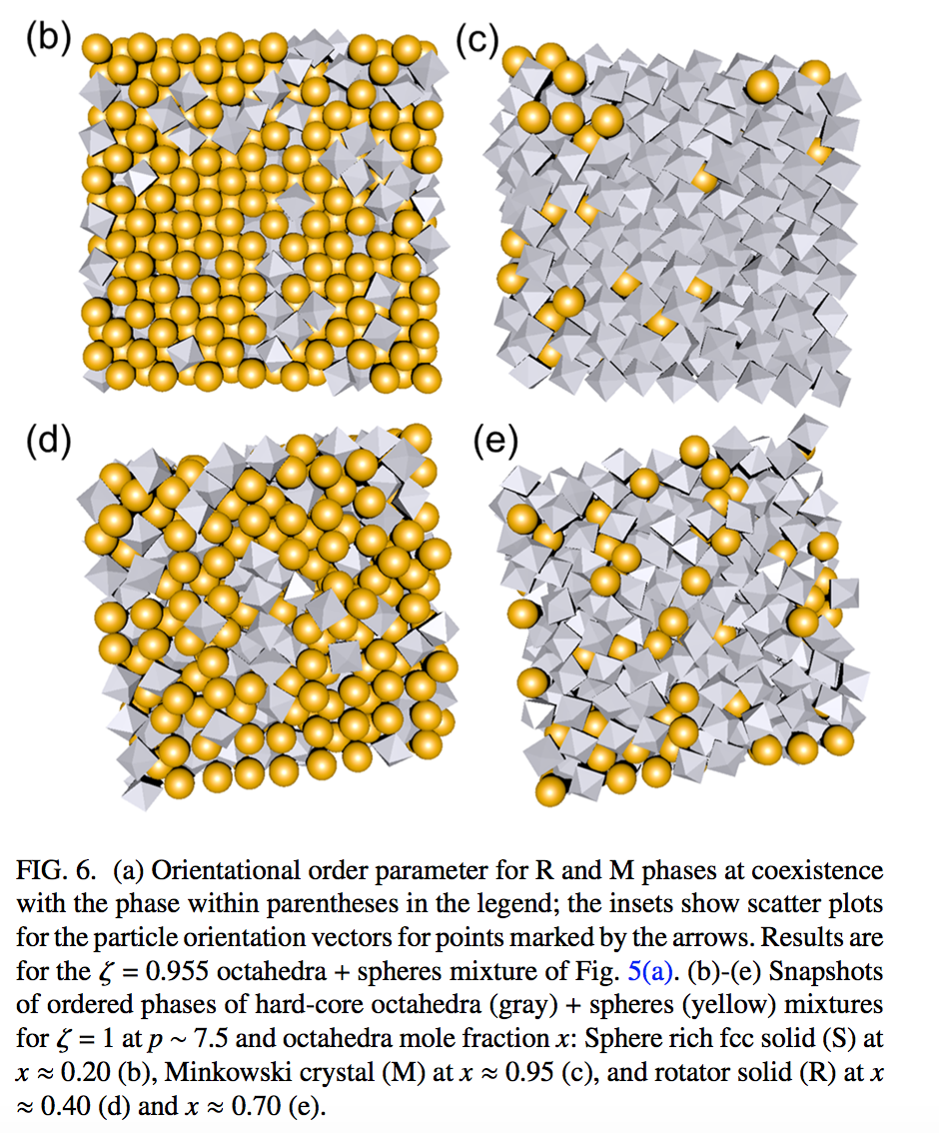
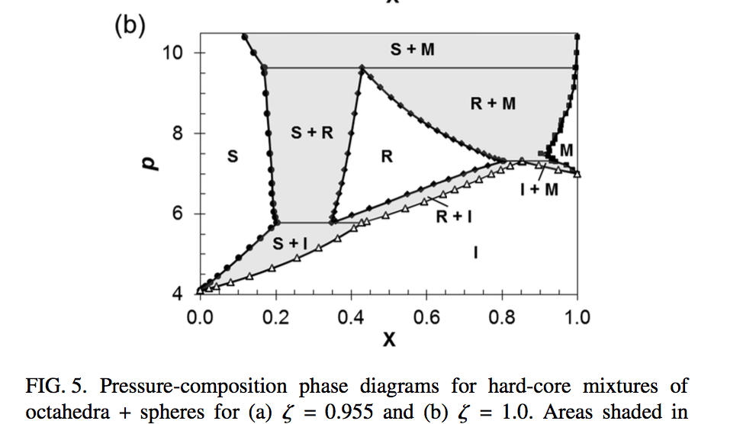
Spheres
(S)
Octahedra
(M)
Mixed Spheres+
Octahedra (R)

Slide 27
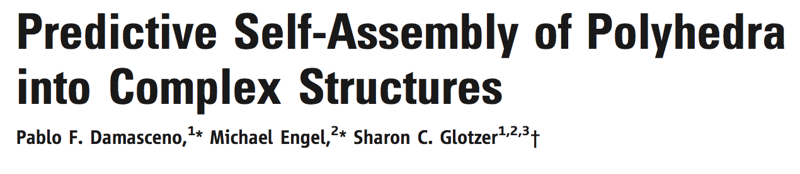
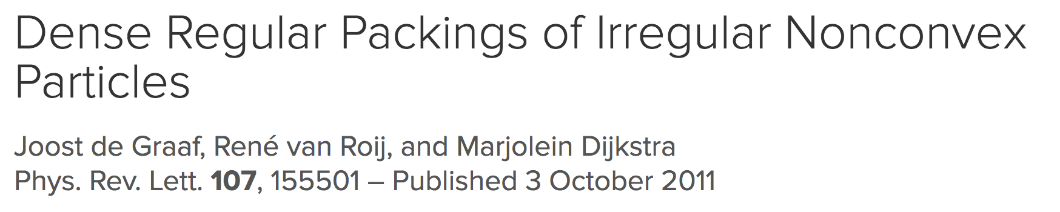

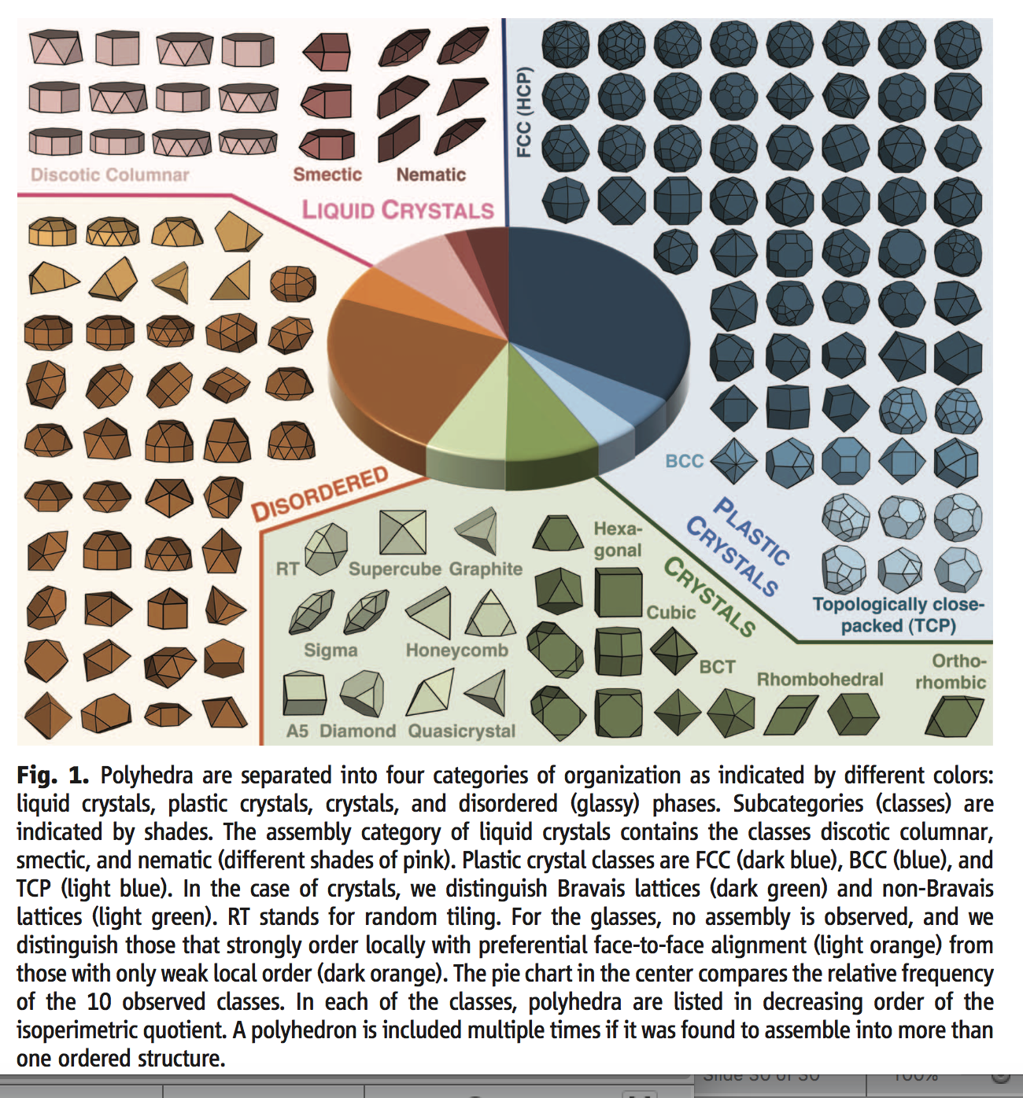

Slide 29
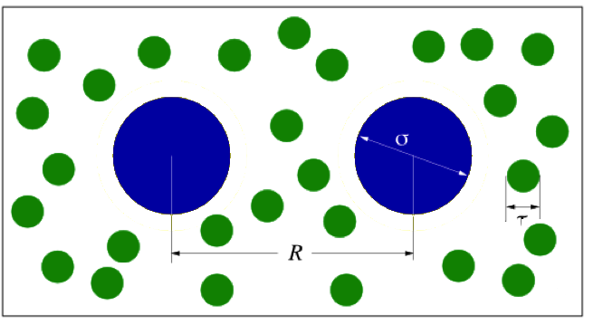

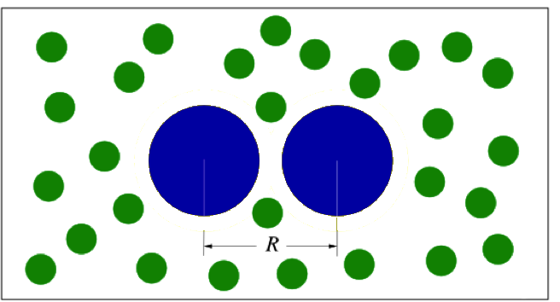
Entropic Attraction
Large HS in a bath of small HS
Which distance is
most probable ?

Slide 30
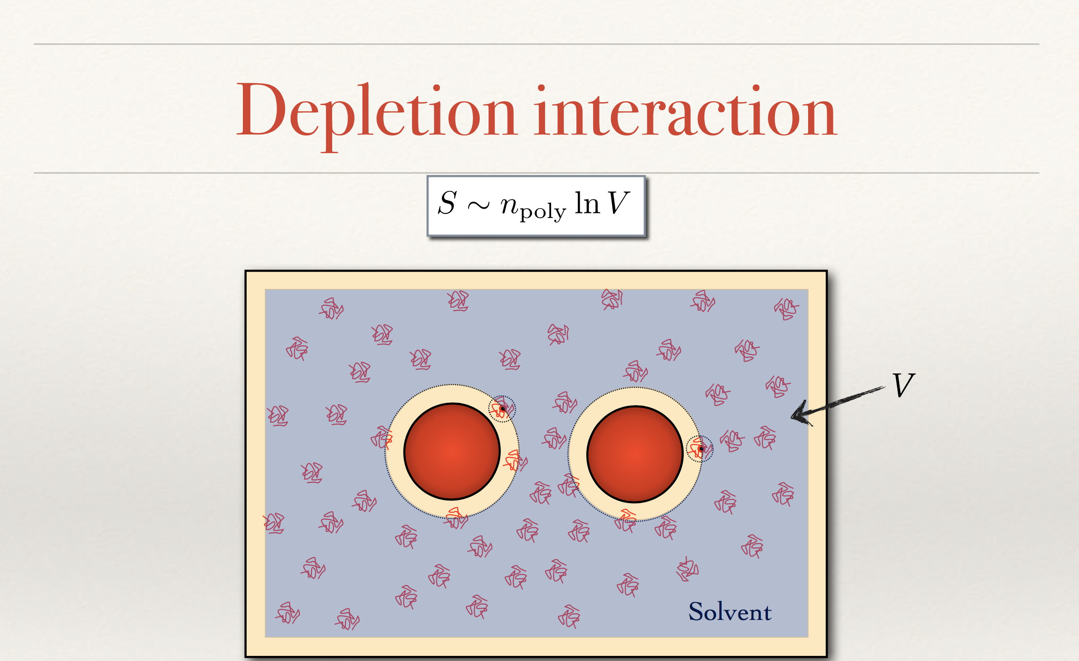

Slide 31
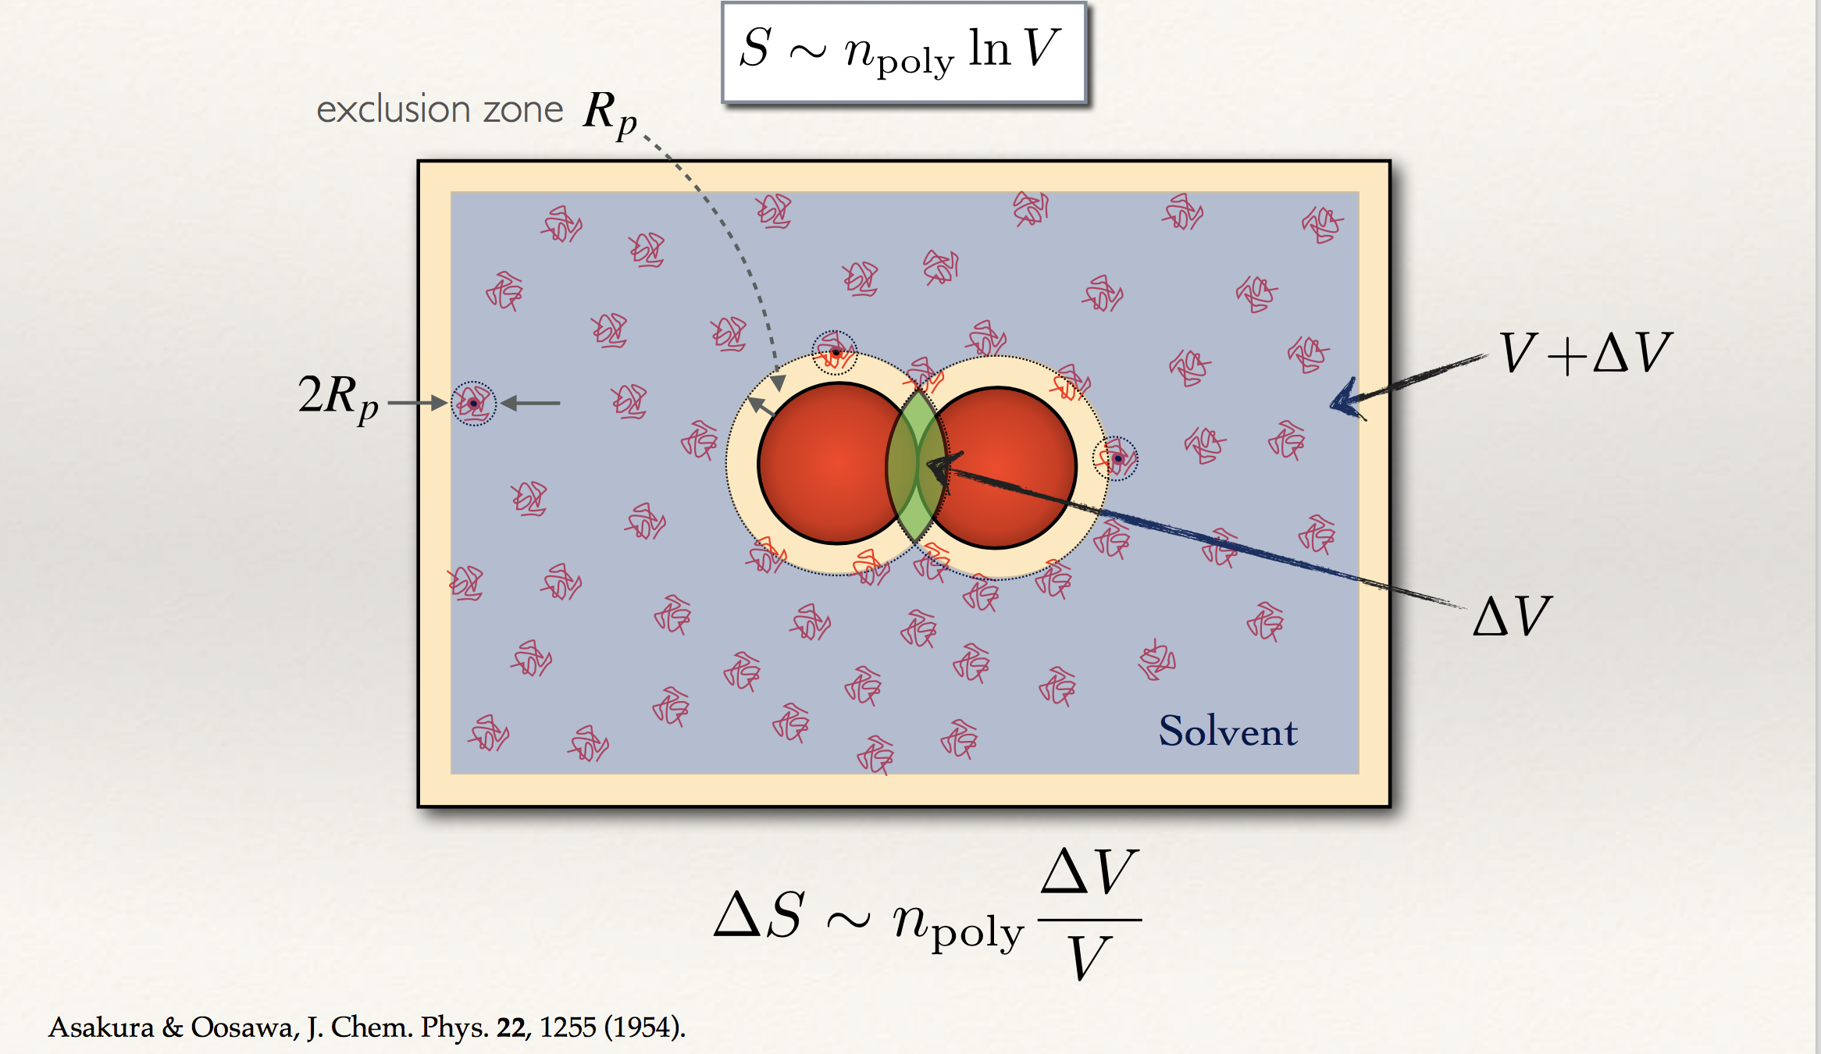

Slide 32
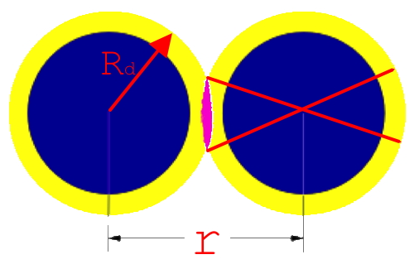
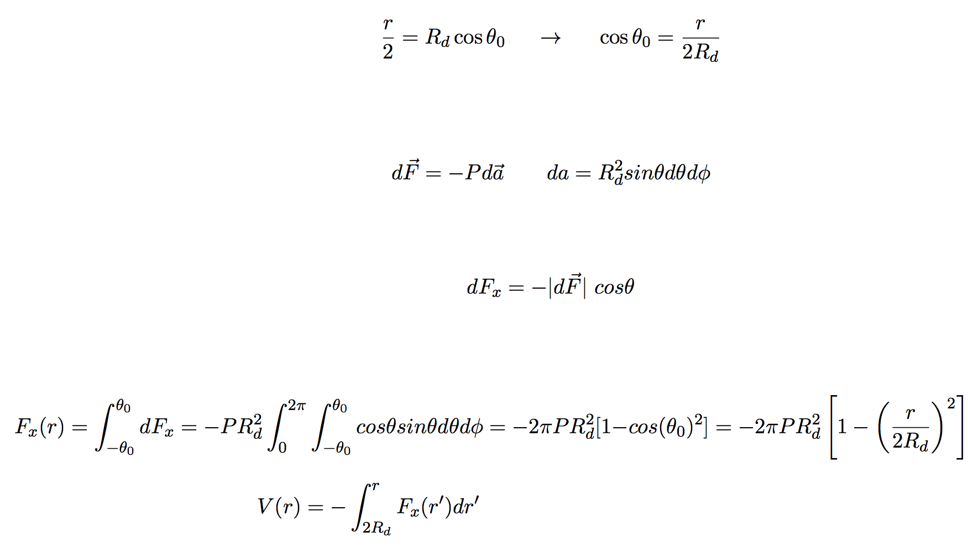
R_{d}
Same story from a different perspective
θ_{ο}
θ_{ο}
r/2

Slide 33
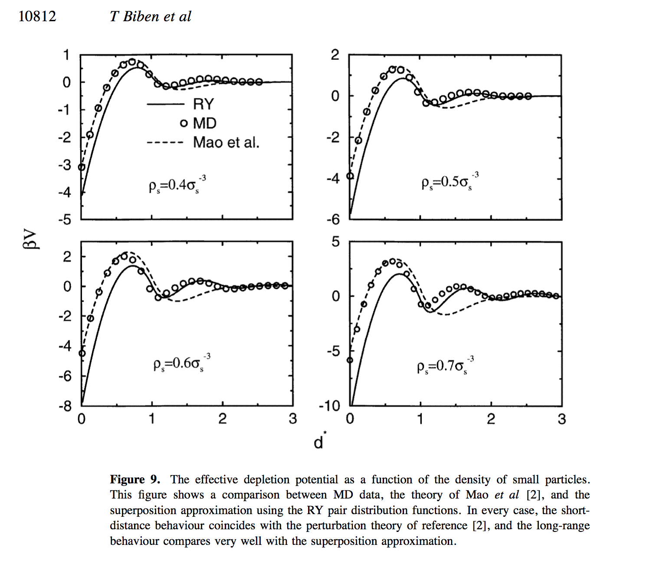
Real hard-spheres

Slide 34
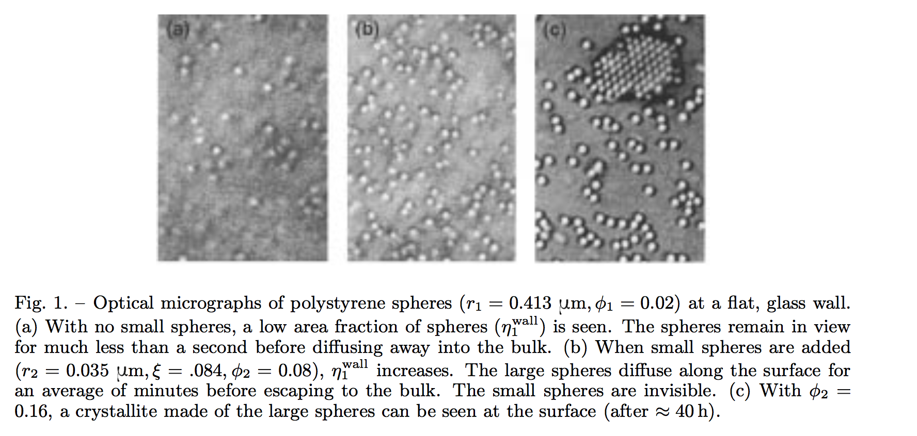
Visualizzation of depletion forces
Phase separation of a bidisperse sphere mixture:
r_{b}= 413nm, r_{s}= 35nm,
Volume fraction: Φ_{b}= 0.02
(visible),
(not resolved)
A.D. Dinsmore, P. B. Warren, W. C. K. Poon, and A. G. Yodh,
EPL 40, 337 (1997).

Slide 35
For depletion interactions, arrest at low φ (gelation) is the result of a phase separation process interrupted by the glass transition
CONFOCAL
IMAGES
First Order Transition

Slide 36
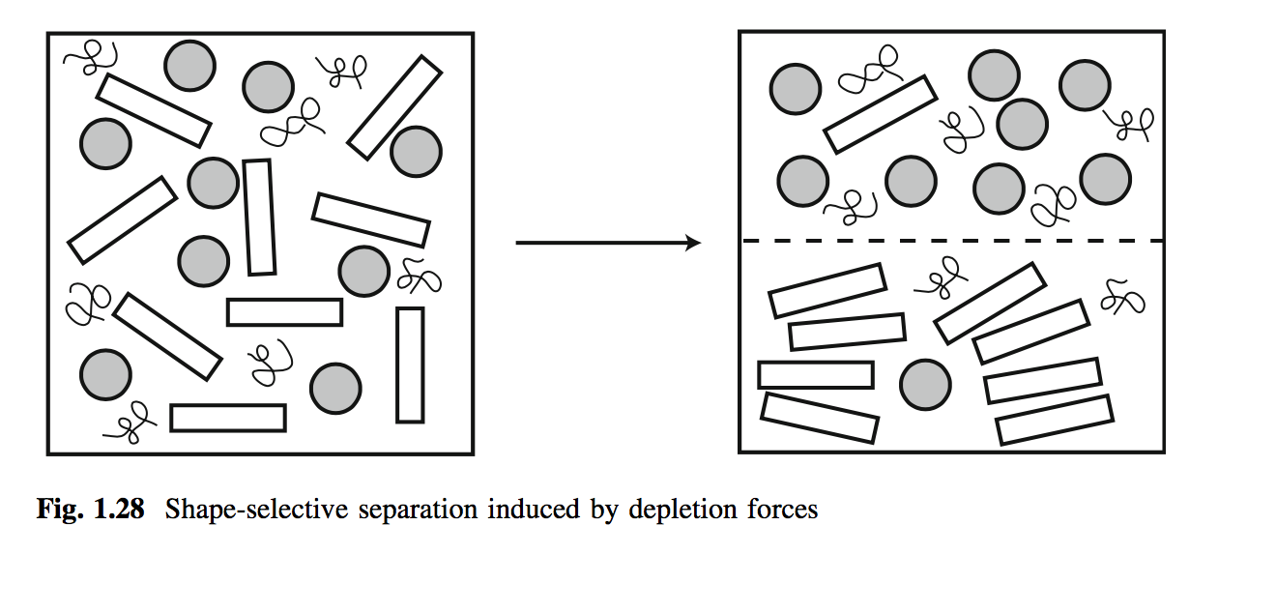
Depletion: shape and roughness

Slide 37
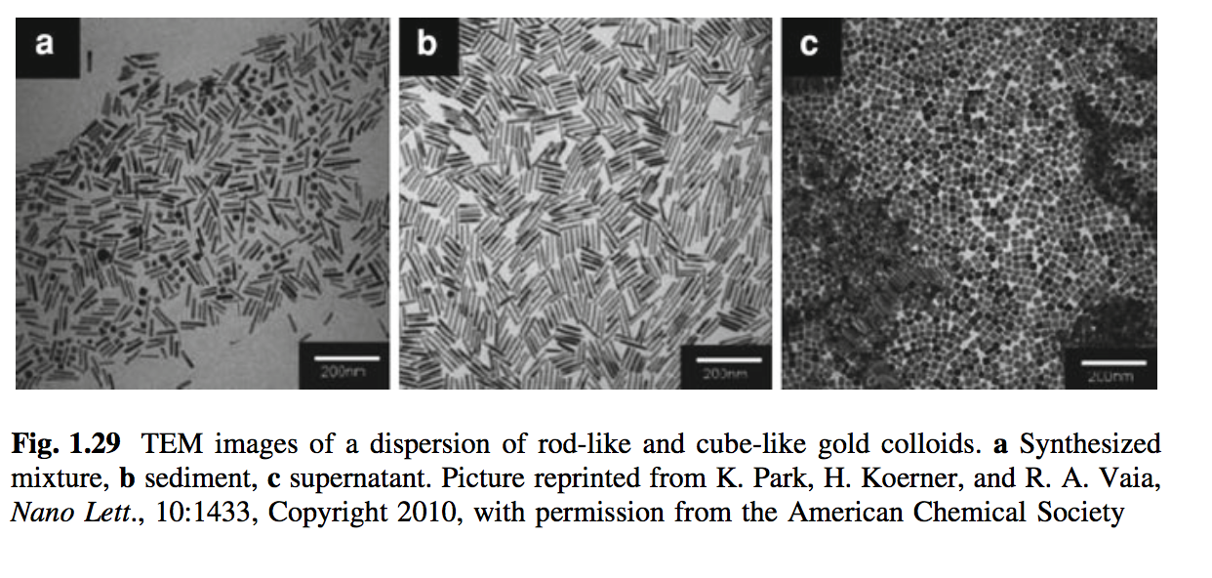
Another example

Slide 38
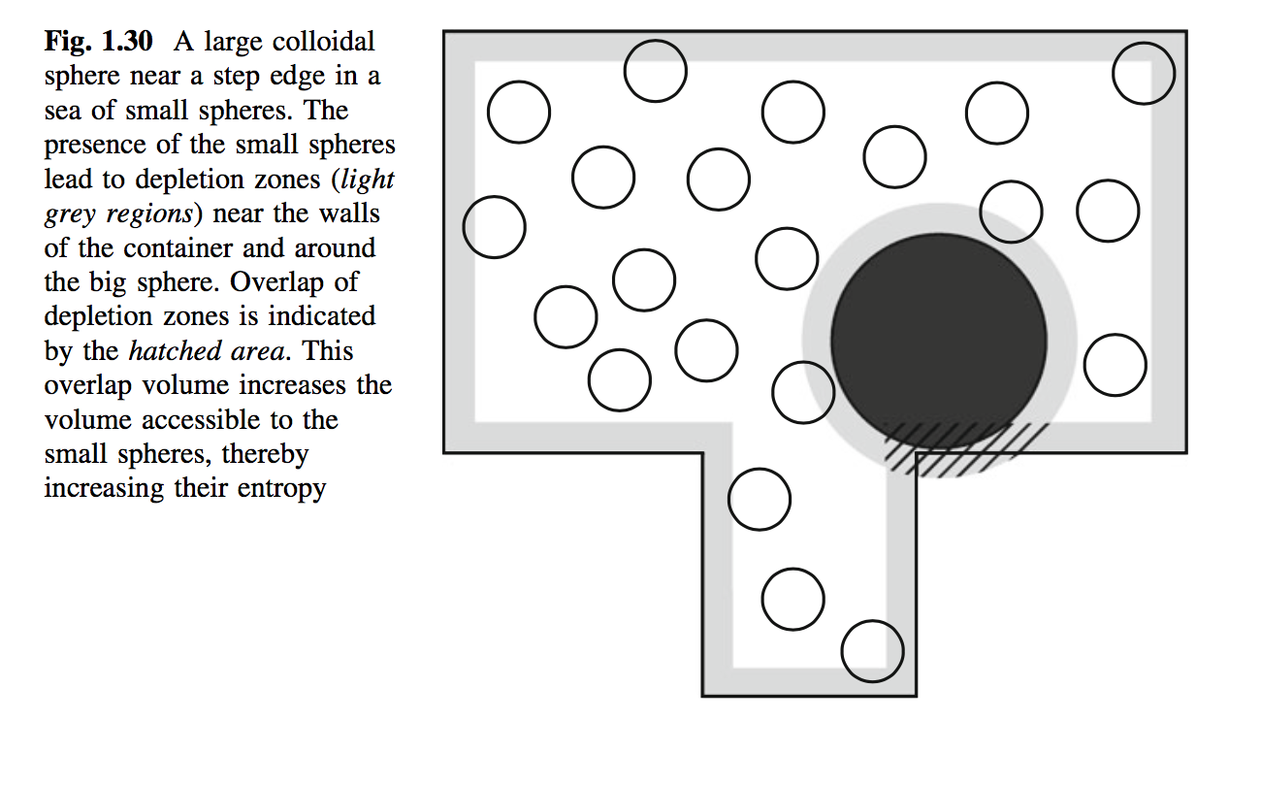


Slide 39


Slide 40





Slide 41





Slide 42

Playing with the properties of the co-solute
Depletant Shape...

Slide 43



Polymerizing solvent ...

Slide 45






Safran’s attraction
Another important
source of entropy:
Combinatorial Entropy
A network ?
... or ....
.. a gas of isolated droplets ?

Slide 46




Slide 47



Another important
source of entropy:
Combinatorial Entropy
Oleg Gang (Brookhaven and Columbia)
------CGCG
------CGCG

Slide 48


A coarse-grained version of the
DNA-decorated gold nanoparticle
Can we quantify the entropic gain ?

Slide 49
N RED + N YELLOW
Reactive sites
Ω=(N− 1)!!
Ω=(N− 1)!!
Ω=(2N− 1)!!

Slide 50

Umbrella sampling based
evaluation of the effective potential

Slide 52





Slide 53


Slide 54


Catalyst … Arrhenius Dynamics
“Strong glass former”

Slide 55



Wertheim theory: free energy
Using thermodynamic perturbation theory, we can approximate the (Helmholtz) free energy of the model system.
Free energy change as a result of forming bonds, in the limit of T going to zero (strong bonds):
Combinatorial entropy term:

Slide 56


Entropy in Theory and Simulation: comparison
Comparison between the entropy from simulations (red) and theory (blue).
Number density
Entropy per particle
composition

Slide 57




T=0 K Equilibrium phase diagram (Entropy Only!)
Placing a vitrimer network in a good solvent leads to swelling
The network phase is closer to the ideal x
the network never fully dissolves
Theory: black dashed line
Simulations: points, solid line

Slide 59

^{R}
Thanks for your attention !

Slide 60

Attracting without phase separating (hyper-branched)

Slide 61

One unreacted site (A) per cluster
Only sol-phase (the infinite cluster
appears only when p_{A}=1)
No gas-liquid phase separation can
exist.
When p_{A}=1, there is
one percolating cluster,
independently on density
(Flory-Stockmayer mean-field results)
Strong assumption:
no intra-cluster bonds

Slide 62


Intra-cluster bonds !
OxDNA based MD simulations

Slide 63

High T
Intermediate T
Low T
OxDNA

Slide 64



Slide 66


Slide 67
α=10, f(θ)
f(θ)
θ

Slide 68



Slide 69
55
Full ➔Nematic
Dashed➔Isotropic
5
1

Slide 70




Slide 71





Slide 72
Another interesting soft-matter case
DNA-grafted gold nanoparticles
(palindromic sticky sequences)

Slide 74



Slide 75


Slide 76


Small-small
Small-large
Asakura, S., Oosawa,F, On Interaction between Two Bodies Immersed in a Solution of Macromolecules, JCP 22 (7): 1255 1954.

Slide 77





Slide 78


Slide 79


Slide 80





2

Slide 81




Slide 82

Sterically stabilized PMMA particles (polydispersity 5-10 %)
Courtesy P. Pusey

Slide 83

The patchy model analog
Bonding volume and energy scale….

Slide 84
Connections to patchy particle
Network formed by a mixture of particles with valence f₁ and f₂ in non-stochiometric ratio in
which all possible bonds between particles of different type are present!
Where is T ? T=0 K !
What does it mean to switch ? Explore the different
configurations of the ground state
There is life in the ground state !

Slide 85

Self complementary DNA sequences

