Slide 1


Subtle Entropy Effects
in Associative Polymers
Francesco Sciortino
http:www.roma1.infn.it/~sciortif

Slide 2

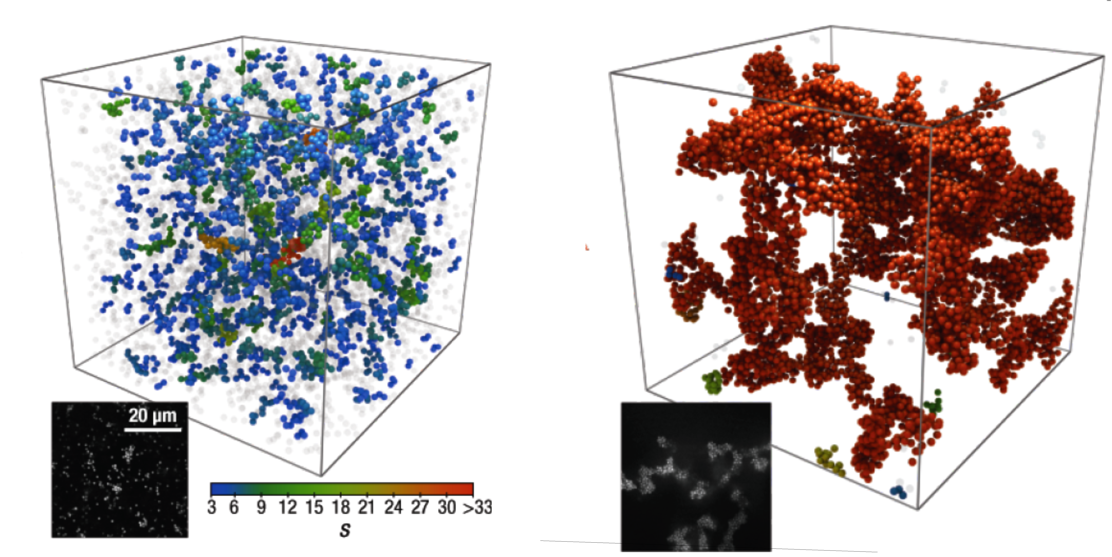
Entropy Attracts !
Suggested for students:
Francesco Sciortino
Entropy in self assembly
Riv. Nuovo Cimento, Vol. 42 (2019) 511, DOI: 10.1393/ncr/i2019-10165-1

Slide 3
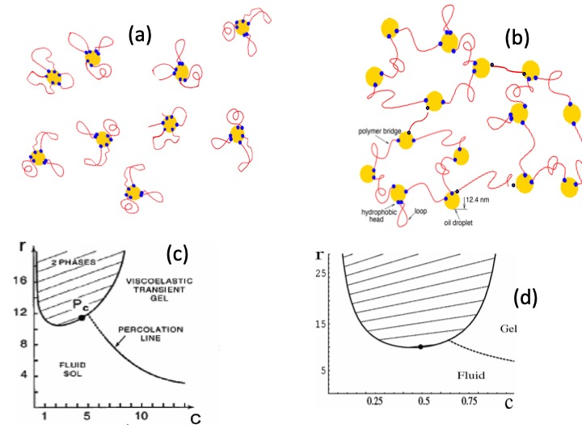
Combinatorial Entropy ….
Competition between exploring the volume
and binding multiplicity

Slide 4
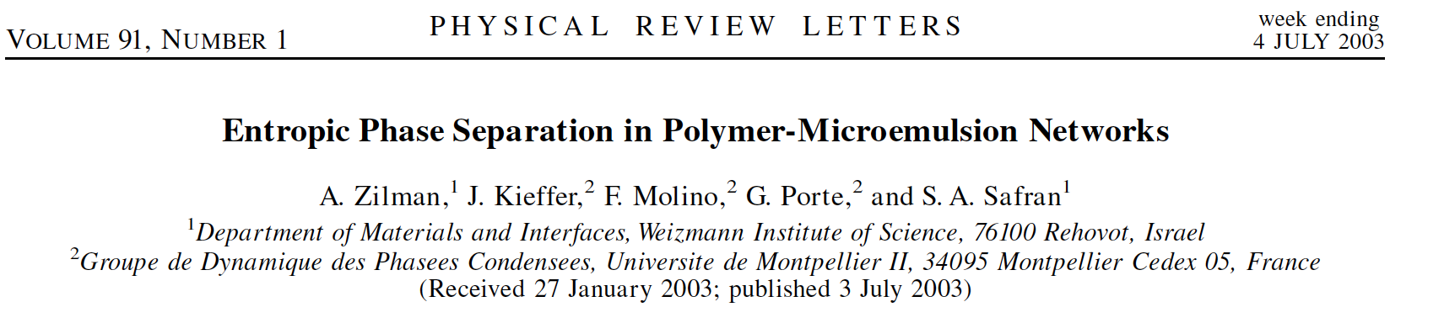
Another important
source of entropy:
Combinatorial Entropy
(Exp)
(Teo)

Slide 5
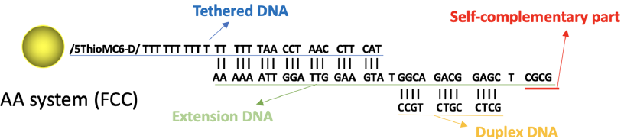
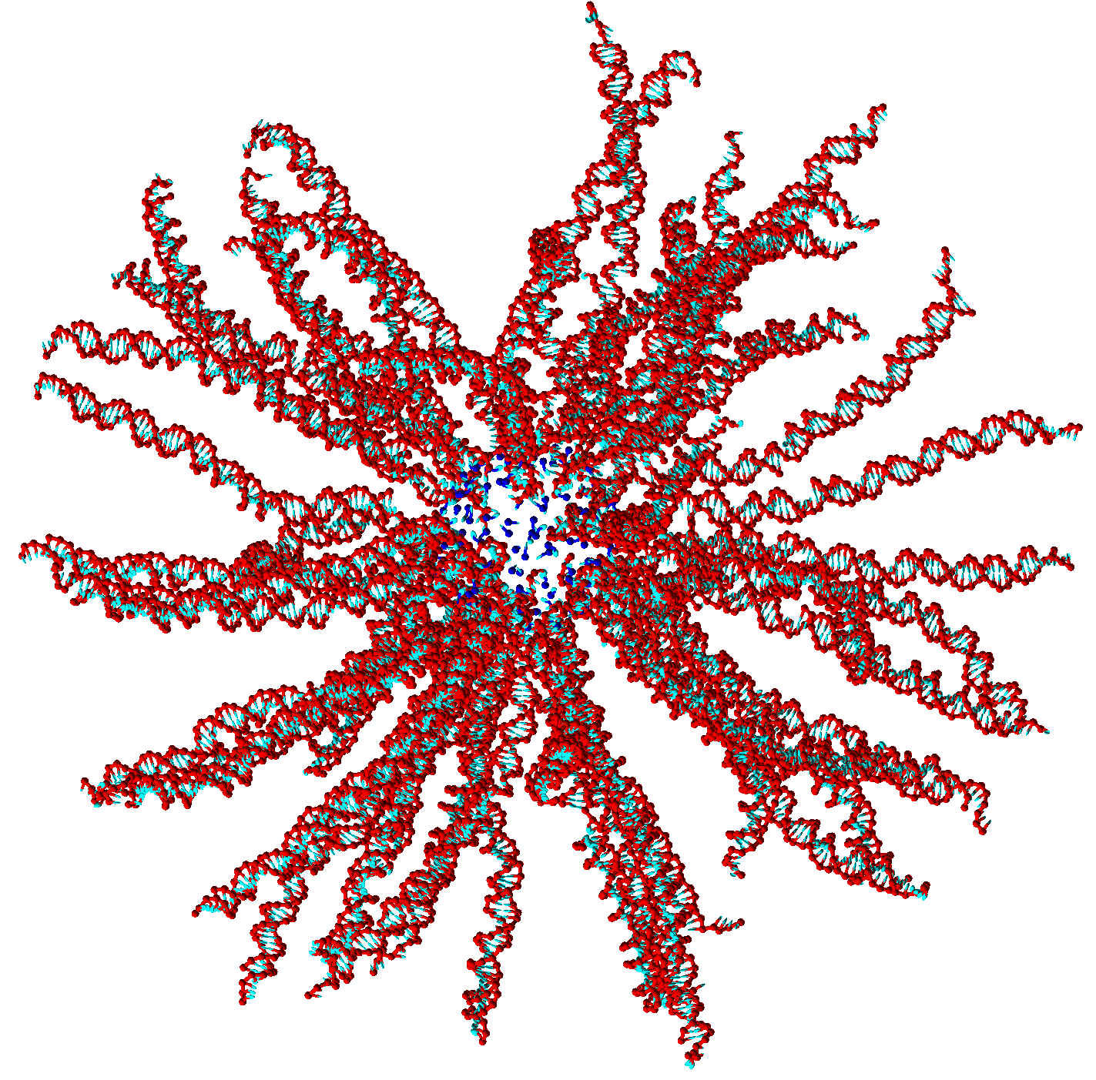
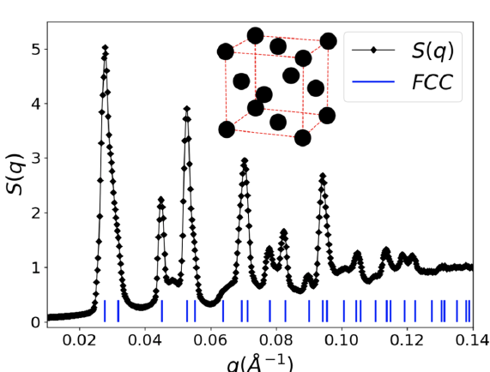
Another
interesting
particle
Oleg Gang (Brookhaven and Columbia)
------CGCG
------CGCG

Slide 6
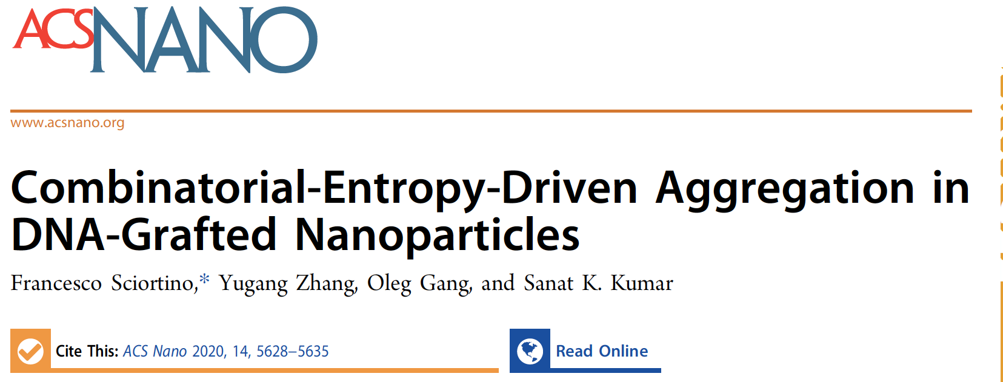
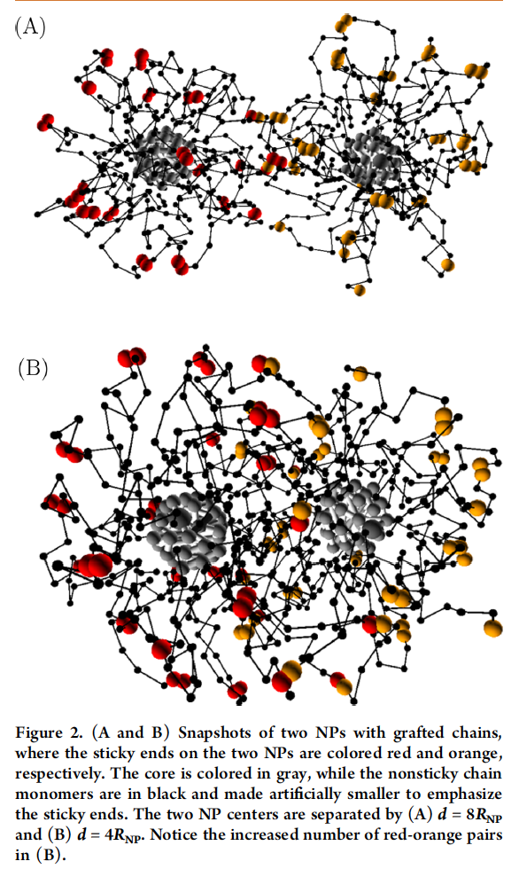
A coarse-grained version of the
DNA-decorated gold nanoparticle
Can we quantify in a simple way the entropic gain ?

Slide 7
N RED + N YELLOW
Reactive sites
Ω=(N− 1)!!
Ω=(N− 1)!!
Ω=(2N− 1)!!

Slide 8
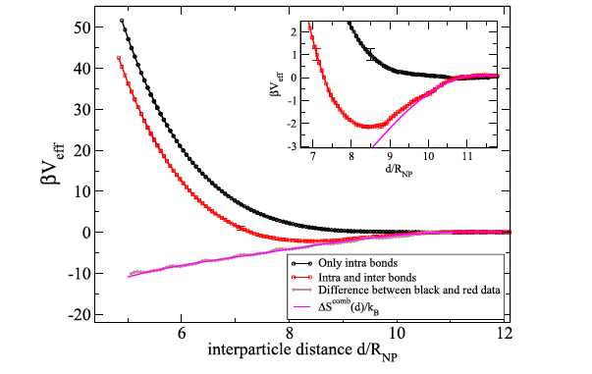
Umbrella sampling based
evaluation of the effective potential

Slide 9
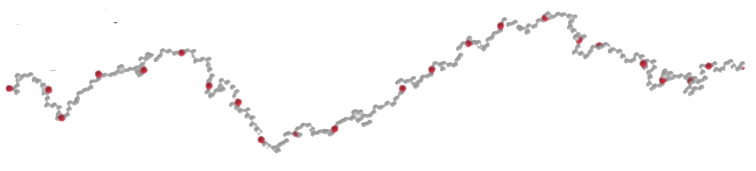
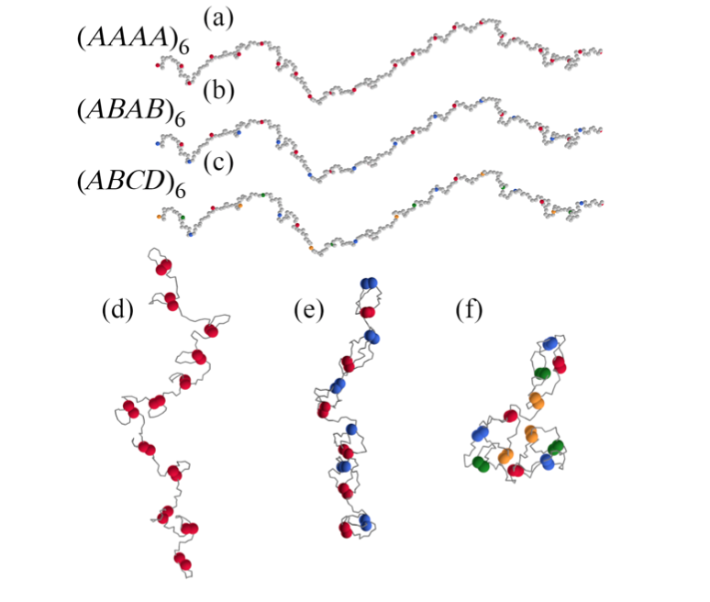
Does it works also in ”sticky” polymers ?
Fully Bonded SingleChainNanoParticles

Slide 10
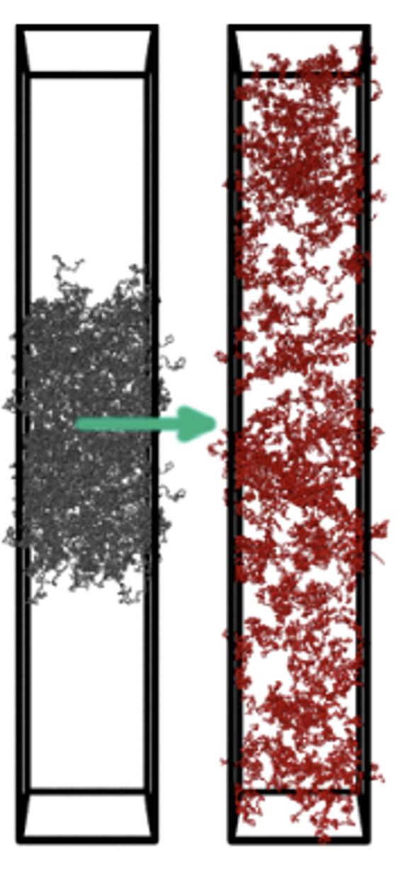
Combinatorial entropy does not suffice to stabilize a ”gas-liquid” coexistence
Consistent with predictions by
Semenov and Rubinstein
Macromolecules 31, 1373 (1998)
Initial time
final time

Slide 11
Interlude… how did we equilibrate at low T ?
Swapping instead of breaking

Slide 12
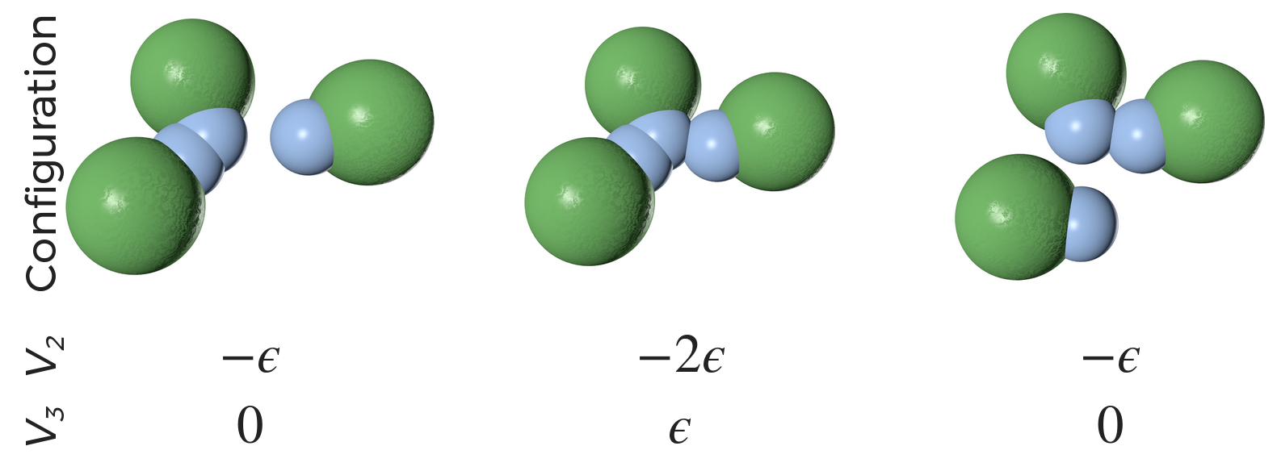
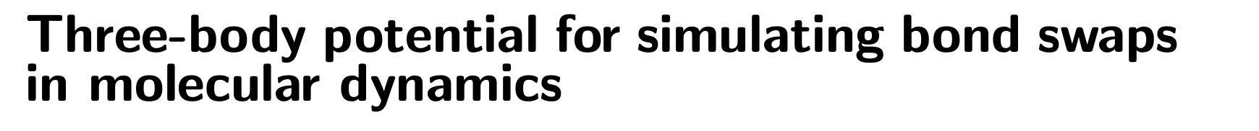
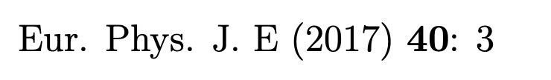
Molecular Dynamics of Swap Events
Short-range with clear minimum and cut-off
A
B
kT<ε

Slide 13
Molecular Dynamics of Swap Events
A
A
A
B
B
B
B
B
B
§
We need a flat energy surface for swap

Slide 14
Molecular Dynamics of Swap Events
A
A
A
B
B
B
B
B
B
We need a flat energy surface for swap

Slide 15
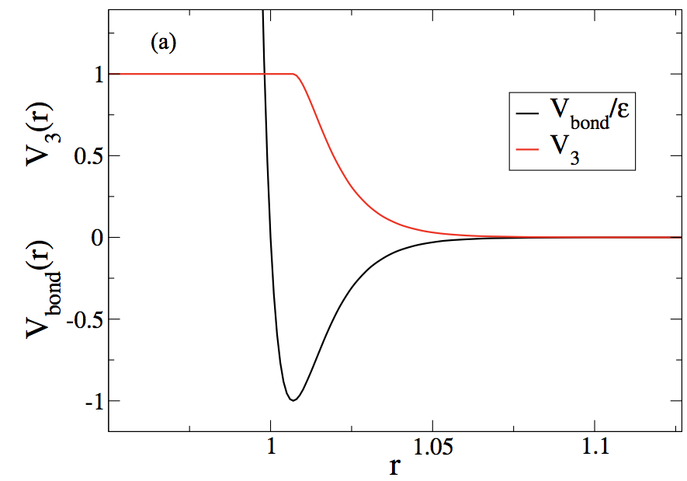
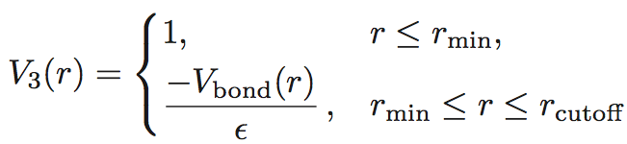
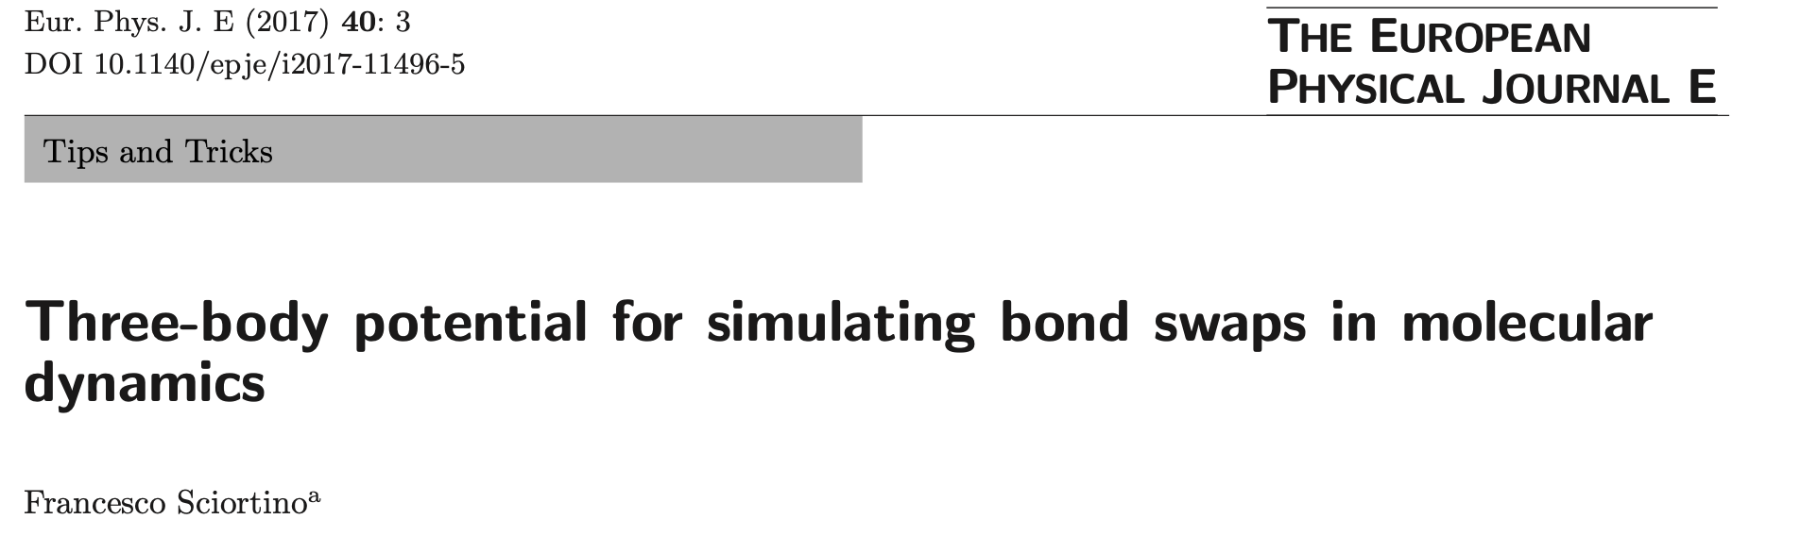
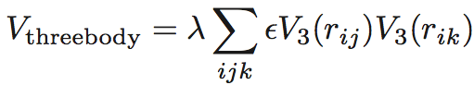
Molecular Dynamics of Swap Events
(always positive)
Notes:
/Users/fs/Dropbox/Q0COLLECTIVEVITRIMER/MACROMOLECULES/fqt-X0332.pdf

Slide 16
Let’s go back to our problem
No phase separation, independently on the polymer length,
# of attractive monomers, distance between attractive monomers.

Slide 17
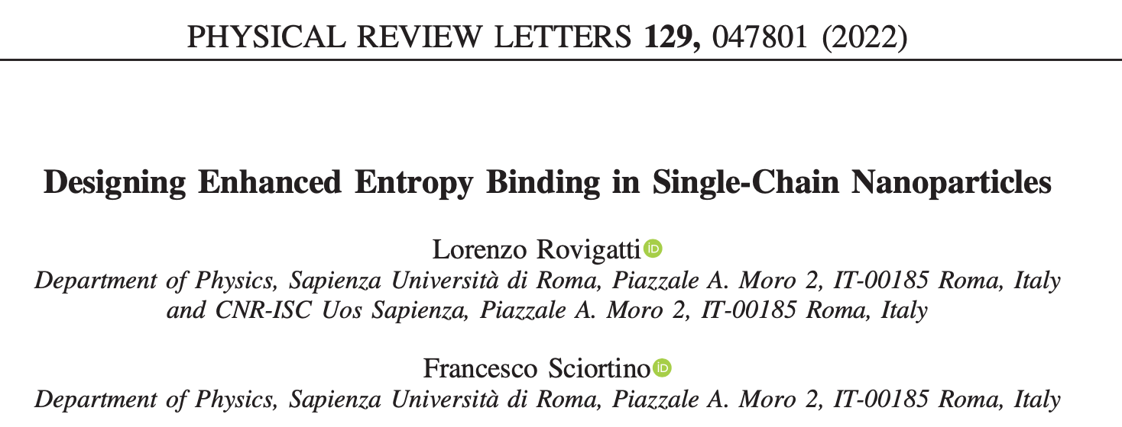

Slide 18
FT
B₂= 6700 σ³
B₂= 5500 σ³
B₂= 8400 σ³
Tuning polymer entropy with the sequence

Slide 19
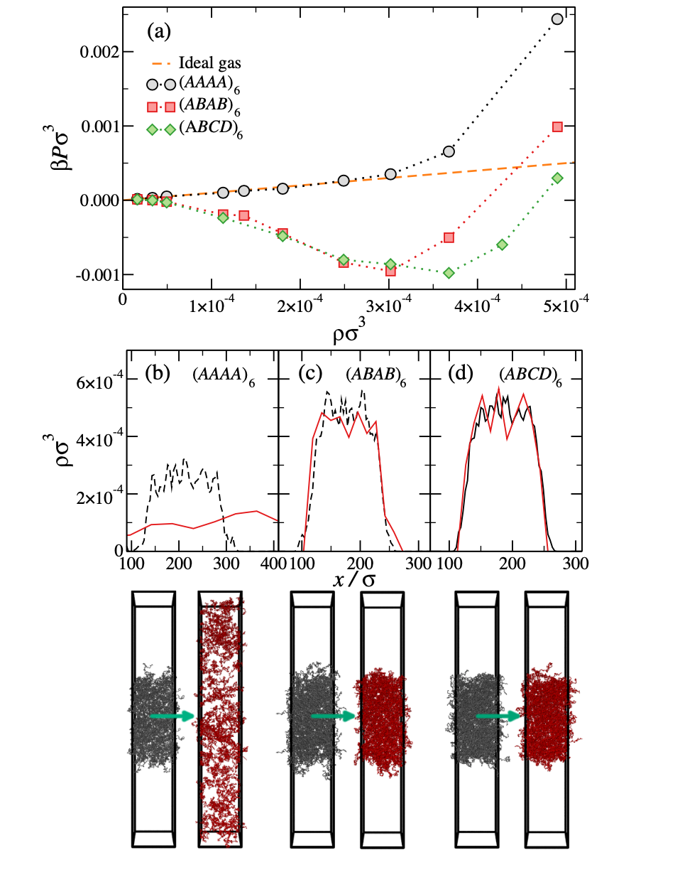
Equation of states

Slide 20
Phase behavior

Slide 21
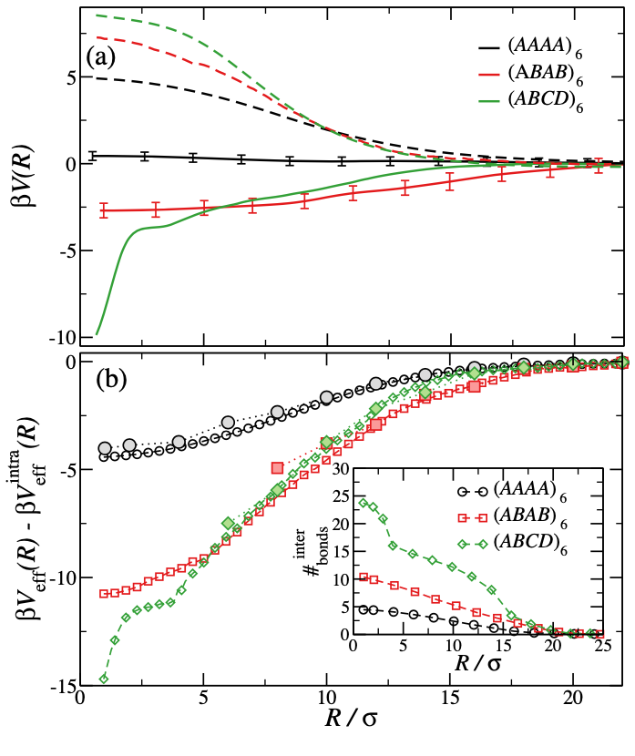
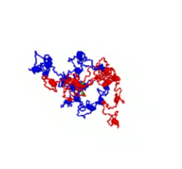

Slide 22
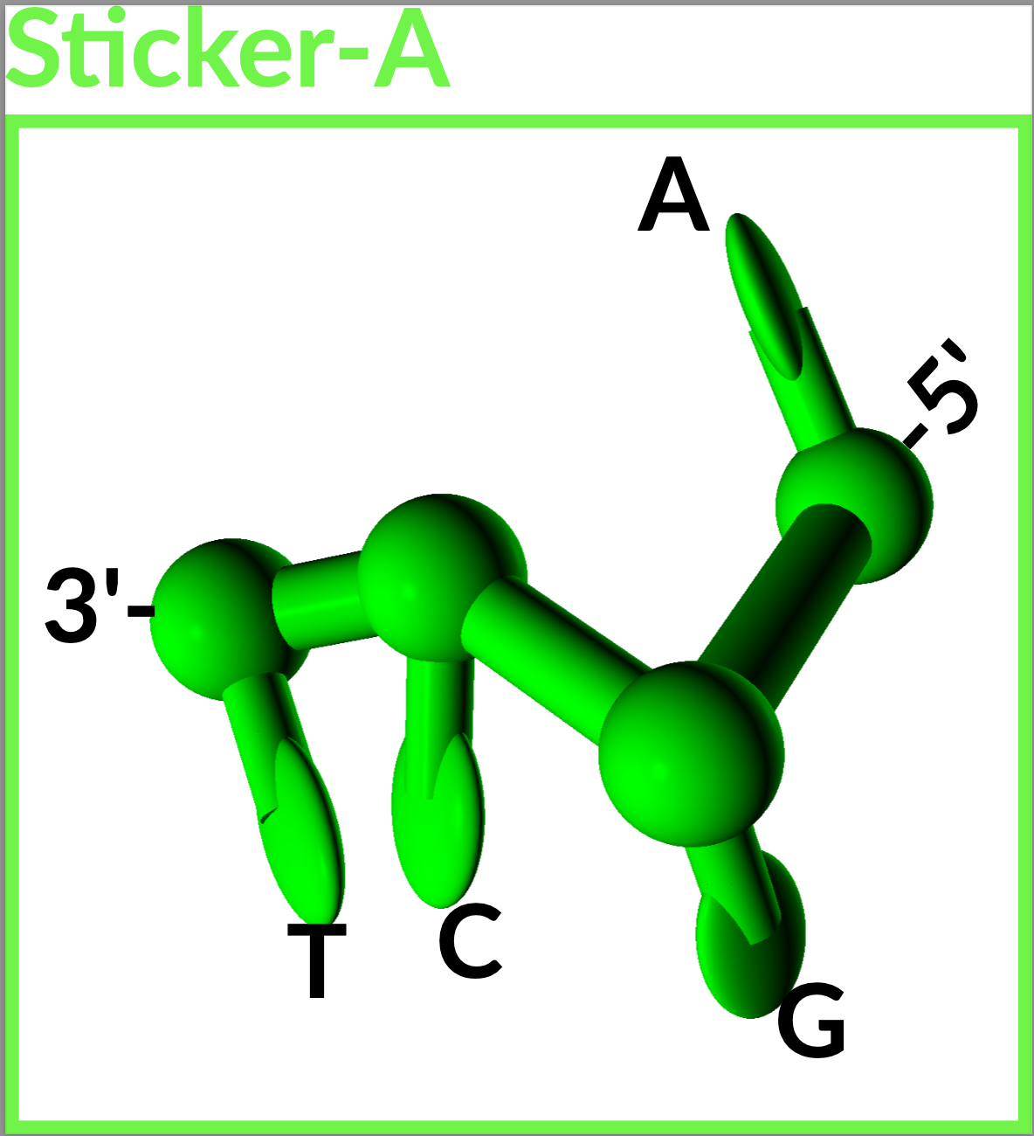
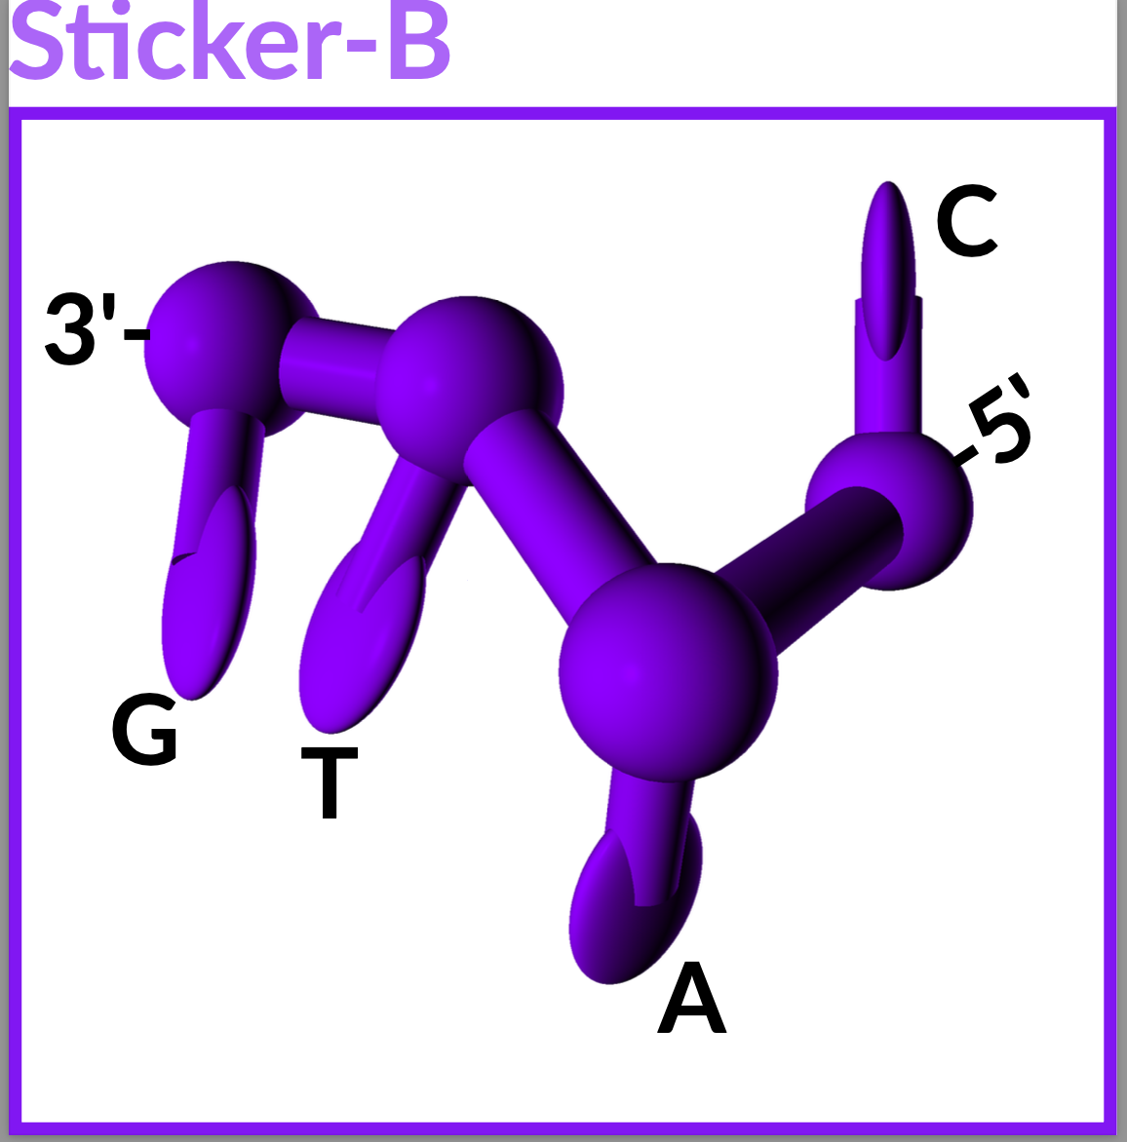
Make it with (ox-)DNA
(on the way to the lab)
SELF-COMPLEMENTATY SEQUENCES
3’-TCGA-5’
3’-GTAC-5’
3’-TCGA-5’
3’-GTAC-5’

Slide 23
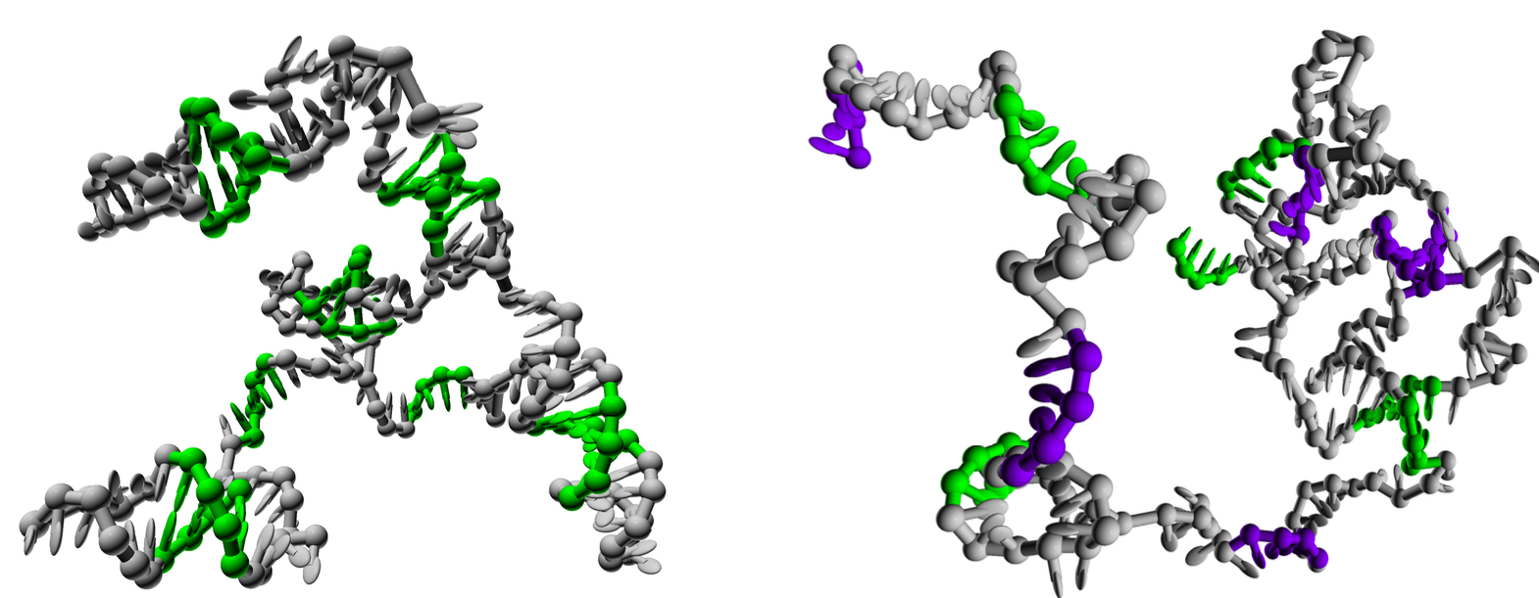
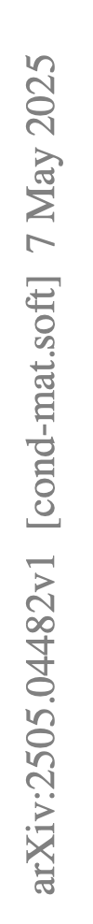
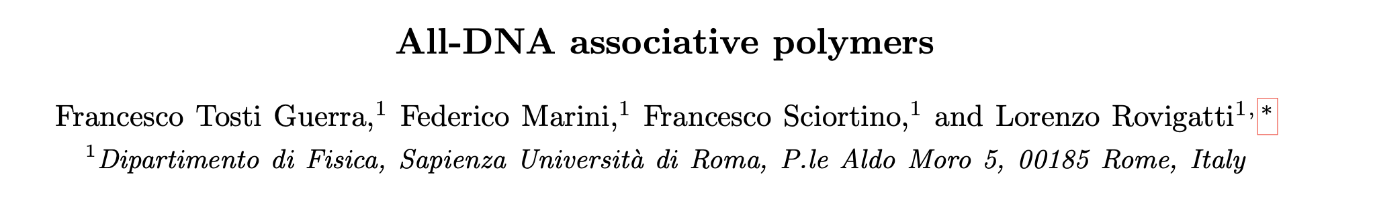
158 nucleotides, 12 sticker regions, 128 polymers in the NVT ensemble
(AA)₆
(AB)₆

Slide 24
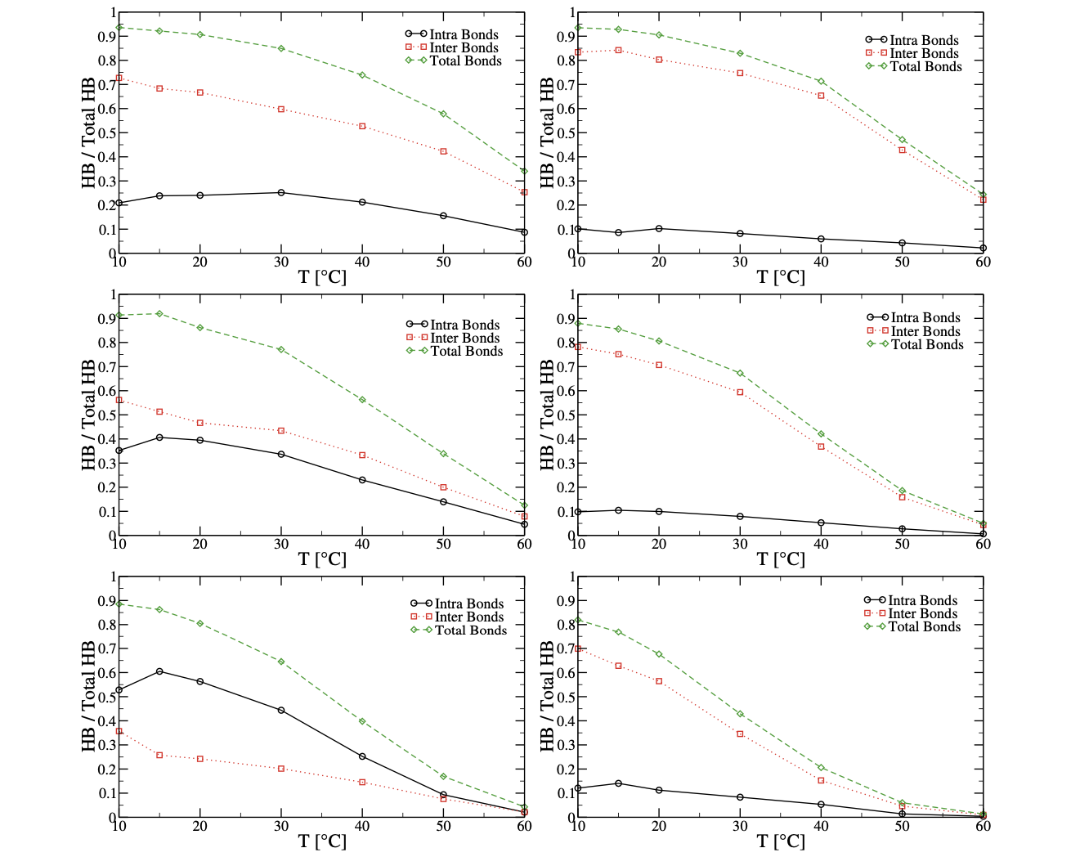
Intra or Inter bonds ?
Green
(total bonds)
Red
(Inter bonds)
Black
(Intra bonds)
density
(AA)₆
(AB)₆

Slide 25
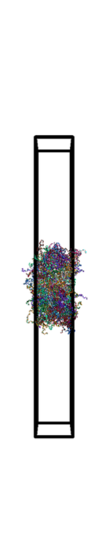
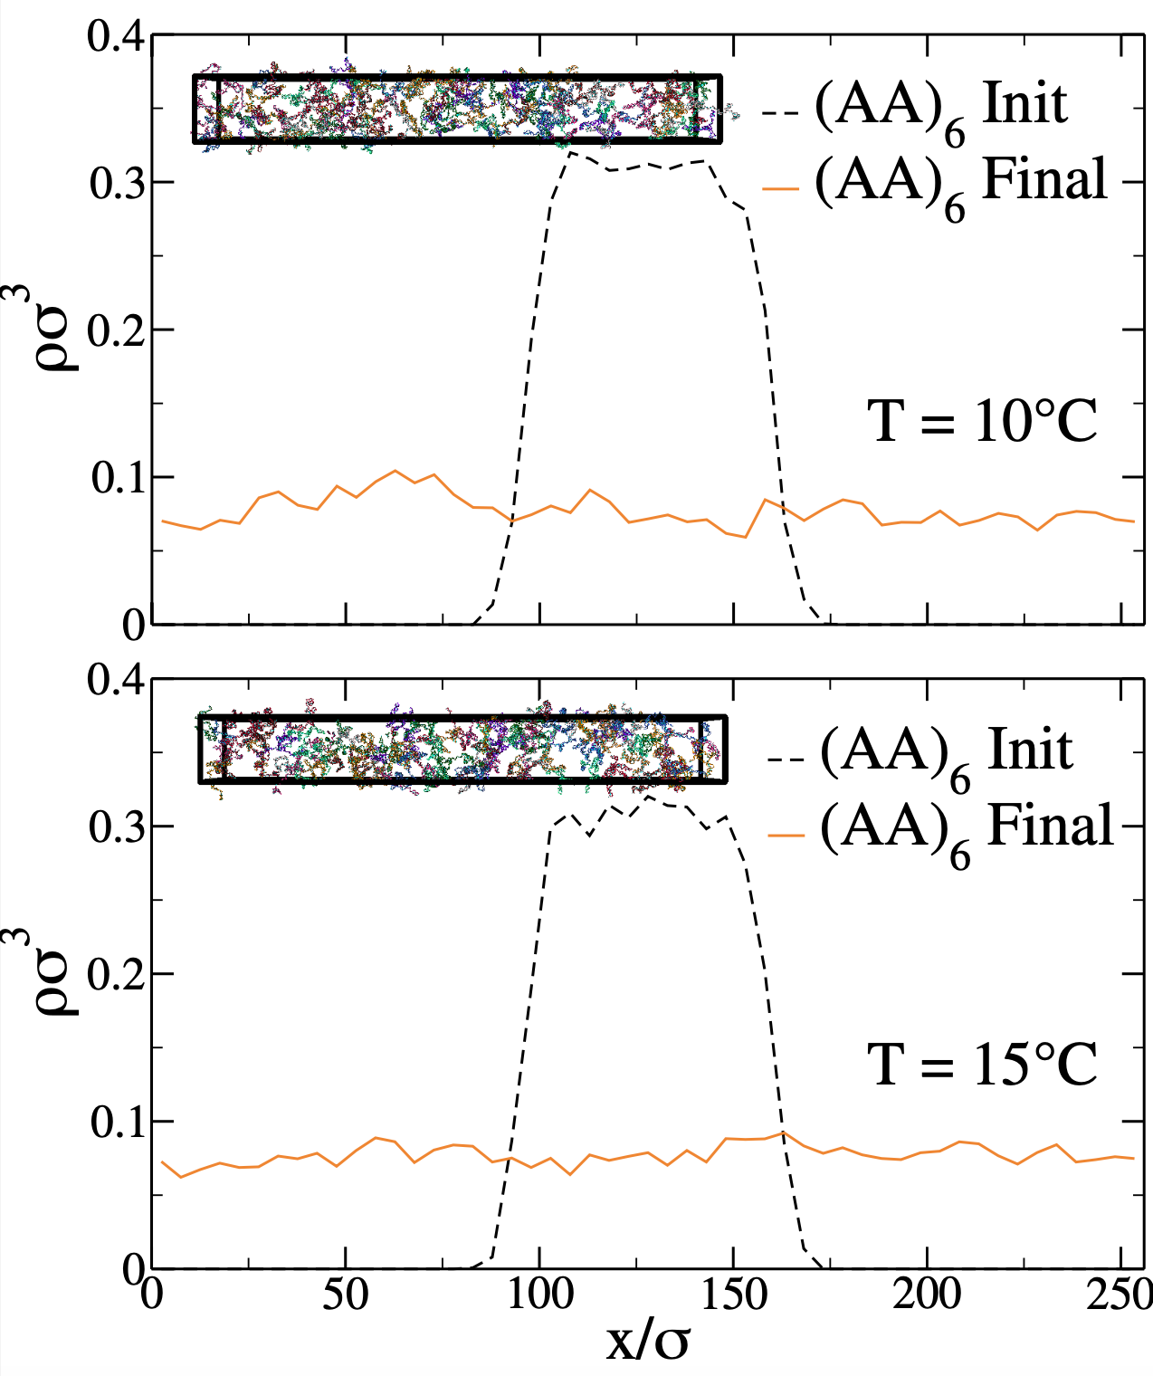
Direct Coexistence
simulations
(AA)₆ system

Slide 26
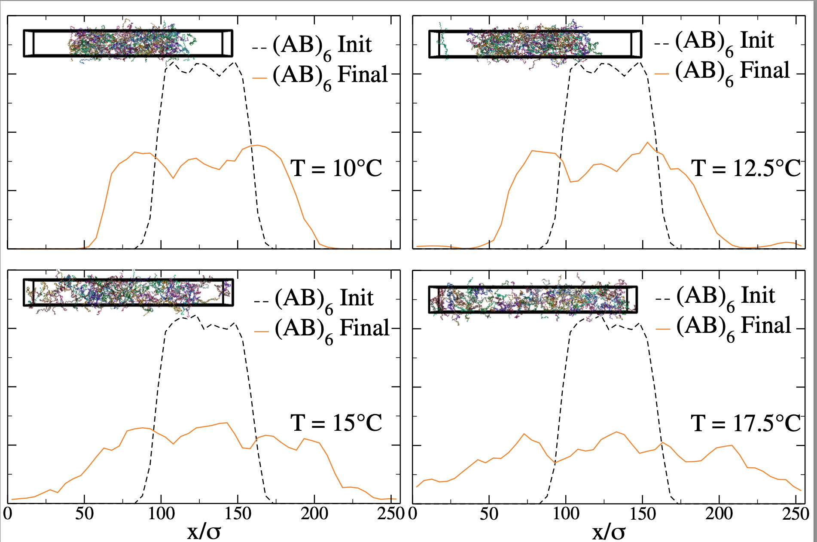
(AB)₆ system

Slide 27
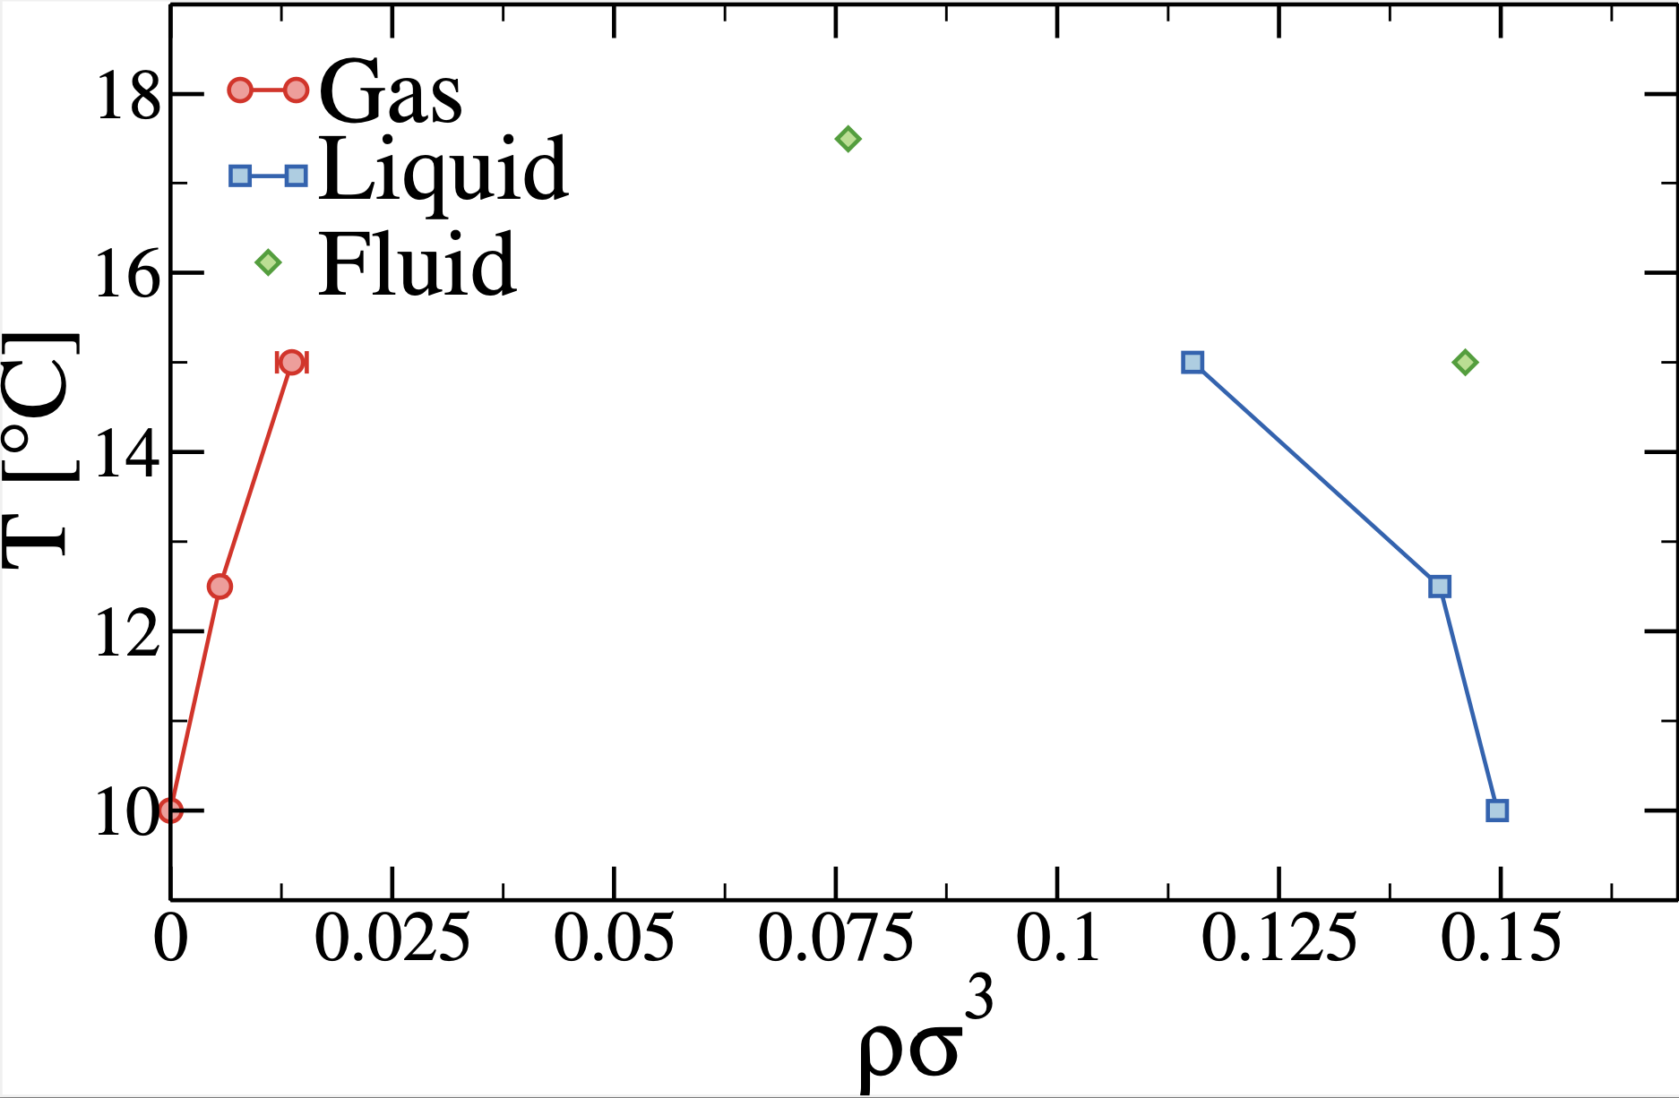
(AB)₆ system

Slide 28
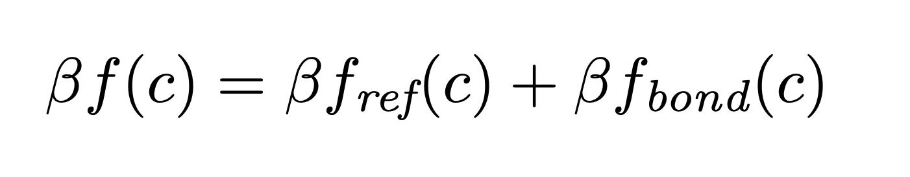
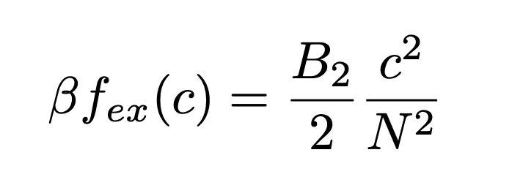
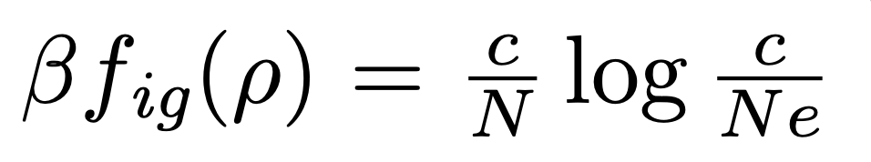
Why is this (preliminary results)?
ρ = polymer number density
C = monomer number density
N = length of the polymer
L = # of spacer monomers

Slide 29
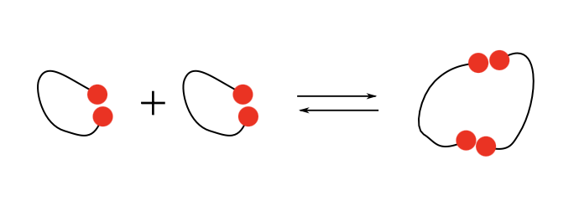
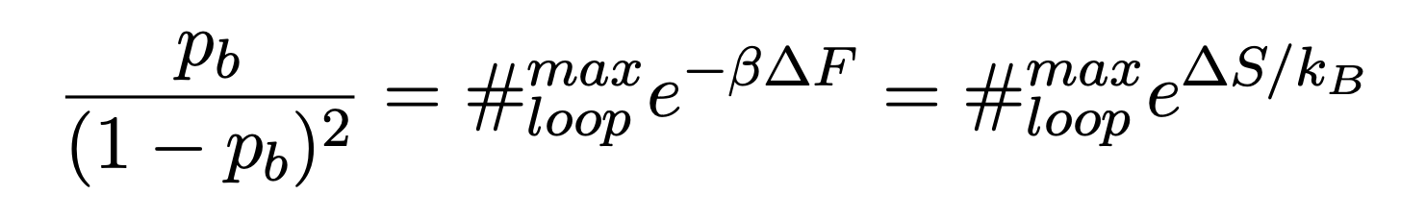
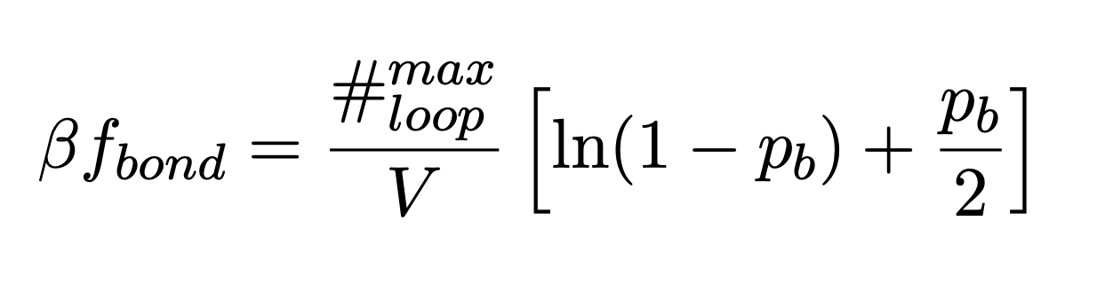
Why is this (preliminary results)?

Slide 30


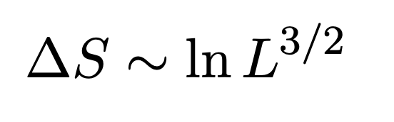
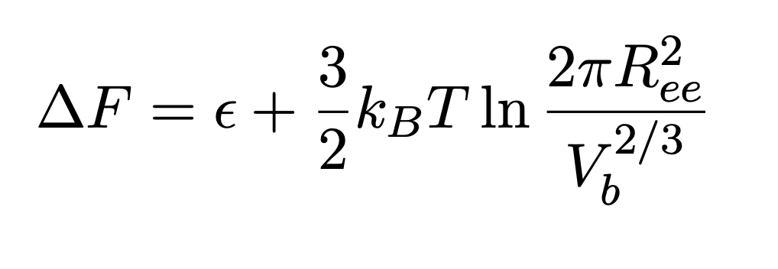
Three steps for ΔS
2 X
2 X
ΔS₁
+
ΔS₂
ΔS₃

Slide 31
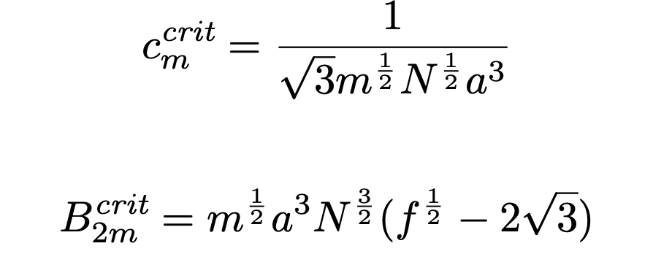
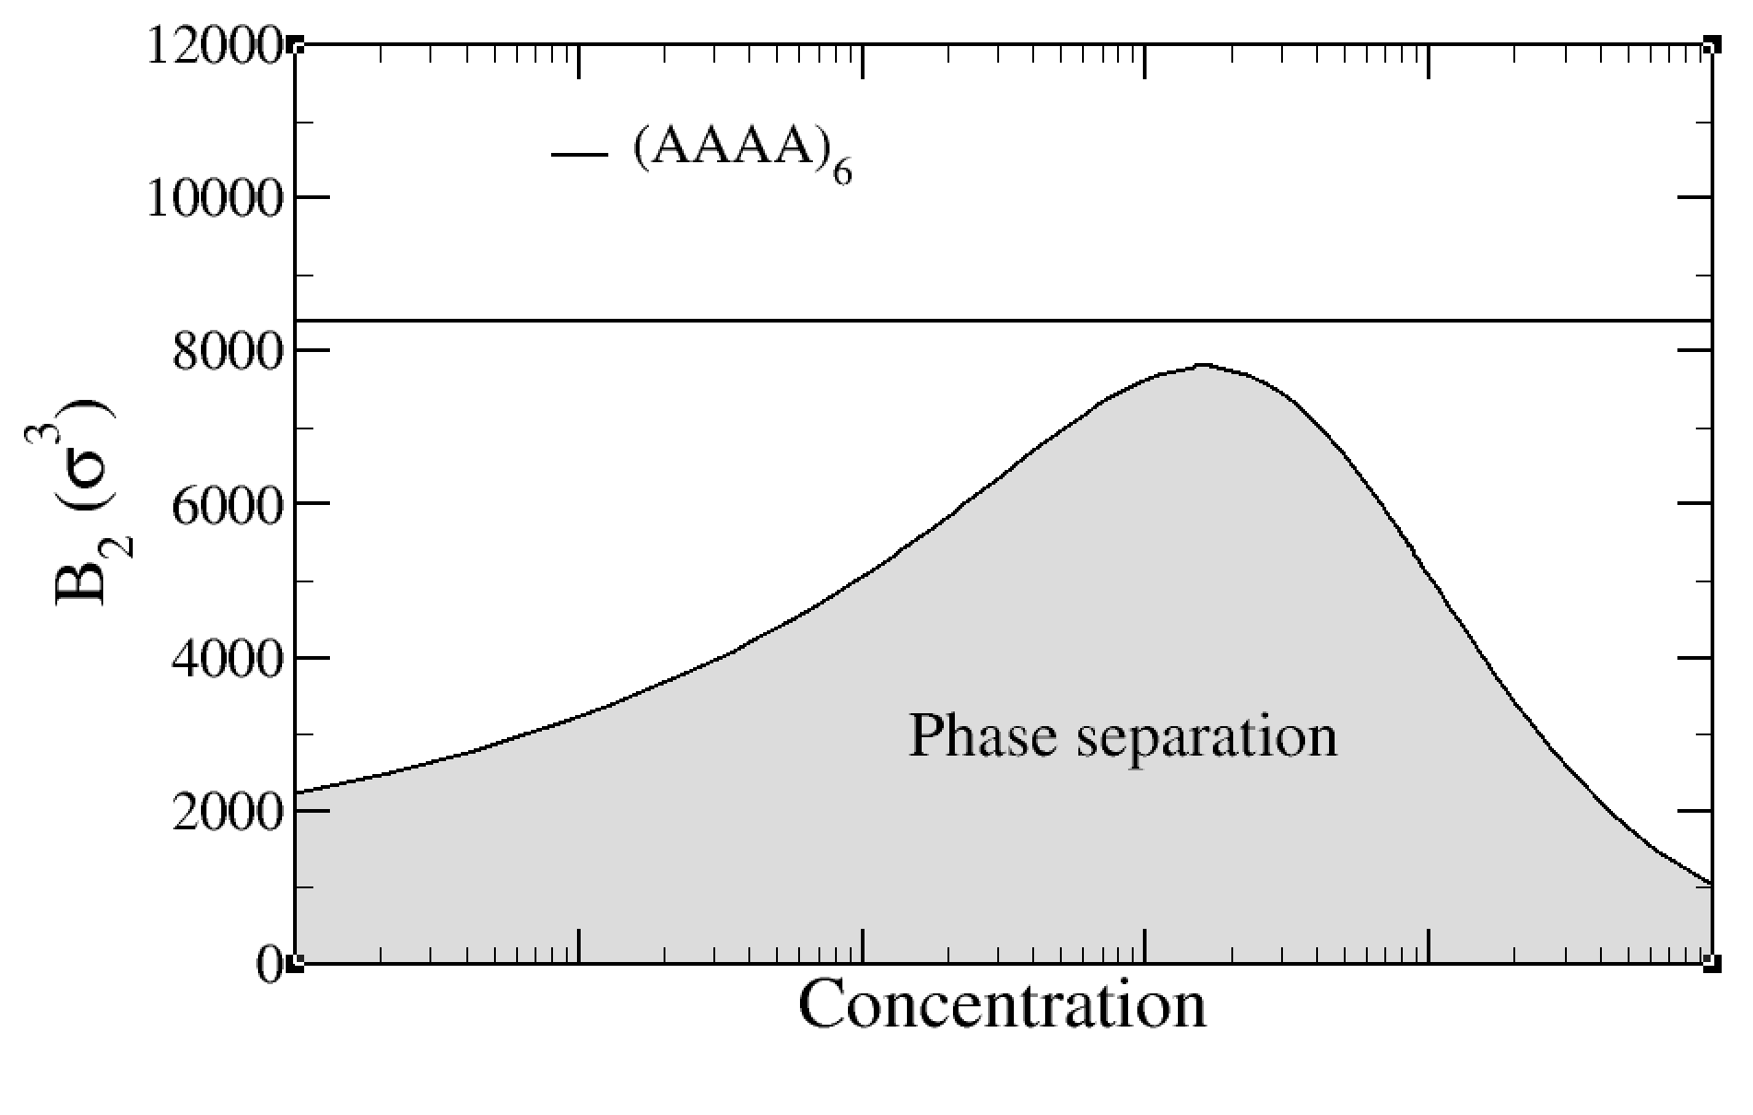
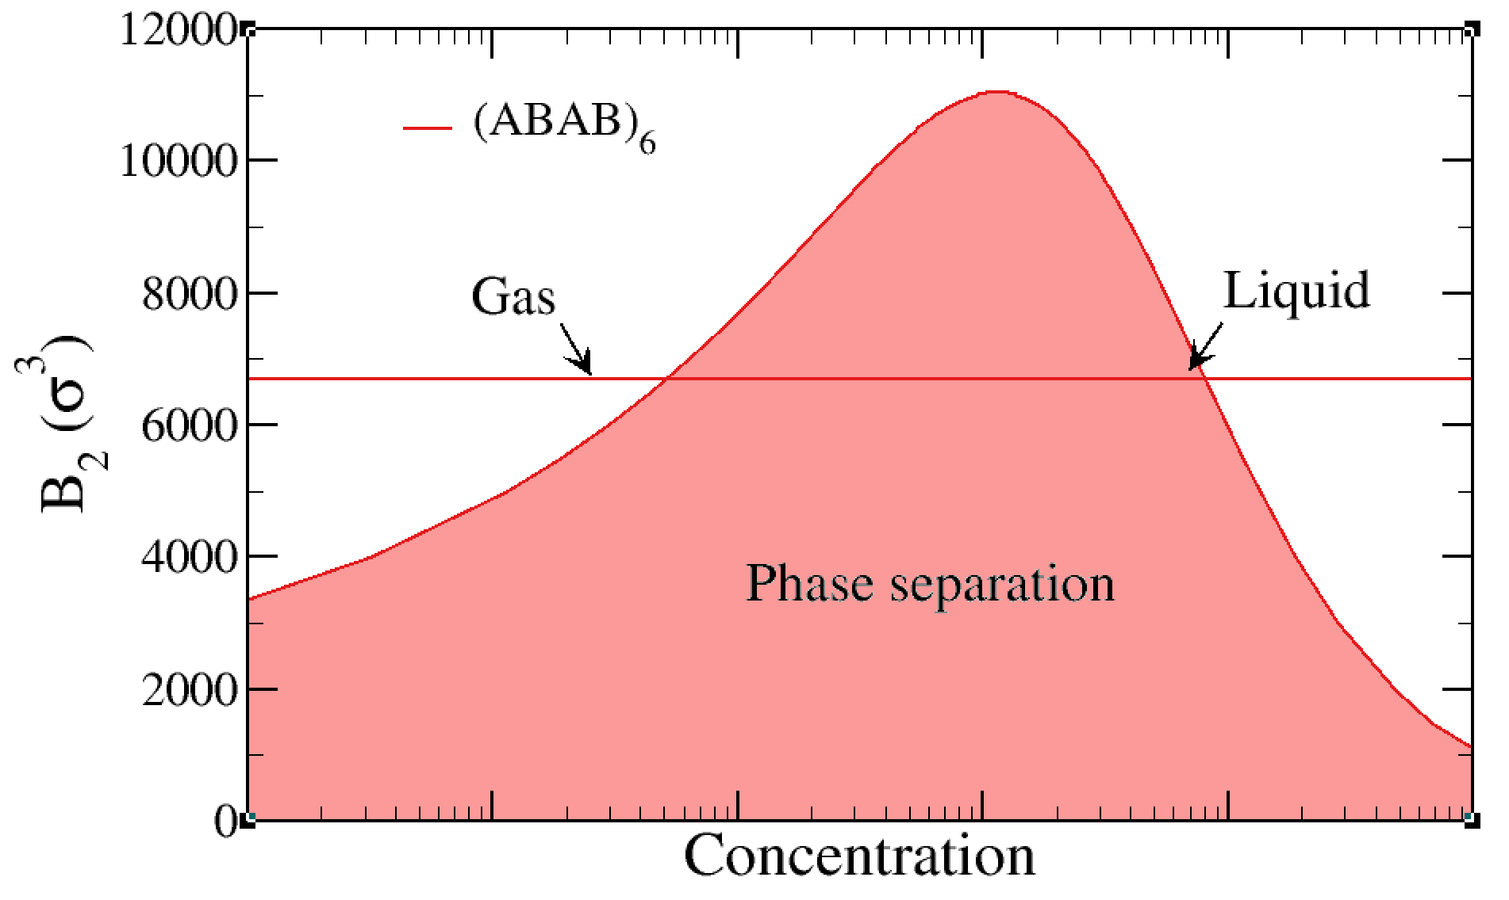
a = monomer size
f = # of stickers
m = # of stickers type

Slide 32
Take home messages
Subtleties in the phase behavior of SCNP
Competitions between different entropic sources
Possible connections with IDP and their phase behavior
Swap if you want to sample the ground state !

Slide 33



Thanks to
Lorenzo Rovigatti
Marco Cappa (Theory)
Francesco Tosti Guerra (oxDNA simulations)

