Slide 1
Exploring bio-inspired systems:
a synergy between multiscale experimental and
Computational approaches
Wien, September 4, 2024 - September 7, 2024
Guiding colloidal SAT-assembly
The power of patchyness
!
Francesco Sciortino, Sapienza Universita’ di Roma

Slide 2
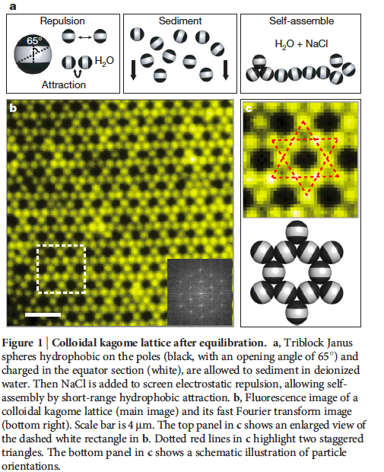
Educated Guess Design
DNA wireframe origami
Triblock Janus Particles
Small patch (chains)
Medium patch (Kagome)
Large patch (dense crystal)

Slide 3
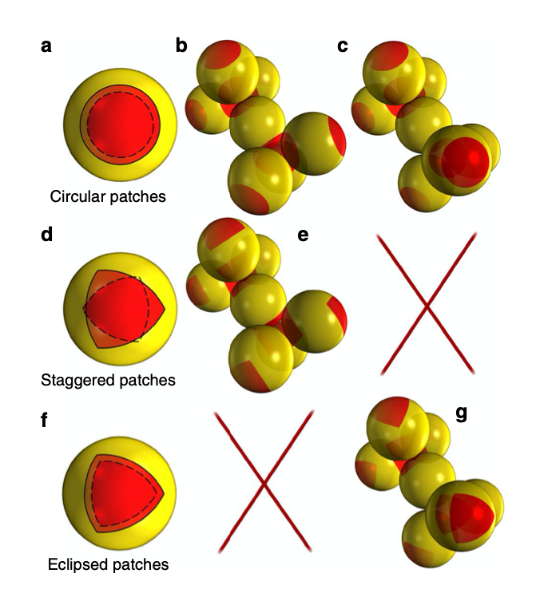
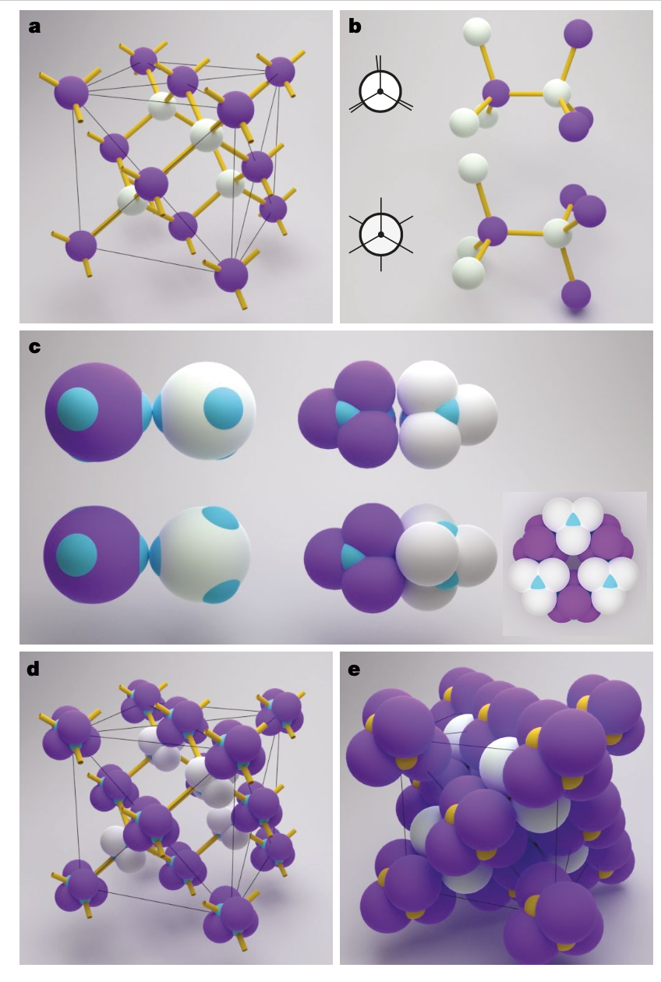
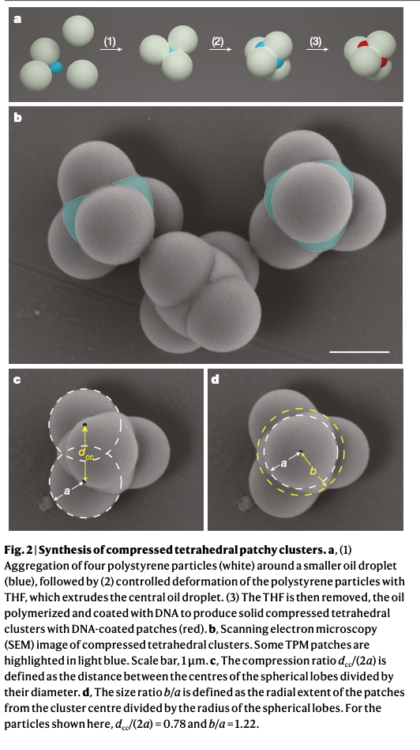
Educated Guess Design

Slide 4
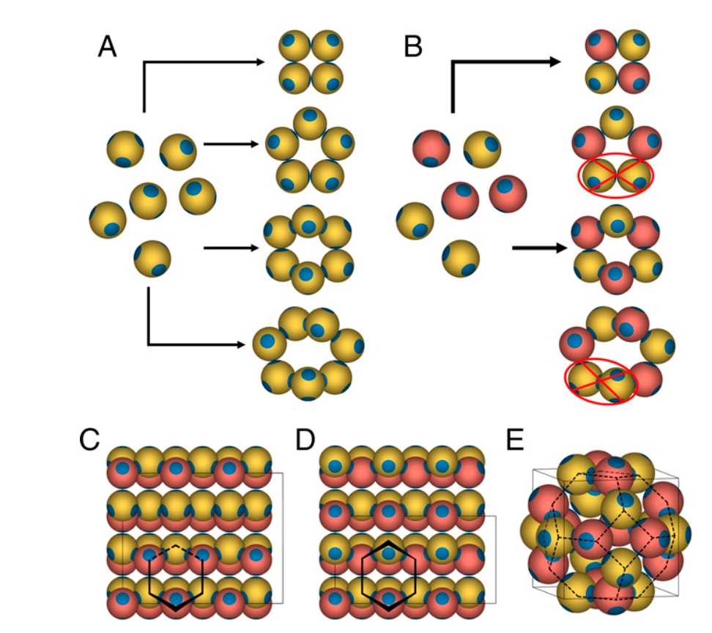
Educated Guess Design

Slide 5
Potential pitfalls typically encountered in self- assembly
* metastable states that can compete with the final product;
(cubic diamond, hexagonal diamond, clathrates)

Slide 6
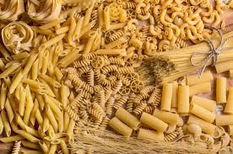

Slide 7
Potential pitfalls typically encountered in self- assembly
* metastable states that can compete with the final product;
* dynamically arrested states (kinetic traps);
(glasses, gels)

Slide 9
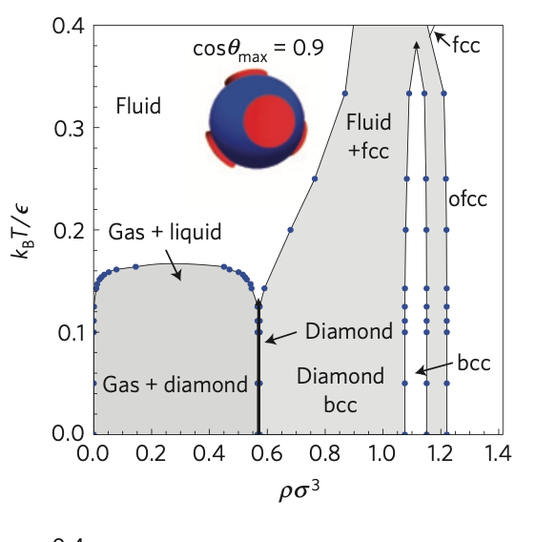
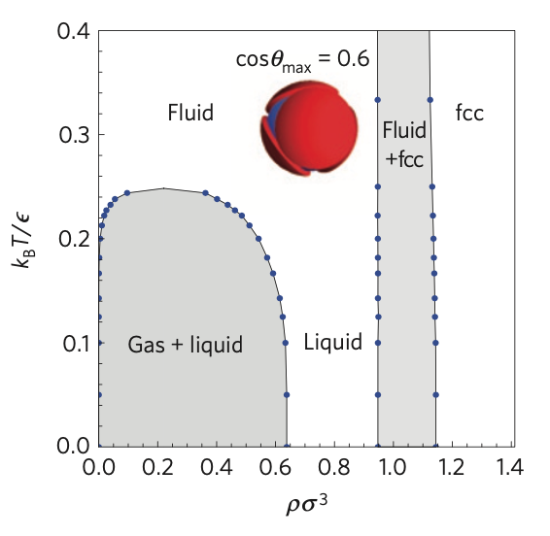
Tetrahedral patchy particles phase diagram – role of the potential parameters
Directional bonds
Flexible bonds

Slide 10
The SAT assembly way
From patchy particles to finite size, periodic and
a-periodic selected structures

Slide 11
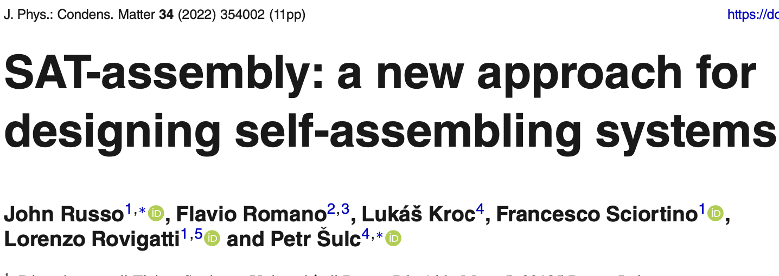
The SAT assembly way
Use patchy colloidal particles as building blocks
Define as logical variable the lattice and the particle properties
Write the solution in term of CLAUSES which need to be satisfied
Find with a SAT-solver the possible solutions

Slide 12
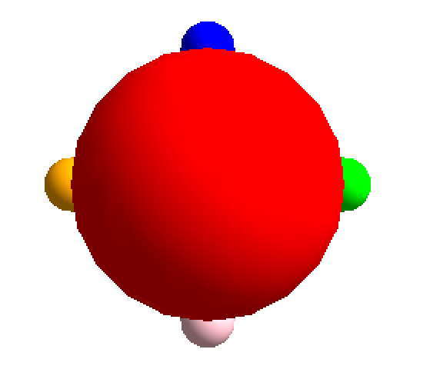
Why Patchy particles as building blocks ?
(i) Can be experimentally realized (colloids, origami)
(ii) The thermodynamic behaviour of these models is very well understood (Wertheim theory)
(iii) Computationally efficient (this is required to observe self-assembly phenomena in silico).

Slide 13
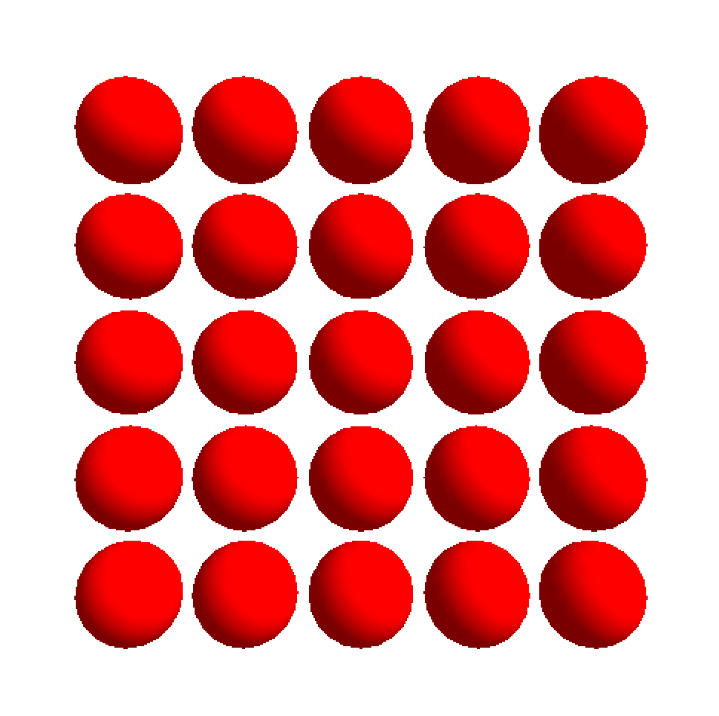
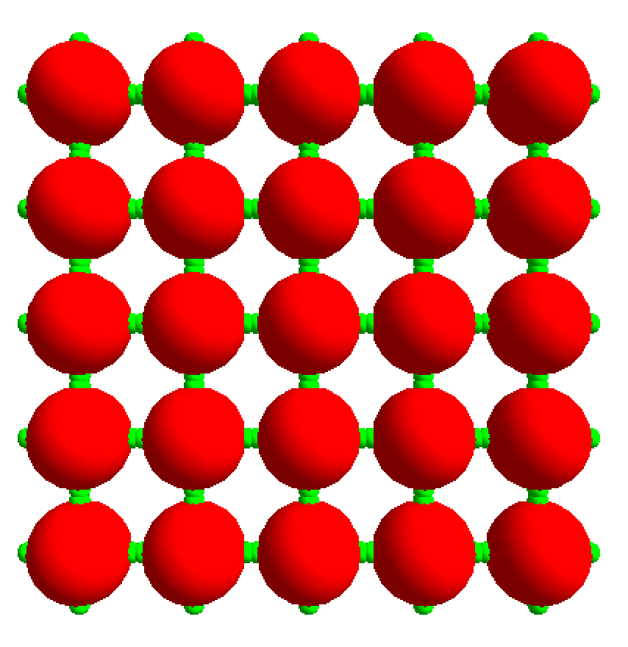
SAT Assembly Steps:
Pick the target (square) lattice (0<i<L lattice sites)
Define the connections (slots) – 4 per particle -- (patchy particles)
Define the number of different
patchy particles and the number of different colours (N_{p}, N_{c})
Define orientations

Slide 14
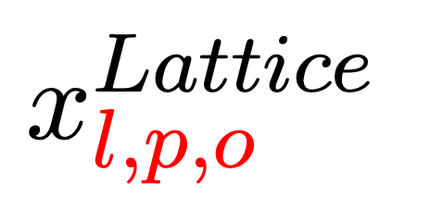
(some of ) The logical variables defined to solve the coloring process
True if lattice site l is occupied by particle type p with orientation o
True if patch number s of particle p has color c
True if color c_{i} interact with color c_{j}
True if the slot s of lattice site l has colour c
10⁵ variables

Slide 15
(some) Clauses to solve the coloring process (NOT ⁻⁻⁻ and OR V)
Each site is occupied by only one particle type with specified orientation
Each color can be complementary to only one other color
Neighboring positions l_{i} and l_{j} connected by slots s_{i} and s_{j}
must have color c_{i} and c_{j} that can bind to each other
# of colors must be N_{c} and # of particles must be N_{p}
number of clauses 10 ⁵

Slide 16
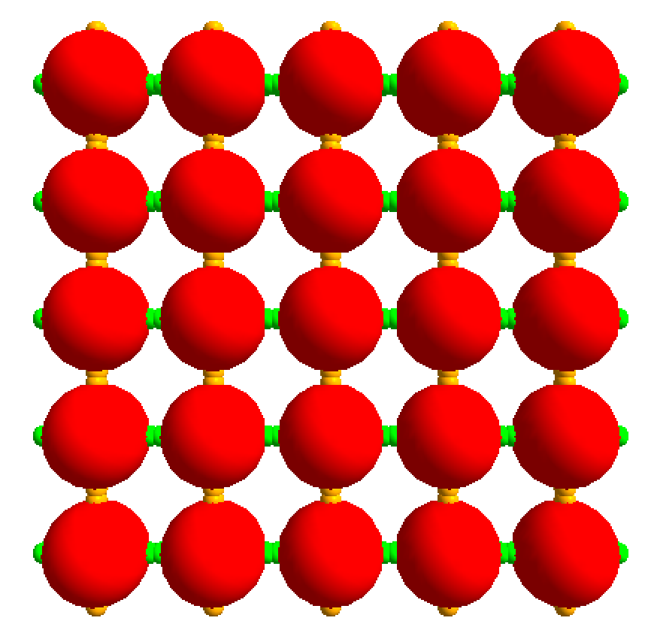
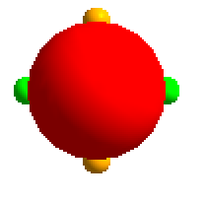
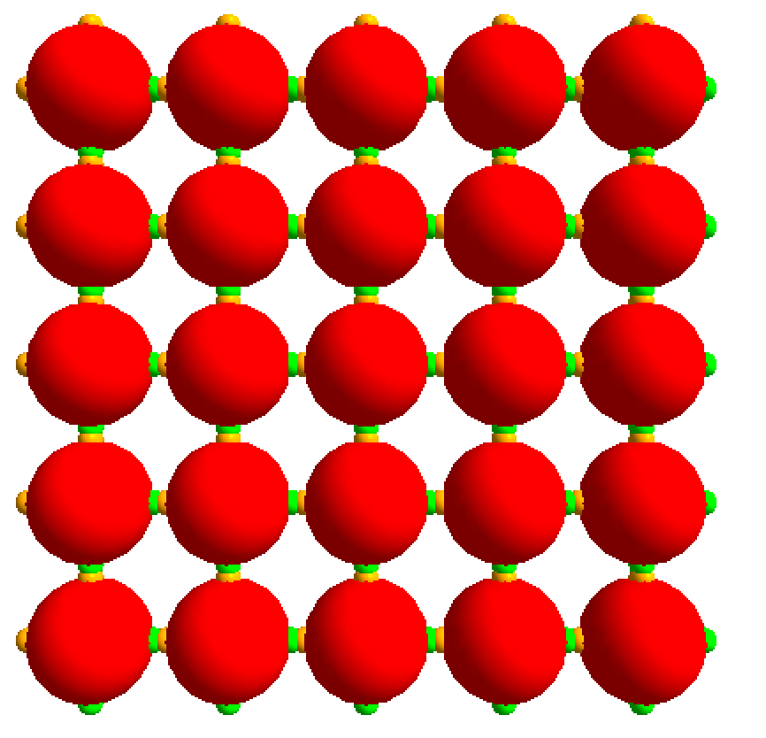
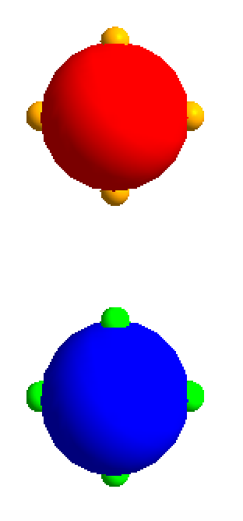
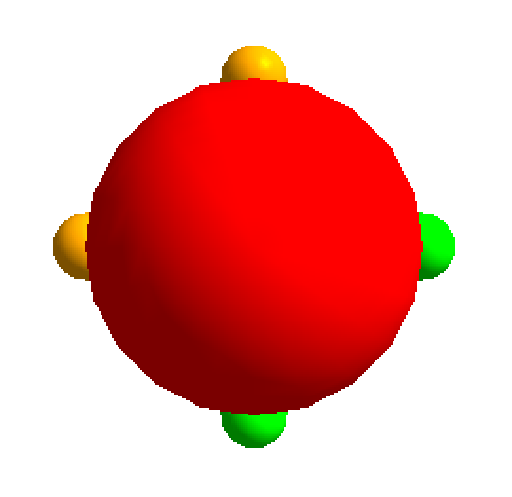
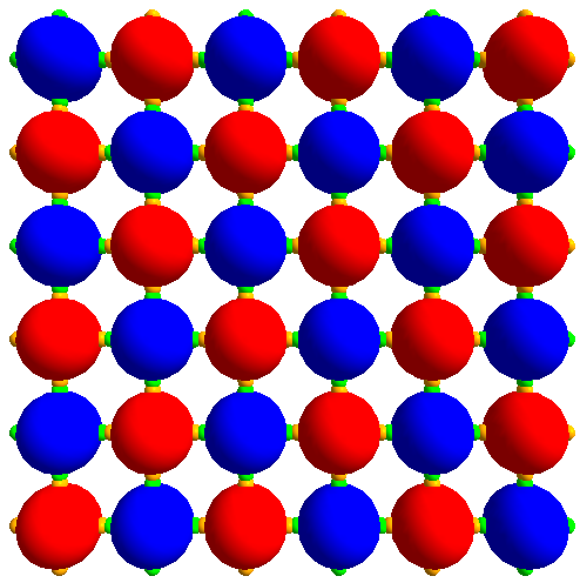
Some solutions:
N_{p}=1, N_{c}=2 G-G, O-O
N_{p}=2, N_{c}=2 G-O
N_{p}=1, N_{c}=2 G-O

Slide 17
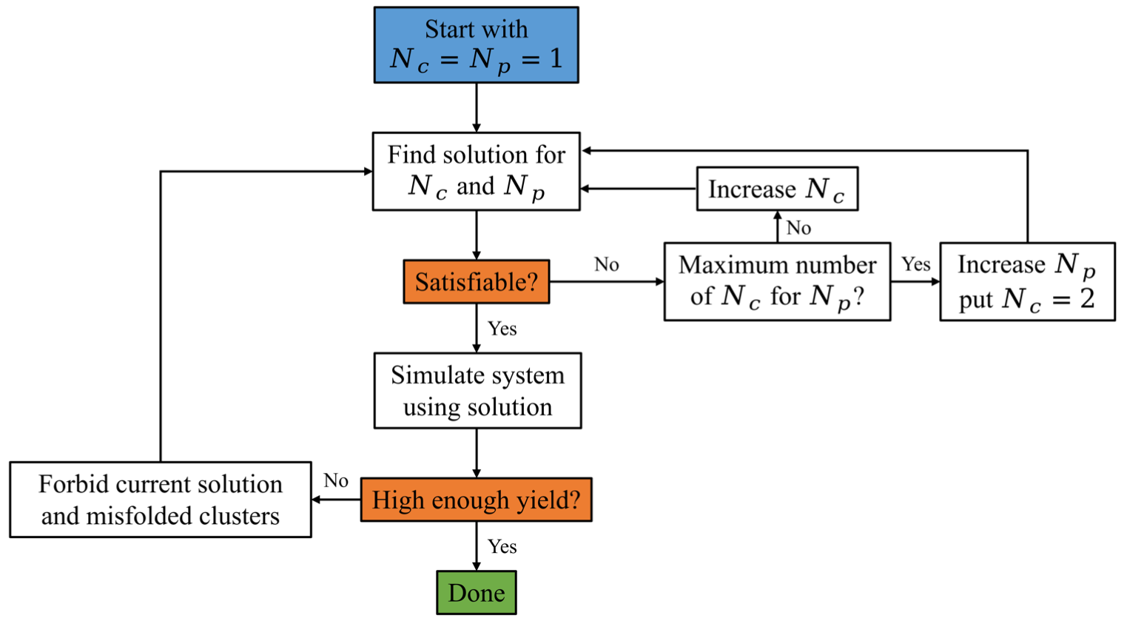
The SAT-ASSEMBLY pipeline

Slide 18
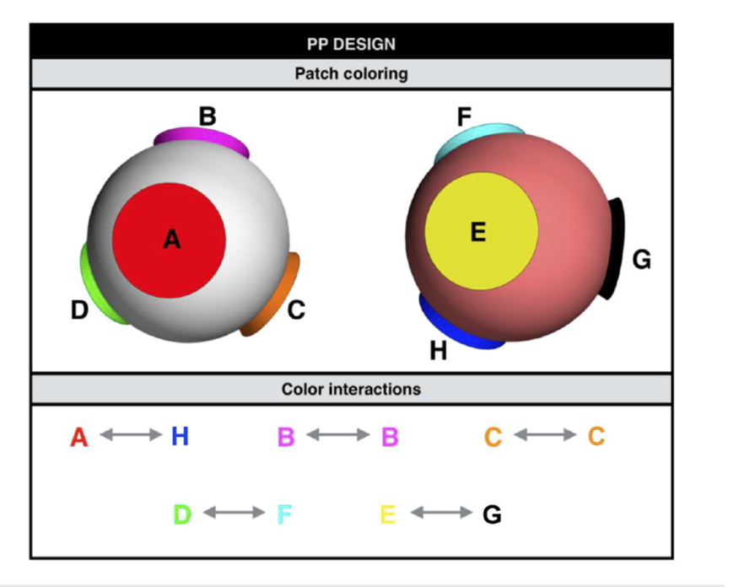
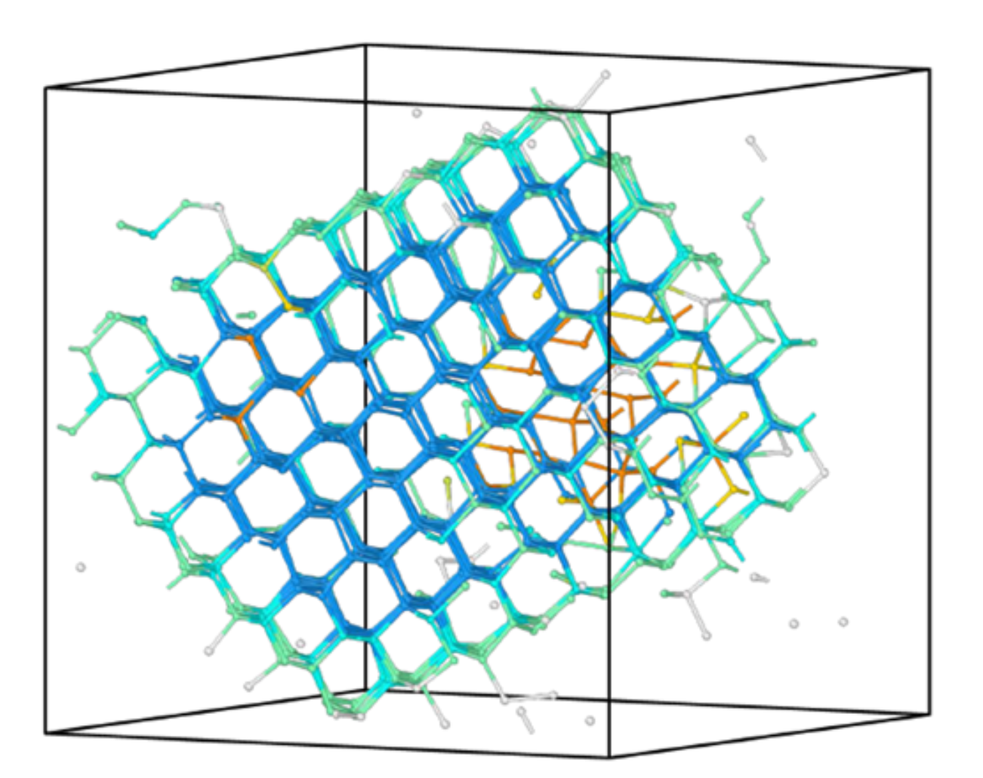
Cubic (and only cubic)
diamond
N_{p}=2, N_{c}=8

Slide 19
Self Assembly in Multi component systems….
Gas → Liquid → Crystal
Consumption of the minority component
Gas → Liquid → Crystal
Consumption of the minority component
Azeotropy: when a multicomponent system behaves as a one component one
When coexisting phases have the same composition

Slide 20
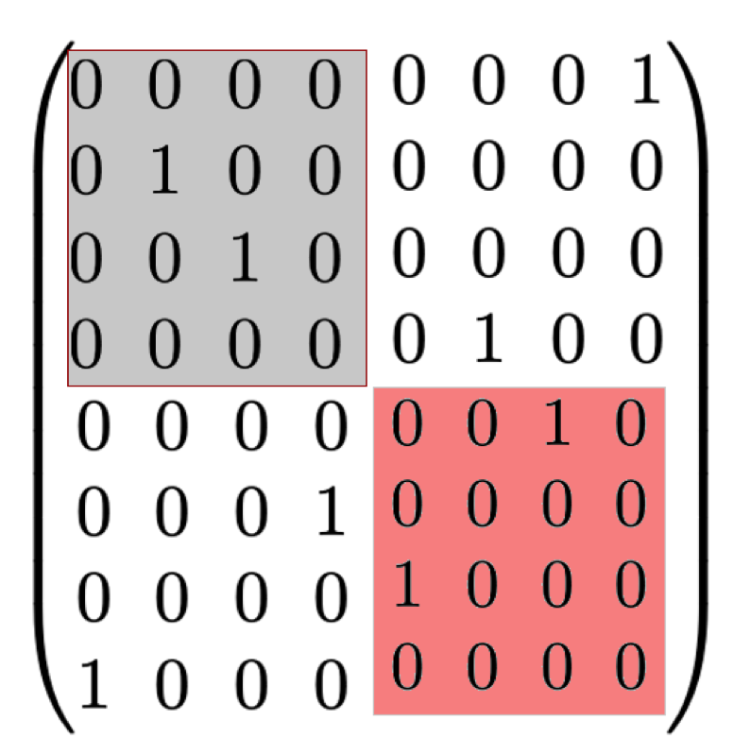
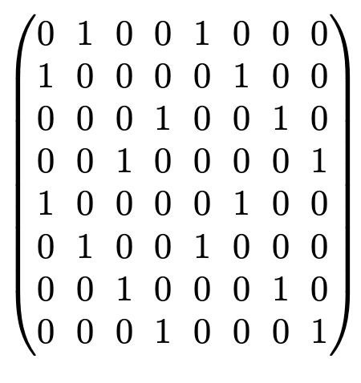
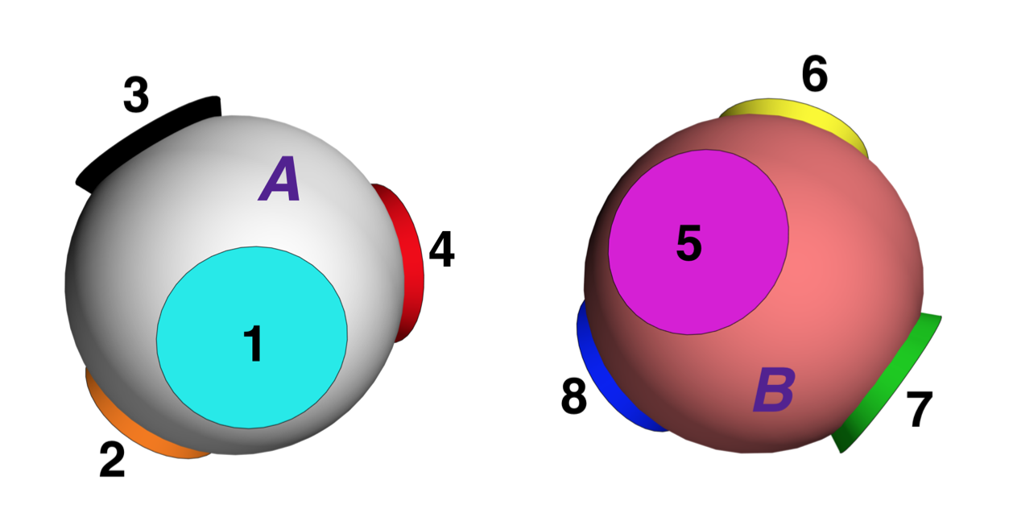
N_{p}=2, N_{c}=8
Two 1 in each row
(but on different particles, azeotropic at all compositions)
One 1 in each row
(azeotropic at equimolar)

Slide 21
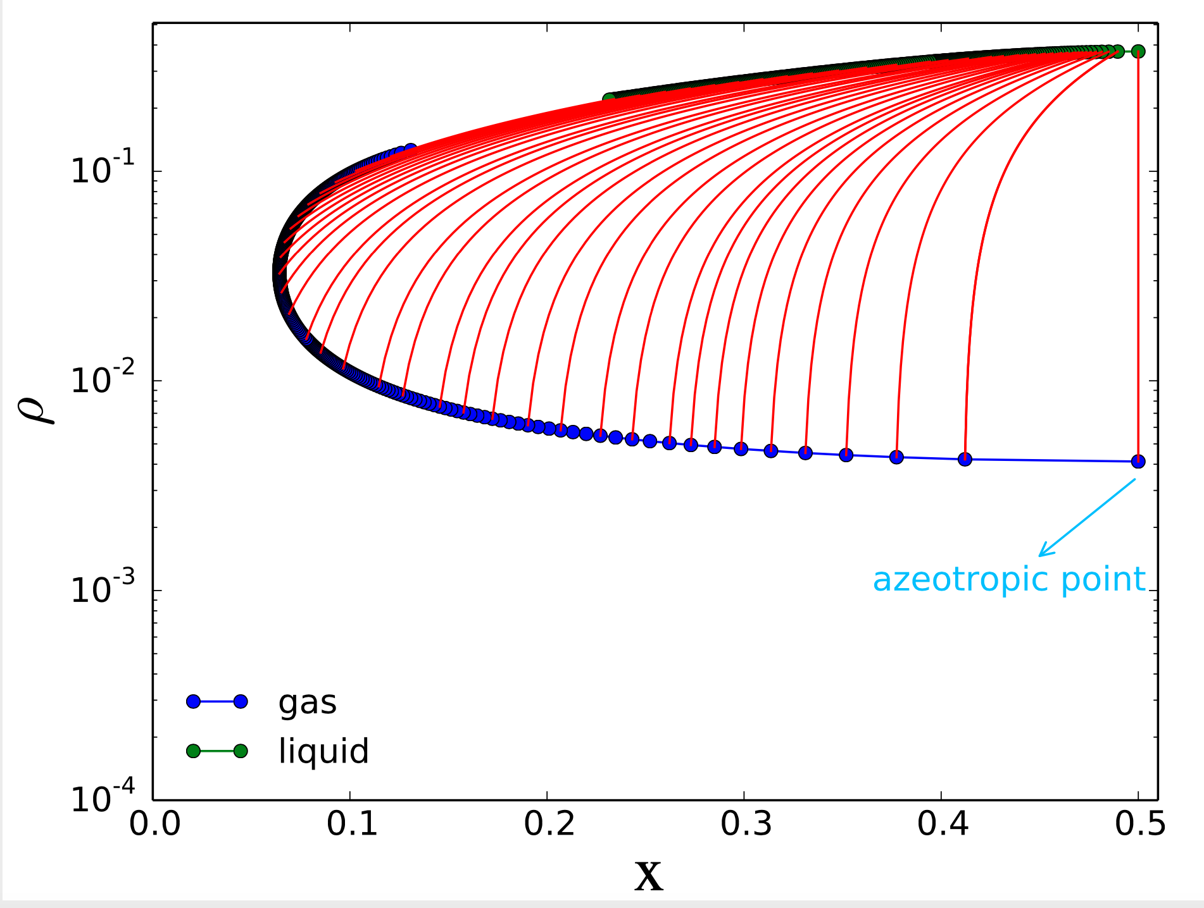
Theoretical predictions based on Wertheim theory
(case: azeotropic at equimolar)

Slide 22
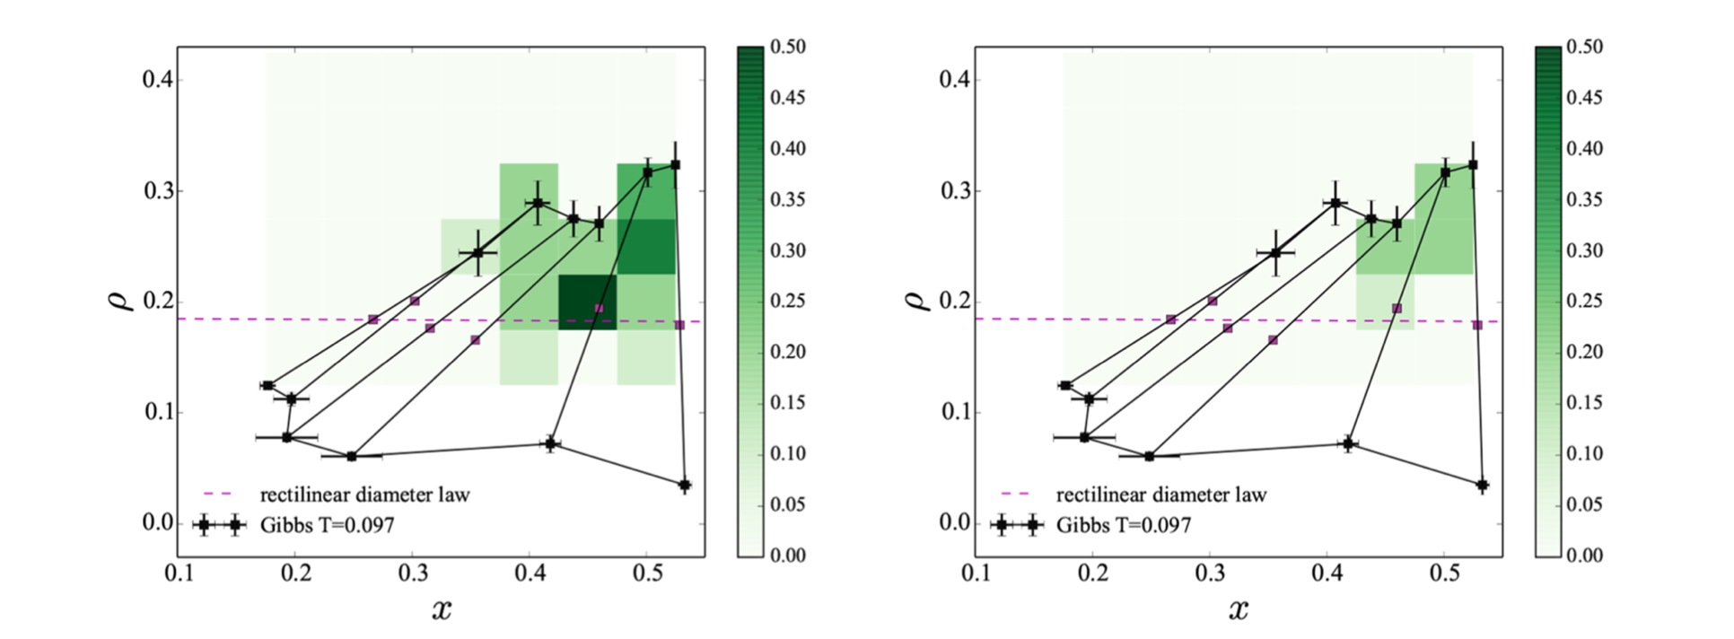
Numerical results: Azeotropy favours nucleation !

Slide 23
Finite size clusters
Archimedean polyhedral shells that can be assemble from building blocks with a coordination number of five:
the 12-particle icosahedron,
the 24-particle snub cube,
the 60- particle snub dodecahedron.

Slide 24
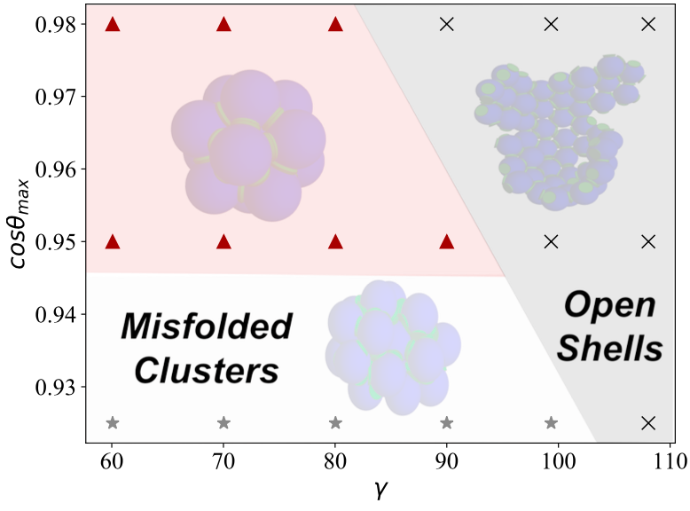
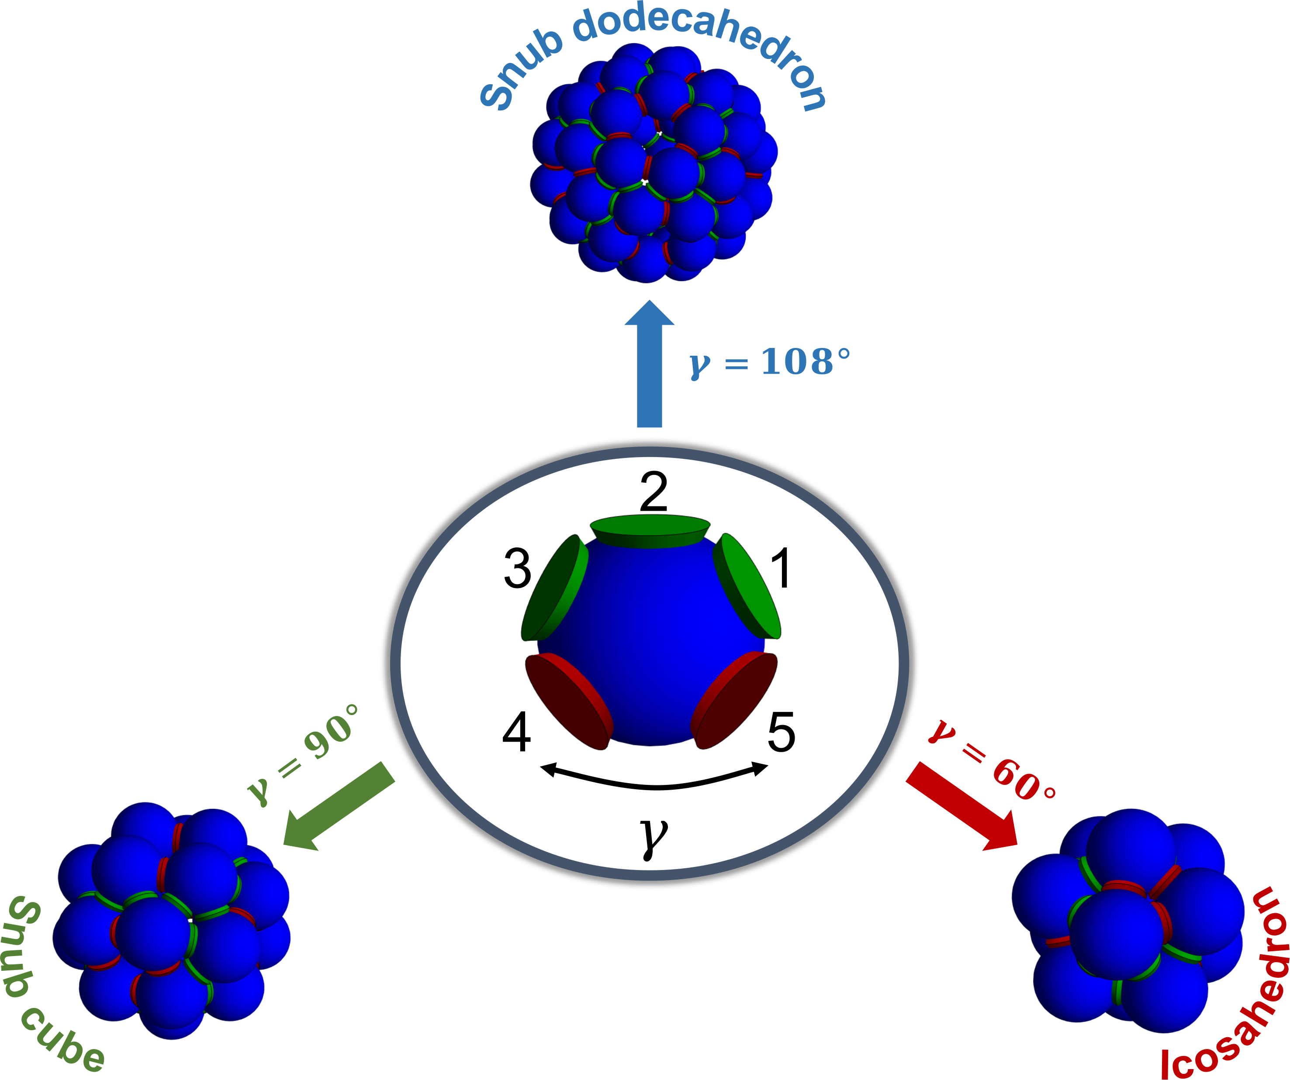
The educated guess design : misfolded and low yield
N_{c}=1 N_{p}=1
(Patch opening angle)
(angle between patch 4 and 5 – see figure)

Slide 25
N_{p}=1,N_{c}=2,3,4,5 : Colouring improves:
Increasing the Number of Colours Increases the Yield.
Decreasing the Symmetry of the Building Block Increases the Yield.

Slide 26
Finite size
clusters
Minimum Design for exclusive assembly
N_{c}=5
N_{c}=5
N_{c}=11

Slide 27
SAT-assembly and the experiments….
A complete pipeline
Tetrastack:

Slide 28
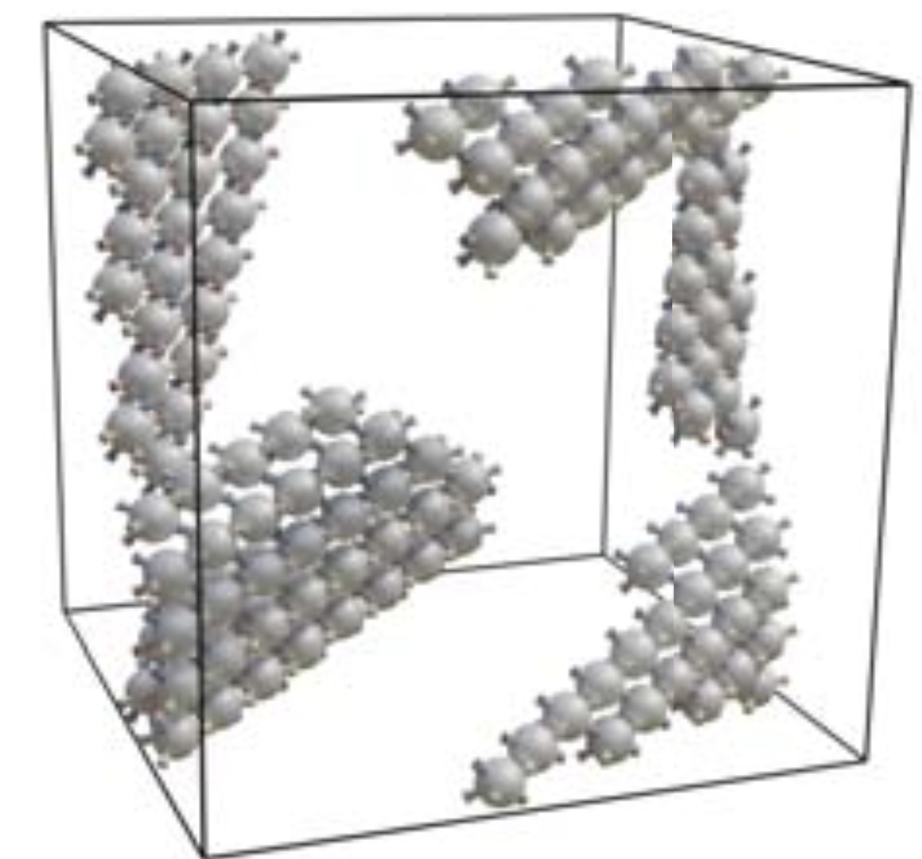
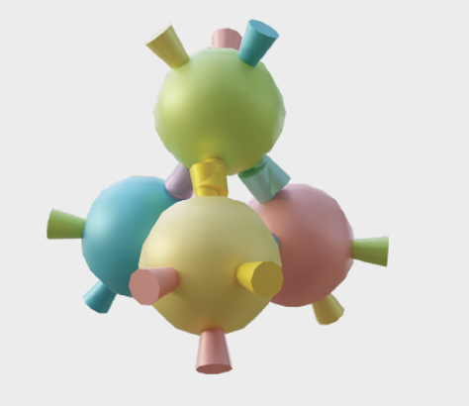
SAT-assembly and the experiments….
Tetrastack:
N_{p}=4, N_{c}=24 (Maximum number of colors)
N_{p}=1 (kinetic traps, alternative structure)
N_{p}=2 OK but with same-particle bonds
N_{p}=4 OK with no same-particle bonds

Slide 29
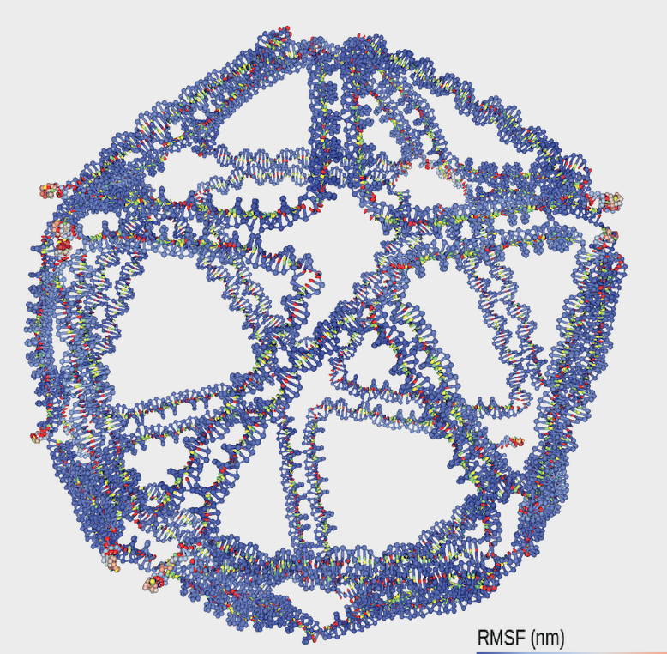
SAT-assembly and the experiments….
Tetrastack
Octahedral
icosahedral

Slide 30
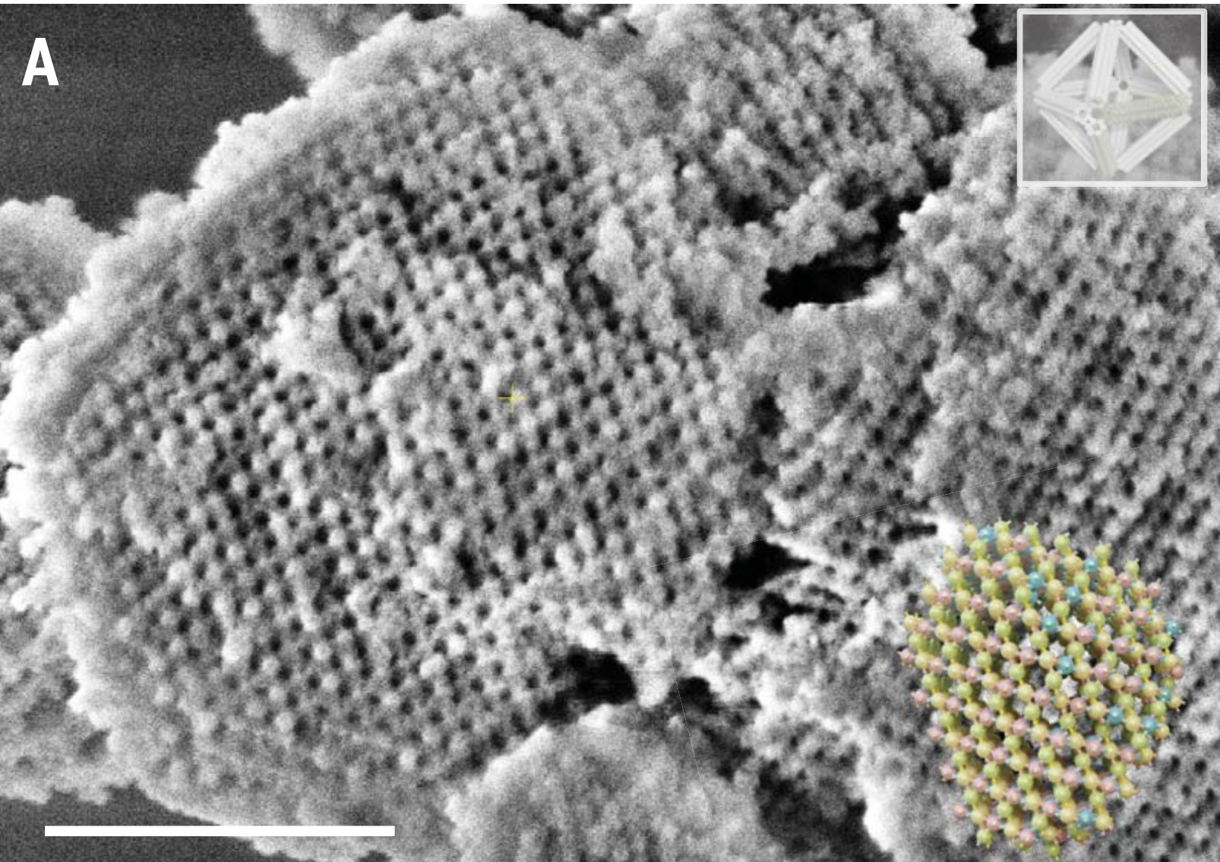
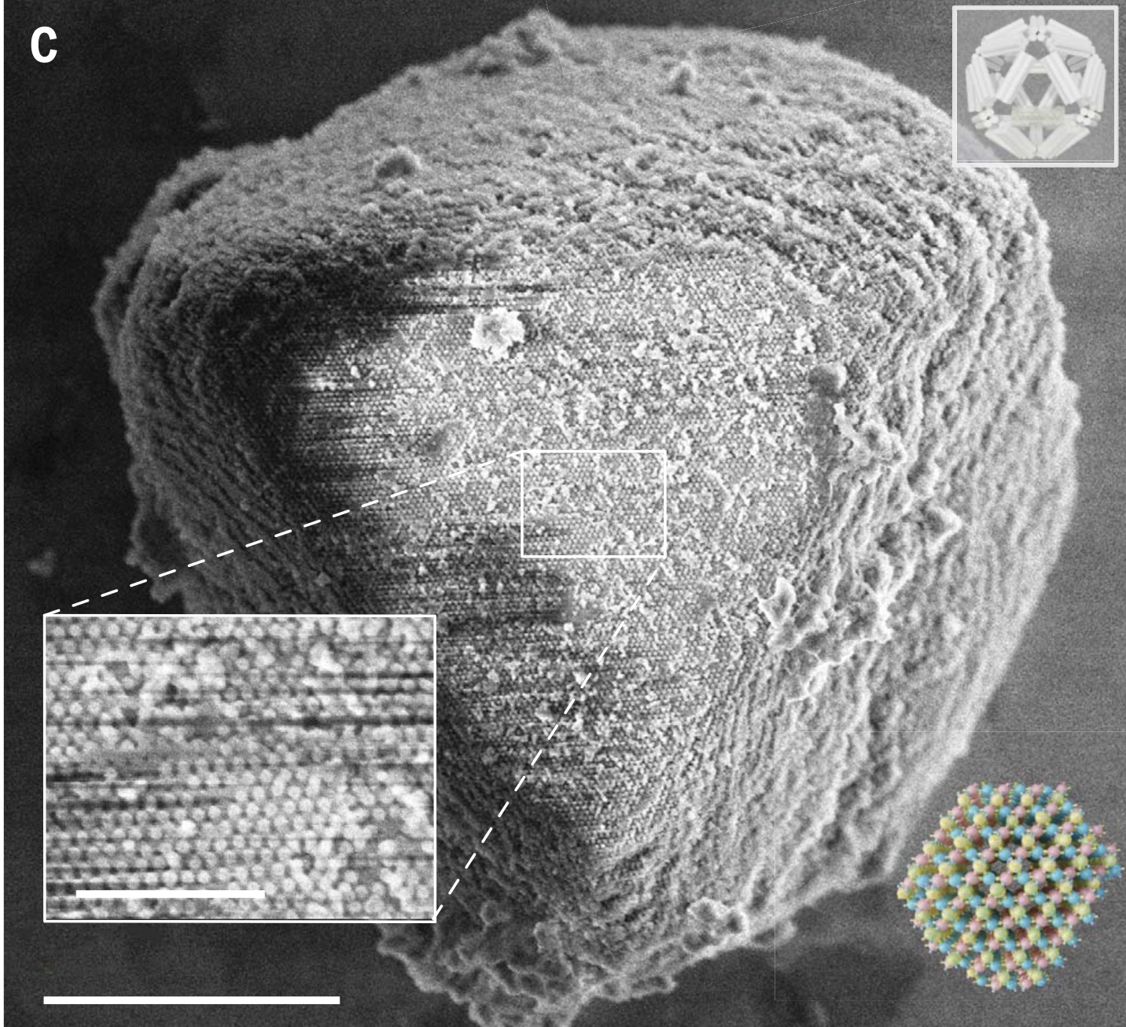
Silica-coated SEM images
Octahedral
icosahedral
Micron-scale

Slide 31
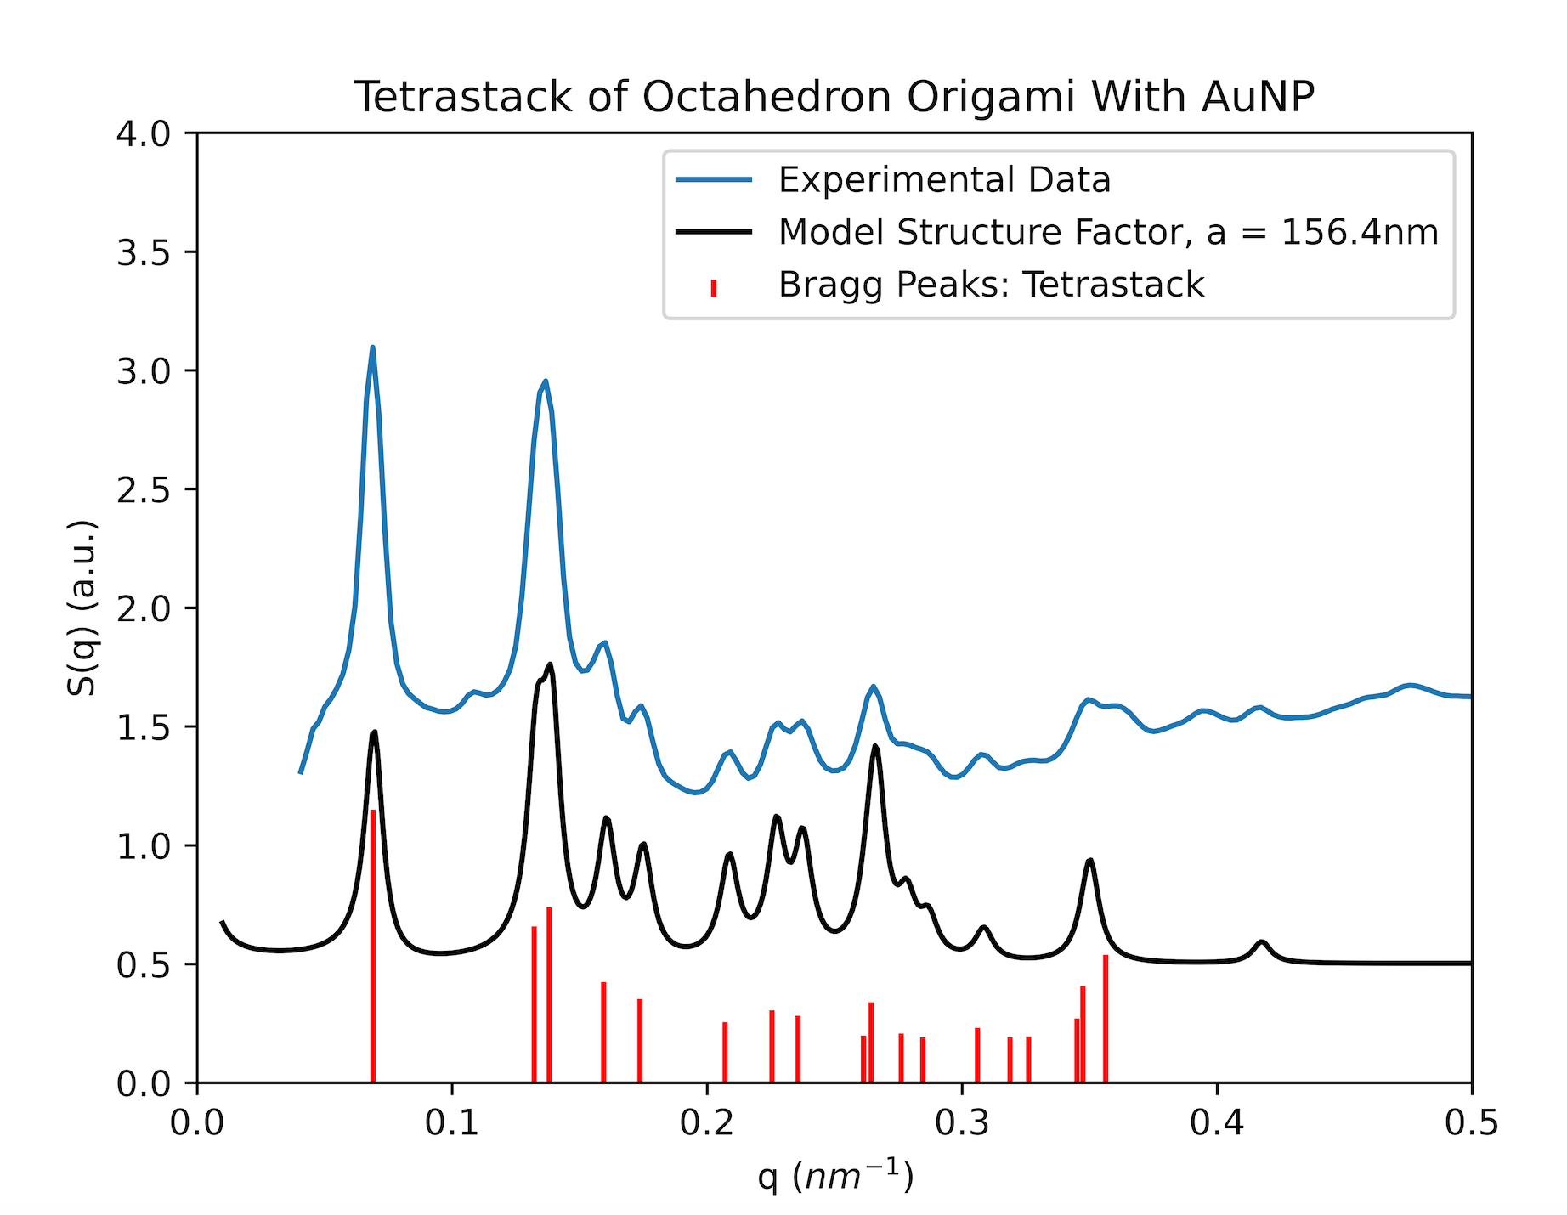

Slide 32
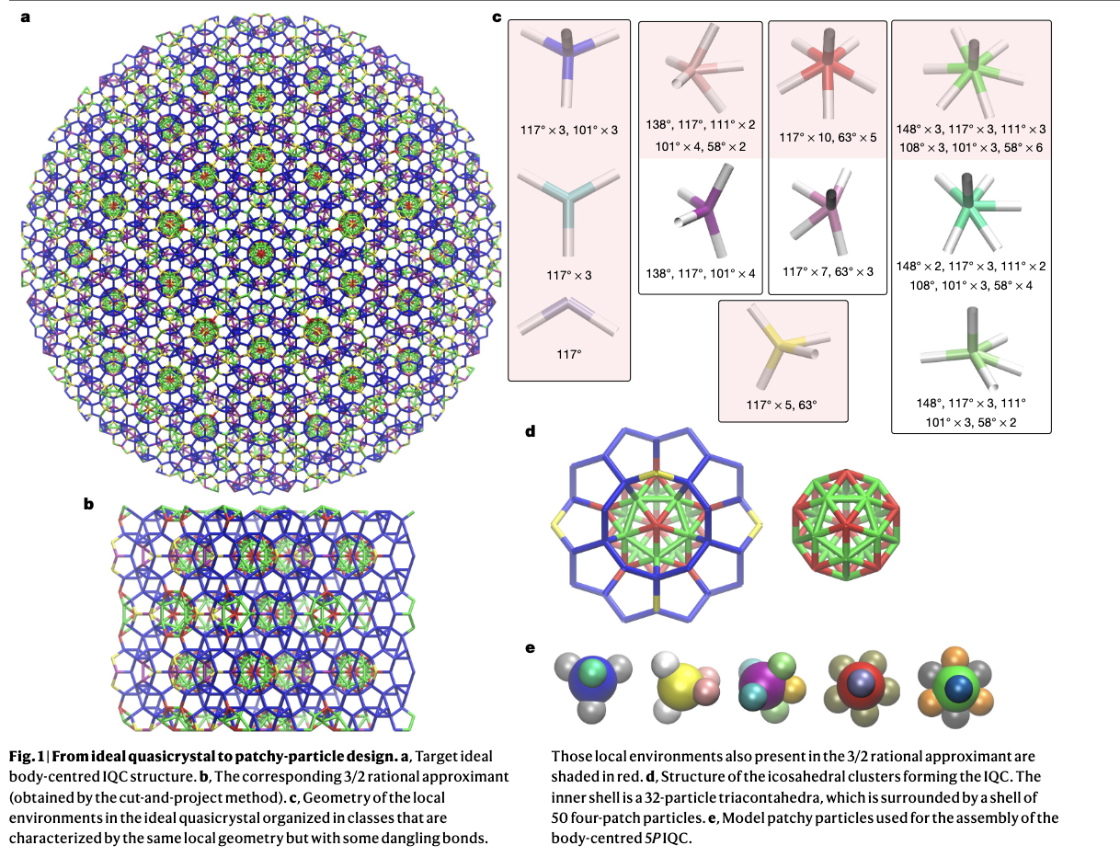

Slide 33
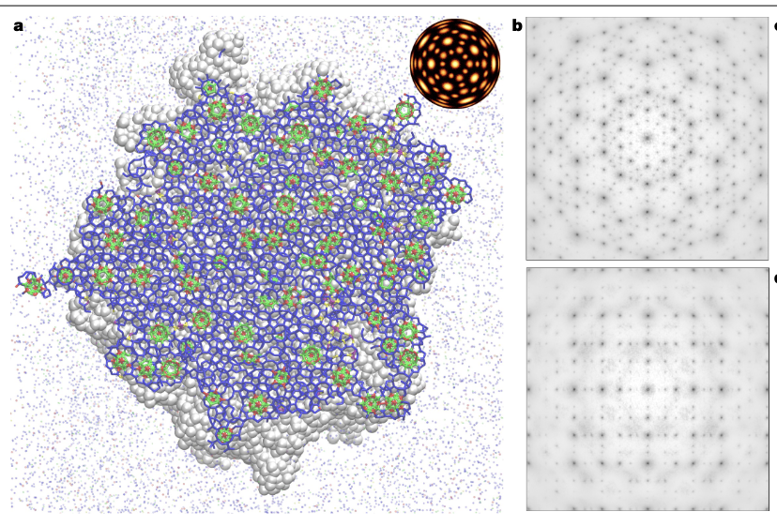

Slide 34
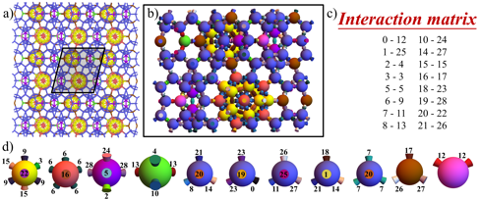
Proof of concept: Can SAT-assembly solve the problems with colours instead of torsion ?

Slide 35
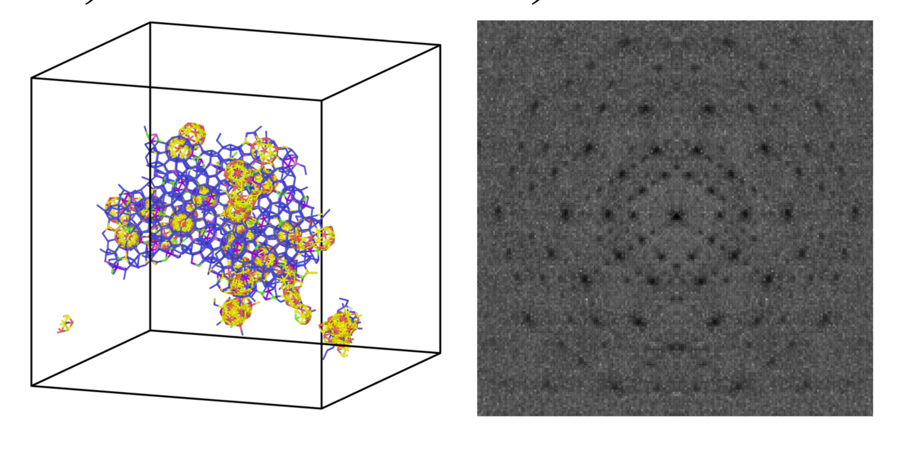
Spontaneous formation of the approximant
N_{p}=11 N_{c}=29

Slide 36
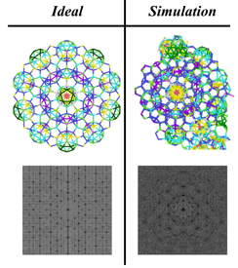
portion of an ideal
quasicrystal with
N = 1538
N_{p}=28 N_{c}=27

Slide 38
Take home messages
SAT-Assembly appears to be a valuable
method to solve the self-assembly process
based on patchy particle’s building blocks
Ability to eliminate solutions presenting kinetic traps
Or ending in competing structures
Or encoding experimental requests
Possibility to encode the results into DNA-origami wireframe particles

Slide 39
Take home messages
More colors, easier self-assembly
Less symmetry, easier self-assembly
Azeotropic composition, easier self-assembly

Slide 40
THANKS FOR LISTENING !
Take home messages
More colors, easier self-assembly
Less symmetry, easier self-assembly
Azeotropic composition, easier self-assembly
John Russo
Diogo Pinto
Lorenzo Rovigatti
Pets Sulc
Camilla Beneduce

Slide 42
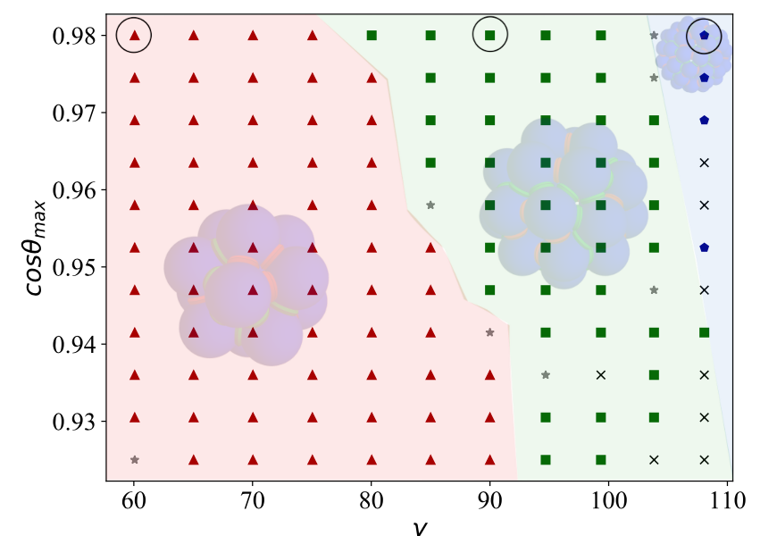
Colouring improves: N_{p}=1,N_{c}=2
Higher yield, no misfolded,
competing structures.

Slide 43
Sufficient condition for azeotropy

Slide 44
bond exclusivity
each patch has only one bonding partner (that can be itself in case of self-complementarity) among all patches of all species in the mixture.
Azeotropic at equal molar conditions
fully-connected bond
each patch can bind with N_{s} patches, each located on a different species.
Azeotropic at all molar conditions

Slide 45
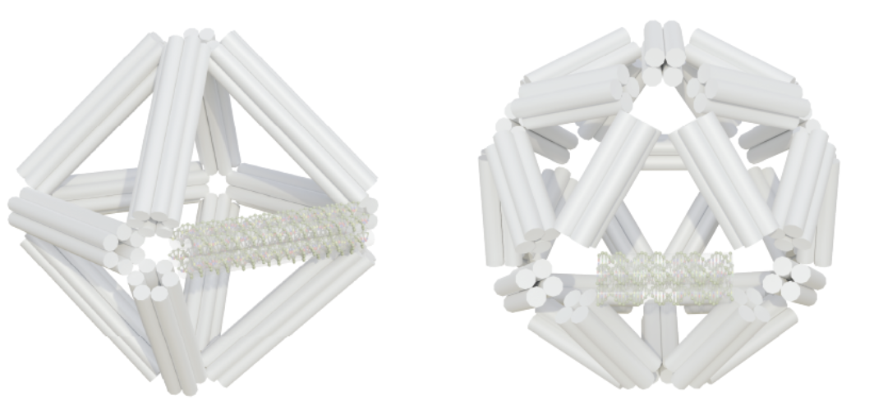
SAT-assembly and the experiments….
Tetrastack:
N_{p}=4, N_{c}=24 (Maximum number)

Slide 46
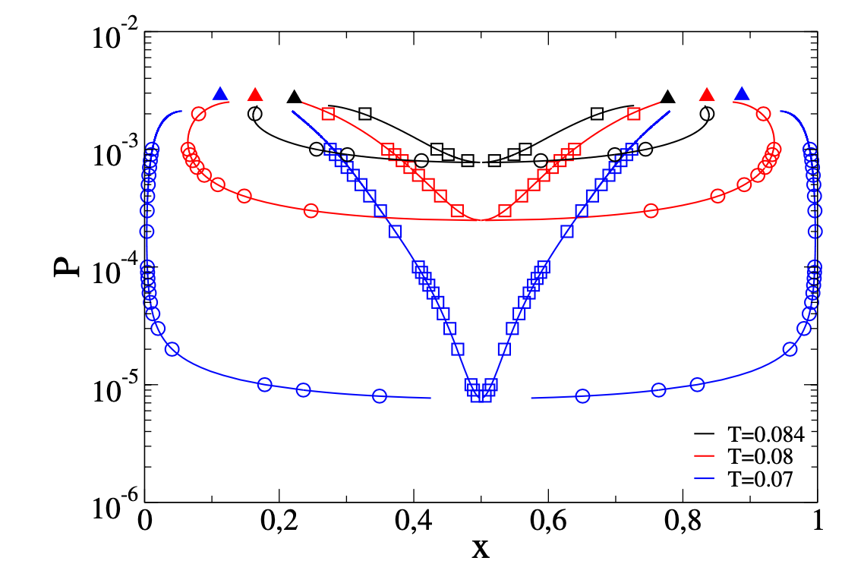
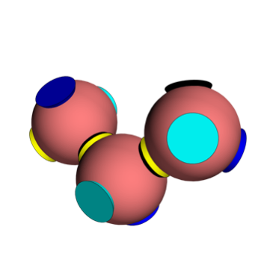
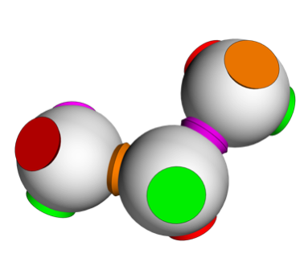
Theoretical predictions based on Wertheim theory
(case: azeotropic at equimolar)

Slide 47
Potential pitfalls typically encountered in self- assembly
* metastable states that can compete with the final product;
* dynamically arrested states (kinetic traps);
* low aggregation rates;
* lack of knowledge of the underlying phase behaviour of the building-blocks, especially for mixtures with many components.

Slide 48
From an experimental point-of-view one need to consider:
* the difficulty in realizing bulk quantities of building blocks,
their size (gravitational effect)
* the interaction polydispersity (promoting disordered arrest)
* The difficulty in controlling mechanical and molecular properties, such as softness and flexibility.

Slide 49
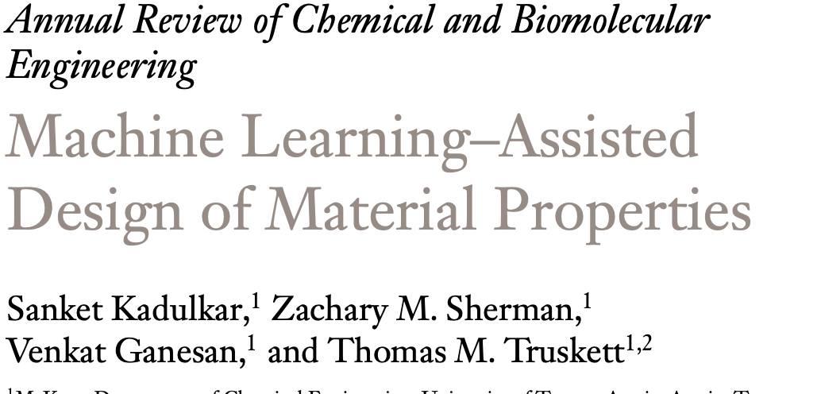
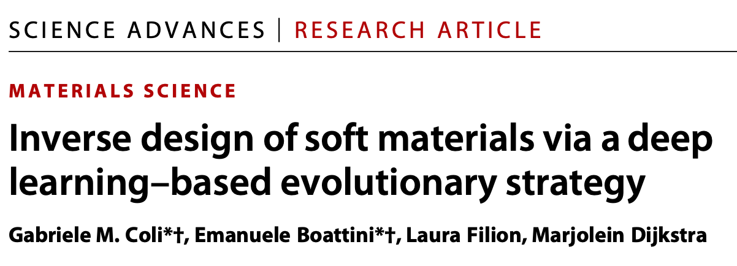
Theoretical Approaches

Slide 53
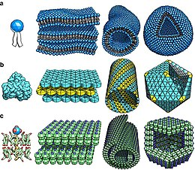
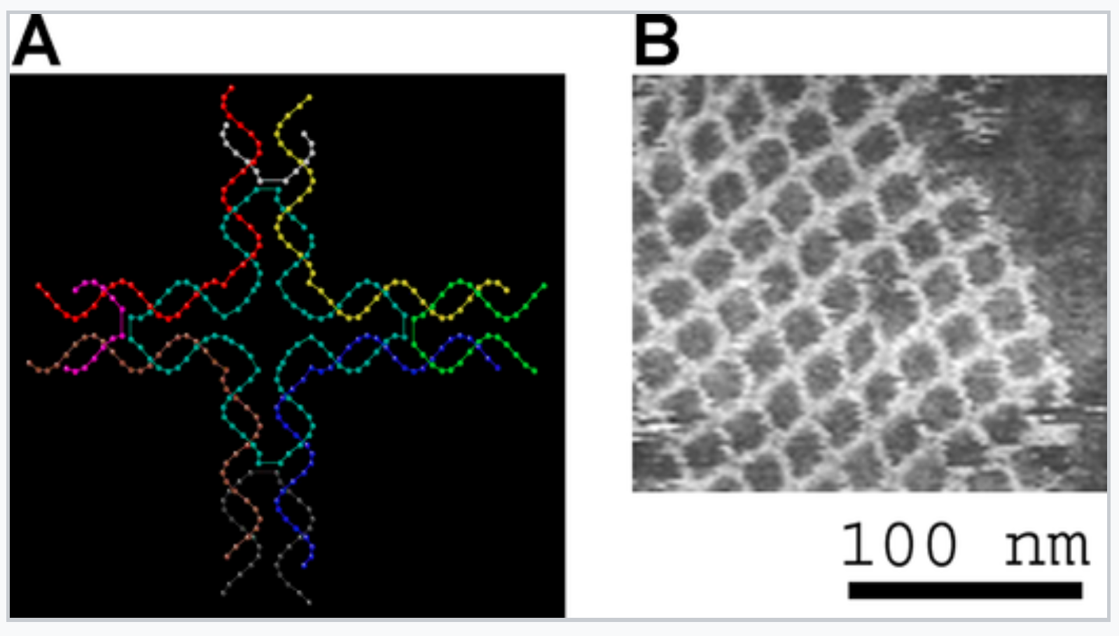
lipids
proteins
surfactant (SDS)

Slide 54
probability that patch α of particle i is not bonded
(mass action law)

