Slide 1
Sterically stabilized colloids

Slide 2
Hard spheres phase diagram (1957) Adler and Wainwright

Slide 4
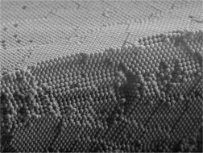
An hard-sphere crystal

Slide 5
Adding Attraction……
Temperature

Slide 6
Is attraction sufficient to generate a liquid state ?
Temperature
Packing fraction

Slide 7
Lysozime phase diagram (Vekilov)

Slide 8
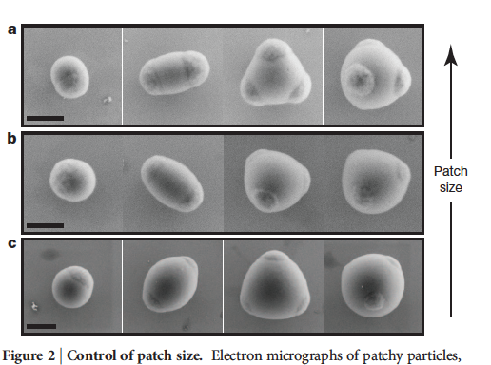
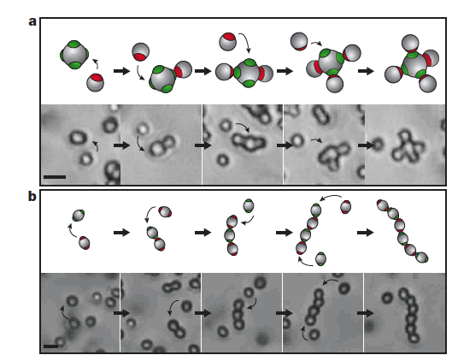

Slide 9
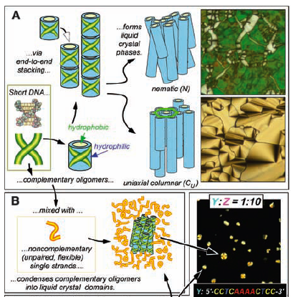

Slide 10
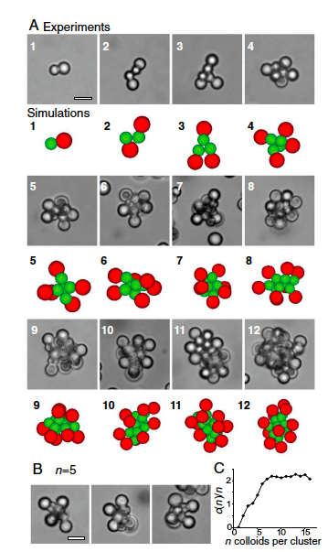
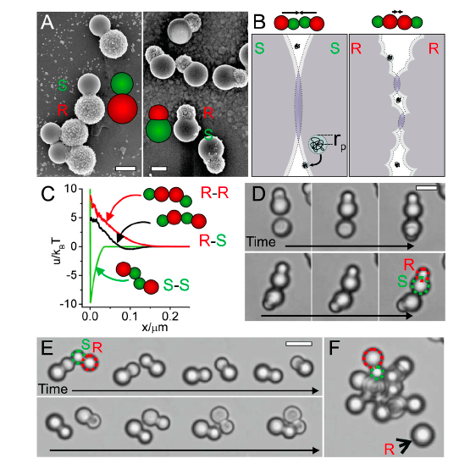

Slide 11
Molecole Anfifiliche
Hydrophilic head
Hydrophobic tail

Slide 12
Forme tipiche di aggregati di surfattanti:
Micelle sferiche, cilindriche, lamelle, vescicoli
Spherical micelles
Cylindrical micelles
Lamellae
Surfactant
H₂O
micelles are small,
~ 4 nm in diameter
H₂O

